Slide 1
TASK-1:
TO IDENTIFY HOW MANY PATIENTS DETECTED WITH HEART DISEASE

Slide 2
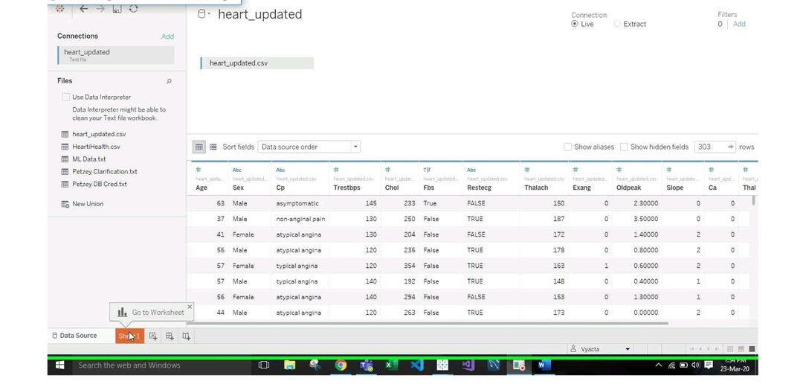

Slide 3
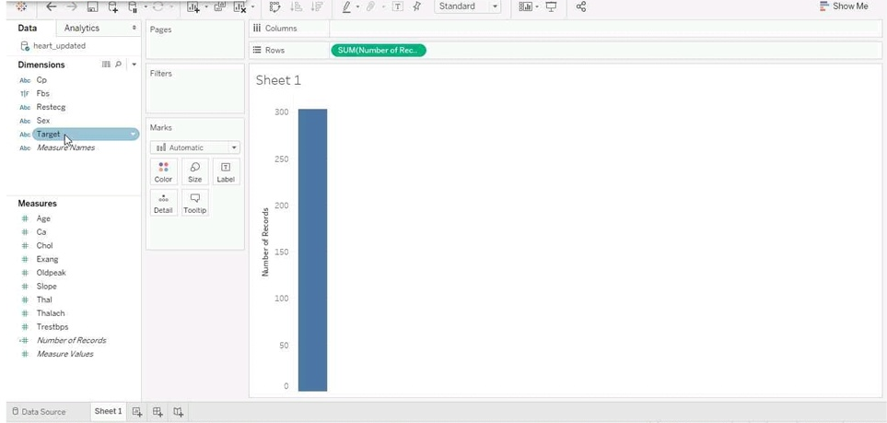

Slide 4
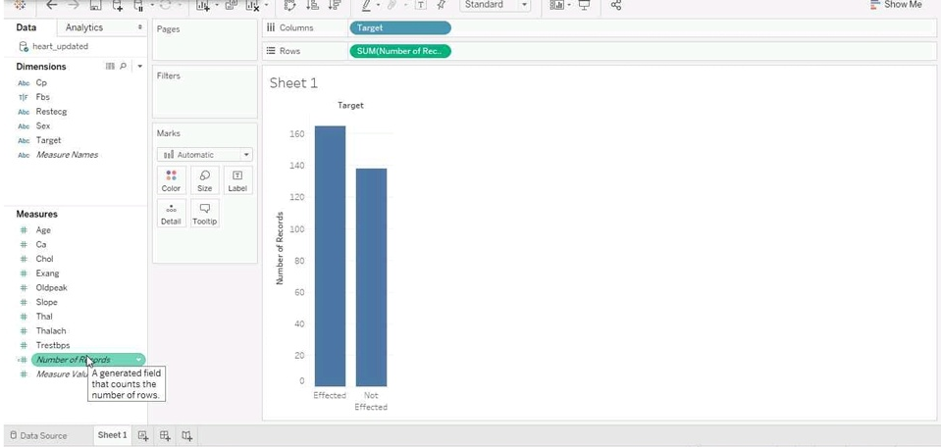

Slide 5
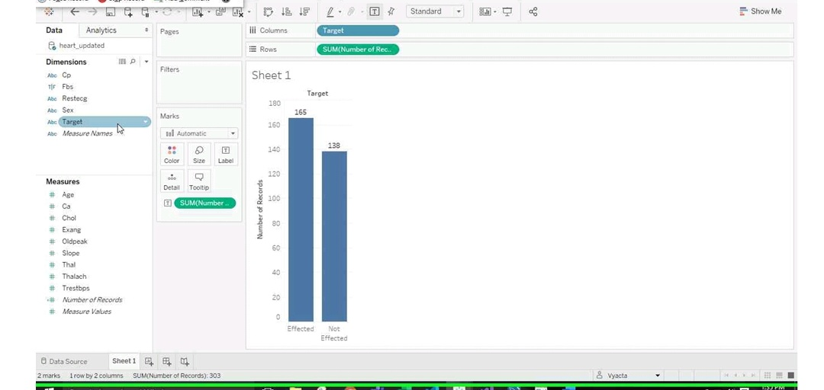

Slide 6
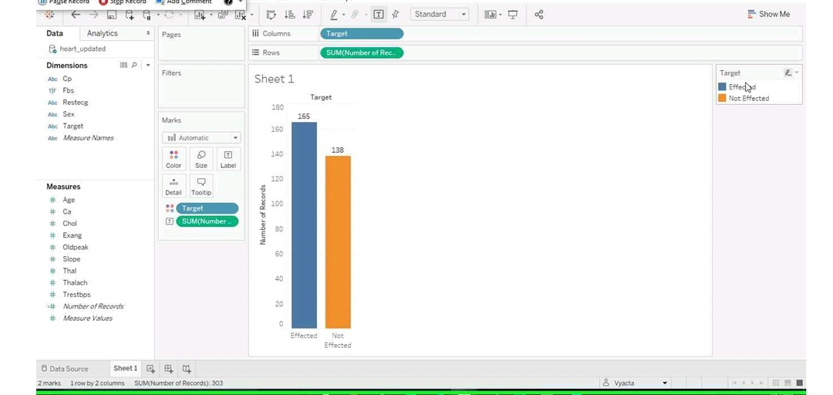

Slide 7
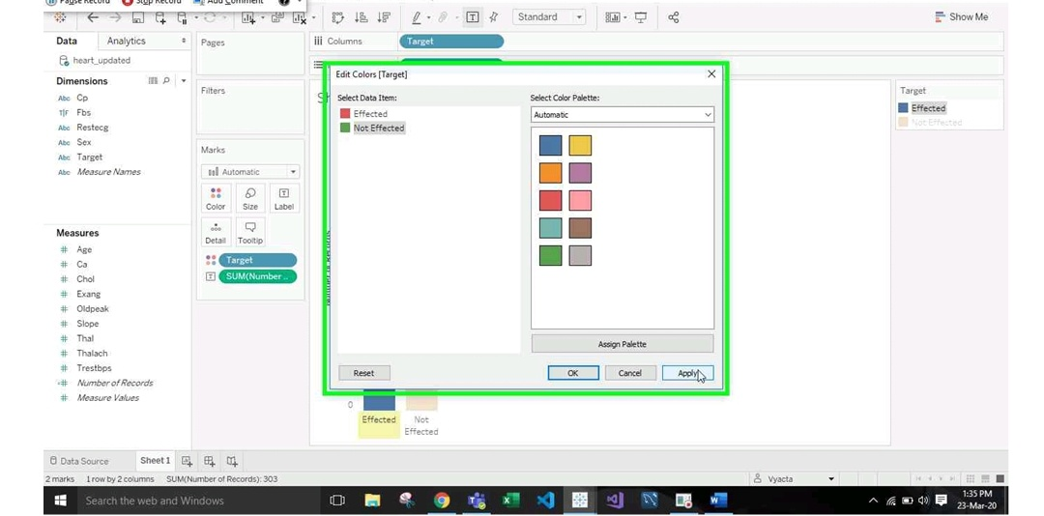

Slide 8
