Slide 1
TASK-2:
TO IDENTIFY AGE GROUP WHICH IS HAVING HIGH PROBABILITY OF HEART DISEASE.

Slide 2


Slide 3


Slide 4
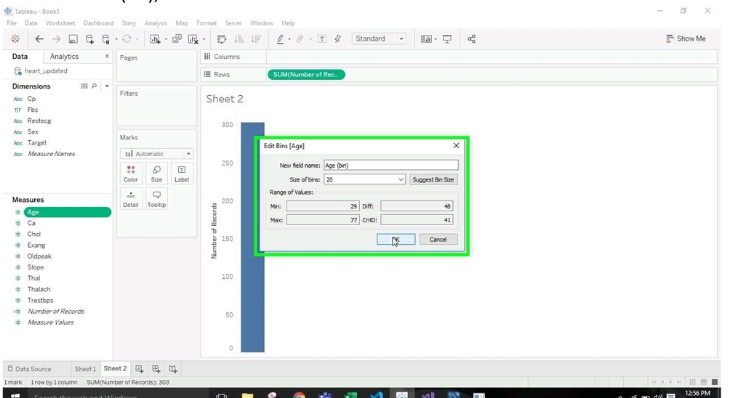

Slide 5


Slide 6
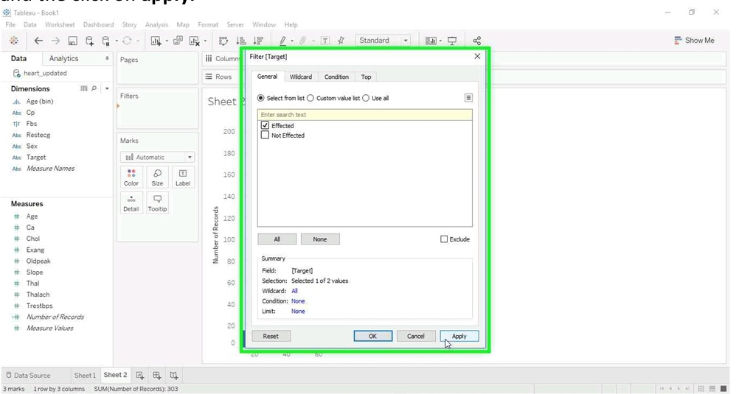

Slide 7
