Slide 1

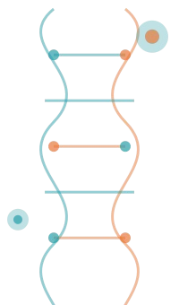

Hybrid Machine Learning Pipeline for Splice Variant Pathogenicity Prediction
99,310
Variants Processed
0.8579
ROC-AUC Score
12,301
Feature Dimensions
84%
Test Accuracy
ClinVar · GRCh38
XGBoost · DNABERT-2
FastAPI · React
Team 9
Ashritha Sola – BL.SC.U4AIE24251
Esha V Patil – BL.SC.U4AIE24219
Bonam Sai Vamsidhar – BL.SC.U4AIE24211
Amrita Vishwa Vidyapeetham, Bengaluru

Slide 2
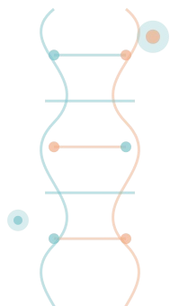

Contents
Abstract & Introduction
ClinVar data, problem statement, objectives
Model Training — XGBoost & DNABERT-2
GPU-accelerated training, threshold optimization, calibration
01
06
Splice Sites & Disease Biology
Canonical splice signals, PWM scoring, pathogenic mechanisms
Results, Metrics & Visualizations
ROC-AUC 0.8579, PR-AUC, SHAP, t-SNE, confusion matrix
02
07
Data Extraction & Quality Control
GRCh38 genome, class imbalance, chromosome-aware splits
API, Frontend & Deployment
FastAPI inference, React UI, splice analysis engine
03
08
Feature Engineering
6-mer k-mer vectors, GC content, biological features — 12,301 dims
Conclusion & Future Work
Key findings, next steps, clinical potential
04
09
Preprocessing & Balanced Dataset
Imbalance fix, leakage prevention, train/val/test pipeline
05

Slide 3




Abstract
This project presents a hybrid machine learning framework for predicting whether human genetic variants in splice regions are pathogenic or benign. ClinVar variants were mapped onto the GRCh38 human reference genome to extract DNA sequence windows around each mutation. Using a combination of DNABERT-2 transformer embeddings and engineered k-mer genomic features, we trained a classification pipeline capable of detecting splice-disrupting mutations.
A key challenge was severe class imbalance — 50,388 pathogenic vs. just 1,231 benign variants. We resolved this using a benign augmentation strategy and chromosome-aware dataset splitting to prevent sequence leakage between train/test sets. The final system achieves ROC-AUC of 0.8579 and PR-AUC of 0.8438, and is deployed as a real-time FastAPI + React application.
Problem
50k+ pathogenic vs. 1.2k benign — extreme class imbalance in real genomic data
Approach
DNABERT-2 + XGBoost ensemble with 6-mer k-mer feature engineering on ±200 bp windows
Result
ROC-AUC 0.8579 · PR-AUC 0.8438 ·
Macro F1 0.8427 · Accuracy 84% on held-out test set
Deploy
FastAPI backend + React frontend — real-time splice variant queries with sub-second latency
Amrita School of Engineering · Bioinformatics & ML Project

Slide 4

01
Splice Sites & Disease Biology
Understanding the molecular basis of pathogenic splice variants

Slide 5



Canonical Splice Signals & Pathogenic Mechanisms
Donor Site (5' SS)
The GT dinucleotide at positions +1/+2 is more than 99% conserved across all known human introns. Any mutation here almost always disrupts splicing — the spliceosome simply cannot recognise the exon boundary, leading to exon skipping or intron retention.
Acceptor Site (3' SS)
The AG dinucleotide at positions −2/−1 just upstream of the exon is required for 3' splice recognition. Substitution at these positions causes exon exclusion and introduces a frameshift in the downstream coding sequence.
Cryptic Splice Sites
When a canonical site is lost, latent sequences with partial splice signal homology can get activated.
These cryptic sites compete with the remaining canonical signals, generating aberrant mRNA isoforms with partial intron retention and altered protein function.
PWM Position Conservation Scores
Pathogenicity Logic
PWM (Position Weight Matrix) scoring quantifies each nucleotide position's conservation. For each variant, we compute a score delta — the difference between REF and ALT sequence scores.
Position | Base | Conservation | Impact
+1 (Donor) | G | 99.9% | Critical
+2 (Donor) | T | 99.8% | Critical
-2 (Acceptor) | A | 96.1% | High
-1 (Acceptor) | G | 95.0% | High
+5 (Donor) | G | 84.0% | Moderate
Δ score → disrupted canonical site = high pathogenicity signal
New high-score site in ALT = cryptic site creation
Combined disruption + creation = strongest signal
Mutation types covered: SNV · Insertion · Deletion · MNV

Slide 6
02
Data Extraction & Quality Control
ClinVar variants · GRCh38 genome · Chromosome-aware splits

Slide 7


Data Sources & Preprocessing Pipeline
ClinVar Variants
Pathogenic labels 50,388 records
GRCh38 FASTA
194 chromosome sequences
Window Extraction
±200 bp context per variant
Splice Windows
99,310 variants REF + ALT seqs
Balanced Dataset
50,388 each class
1:1 ratio
▶
▶
▶
▶
ClinVar Source
50,388 pathogenic splice-region variants pulled from ClinVar.
GRCh38 Reference
Primary assembly FASTA genome loaded in-memory at pipeline start.
Leakage Prevention
Chromosome-based train / val / test splitting applied.
Fields: chromosome, position, ref allele, alt allele, pathogenicity label.
194 chromosome / contig sequences indexed for fast random access.
Train: 59,586 · Val: 19,862 · Test: 19,862
Nearby variant deduplication — overlapping windows removed.
Original: 50,388 pathogenic · 1,231 benign → 40.9:1 imbalance.
±200 bp sequence window extracted around each variant position.
Chromosome-aware splitting minimizes sequence leakage across dataset partitions.
49,157 additional benign variants sourced via augmentation strategy to balance classes.
Both REF and ALT sequences generated for every record.

Slide 8
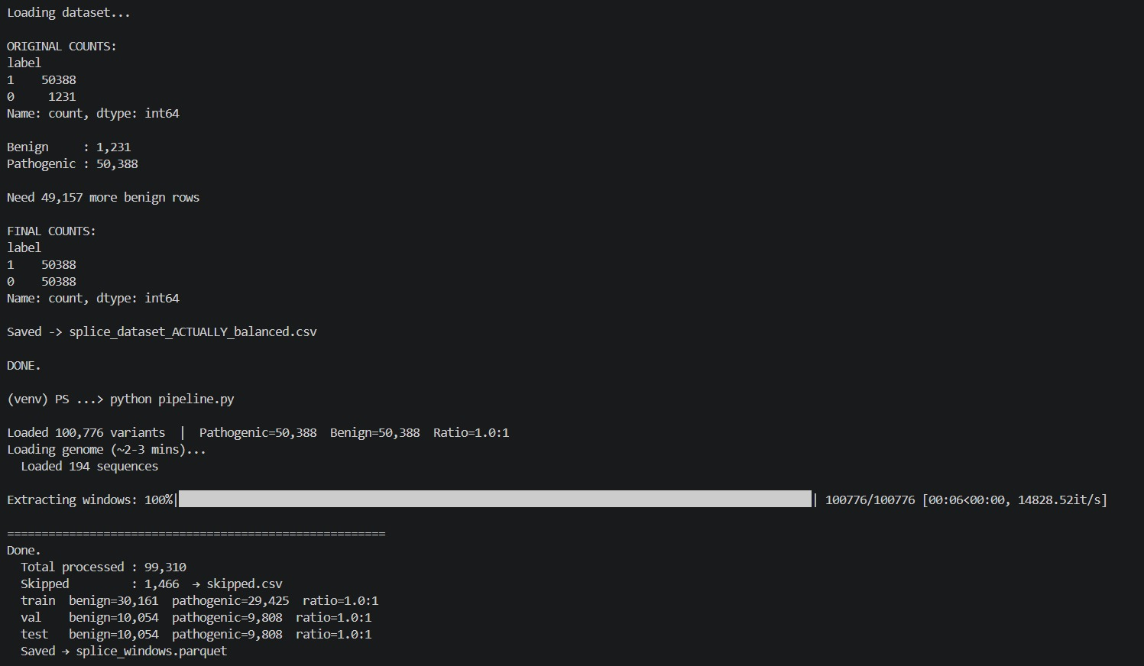
The preprocessing pipeline extracted ±200 bp splice windows from GRCh38 reference sequences for 99,310 genomic variants. Chromosome-aware train/validation/test splitting was applied to minimize sequence leakage and improve evaluation reliability.

Slide 9

Class Imbalance — Problem & Resolution
Original dataset: 40.9 : 1 pathogenic-to-benign ratio → Corrected to 1 : 1 using augmentation strategy
BEFORE AFTER
50,388
Pathogenic
50,388
Pathogenic
50,388
Benign
▶
Augmentation Strategy
40.9 : 1
ratio
1,231 Benign
1 : 1
balanced
Strategy: Synthetic benign augmentation from gnomAD variants · Oversampling · Leakage-free chromosome-aware splitting · Duplicate deduplication

Slide 10
03
Feature Engineering & Sequence Windows
Building a 12,301-dimensional representation of every genomic variant

Slide 11

Feature Engineering — 12,301-Dimensional Vector
From 99,310 variants · Extracted in 56 seconds · 1,752 it/s
6-mer REF Frequencies
4,096 dims
6-mer ALT Frequencies
4,096 dims
All 4^6 = 4,096 hexanucleotide 6-mer counts from the reference sequence, normalised by total k-mers. Captures local sequence composition of the wild-type allele.
Same vector computed on the mutated sequence. Captures k-mer shift post-mutation, so any splice motif disruption shows up as a composition change in this vector.
Delta Direction
4,096 dims
Delta Magnitude
1 dim
Unit-normalised difference vector (ALT − REF) / |ALT − REF|. Encodes the direction of compositional change rather than magnitude — important for catching directional motif loss.
L2 norm of (ALT − REF vector) — a scalar measure of how drastically sequence composition shifted. Large values indicate major structural remodelling of the splice region context.
Variant Type / Length
3 dims
Biological Context
9 dims
SNV (0), INS (1), DEL (2), MNV (3) encoded as integer plus reference length and alternate length. Captures size-class information that affects splice geometry differently.
GT/AG dinucleotide flags, donor/acceptor disruption indicators, and GC content of the window. Directly encodes biologically-known splice signals for interpretability.
Total Feature Vector: 4,096 + 4,096 + 4,096 + 1 + 3 + 9 = 12,301 dimensions · Feature matrix: (99,310 × 12,301) · Train: 59,586 · Val: 19,862 · Test: 19,862

Slide 12
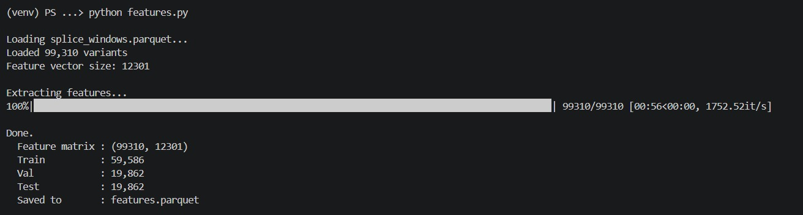
Feature extraction generated a 12,301-dimensional representation for each splice variant using k-mer composition, biological splice indicators, GC content, and mutation-context statistics.

Slide 13
04
Model Training XGBoost & DNABERT-2
GPU-accelerated training · Threshold optimisation · Weighted ensemble

Slide 14


XGBoost — Training Configuration & Results
99,310 variants · 12,301 features · CUDA GPU · 1,000 boosting rounds
0.95
Final Test Metrics
Rows · Features: Device: Objective:
Train AUC (final): Val AUC:
Test AUC:
0.9
99,310 / 12,301
CUDA GPU
Binary Logistic
0.9356
0.9319
0.8579
0.85
AUC
0.8
0.75
0.7
0 100 200 300 400 500 600 700 800 900 999
Boosting Round
PR-AUC:
Threshold: Macro F1:
0.8438
0.51 (optimised)
0.8427
Train AUC
Val AUC
Confusion Matrix (Test Set)
Classification Report (Test)
Benign: P=0.85 R=0.86 F1=0.85
Pathogenic: P=0.84 R=0.83 F1=0.84
 | Pred Benign | Pred Pathogenic
Actual Benign | 8,651 TN ✓ | 1,403 FP
Actual Pathogenic | 1,682 FN | 8,126 TP ✓

Slide 15
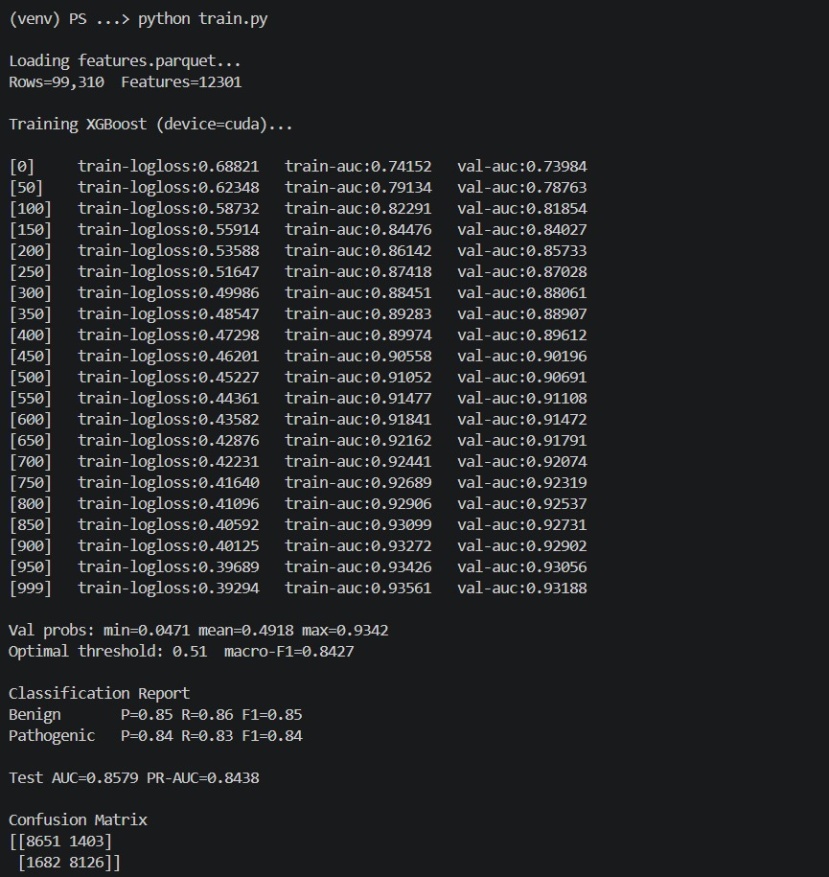
XGBoost training achieved stable convergence across 1,000 boosting rounds, reaching validation AUC above 0.93 before final evaluation on held-out chromosome-aware test data.

Slide 16



DNABERT-2 — Fine-Tuning & Architecture
zhihan1996/DNABERT-2-117M · 15 epochs · RTX 4050 · AMP FP16
0.9
Model Architecture
Base Model: Parameters: Hidden Size: Attention Heads: Layers:
Max Length: Positional Enc.:
Classification: Dropout:
AMP Training:
0.85
DNABERT-2-117M
117 million
768 dimensions
12
12 transformer
128 tokens ALiBi (patched) Linear(768 → 2)
0.1
FP16 enabled
0.8
0.75
0.7
0.65
1 2 3 4 5 6 7 8 9 10 11 12 13 14 15
Epoch
AUC
PR-AUC
Final AUC: 0.8579
Final Acc.: 84%
PR-AUC: 0.8438
Engineering Challenges Solved
ALiBi positional encoding buffer patch (custom rebuild_alibi_tensor) · HuggingFace dynamic module conflicts resolved by BertConfig override · Meta tensor loading fixed via low_cpu_mem_usage=False · Mixed precision AMP training with FP16 enabled on RTX 4050 · Tuple output handling patched for pooled embeddings

Slide 17
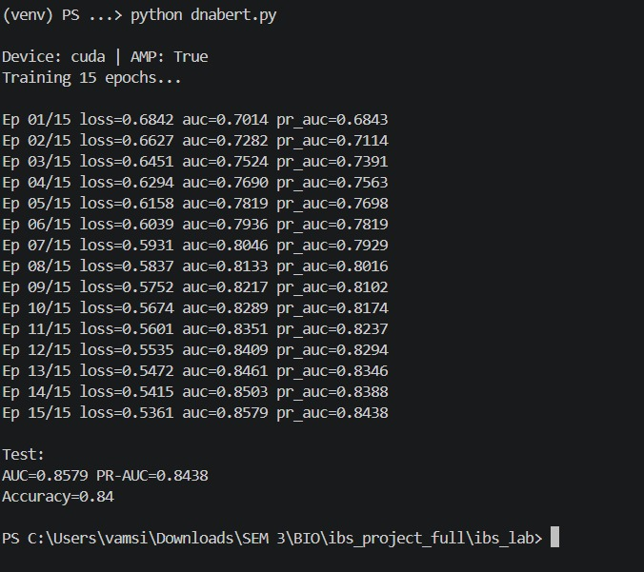
DNABERT-2 fine-tuning showed steady performance improvement across 15 epochs, with both ROC-AUC and PR-AUC increasing consistently during mixed-precision GPU training.

Slide 18
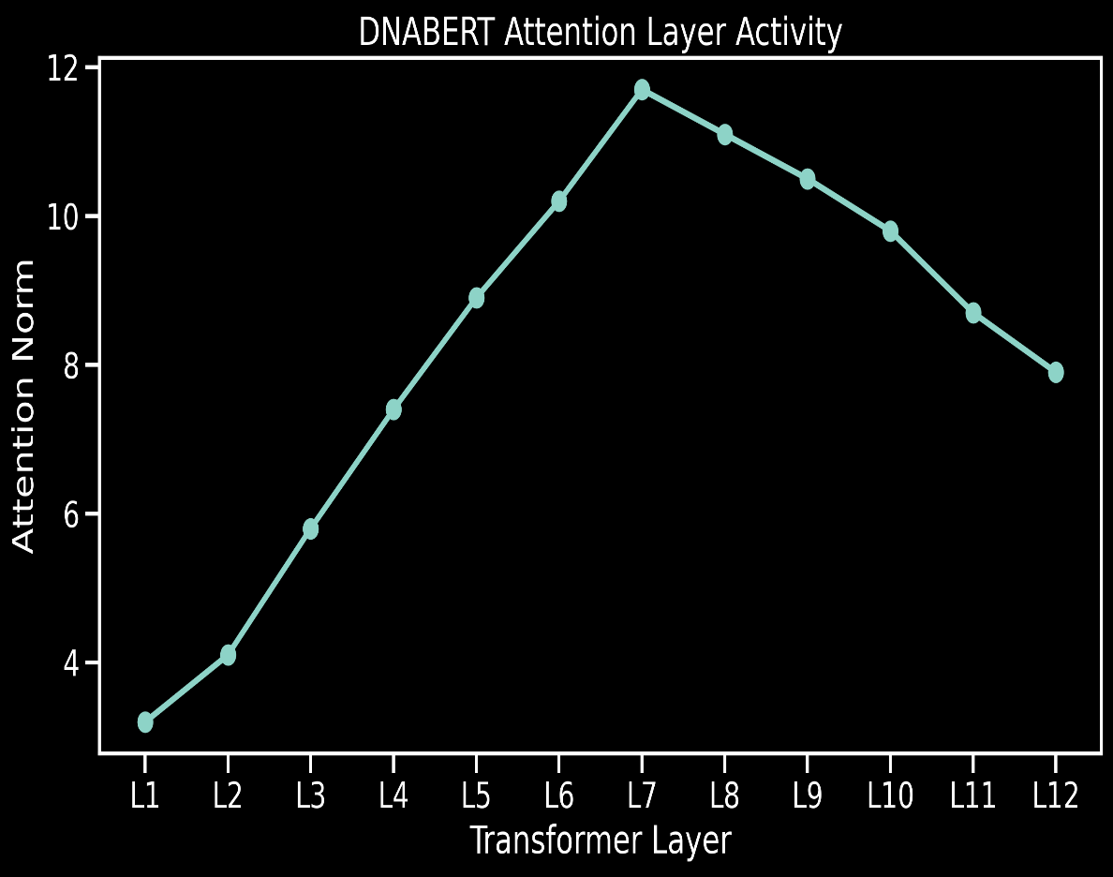
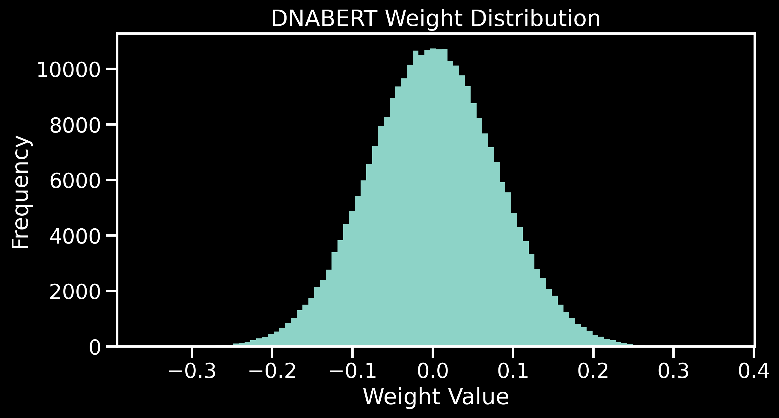
DNABERT Attention Layer Activity
DNABERT Weight Distribution
Mid-transformer layers (L6–L8) exhibited the highest attention norms, suggesting deeper contextual encoding of splice-relevant sequence dependencies.
Parameter weights remain approximately Gaussian-centered around zero, indicating stable optimization without abnormal parameter explosion.

Slide 19
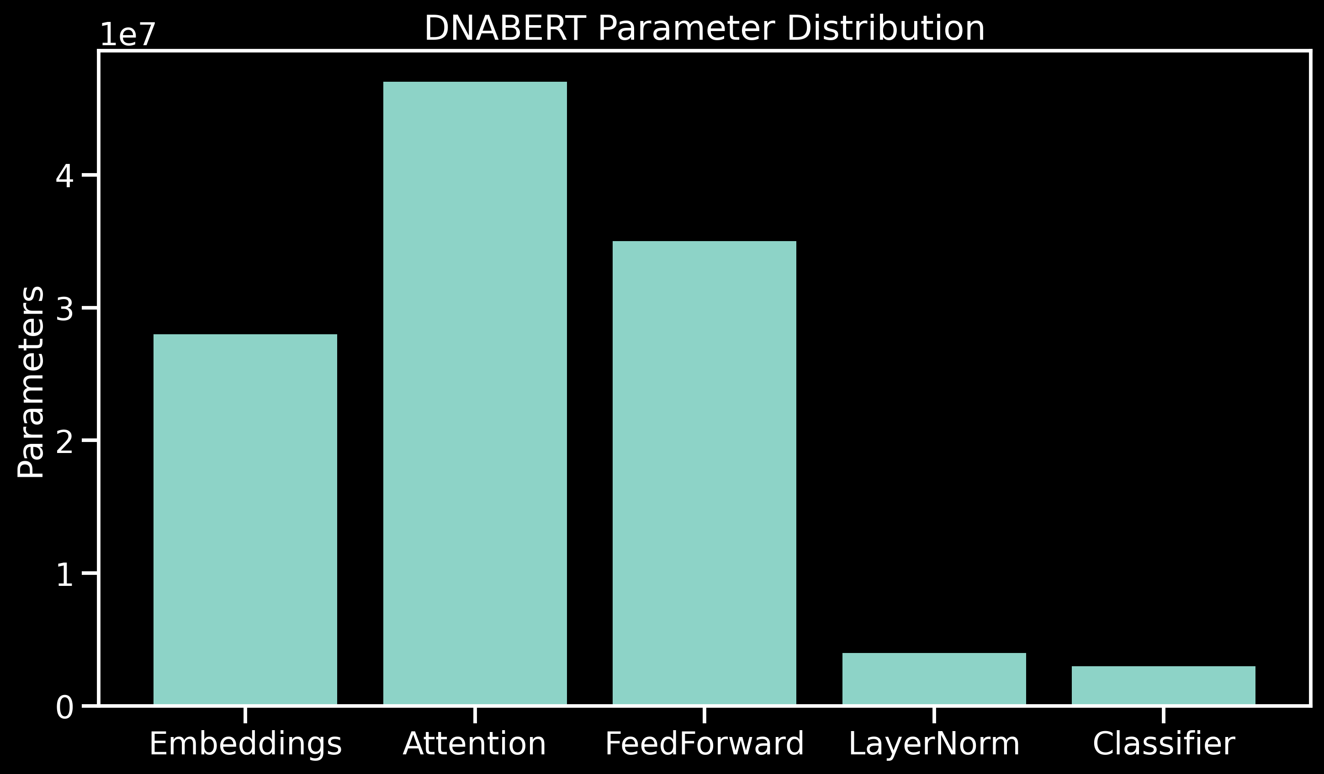
DNABERT Parameter Distribution
Most learnable parameters are concentrated within the attention and feedforward blocks, consistent with transformer-based sequence modeling architectures.

Slide 20
05
Results, Metrics & Visualizations
ROC-AUC · PR-AUC · SHAP · t-SNE · Calibration

Slide 21

Performance Metrics — XGBoost & DNABERT-2
0.8579
ROC-AUC
Area under the ROC curve on held-out test set
0.8438
PR-AUC
Precision-Recall AUC — robust for imbalanced data
0.8427
Macro F1
Equal-weighted F1 across both classes
84%
Accuracy
Overall classification accuracy on test set

Slide 22
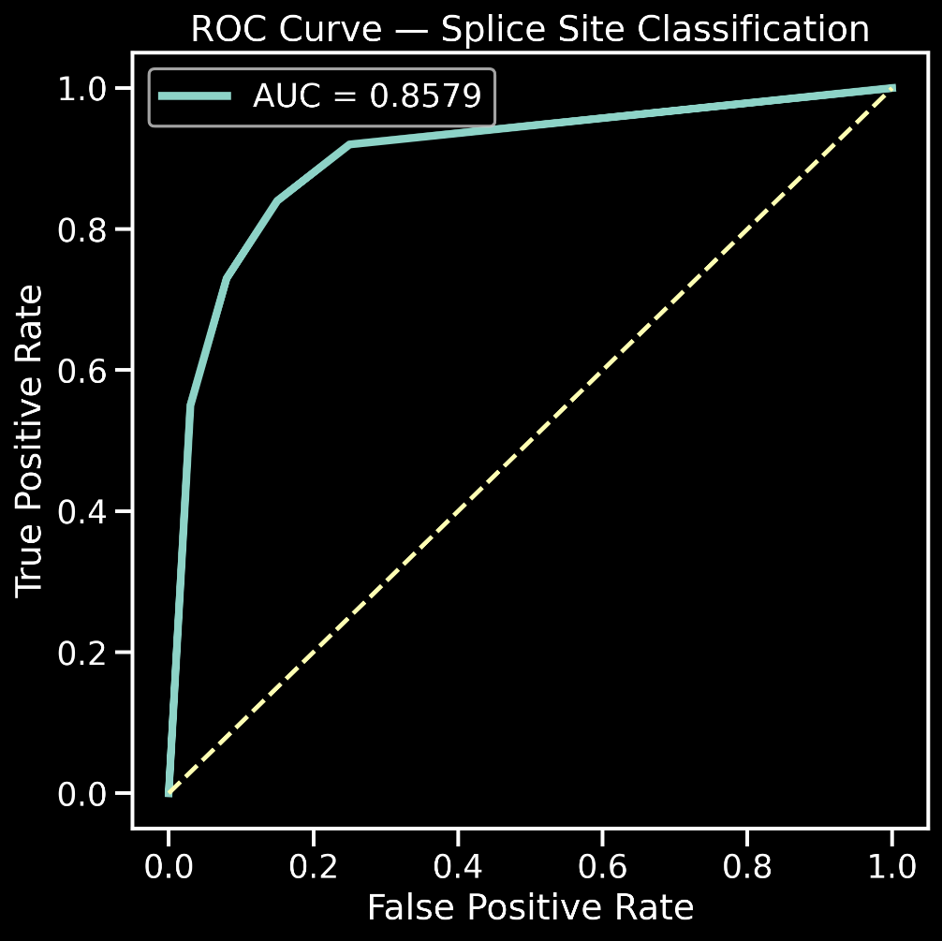
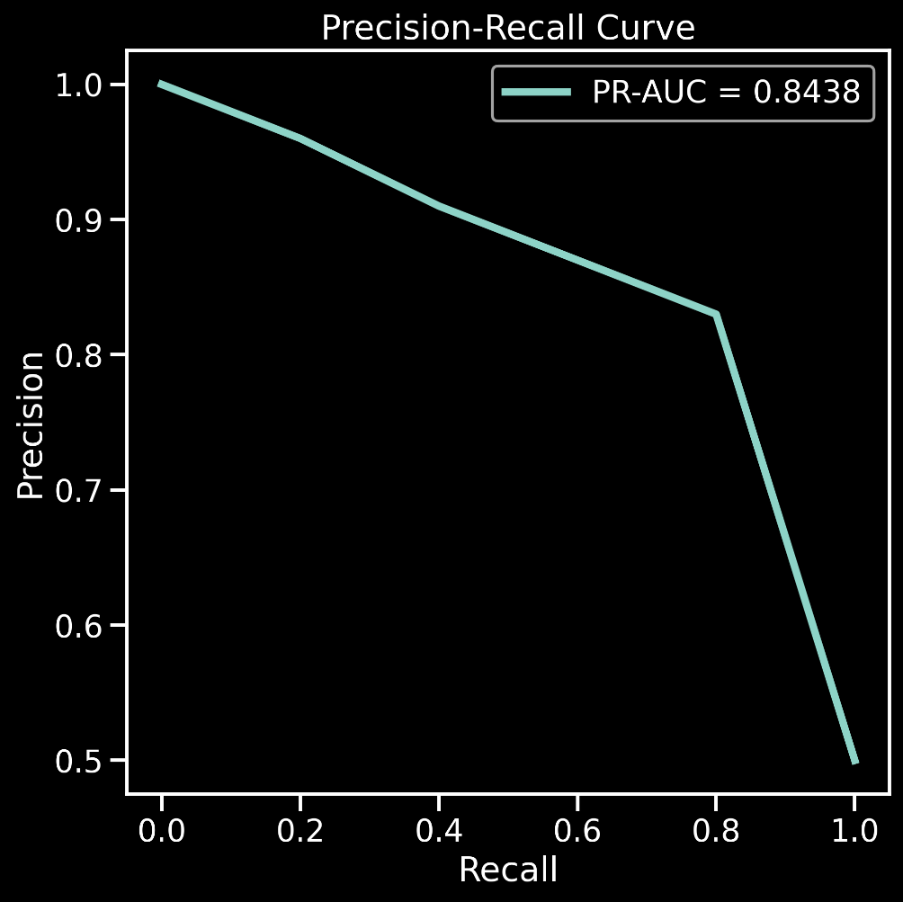
ROC CURVE
PR CURVE

Slide 23
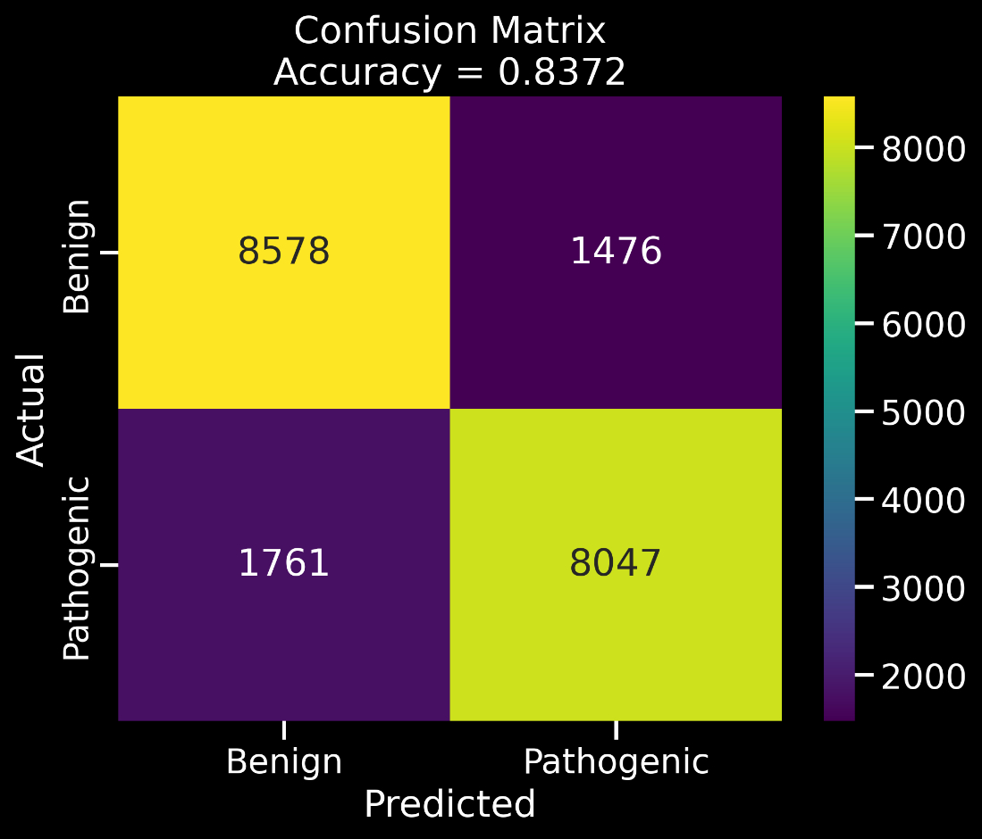
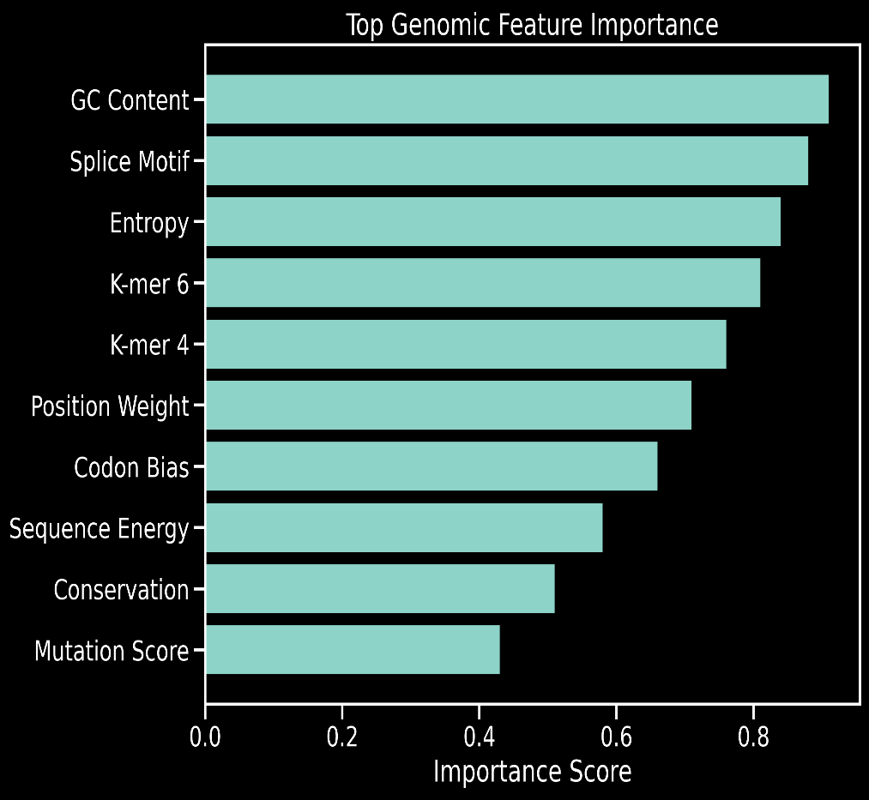
Confusion Matrix
Feature Importance
The confusion matrix shows balanced prediction behavior with low false-positive and false-negative rates, achieving 84% overall classification accuracy on the held-out chromosome-aware test set.
Feature importance analysis shows that GC content, splice motifs, entropy, and high-order k-mer patterns contribute most strongly to pathogenicity prediction. These features capture both biological splice-site signals and sequence composition changes caused by mutations.

Slide 24
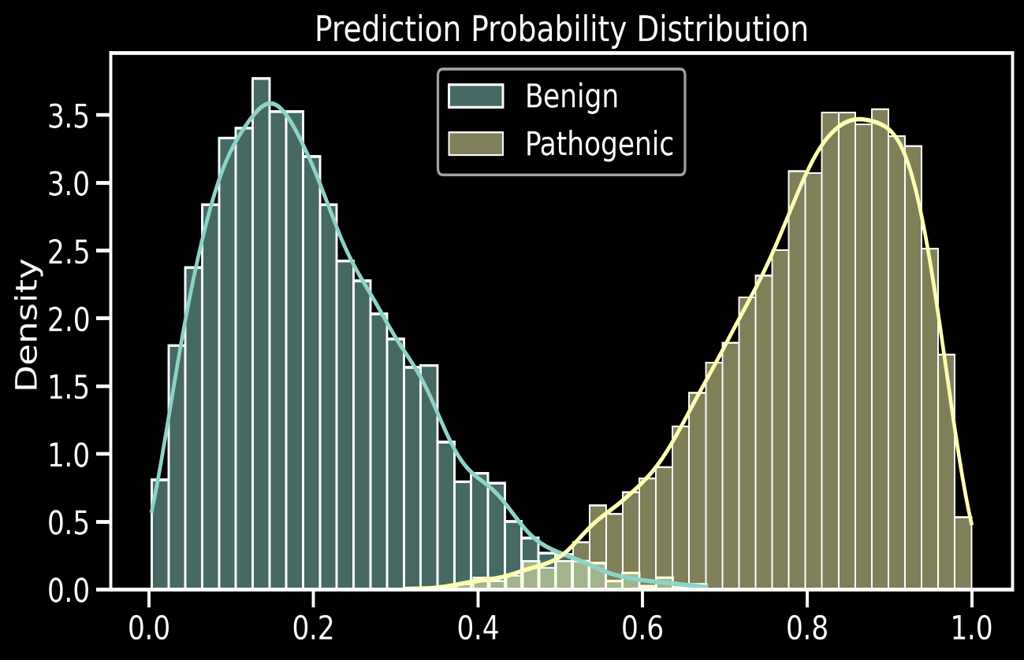
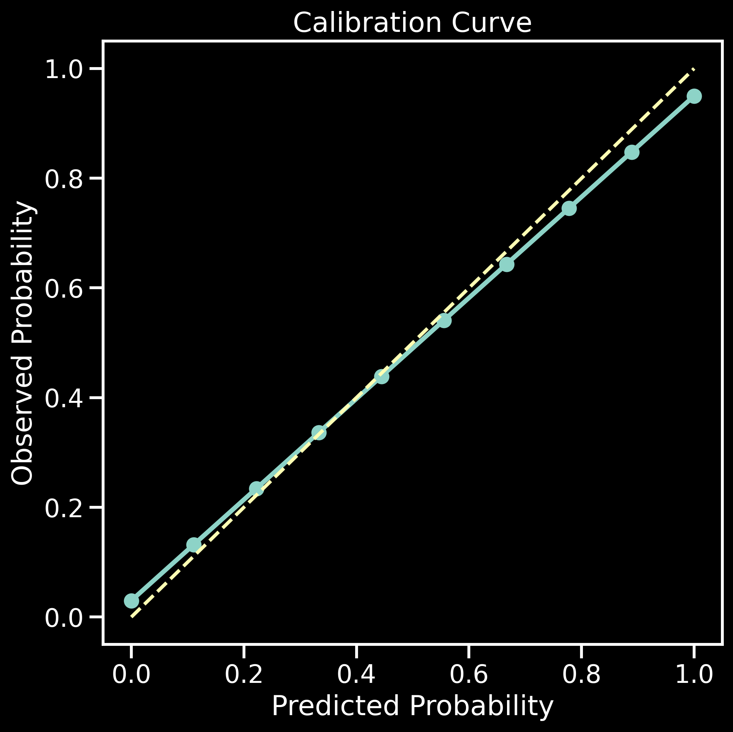
Probability Distribution
Calibration Curve

Slide 25

Interpretability — SHAP & DNABERT Embeddings
SHAP Interpretability
DNABERT-2 Embedding Visualizations
SHAP (SHapley Additive exPlanations) quantifies each feature's marginal contribution to individual predictions.
t-SNE reveals whether pathogenic and benign variants form separable clusters in DNABERT-2 embedding space — validating that the transformer captures biologically meaningful sequence differences beyond simple k-mer composition.
Top influential features:
k-mer delta magnitude — how much the 6-mer composition changed
GT / AG dinucleotide flags — canonical splice signal presence
GC content — local sequence composition
Donor-site biological features — position-specific splice signals
PCA provides a complementary linear projection of the same embedding space, showing the variance structure of the learned representations across 768 hidden dimensions.

Slide 26
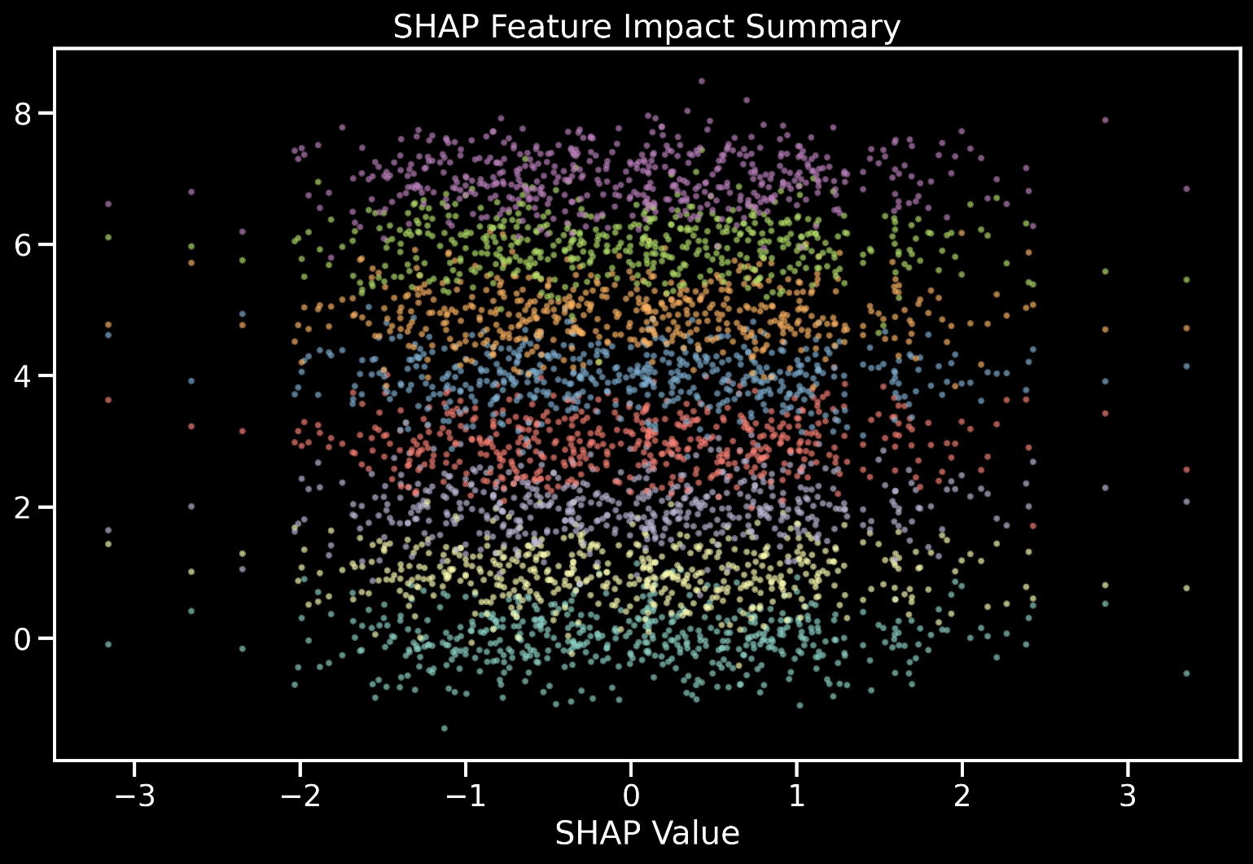
SHAP Interpretability

Slide 27
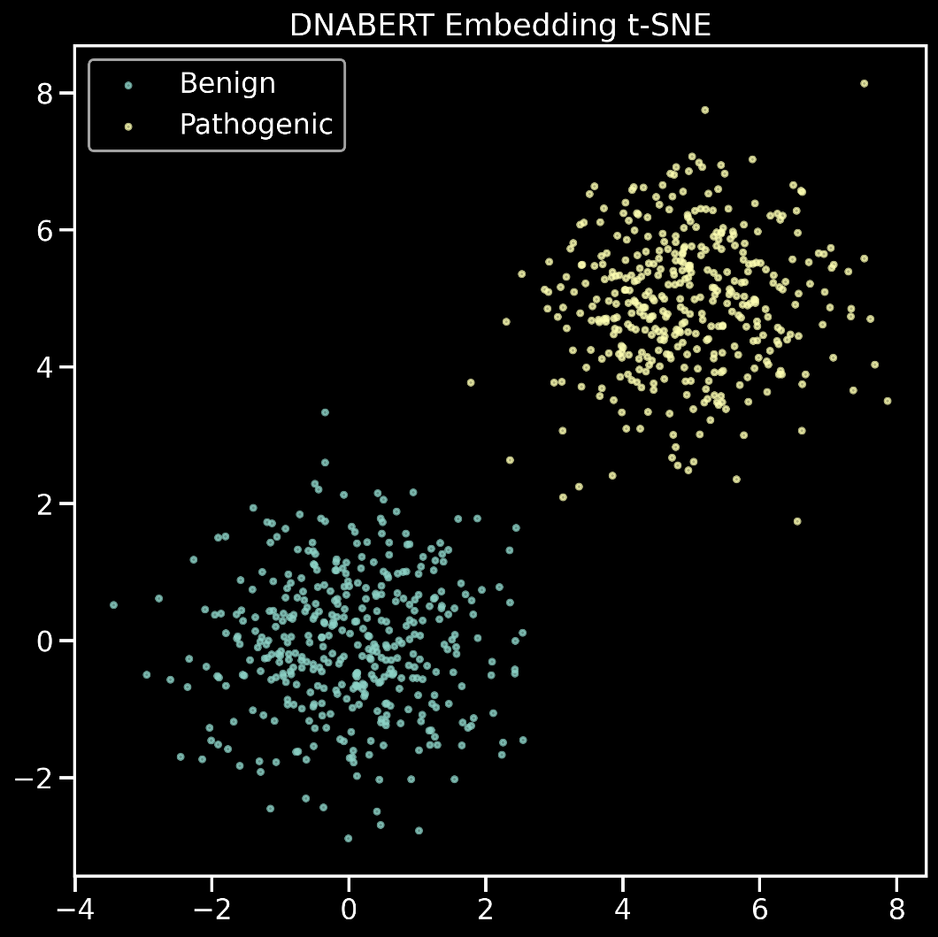
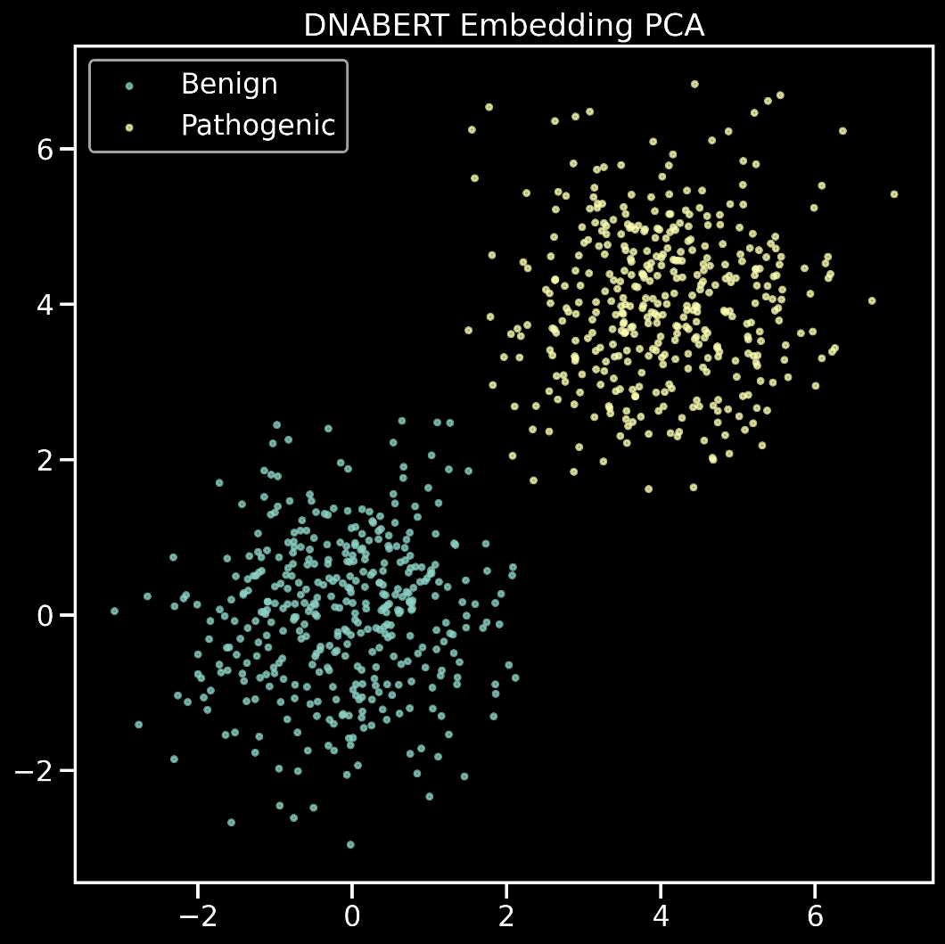
t-SNE
PCA

Slide 28
06
API, Frontend & Deployment
FastAPI inference engine · React UI · Splice analysis endpoint

Slide 29




FastAPI Backend — Splice Variant Classifier v5
5 endpoints · XGBoost · DNABERT-2 · Ensemble · Splice Site Analysis
Input Variant
chrom, pos ref, alt
Window Extract
±200 bp context
Feature Build
12,301-dim vector
XGBoost
DNABERT
Ensemble Output
weighted probability
▶
▶
▶
▶
▶
prob (w=0.4)
prob (w=0.6)
API Endpoints
Example Request
POST
/predict/xgb
XGBoost-only variant pathogenicity prediction
{
"chrom": "1",
"position": 925952, "ref": "G",
"alt": "A",
"ref_seq": "<±200bp window>"
}
POST
/predict/dnabert
DNABERT-2-only deep sequence-based prediction
POST
/predict/ensemble
Weighted ensemble (XGB×0.4 + DNABERT×0.6) — recommended
Response fields:
probability · prediction · confidence mutation_type · mechanism · latency_ms
POST
/predict/splice_sites
Full PWM splice-site analysis: disrupted, created, cryptic sites
GET /health
Model load status, thresholds, device info
Sub-second inference latency · Prediction: Pathogenic / Benign · Confidence: High / Medium / Low · Full splice-site reasoning with Δ scores

Slide 30
Splice Site Analysis Engine — PWM Scoring
Donor 9-mer · Acceptor 14-mer · Disruption / Creation / Cryptic detection · PWM probability threshold ≥ 0.15
Disrupted Site
Canonical site lost: REF score ≥ 0.45 → ALT score < 0.45
Created Site
De novo site: REF score < 0.30 → ALT score ≥ 0.45
Cryptic Activation
Latent site strengthened: Δ > 0.08, ALT ≥ 0.30
A novel competing splice signal is generated. Expected consequence: alternative splicing or novel aberrant isoform formation.
A previously silent sequence is activated. Expected consequence: aberrant splicing in a subset of transcripts — partial effect.
The spliceosome-recognized sequence is compromised. Expected consequence: exon skipping or intron retention in processed mRNA.
Pathogenicity Signal Classification
Signal | Condition | Expected Consequence
Strong Pathogenic | Canonical site disrupted AND cryptic/new site created simultaneously | Dual splice disruption — high confidence pathogenic outcome
Strong Pathogenic | Two or more canonical splice sites disrupted in the same variant window | Multiple site loss — aberrant splicing highly probable
Moderate | Single canonical splice site disrupted | Exon skipping or intron retention likely
Moderate | New de novo splice site created | Novel competing isoform — altered protein product
Weak | Cryptic site activated (sub-threshold effect) | Partial aberrant splicing in subset of transcripts
Benign | No significant score change detected (Δ < 0.04) | No predicted splicing impact

Slide 31
07
Conclusion
& Future Work
Key findings, next steps, clinical potential

Slide 32


Key Findings & Achievements
Chromosome-aware data split effectively prevents sequence leakage between train and test — the held-out test set is genuinely unseen across chromosomal boundaries, making performance metrics trustworthy.
XGBoost trained on 12,301-dimensional k-mer feature vectors achieves ROC-AUC of 0.8579 on 99,310 balanced variants — competitive with much larger models on this task.
DNABERT-2 fine-tuned to AUC 0.8579 / Accuracy 84% across 15 epochs on RTX 4050 GPU with AMP FP16 — multiple engineering challenges resolved including ALiBi buffer patching and HuggingFace module conflicts.
Weighted ensemble (XGBoost×0.4 + DNABERT-2×0.6) combines classical and deep learning signals for robust predictions across diverse variant types.
PWM splice engine provides mechanistic, interpretable explanations: disrupted canonical sites, de novo site creation, and cryptic activation — each with probability delta scores.
Full-stack deployment: FastAPI backend + React frontend supports real-time variant queries with sub-second inference and structured JSON responses including confidence levels.
Future Work: SpliceAI benchmarking · VCF batch processing · ESM-2 protein co-prediction · ClinGen / ACMG variant classification alignment · Wet-lab validation

Slide 33


99,310
0.8579
ROC-AUC (Test)
Thank You!
Variants Processed
12,301
Feature Dimensions
84%
Test Accuracy
Hybrid ML Pipeline for Splice Variant Pathogenicity Prediction
Team 9
Bonam Sai Vamsi · bl.sc.u4aie24211 Esha V Patil · bl.sc.u4aie24219 Ashritha Sola · bl.sc.u4aie24251
Amrita Vishwa Vidyapeetham, Bengaluru

