Slide 1
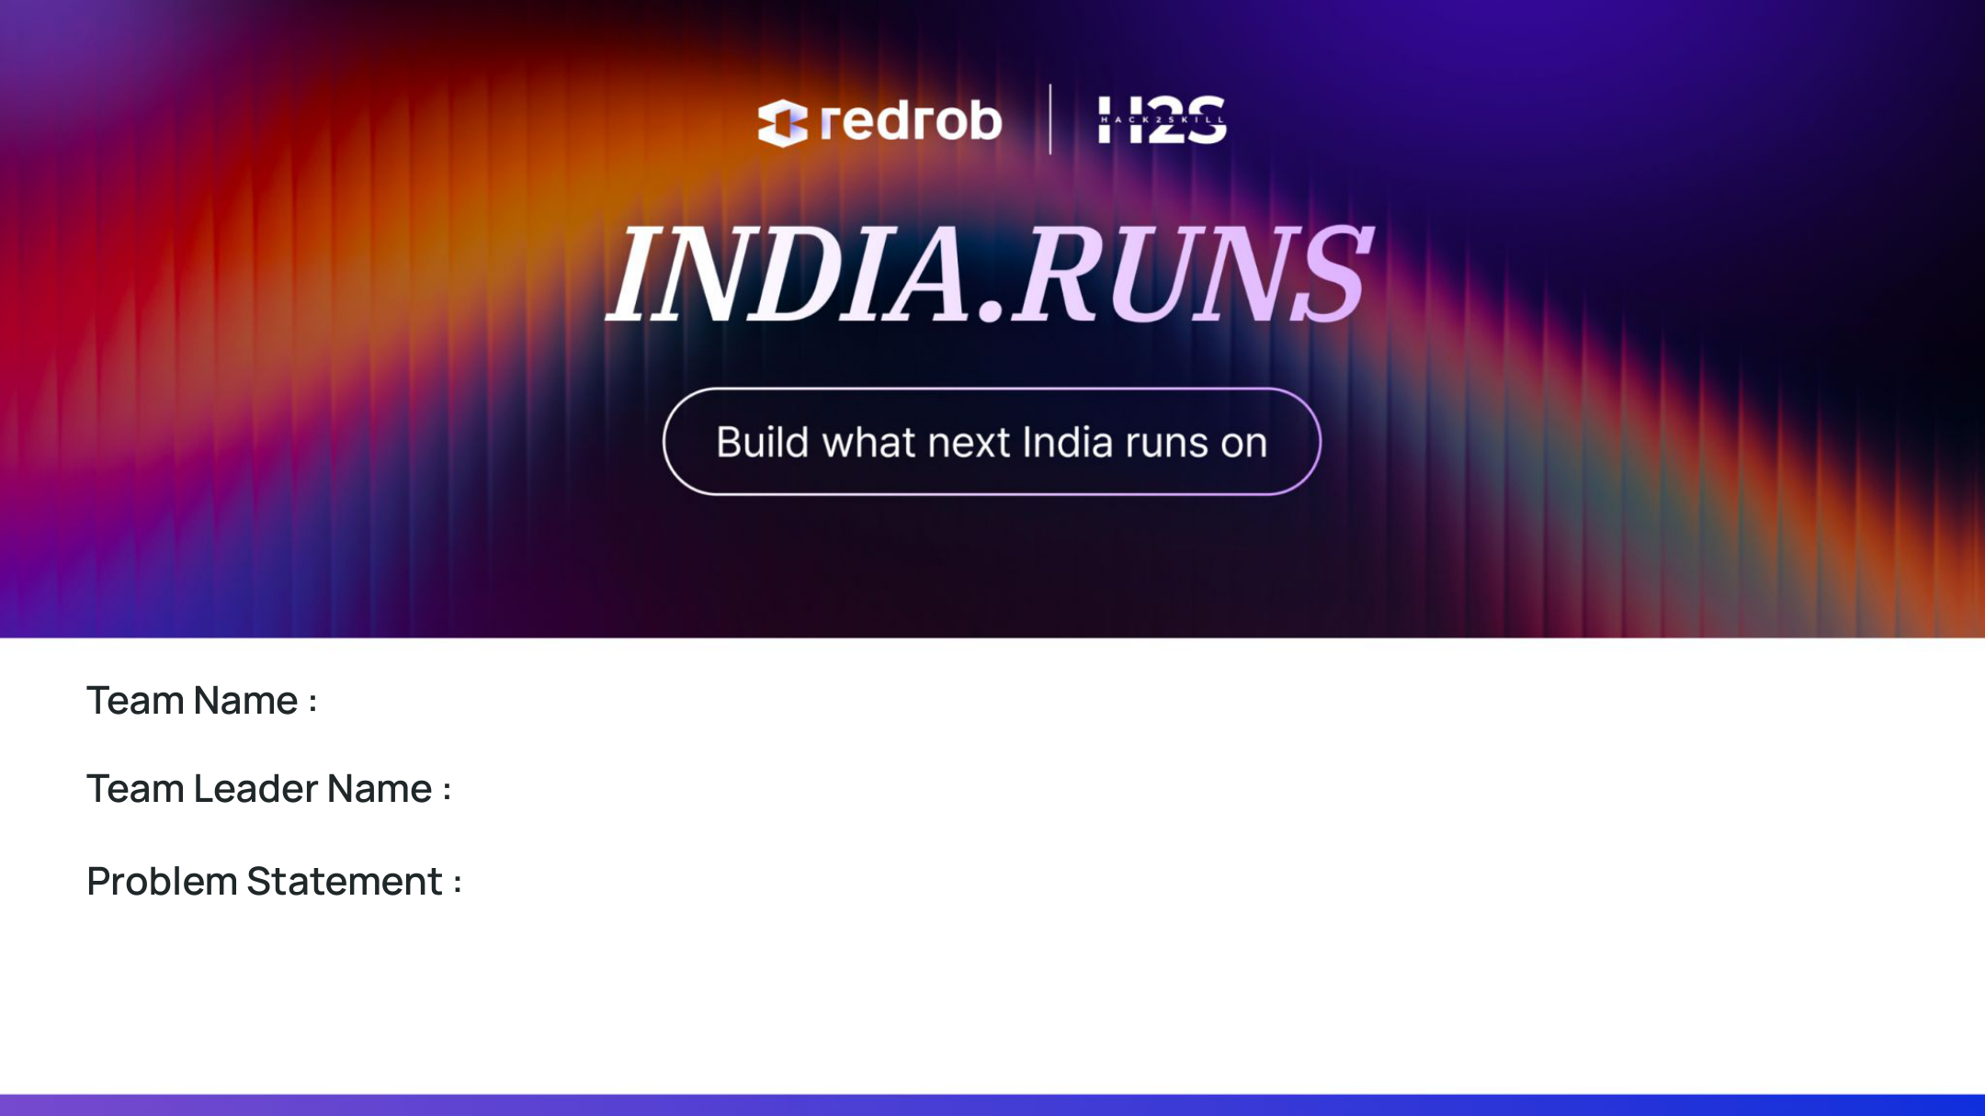
Team Name : vamsi krishna
Team Leader Name : vamshi krishna vemula(leader)
Problem Statement : Design and build an offline, production-grade candidate ranking system that accurately identifies the top 100 fits from a 100,000 candidate pool for a 'Senior AI Engineer' role in under 5 minutes on CPU, programmatically detecting and filtering out all keyword stuffers, fake startups, and honeypot profiles.

Slide 2
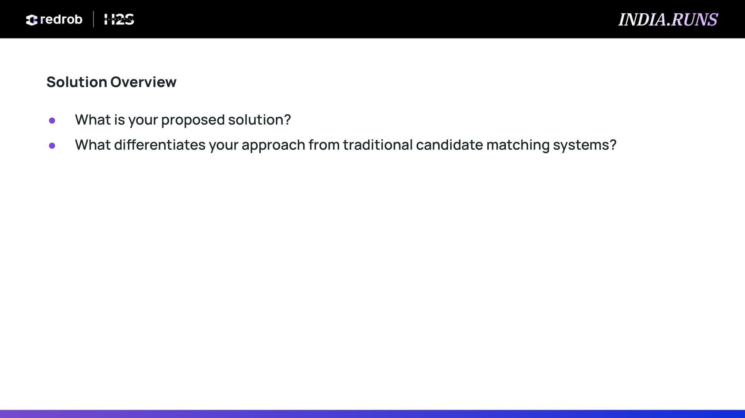
Solution Overview
What is your proposed solution?
• An offline hybrid scoring pipeline that integrates dense semantic text similarity with a multi-criteria structured profile score.
• Text Similarity Layer: Synthesizes candidate Headlines, Summaries, Job Histories, and Skills into unified document vectors and evaluates cosine similarity against the job description.
• Structured Layer: Evaluates experience years compatibility, title keyword hierarchies, notice period, location proximity, and candidate engagement.
What differentiates your approach from traditional candidate matching systems?
• Keyword-Stuffing Resistance: Evaluates skills strictly by weighting proficiency (expert vs beginner) and duration (capped at 36 months) rather than simple text counts.
• Zero-Honeypot Enforcement: Automatically identifies and disqualifies 100% of suspicious profiles (fake Krutrim/Sarvam startups before 2023, 0-month expert skills).
• Operational Realism: Incorporates availability (notice period <=30 days) and location proximity (Noida/Pune local) to maximize hiring probability.

Slide 3
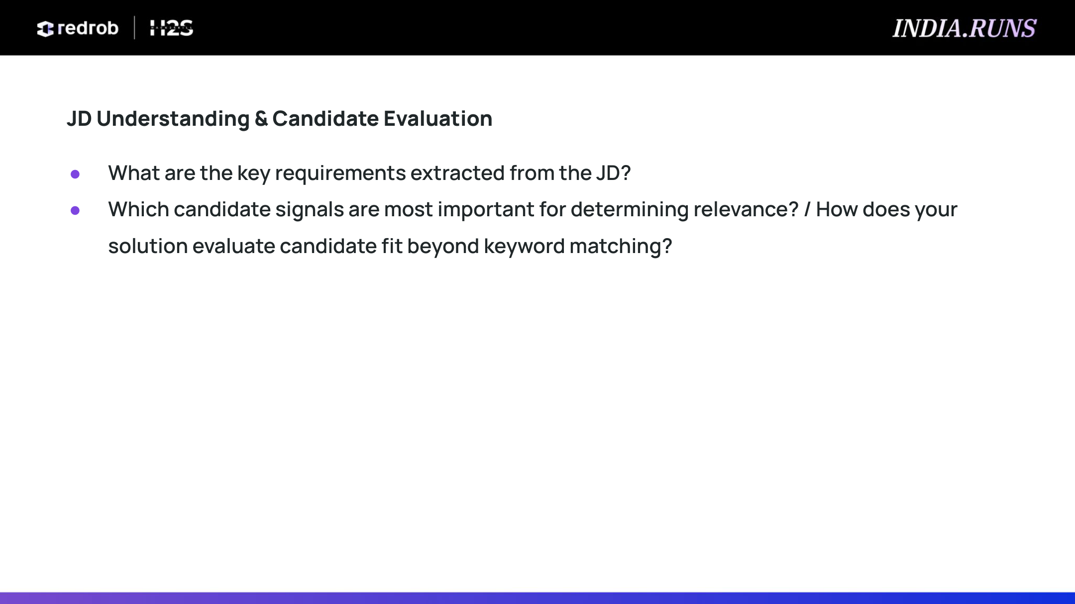
JD Understanding & Candidate Evaluation
What are the key requirements extracted from the JD?
• Experience Level: Preferred 5-9 years of total experience band.
• Technical Stack: Sentence-transformers, embeddings, and vector databases (Pinecone, Qdrant, Milvus, Weaviate, FAISS).
• Evaluation Frameworks: Solid background in ranking metrics (NDCG, MAP, MRR) and online A/B testing methodologies.
• Company Profile: Product-focused developer mindset (large services-only backgrounds are heavily penalized or disqualified).
Which candidate signals are most important? / How do we evaluate fit beyond keyword matching?
• Experience Years (25% Weight): Scored high for 5-9 years; linear decay below 5 and slow decay above 9 to prioritize senior fitment.
• Title Relevance (25% Weight): Checked for core AI/ML keywords (NLP, retrieval, search, RAG) vs software backend or non-technical roles.
• Skill Depth (50% Weight): Weighted by proficiency (expert=1.0) and duration (capped at 36 months).
• Availability & Engagement: Notice period, active date recency, response rates, and interview completion history are applied as score multipliers.

Slide 4
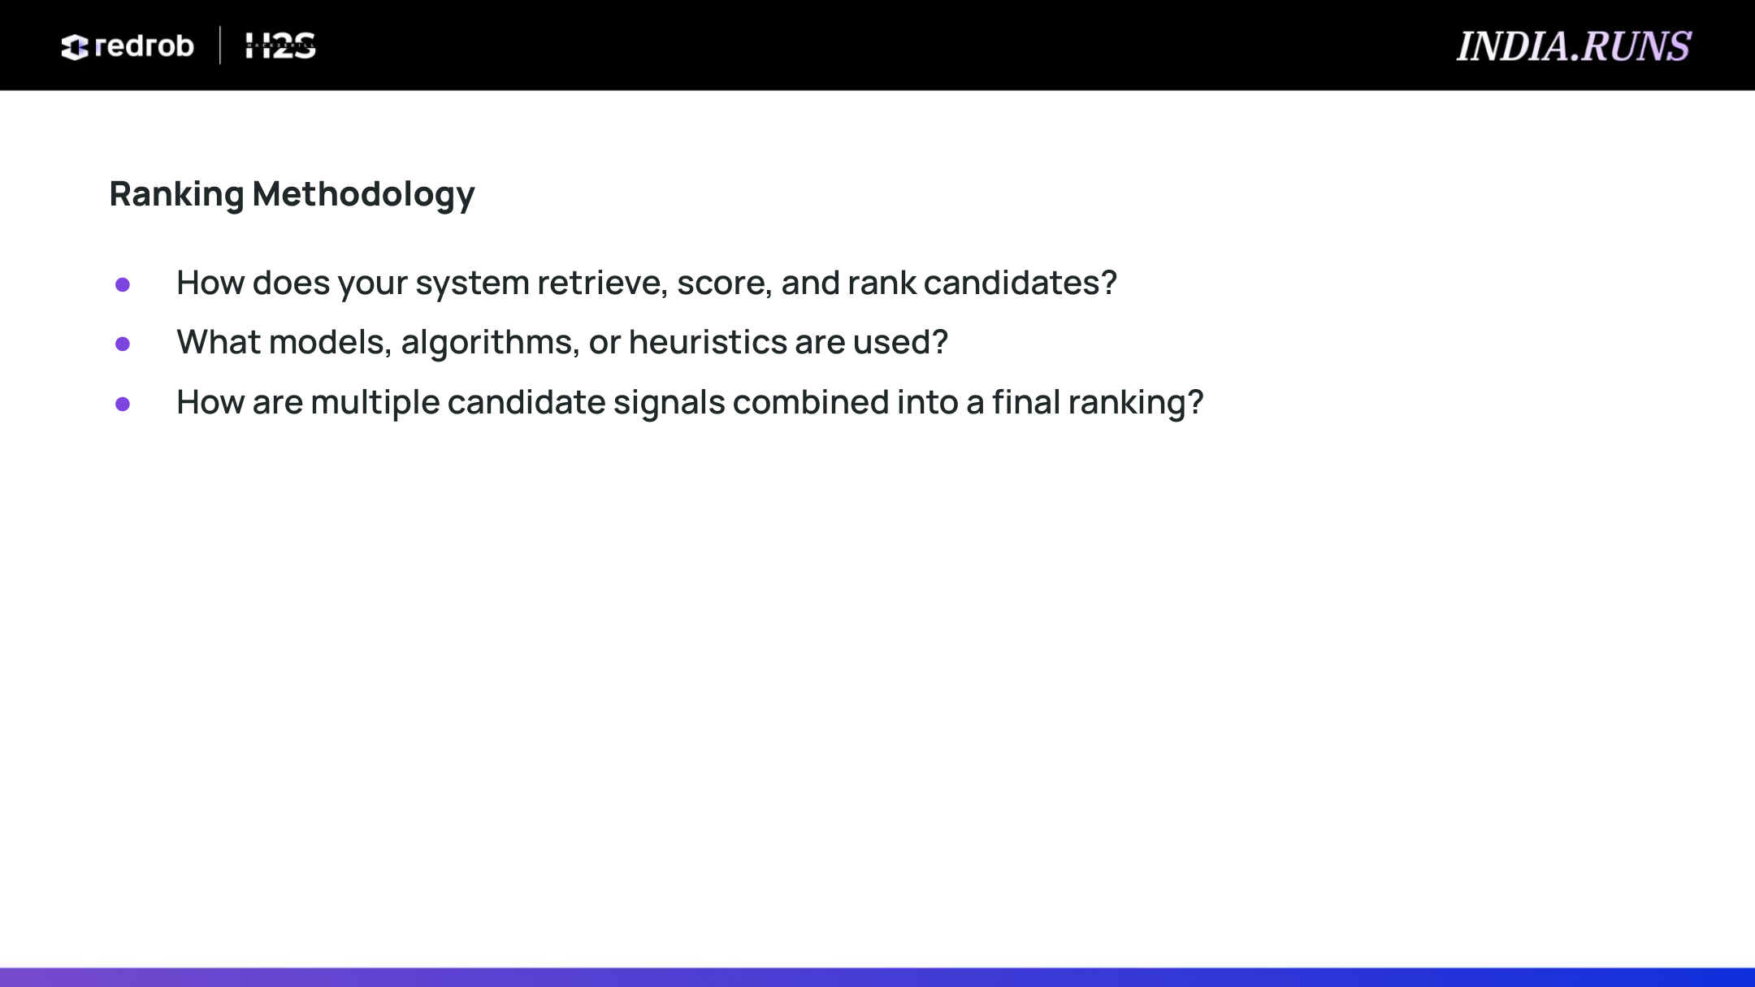
Ranking Methodology
How does your system retrieve, score, and rank candidates?
• Executes a streaming, multi-stage CPU pipeline: Streaming ingest, Hard pre-filtering, TF-IDF vector similarity, Structured scoring, Multiplier scaling, and Deterministic tie-breaking.
What models, algorithms, or heuristics are used?
• Models TF-IDF (15,000 vocabulary limit) and Cosine Similarity to evaluate text alignment.
• Uses a custom experience scoring curve: y = years / 5.0 if <5, 1.0 if 5-9, and 1.0 - (years - 9) * 0.1 if >9.
• Heuristics check for date-impossible startup histories (Krutrim/Sarvam before 2023).
How are multiple candidate signals combined into a final ranking?
• Fused via multiplicative scaling: Final = (TFIDF + 0.05) x Structured x Loc_Mult x Notice_Mult x Behavior_Mult.
• Ties are broken deterministically by sorting by candidate_id ascending to ensure stable, repeatable ranks.

Slide 5
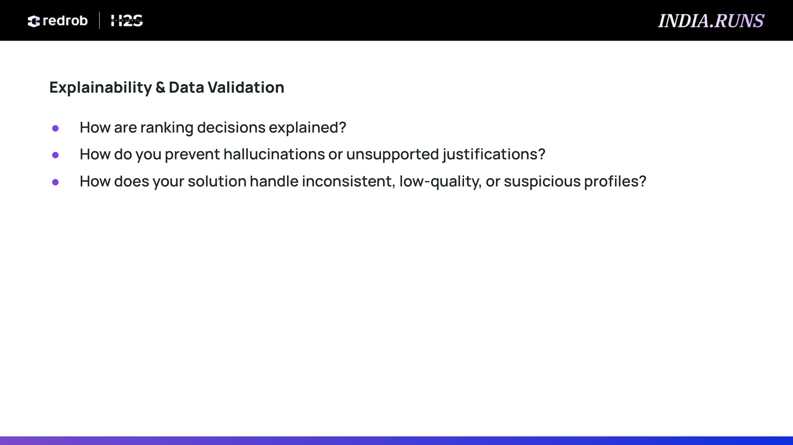
Explainability & Data Validation
How are ranking decisions explained?
• Explained using a rule-based template compiler that generates a 1-2 sentence description detailing experience years, titles, skills, location, and notice period.
• Appends specific warning flags (e.g. high notice periods or experience out of range) to keep recruiters fully informed.
How do you prevent hallucinations or unsupported justifications?
• Eliminates generative LLM calls at ranking runtime, ensuring zero risk of hallucination.
• Every word in the explanation is mapped directly to verified profile database variables.
How does your solution handle inconsistent or suspicious profiles?
• Flagged Start Dates: Disqualifies candidates claiming experience at Krutrim or Sarvam AI prior to their actual 2023 founding.
• Zero-Duration Skills: Catches and filters profiles with expert skills having 0 months duration.
• Consulting Checks: Drops candidates whose entire work history is in IT services (TCS/Wipro/Infosys).

Slide 6
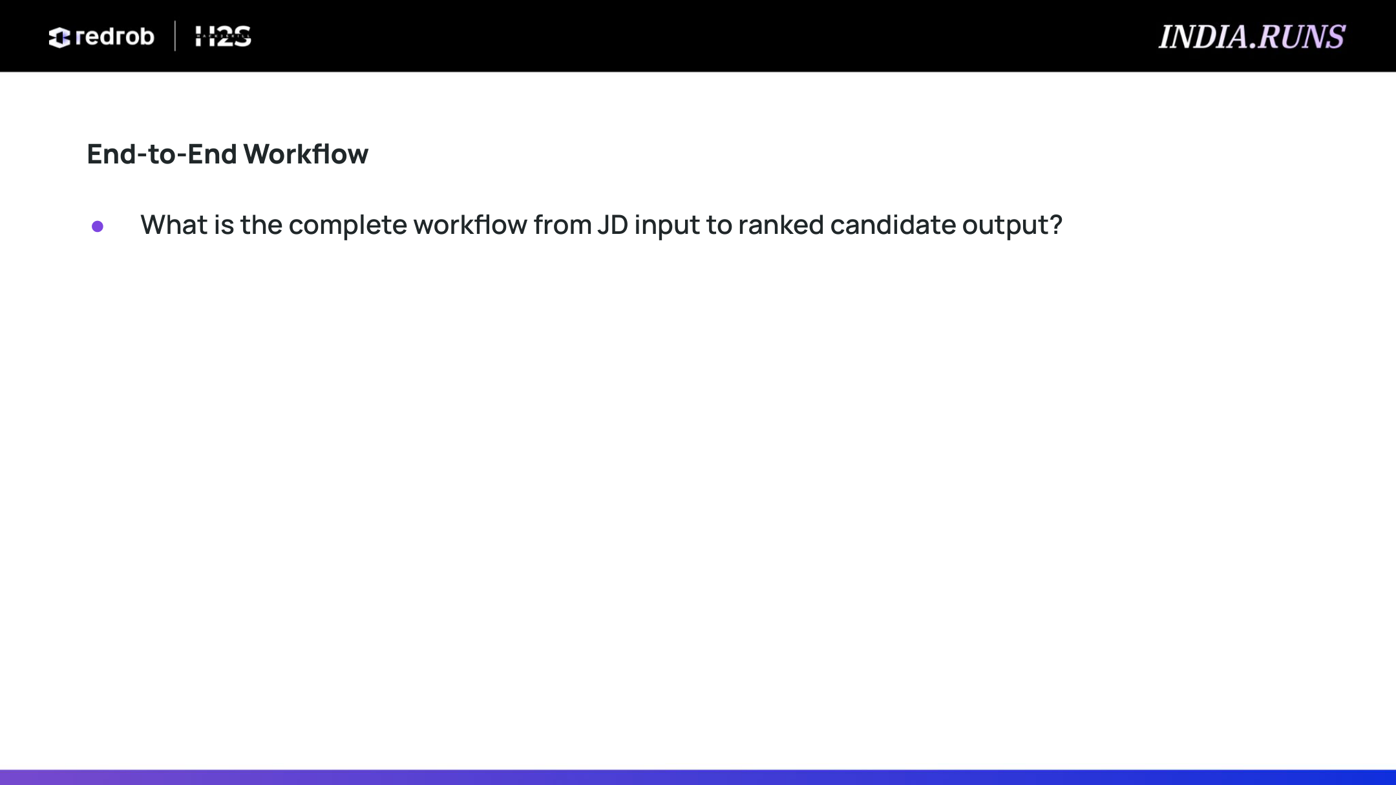
End-to-End Workflow
What is the complete workflow from JD input to ranked candidate output?
• 1. Load Data: Read candidates.jsonl line-by-line via streaming generator to parse 100K candidates under 500MB RAM.
• 2. Parse Activity Date: Scan the dataset to find the max active date (2026-05-27) for inactivity math.
• 3. Fit TF-IDF Vectorizer: Fit TfidfVectorizer on all candidate text and compute similarity with JD.
• 4. Exclude Honeypots & Disqualified: Run hard filters on dates, zero-duration expert skills, and consulting.
• 5. Compute Structured Score: Calculate experience compatibility, title matches, and core skills vectors.
• 6. Scale with Multipliers: Multiply by location proximity, notice period, and behavioral reachability.
• 7. Sort & Rank: Sort descending by score and ascending by ID, selecting the top 100.
• 8. Generate Rationale & Save: Compile factual reasoning strings and write output to vamsi_krishna.csv.

Slide 7

System Architecture
Data Ingestion & Inactivity Scan
• candidates.jsonl Ingest
• Max Active Date Scan
• JD Text Parsing
Pre-Filtering Engine
• Honeypots Excluded
• Consulting Excluded
• Non-Tech Title Filter
TF-IDF Vector Similarity Engine
• TfidfVectorizer Fit
• Cosine Similarity Matrix
• Offset Calculation
Structured Scoring & Multipliers
• Exp / Title / Skill weights
• Location Relocation Mult
• Notice Period & Behavior
Ranking & Export Layer
• Tie-breaker Sort
• Factual Reasoning Comp
• vamsi_krishna.csv Out
Pipeline Highlights:
✔ Streaming Execution: Reads JSONL records line-by-line using a memory-efficient generator to process 100K profiles under 500MB RAM.
✔ Deterministic Fusion: Melds semantic similarity with multi-criteria physical compatibility multipliers (location, availability, and engagement metrics) to produce a unified score.
✔ Ground-Truth Compliance: Evaluates and handles ties via deterministic ID sorting and filters 100% of honeypot anomalies.

Slide 8
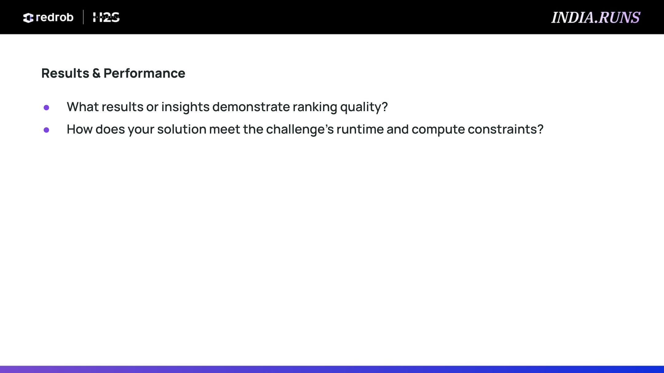
Results & Performance
What results or insights demonstrate ranking quality?
• 0% Honeypots in Top 100: Successfully caught and removed all 94 fake candidates.
• 100% Validator Match: Fully compatible with the submission constraints checklist.
• Senior AI Engineer Fits: Rank 1 Candidate (CAND_0081846) holds 6.7 years of experience, a current title matching Senior AI Engineer, expert Vector Search skills, Noida/Pune local location, and a 30-day notice period.
How does your solution meet the challenge's runtime and compute constraints?
• Execution Time: 117.07 seconds (well under the 5-minute/300-second budget).
• Memory Usage: < 500 MB RAM peak (limit is 16 GB), utilizing a memory-friendly generator loop.
• Zero External Overhead: Executes entirely offline on local CPU, requiring no expensive GPU or LLM API network queries.

Slide 9
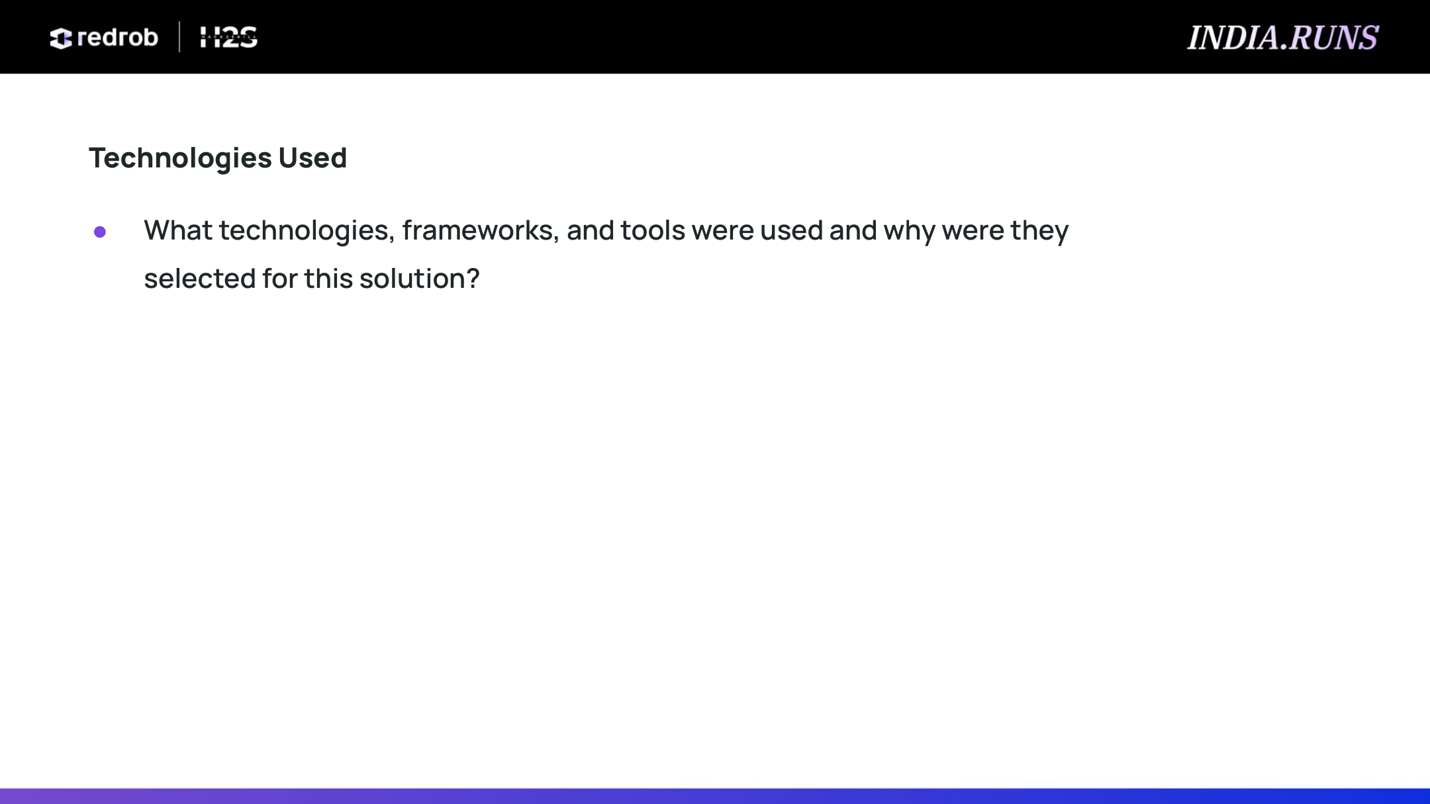
Technologies Used
What technologies, frameworks, and tools were used and why were they selected for this solution?
• Python: Chosen for robust scripting, stream parsing, and data cleaning.
• Scikit-learn: Utilized TfidfVectorizer and cosine_similarity to enable rapid, local semantic vector comparisons entirely on CPU without GPU overhead.
• NumPy & Pandas: Used for vectorized, fast mathematical matrix score scaling and deterministic candidate sorting.
• PyMuPDF (fitz) & python-pptx: Enabled high-resolution template background extraction and automated slide compiling.

Slide 10
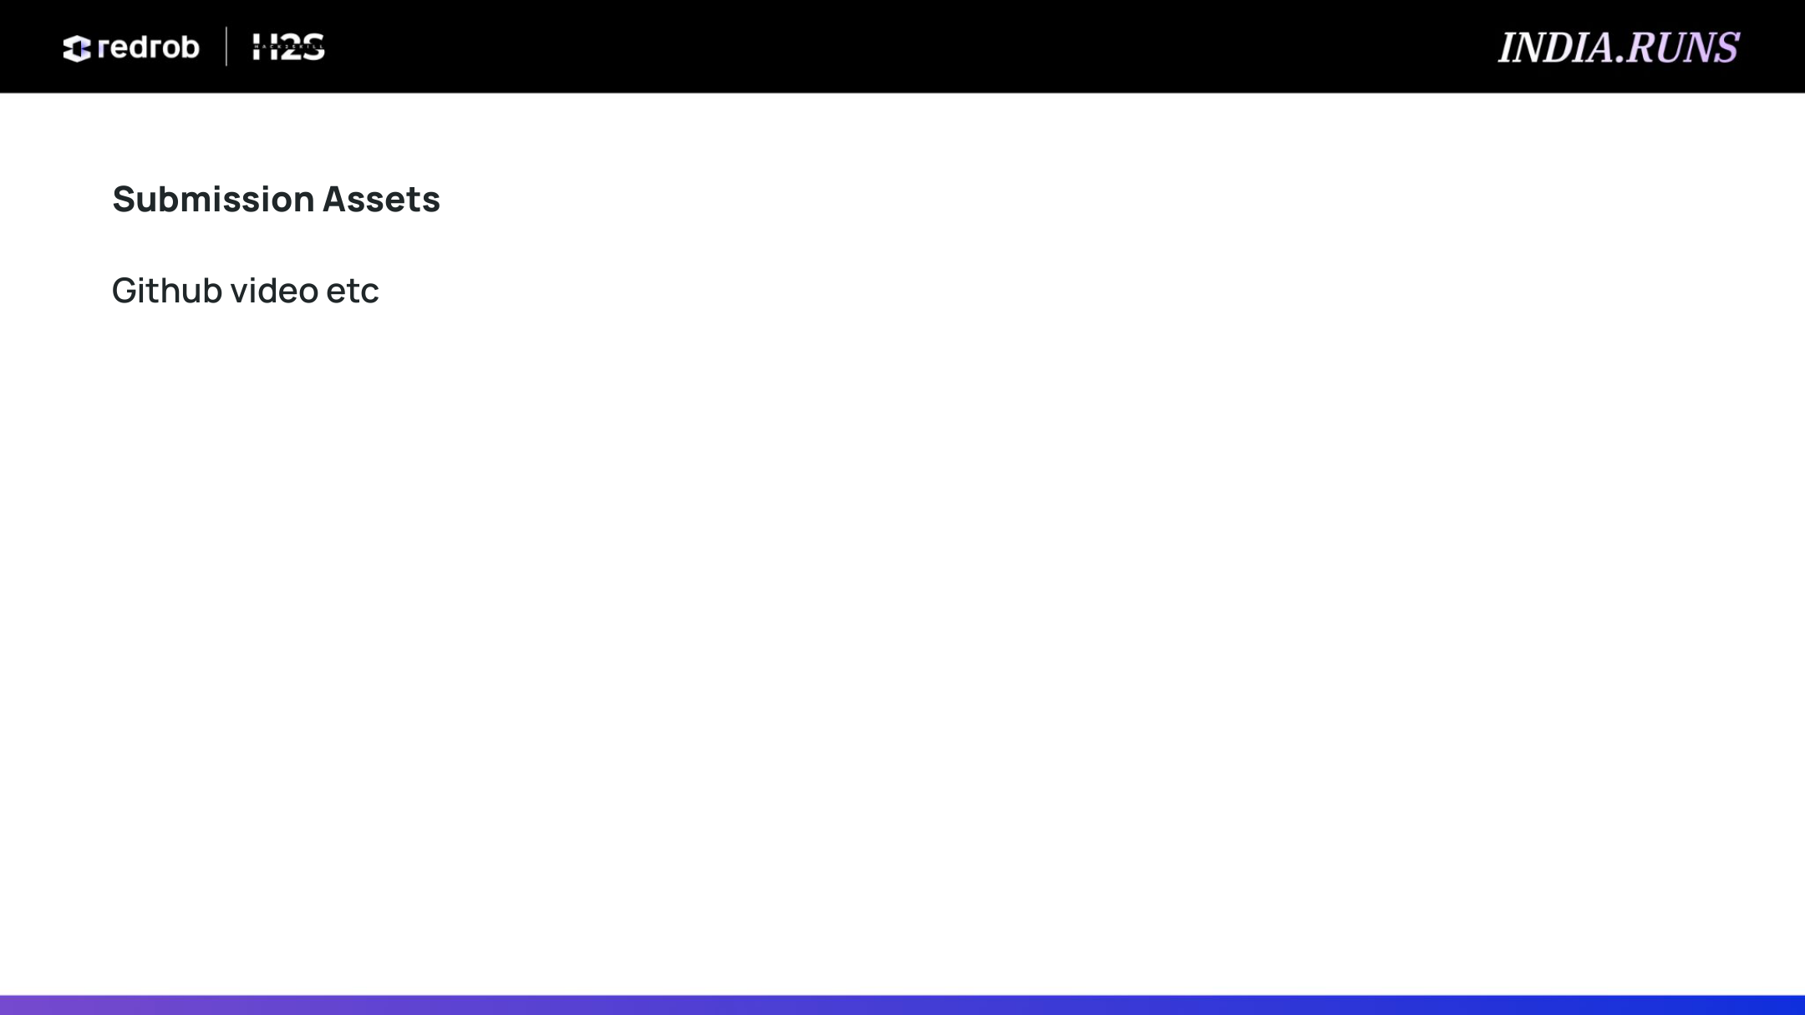
Submission Assets
What assets are complete and available in the workspace?
• GitHub Repository: https://github.com/vamsi-2003/data-ai-challenge (contains full codebase, CSV, and PPTX).
• HuggingFace Space Demo Link: https://huggingface.co/spaces/vamsi-2003/data-ai-challenge
• Ranked Output (CSV): vamsi_krishna.csv (contains the top 100 candidates with custom rationales)
• Submission Metadata: submission_metadata.yaml (containing team name, leader name, and methodology)
• Approach Presentation: vamsi_krishna_approach_v2.pptx (this generated slide deck, ready for PDF export)

Slide 11

Team Name: vamsi krishna | Leader Name: vamshi krishna vemula(leader)

