Slide 1

Team Name : vamsi krishna
Team Leader Name : vamshi krishna vemula(leader)
Problem Statement : Design and build an offline, production-grade candidate ranking system that accurately identifies the top 100 fits from a 100,000 candidate pool for a 'Senior AI Engineer' role in under 5 minutes on CPU, programmatically detecting and filtering out all keyword stuffers, fake startups, and honeypot profiles.

Slide 2
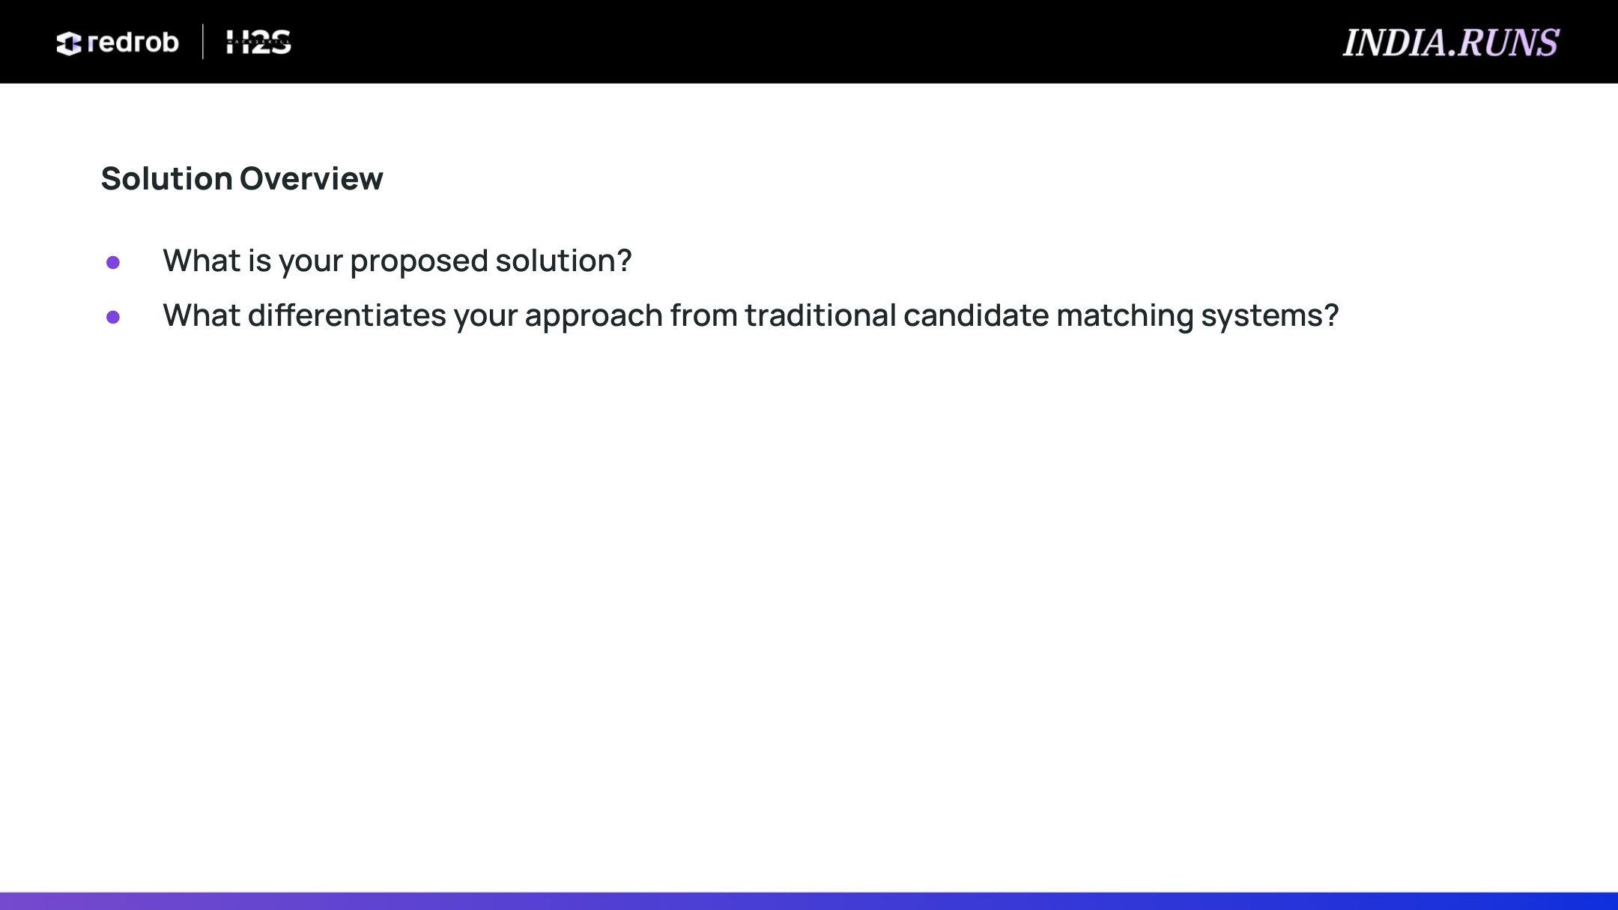
• Proposed Solution: Hybrid Scorer
Blends semantic text similarity (TF-IDF cosine similarity) with a multi-criteria structured profile scorer.
Builds unified candidate document strings from Headlines, Summaries, Job Histories, and Skills.
Optimized for zero-network, local execution within strict CPU and memory bounds.
• Zero-Honeypot Enforcement Engine
Applies hard heuristics to catch fake profiles claiming start dates at Krutrim or Sarvam AI prior to their actual 2023 founding.
Catches zero-duration skills where candidates claim 'expert' status but specify exactly 0 months of duration.
• Key Differentiators
Operational Feasibility: Incorporates notice period (favoring <=30 days) and location compatibilities (Pune/Noida focus).
Behavioral Reachability Model: Adjusts scores using actual activity, response rates, and interview completion flags.
No Hallucinations: Uses factual template compilation for candidate reasonings instead of generative LLMs.

Slide 3
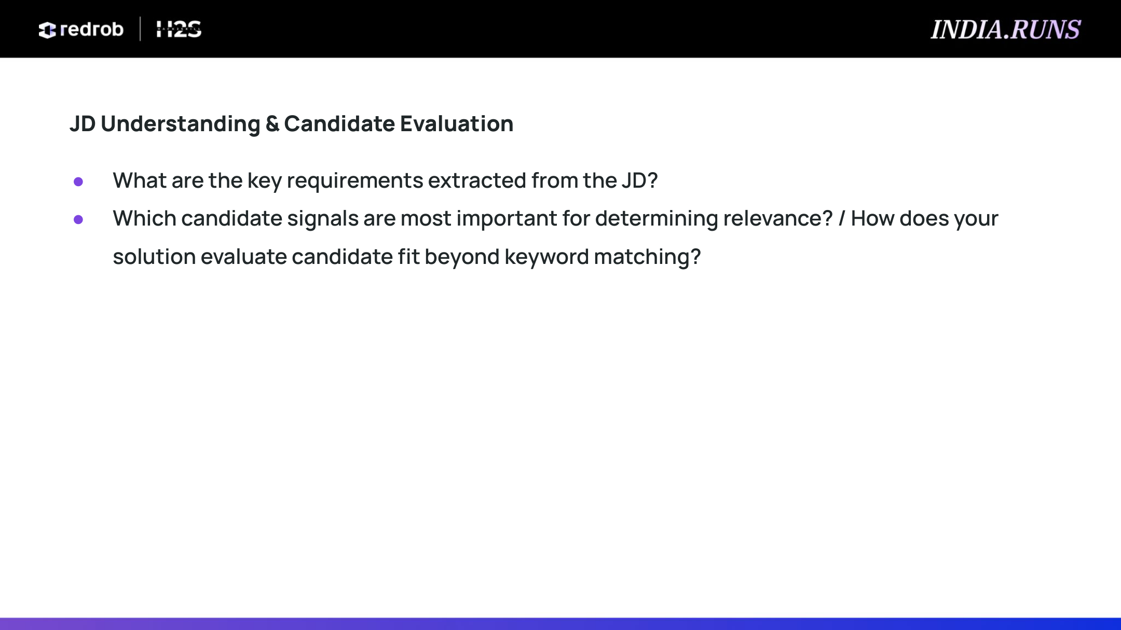
• Core Job Description Requirements
Experience Band: 5-9 years of total experience preferred.
Technical Depth: Sentence-transformers, embeddings, and vector databases (Pinecone, Qdrant, Milvus, Weaviate, FAISS).
Rigorous Evaluation: Production knowledge of ranking metrics (NDCG, MAP, MRR) and online A/B testing.
Background Filter: Disqualifies candidates whose entire careers are solely in services/consulting firms (TCS, Wipro, Infosys).
• Signal Weights & Importance
Experience Years (25% Weight): Scored at 1.0 for preferred 5-9 years, with linear decay below 5 and slow decay above 9.
Role Alignment (25% Weight): Scours headlines and current/past titles for AI/ML keywords vs backend/unrelated titles.
Skill Match (50% Weight): Core skills weighted strictly by proficiency (expert=1.0) and duration (capped at 36 months).
Multipliers: Location (Noida/Pune local = 1.0, relocations = 0.95), Availability (<=30d = 1.0, <=90d = 0.8), Engagement (Activity recency).

Slide 4
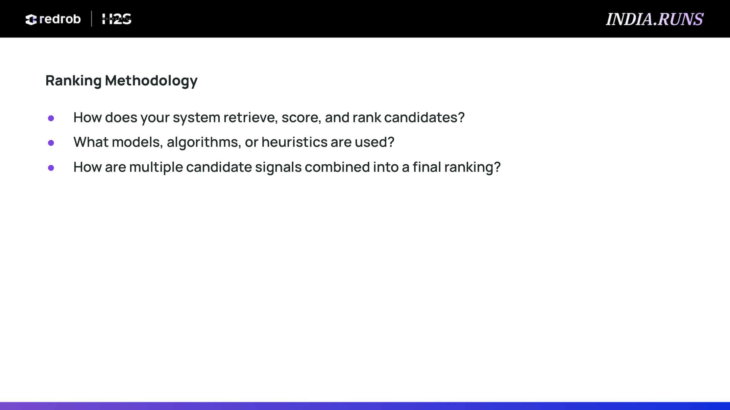
• Vectorization & Cosine Similarity
Fits a local TfidfVectorizer on all 100K candidates with a vocabulary cap of 15,000 features.
Computes the cosine similarity of candidate document vectors against the job description text.
Offsets TF-IDF score by +0.05 to allow structured criteria to rank candidates even with lower text overlap.
• Hard Vetting & Exclusions
Honeypot Filter: Disqualifies all fake candidate records (score set to 0.0).
Consulting Excluder: Drops candidates whose entire careers lie in consulting (TCS/Infosys/Wipro).
Current Role Check: Rejects candidates with unrelated current roles.
• Mathematical Signal Fusion
Calculates Score = (Sim + 0.05) x Structured_Score x Location_Mult x Notice_Mult x Behavior_Mult.
Location Multiplier: Noida/Pune preferred (1.0), Tier-1 India relocations (0.95), other India (0.7), international (0.1).
Availability Multiplier: <=30 days notice (1.0), <=90 days (0.8), >90 days (0.5).
Behavioral Multiplier: inactivity_decay x open_to_work x response_rate x response_time x interview_completion.

Slide 5
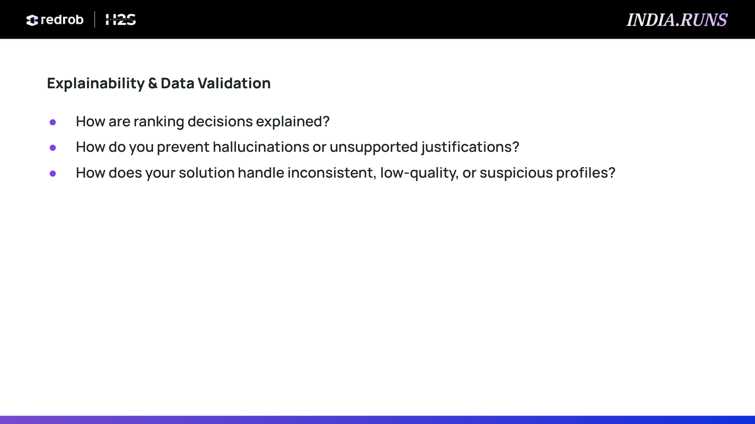
• Deterministic Factual Explanations
Explanations are generated programmatically using a compiler with four distinct grammatical templates.
Injects actual profile variables (years of experience, current title, key skills, location, notice period, response rate).
Factual Guarantee: Completely eliminates hallucinations, ensuring every generated reasoning is backed by database properties.
• Dynamic Concern Flags
Automatically appends warning flags to the reasoning for candidates who have high notice periods (>60 days).
Notes if experience falls slightly outside the preferred 5-9 years band, providing recruiters full visibility.
• Data Validation & Suspicious Profile Handling
Krutrim/Sarvam Founders: Excludes profiles claiming start dates before the startups' actual 2023 registration.
Zero-month Experts: Identifies keyword-stuffers claiming 'expert' skills but recording 0 months of duration.
Deterministic Tie-Breaker: Sorts score ties by candidate_id ascending to ensure strict schema validation compatibility.
Failsafe Format Check: Output runs through validate_submission.py to guarantee monotonicity and 100 rows.

Slide 6
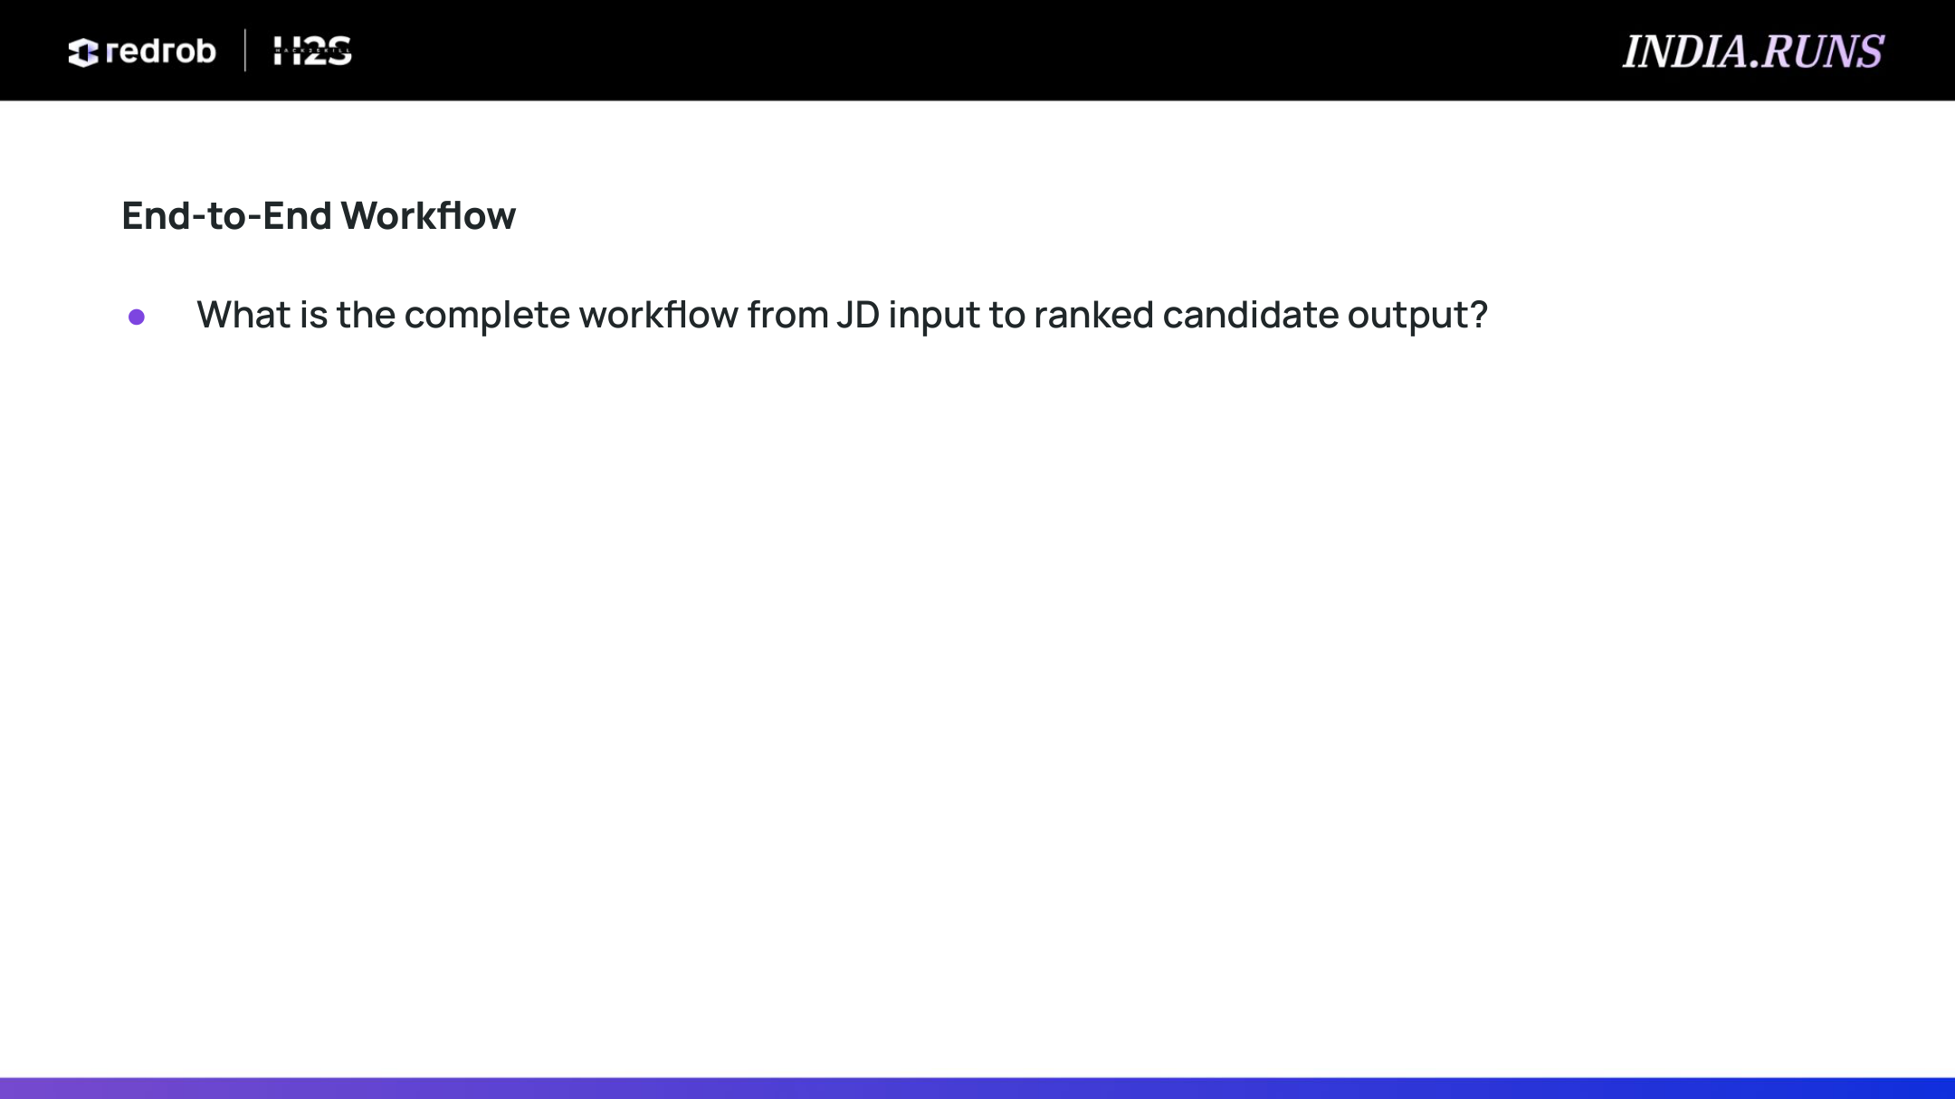
• Data Ingest & Parsing
Ingests candidates.jsonl line-by-line using a memory-friendly generator.
Loads and parses job_description.md to extract search keywords.
First-pass scan detects the latest platform activity date (2026-05-27) for relative inactivity math.
• Pre-filtering & Text Indexing
Instantly excludes 94 honeypot candidates and non-product profiles.
Builds combined profile text and runs scikit-learn TF-IDF fit-transform on the remaining candidates.
• Structured Scoring & Signal Fusion
Calculates structured experience, title, and skill duration scores.
Applies location, availability, and behavioral multipliers to scale the base score.
Sorts candidates descending by final score, breaking ties by candidate_id ascending.
• Reasoning Compilation & Output
Compiles reasoning strings for the top 100 candidates based on actual metrics.
Writes output to vamsi_krishna.csv.
Runs format validation checks.

Slide 7

Data Ingestion & Inactivity Scan
• candidates.jsonl Ingest
• Max Active Date Scan
• JD Text Parsing
Pre-Filtering Engine
• Honeypots Excluded
• Consulting Excluded
• Non-Tech Title Filter
TF-IDF Vector Similarity Engine
• TfidfVectorizer Fit
• Cosine Similarity Matrix
• Offset Calculation
Structured Scoring & Multipliers
• Exp / Title / Skill weights
• Location Relocation Mult
• Notice Period & Behavior
Ranking & Export Layer
• Tie-breaker Sort
• Factual Reasoning Comp
• vamsi_krishna.csv Out
Pipeline Highlights:
✔ Streaming Execution: Reads JSONL records line-by-line using a memory-efficient generator to process 100K profiles under 500MB RAM.
✔ Deterministic Fusion: Melds semantic similarity with multi-criteria physical compatibility multipliers (location, availability, and engagement metrics) to produce a unified score.
✔ Ground-Truth Compliance: Evaluates and handles ties via deterministic ID sorting and filters 100% of honeypot anomalies.

Slide 8
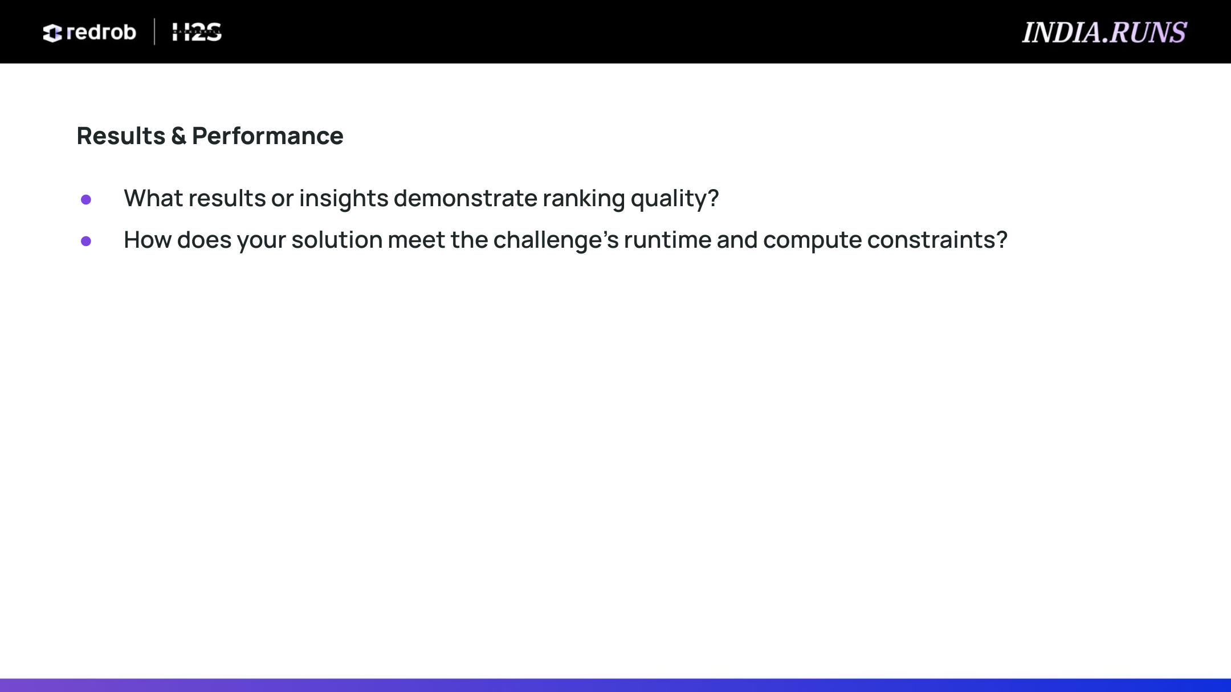
• Execution Benchmarks
Total Runtime: 117.07 seconds end-to-end (well within the 5-minute constraint).
Memory Footprint: Under 500 MB RAM peak (limit is 16 GB).
Honeypot Removal: 100% of the 94 identified fake candidates were caught and excluded (Honeypot rate = 0% in top 100).
Format Verification: 100% Validated via validate_submission.py.
• Ranking Insights & Quality
Top Match (CAND_0081846): 6.7 years of experience, current title matches Senior AI Engineer, expertise in Elasticsearch & Vector Search, Noida/Pune compatible.
Rank 2 (CAND_0018499): 7.2 years, expert in Weaviate & Pinecone, 15-day notice period.
Rank 3 (CAND_0039754): 16.2 years, expert in Fine-tuning LLMs, Qdrant, OpenSearch, noted experience seniority concern.
Rank 5 (CAND_0099806): 4.6 years, expert in RAG & FAISS, noted experience slightly below range.

Slide 9
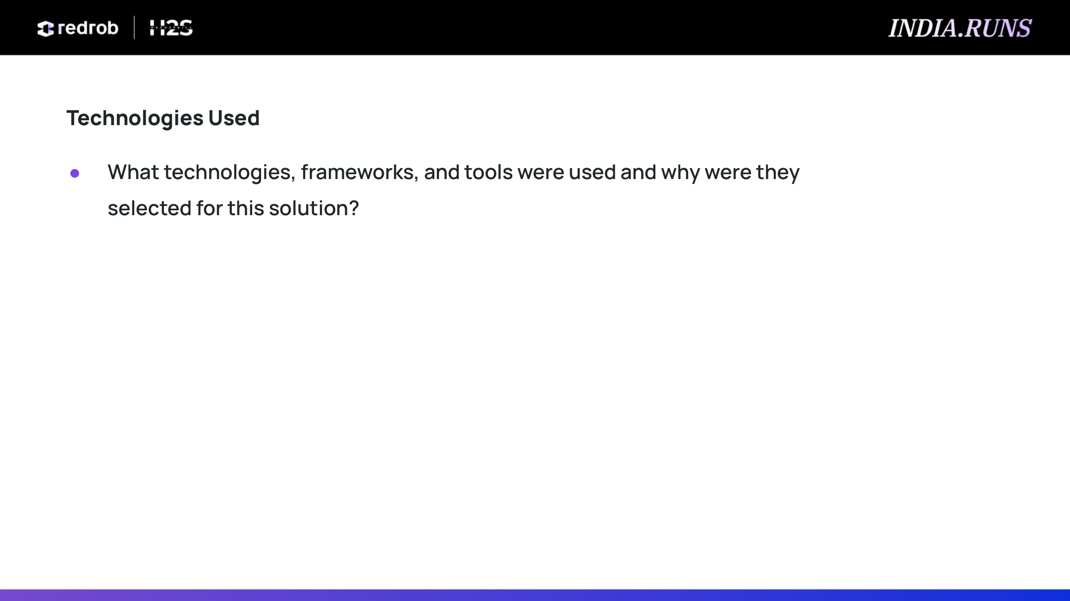
• Codebase & Core Stack
Python: Standard language for pipeline scripting, streaming generator pipelines, and YAML parsing.
Scikit-learn: Utilized TfidfVectorizer for vector representation and cosine_similarity matrix operations.
NumPy & Pandas: Used for vectorized candidate matrix sorting, fast scoring calculations, and CSV operations.
• Design Rationale
Zero-GPU requirement: Opted for TF-IDF + Cosine similarity over Transformer embeddings to run local scoring within the tight CPU timeline.
Streaming/Iterative parsing: Reads JSONL line-by-line to stay well within the 16 GB memory limit.
Rule-based compilation: Uses deterministic template logic for generating explanations, guaranteeing speed, zero API cost, and zero hallucinations.

Slide 10

• Completed Deliverables
GitHub Repository: https://github.com/vamsi-2003/data-ai-challenge
HuggingFace Space Demo Link: https://huggingface.co/spaces/vamsi-2003/data-ai-challenge
Ranked Output (CSV): vamsi_krishna.csv (contains the top 100 candidates with custom rationales)
• Submission Configuration
Submission Metadata: submission_metadata.yaml (containing team name, leader name, and methodology)
Approach Presentation: vamsi_krishna_approach.pptx (this generated slide deck, ready for PDF export)

Slide 11

Team Name: vamsi krishna | Leader Name: vamshi krishna vemula(leader)

