Slide 1
IBM University Engagement Project Submission
“Exploring the Power of Agentic AI with IBM and IBM Bob”

Slide 2

Project Tile – IBM BOB Problem Statement #22: AI Interview Trainer Agent
Domain of Project – Artificial Intelligence / Skill Assessment & Training / Education
Student Name | Recent Passport Photo | Email ID | Mobile number [WhatsApp]
Vamsi Addagarla |  | aa234567addagarlavamsi@gmail.com | 9059102023
Recommended font style and size:
Font Style: Arial
Font Size (Heading): 28
Font Size (Content): 20

Slide 3
Problem Statement -
Problem Statement : AI Interview Trainer Agent
The Challenge
Preparation for technical, behavioral, and HR interviews is often fragmented, static, and expensive. Candidates lack access to realistic, real-time mock interview practice that adapts to their specific experience level, domain, and target job role. Existing tools rely on generic question banks without providing structured feedback, actionable scoring, or domain-specific context, leaving job seekers unprepared for actual interview scenarios.
The Objective
Build an AI-powered Interview Trainer Agent on IBM watsonx Orchestrate and IBM Cloud that conducts personalized, interactive mock interviews and delivers actionable candidate evaluation. The solution should:
Personalized Onboarding & Adaptation – Tailor question domain, difficulty, and context based on candidate experience, target role, and key skill sets (candidate_profile.py).
Knowledge Base RAG Retrieval – Fetch real-world technical and behavioral questions and reference model answers from structured preparation materials (knowledge_base/rag_knowledge.py). .
Structured Evaluation & Scoring – Evaluate candidate answers on a 1–10 scale using Markdown evaluation tables, detailing strengths, missing concepts, and tips (prompt_templates.py).
Multi-Component Architecture –
Candidate Profile Manager (onboarding and session state)
Interview Engine (question selection and scoring logic)
RAG Knowledge Base (domain-specific interview context)
watsonx API Client (LLM communication and execution)s.

Slide 4
Proposed Solution -
Proposed Solution: AI-Powered Nutrition Agent
Overview
The proposed solution is an AI-powered Interview Trainer Agent built using IBM Bob, IBM watsonx Orchestrate, and watsonx.ai (Granite Models) to provide personalized, real-time mock interview coaching and answer evaluation. The system addresses challenges in interview preparation through a modular Python backend and intelligent agent orchestration.
Core RAG Architecture
At its core, the solution utilizes a Retrieval-Augmented Generation (RAG) pipeline (knowledge_base/rag_knowledge.py). It embeds and searches curated interview preparation materials, retrieving domain-specific technical and behavioral reference answers to ensure accurate, context-aware evaluations.
System Architecture & Key Modules:
Candidate Profile Manager (candidate_profile.py) – Collects and manages candidate experience levels, target roles, and key skills to dynamically tailor question difficulty.
Interview Engine (interview_engine.py) – Directs session flow, manages one-question-at-a-time interactions, and handles session controls (skip, quit).
Evaluation & Scoring Module (prompt_templates.py) – Generates structured Markdown feedback tables scoring candidate answers on a 1–10 scale, detailing key strengths, missing gaps, and actionable improvement tips.
watsonx API Client (watsonx_client.py) – Connects the backend engine directly to IBM watsonx services for seamless model execution.
Platform Integration
IBM Bob was used as the primary development platform to build, test, and package the codebase, while IBM watsonx Orchestrate and watsonx.ai power the underlying LLM reasoning, retrieval, and conversation workflows.

Slide 5
Technology Used
IBM Bob platform - Used as the primary cloud development environment for coding, testing, and orchestrating agent components.
watsonx Orchestrate Native Foundation Model (watsonx Orchestrate Frontier / Ilama-3.3-70b) - Powers natural language understanding, dynamic question generation, and structured answer scoring.
IBM watsonx Orchestrate – Serves as the primary platform runtime for hosting, configuring, and executing the Interview_Trainer_Agent.
IBM Cloud – Provides enterprise cloud hosting, authentication, key management, and API access for project resources.
Retrieval-Augmented Generation (RAG) - Pulls reference answers and domain-specific context from curated interview study materials (knowledge_base/rag_knowledge.py).
Python 3.12 Engine – Custom orchestration logic (candidate_profile.py, interview_engine.py, prompt_templates.py, watsonx_client.py) controlling candidate onboarding, scoring rubrics, and session state.

Slide 6
Required Files created using IBM bob -
candidate_profile.py – Manages candidate onboarding information, domain selection, and interview session state.
interview_engine.py – Core engine controlling question selection, answer scoring, and feedback evaluation logic.
prompt_templates.py – Contains evaluation guidelines, scoring rubrics, and onboarding prompt specifications.
watsonx_client.py – Manages direct API connection and model communication with IBM watsonx services.
workspace_config.yaml – Environment and agent workspace configuration settings.
knowledge_base/rag_knowledge.py – Defines RAG knowledge structures and domain-specific interview preparation datasets.
.env.example – Environment variable template holding configuration parameters and key structures safely.
interview_trainer_agent.zip – Exported native agent package ready for watsonx Orchestrate deployment.

Slide 7
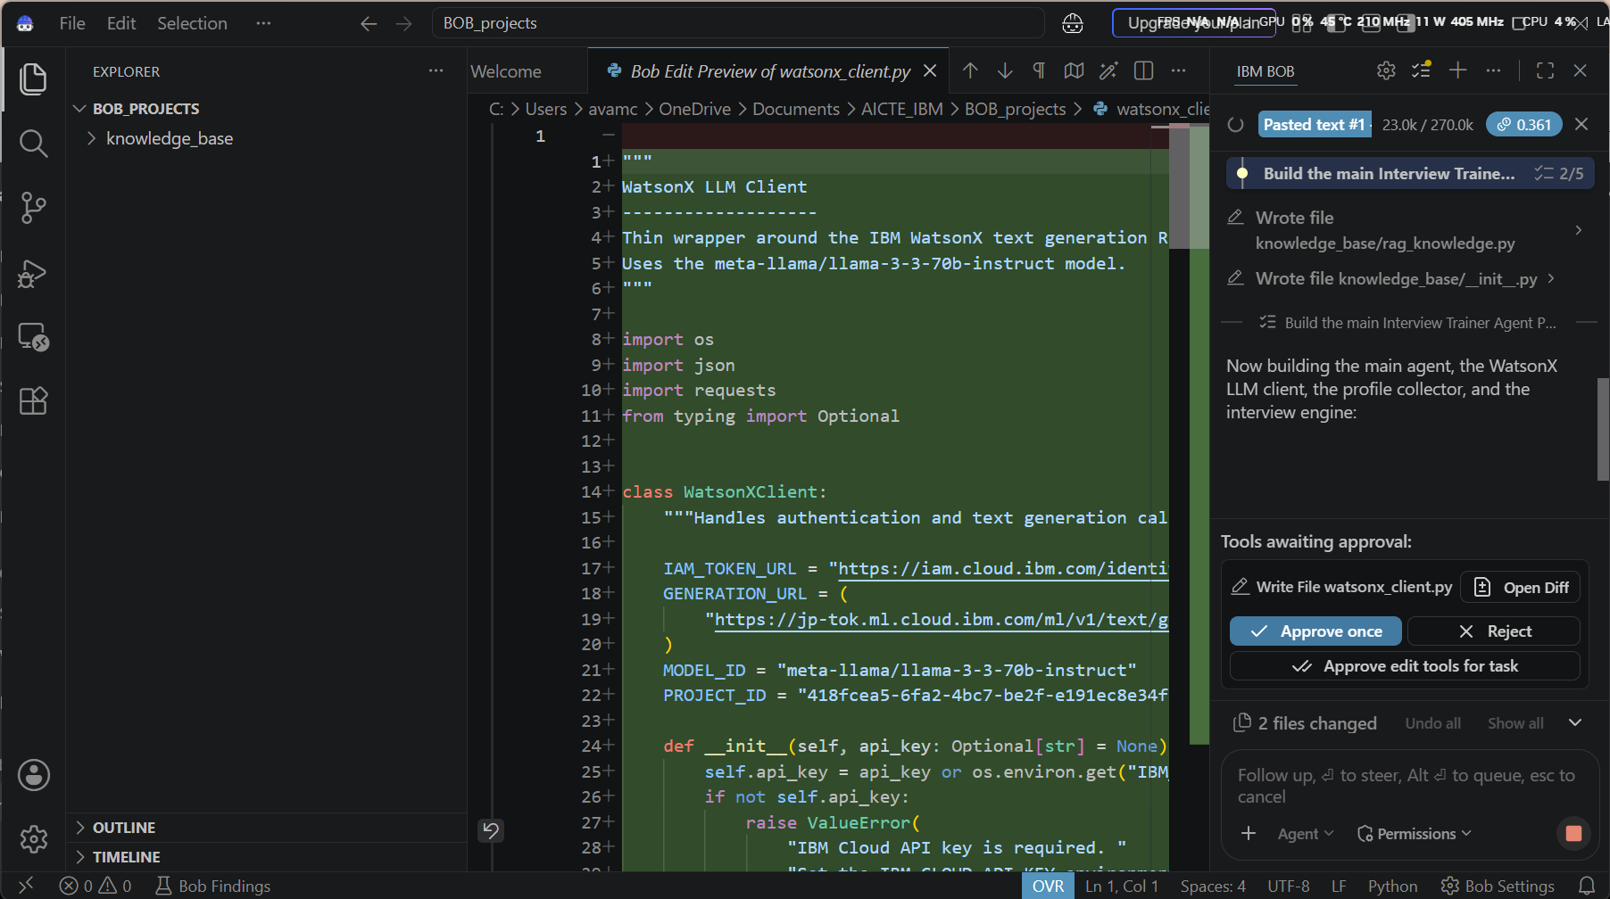
IBM Bob Screenshots:

Slide 8
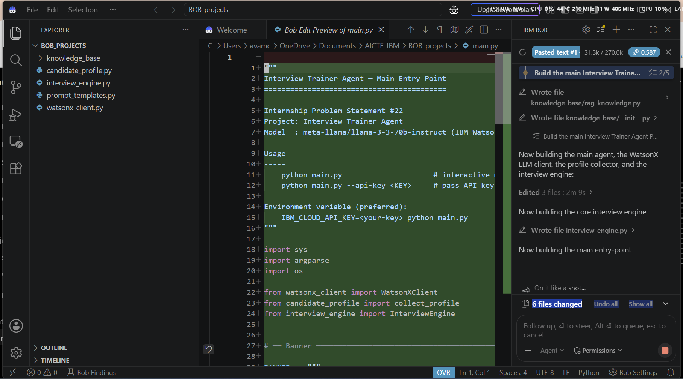

Slide 9
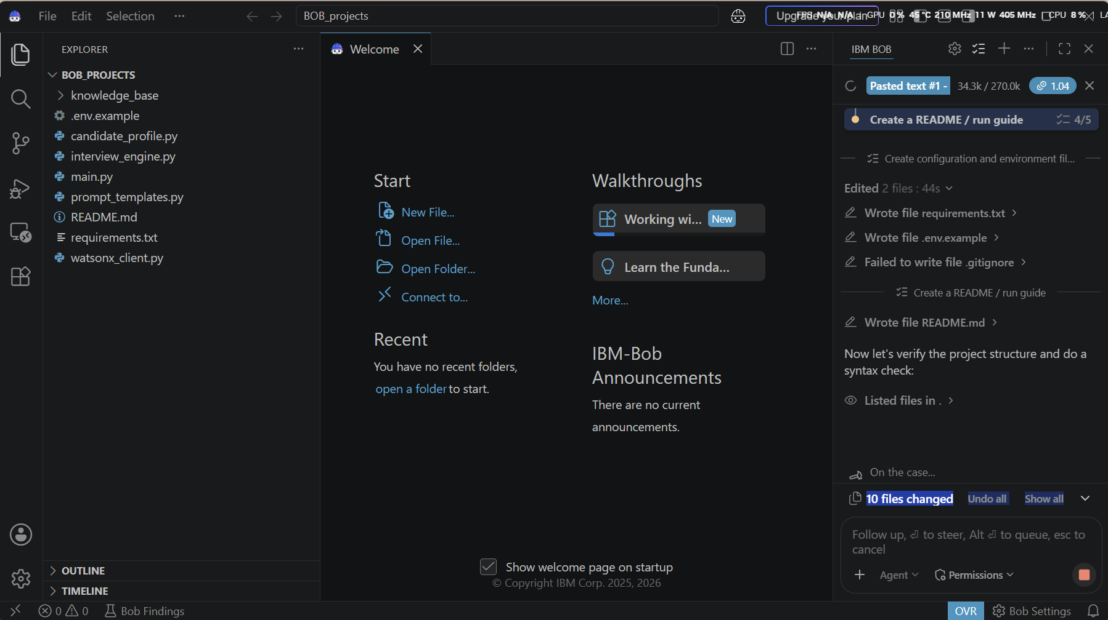

Slide 10
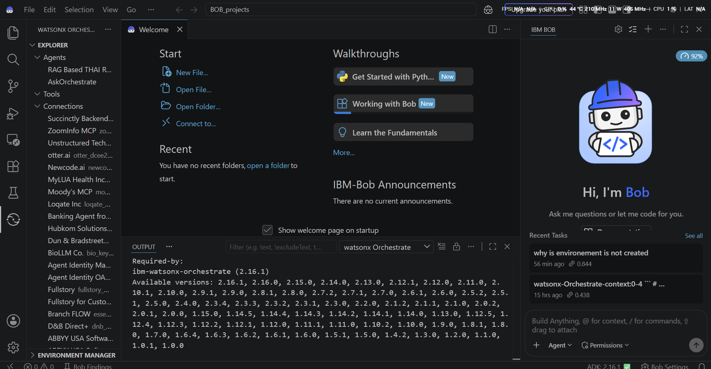

Slide 11
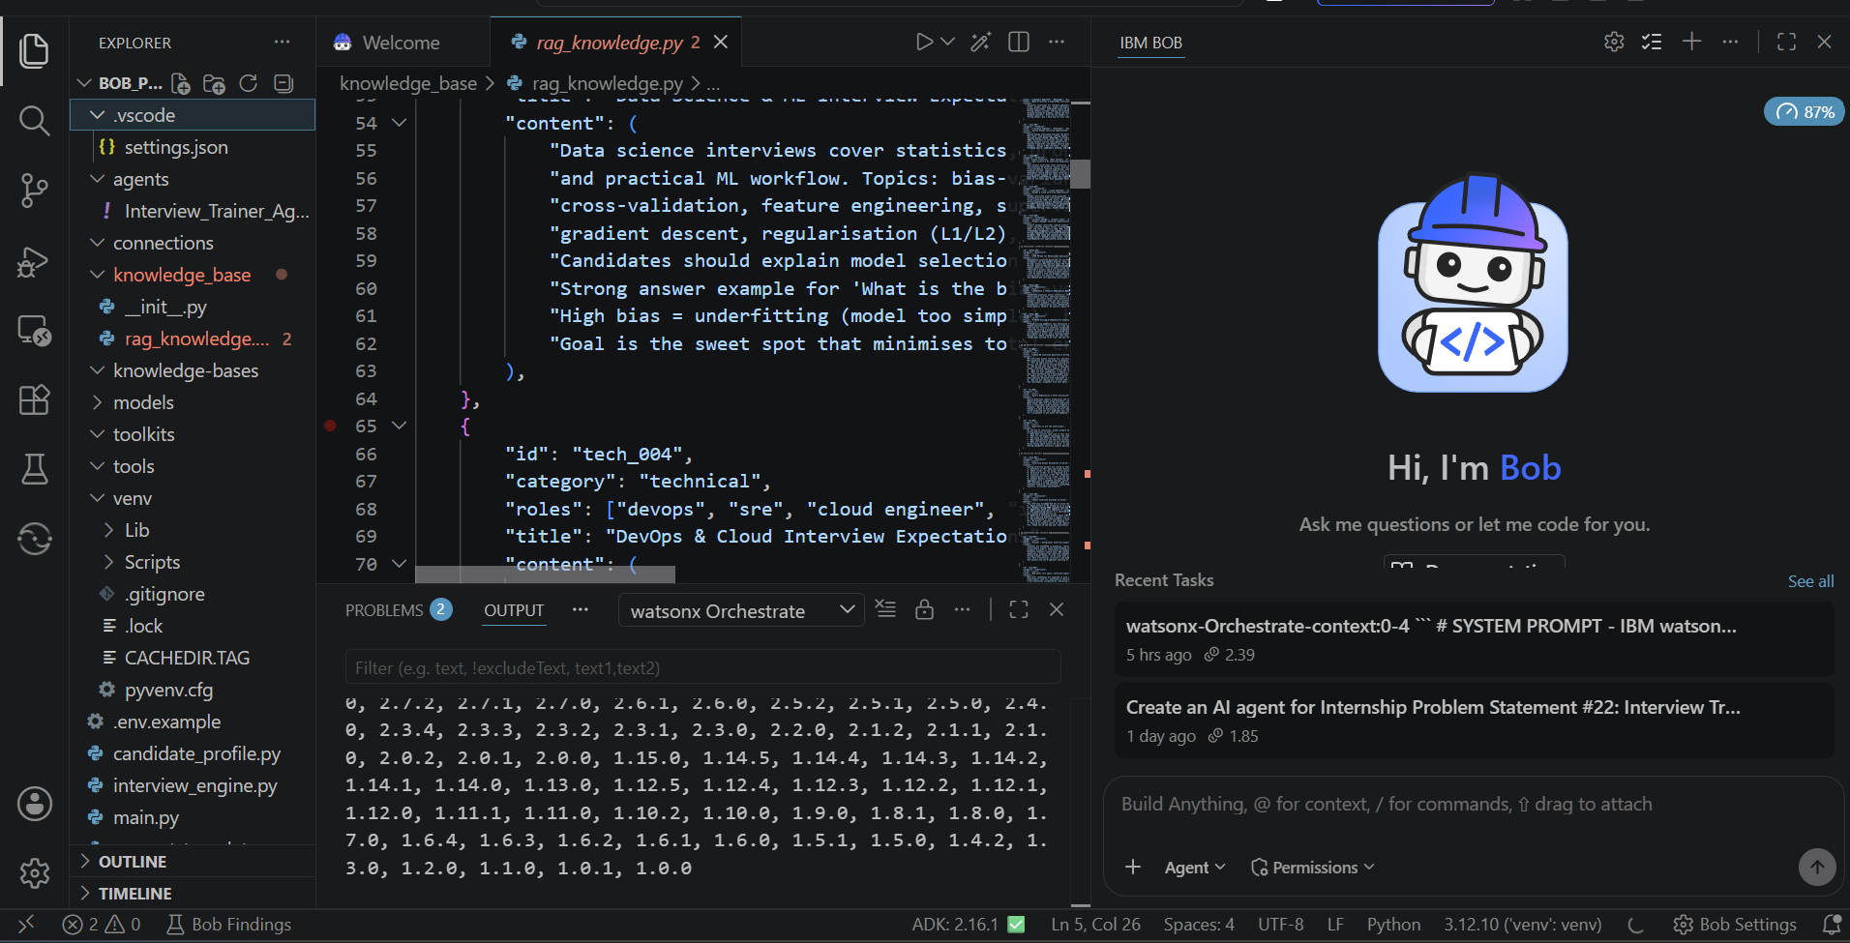

Slide 12
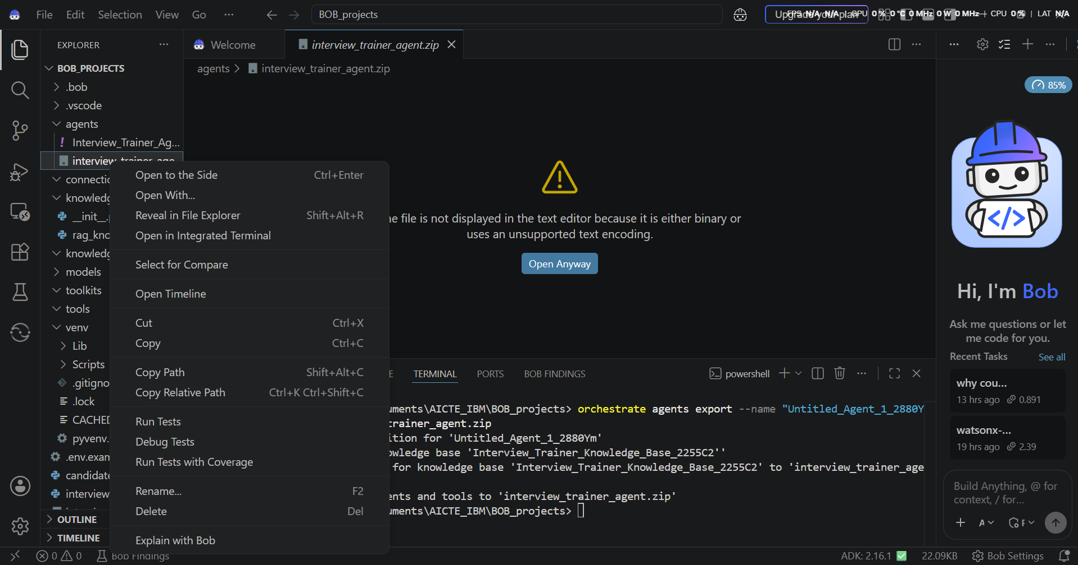

Slide 13
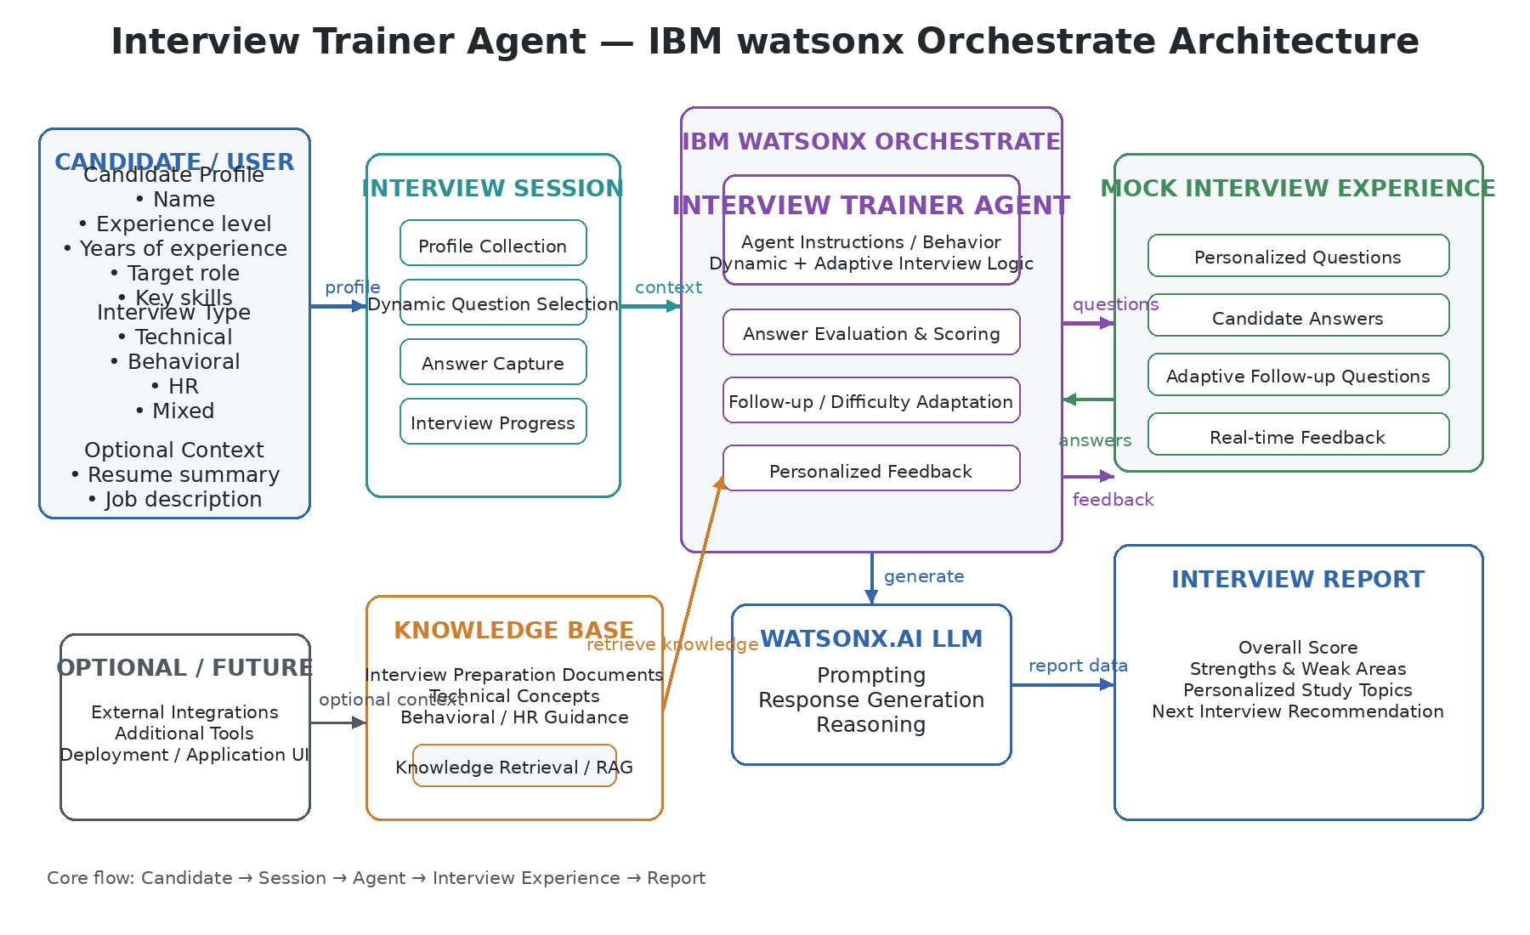
Architecture blueprint for IBM bob:

Slide 14

Role of Agentic AI in the solution
Role of Agentic AI in AI Interview Trainer Agent
Overview
Agentic AI enables the Interview Trainer to function as an autonomous, adaptive coaching system rather than a static question bank or simple chatbot. Powered by IBM watsonx Orchestrate, it coordinates specialized agent workflows to deliver end-to-end interview preparation.
Autonomous Task Coordination
Instead of following fixed scripts, Agentic AI independently manages candidate onboarding, selects domain-appropriate questions, matches responses against knowledge base standards, and formats real-time evaluation rubrics.
Context Awareness & Personalization
The agent maintains continuous context across the session—adapting question difficulty, topic depth, and feedback tone based on the candidate’s specified experience level, key skills, and target job role (candidate_profile.py).
Specialized Agentic Workflows
Onboarding & Profile Agent: Captures candidate details and configures session parameters.
Question Retrieval Agent: Dynamically queries RAG study materials (knowledge_base/rag_knowledge.py) for realistic technical and behavioral scenarios.
Evaluation & Scoring Agent: Analyzes candidate answers, scores performance on a 1–10 scale, and generates structured Markdown feedback tables (prompt_templates.py).
Goal-Driven Session Management
Agentic AI actively directs conversation flow (one question at a time) and handles interactive commands like skip or quit, serving as a proactive, intelligent digital coach for technical career development.

Slide 15
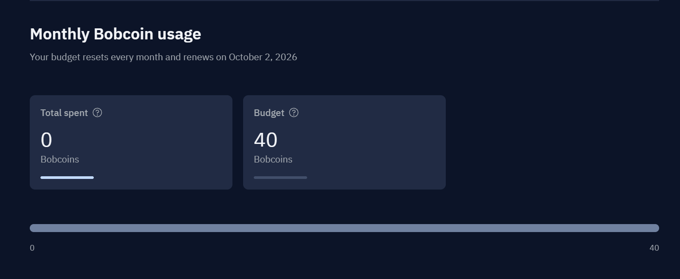
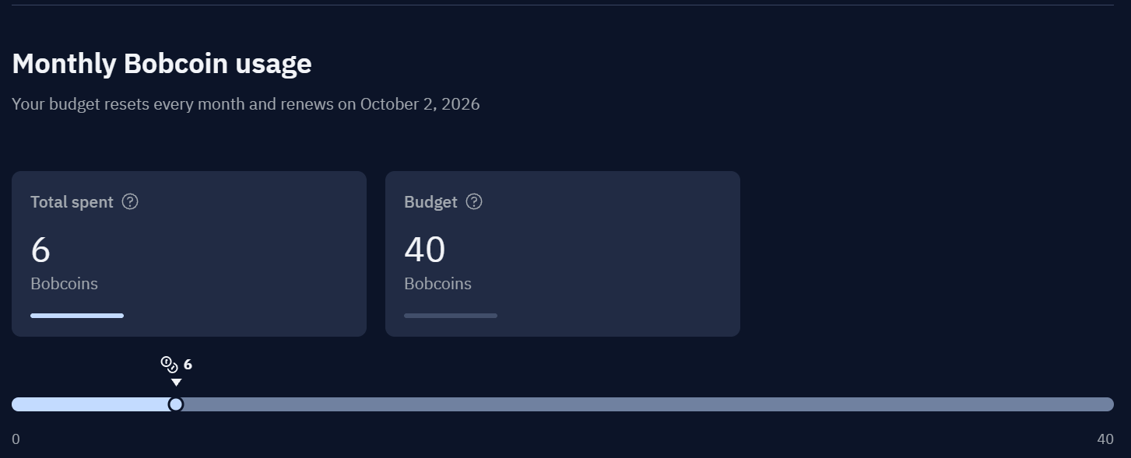
Token Usage
11,761 token are used
Before Prompt
After the Prompt
·
·
·

Slide 16
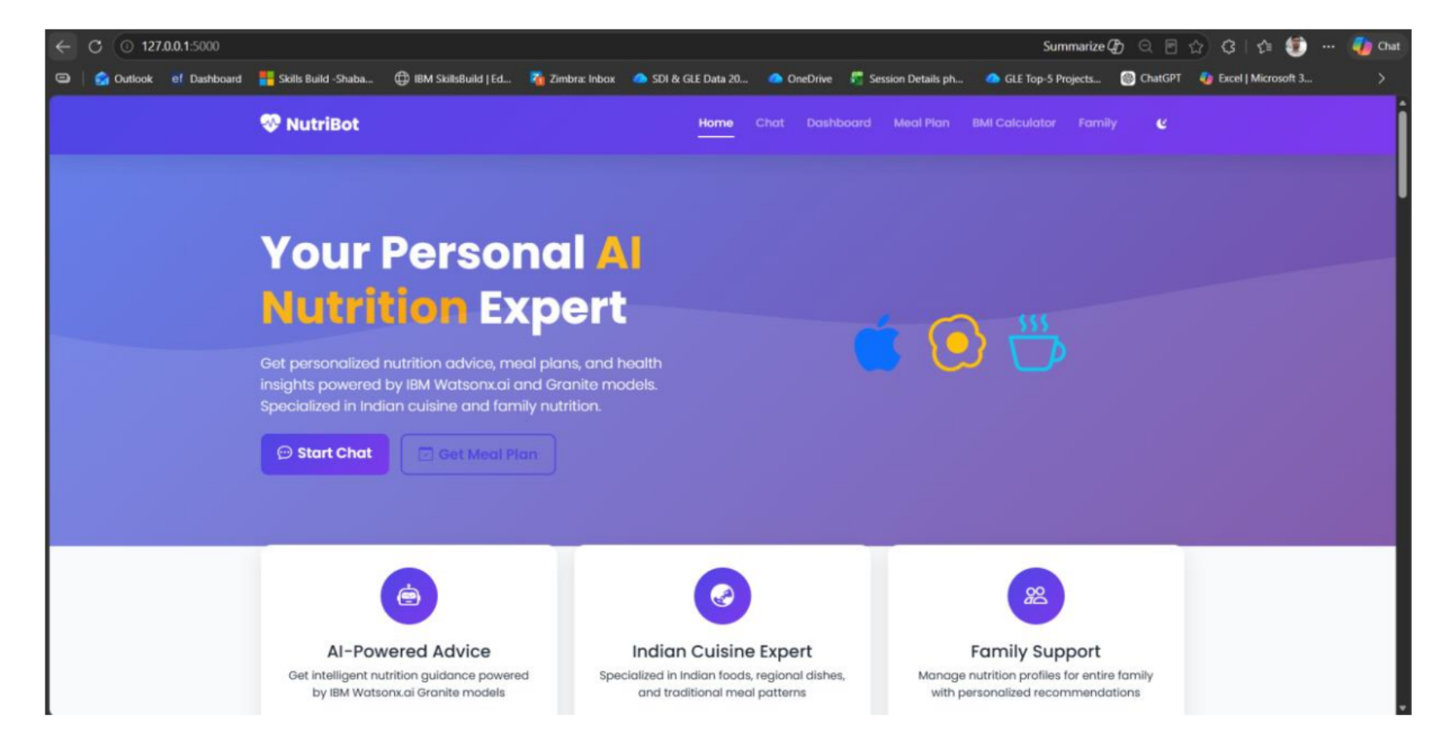
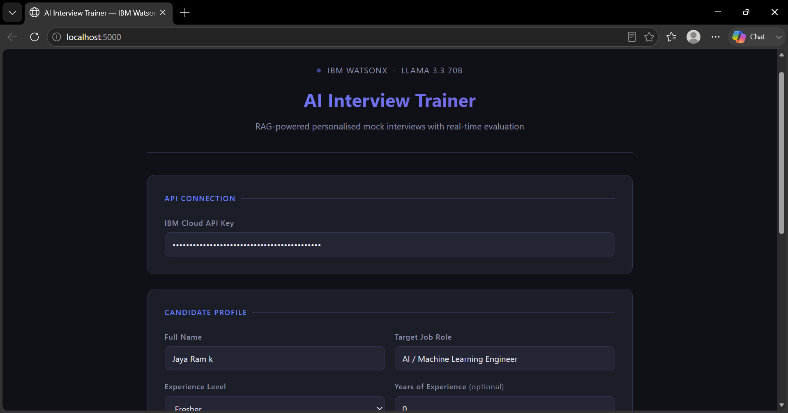
Project Output Screenshot
Please put IBM Bob output screenshots with 2-3 prompts.
You can take 2-3 more slides for each screenshot
·
·
·

Slide 17
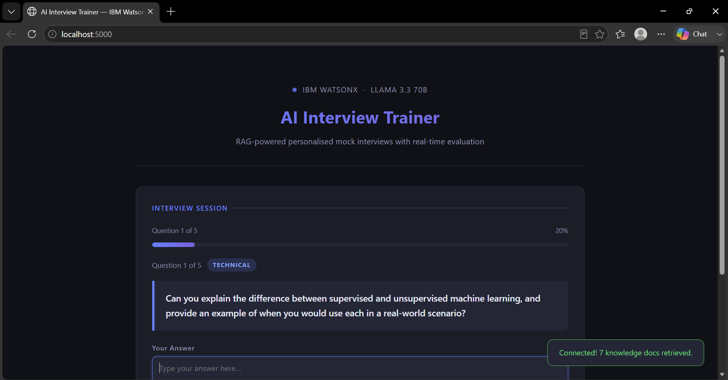


Slide 18
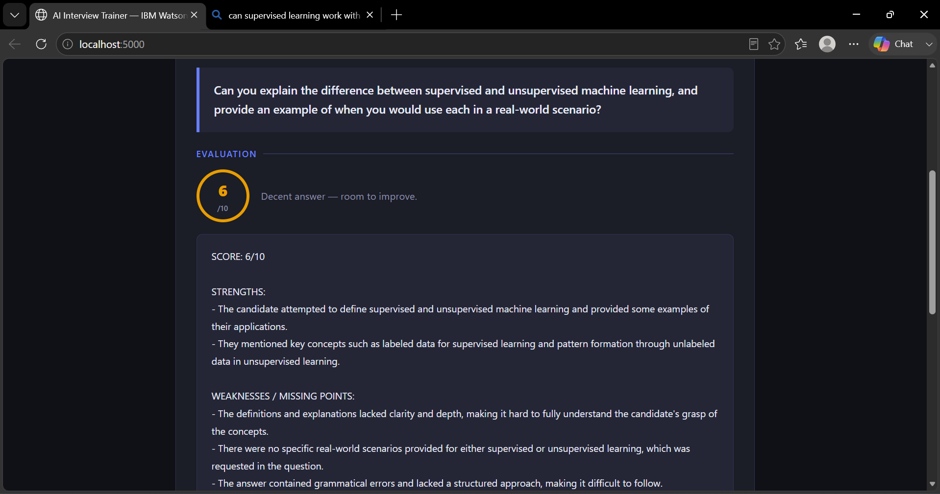
Response for a question

Slide 19
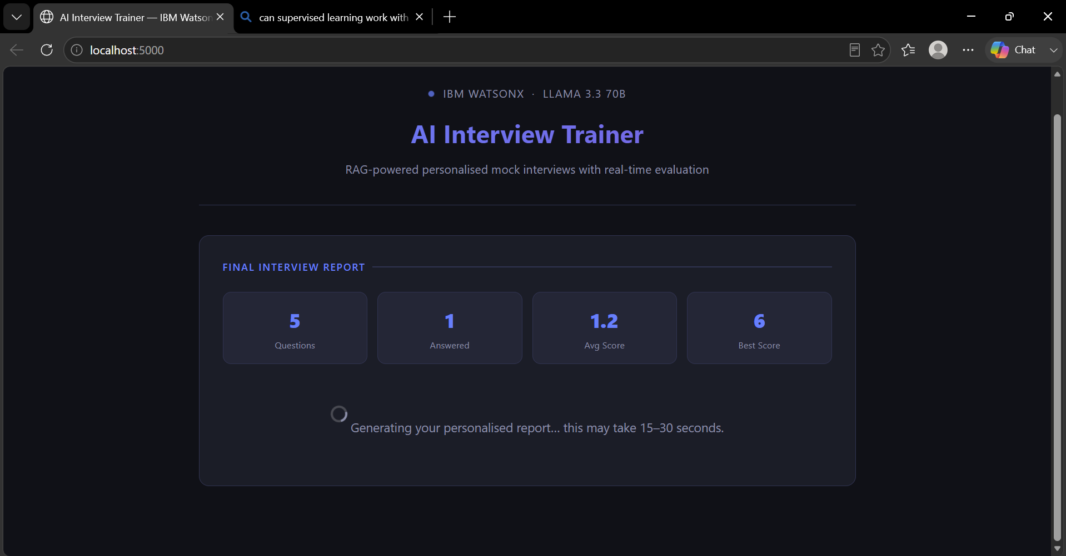
Ouput of the System

Slide 20
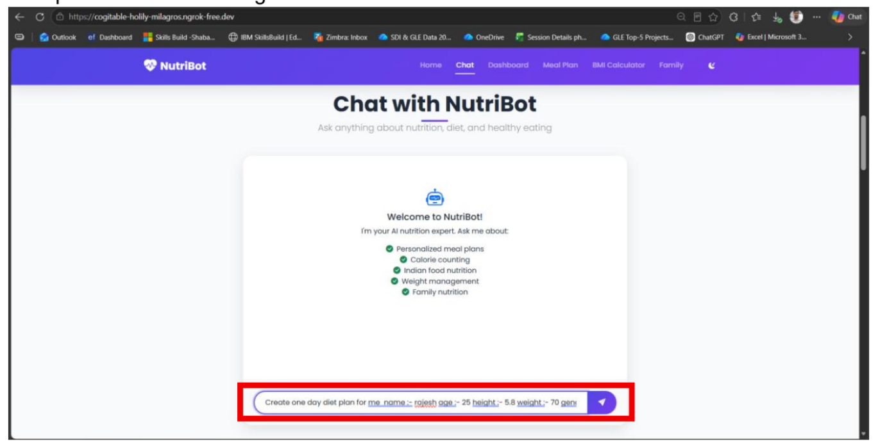
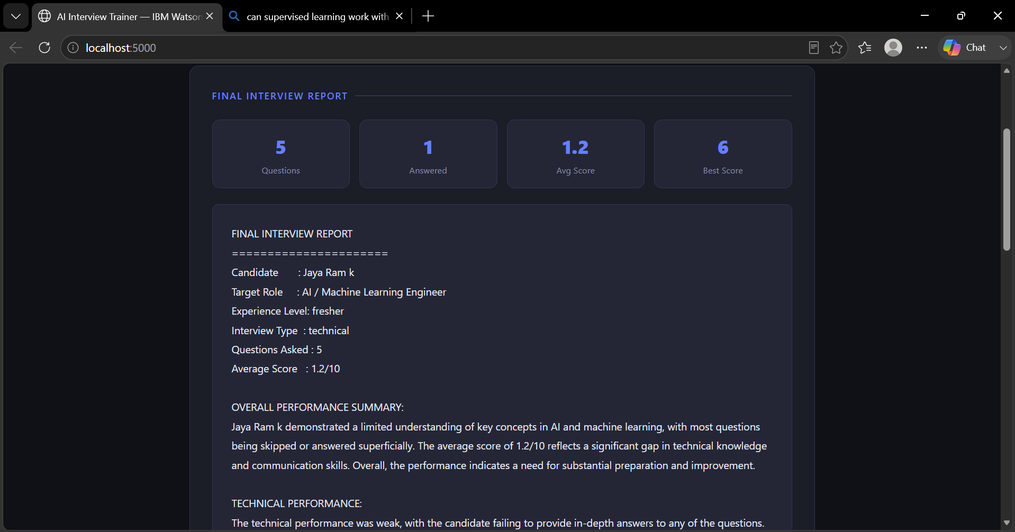
Project Output Screenshot
Please put IBM Bob output screenshots with 2-3 prompts.
You can take 2-3 more slides for each screenshot
·
·
·

Slide 21
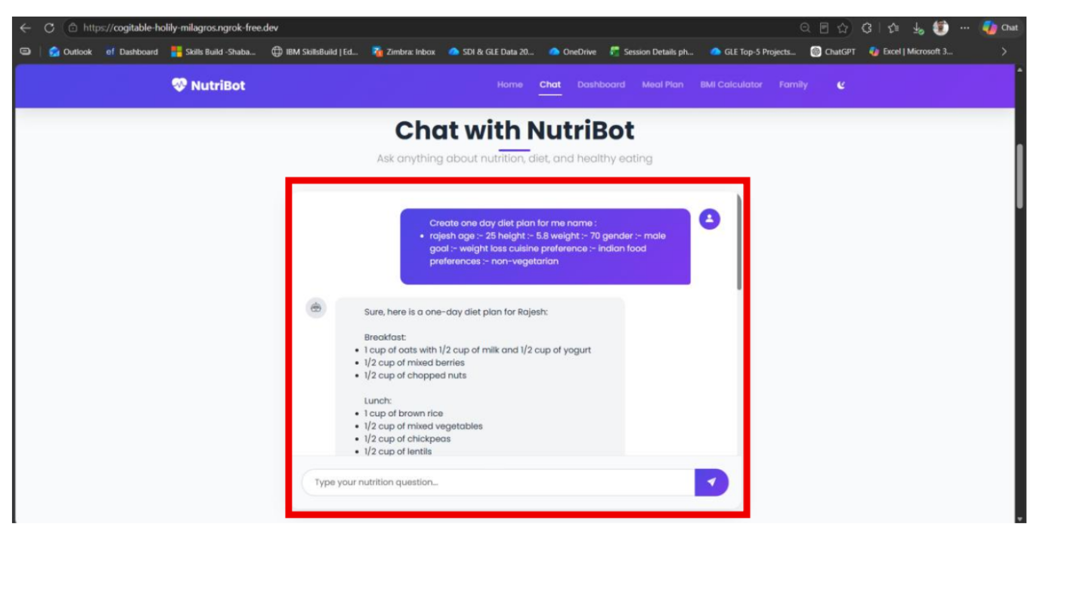
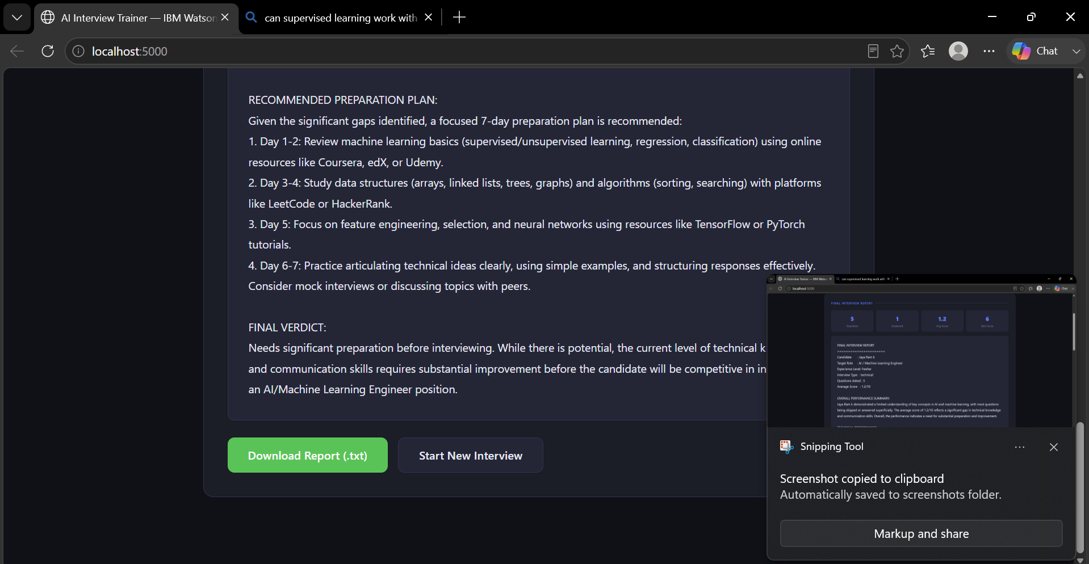
Project Output Screenshot
Please put IBM Bob output screenshots with 2-3 prompts.
You can take 2-3 more slides for each screenshot
·
·
·

Slide 22
Novelty and Uniqueness
The proposed Interview Trainer Agent stands out by combining Agentic AI, personalized interview workflows, adaptive evaluation, and knowledge-grounded feedback into a single intelligent interview preparation system.
Agentic Interview Intelligence – Goes beyond a basic chatbot by following a structured interview workflow, collecting candidate information, conducting the interview, evaluating responses, and generating feedback.
Personalized Interview Experience – Creates interview sessions based on the candidate’s experience level, target job role, skills, resume highlights, and job description.
Knowledge-Grounded Preparation – Uses a structured knowledge base covering DSA, AI/ML, system design, DevOps/cloud, behavioral, leadership, and HR concepts to support relevant interview questions and feedback.
Adaptive Evaluation – Evaluates candidate responses using scores, strengths, weaknesses, improvement areas, and follow-up questions, enabling the interview to respond to the candidate's performance.
Multi-Domain Interview Modes – Supports Technical, Behavioral, HR, and Mixed interviews, allowing the same agent to simulate different real-world interview scenarios.
Job Description Alignment – Uses the candidate’s target Job Description (JD) along with their profile to make the interview more relevant to the role they are preparing for.
Actionable Performance Feedback – Instead of only asking questions, the agent provides performance scores, identified weak areas, follow-up recommendations, and preparation guidance.
IBM watsonx Agent Platform – Built using IBM watsonx Orchestrate / IBM Bob and watsonx foundation models, providing an enterprise-oriented platform for developing and managing AI agents.
This makes the solution an intelligent, personalized, and adaptive interview coach, rather than a static question-and-answer chatbot.

Slide 23
Git Hub Link
· Please create public github repository (Enable Add README button while creating repository) with format –
Please test and Paste the working Github URL – https://github.com/vamsi-3/IBM-BOB-Interview-Trainer
Make sure you have Uploaded following three files into your github repository
1) All Agent relevant files of IBM Cloud , 2) yourproblemstatement.pdf file 3) your projectpresntation.pptx file 4)any other files
·
·
·

Slide 24
Future Scope
1. Voice-Based Mock Interviews & Speech Analysis –
The system can be enhanced with voice interaction to simulate real interview conversations. Speech analysis can evaluate communication clarity, fluency, confidence, pace, and filler words, providing candidates with feedback beyond the content of their answers.
2. Advanced Adaptive Interviewing –
Future versions can dynamically adjust the difficulty, question type, and follow-up questions based on the candidate’s previous responses and performance. This will create a more realistic interview experience that continuously adapts to the candidate.
3. Resume & Job Description Intelligence –
The agent can be enhanced to automatically analyze uploaded resumes and job descriptions to identify skill gaps, required competencies, missing skills, and role-specific preparation areas, generating a high.
·
·
·

Slide 25
4. Multilingual Interview Support –
Integration of multilingual capabilities can allow candidates to practice interviews in their preferred languages. This can improve accessibility and make the system useful for candidates from diverse linguistic backgrounds.
5. Interview Performance Analytics Dashboard –
A dedicated dashboard can track scores, strengths, weaknesses, question-wise performance, progress over multiple sessions, and improvement trends, helping candidates monitor their interview readiness over time.
6. Real-Time Industry & Job Market Integration –
The system can be connected with job portals and real-time industry data to generate interview questions based on current job requirements, emerging technologies, and role-specific skill trends.
7. Enterprise & Recruitment Integration –
The agent can be extended for organizations to support automated candidate screening, role-specific assessments, structured interview workflows, and recruiter analytics, making it useful beyond individual interview preparation.
These enhancements can transform the Interview Trainer Agent from a personalized mock-interview system into a comprehensive AI-powered career and recruitment platform.

Slide 26
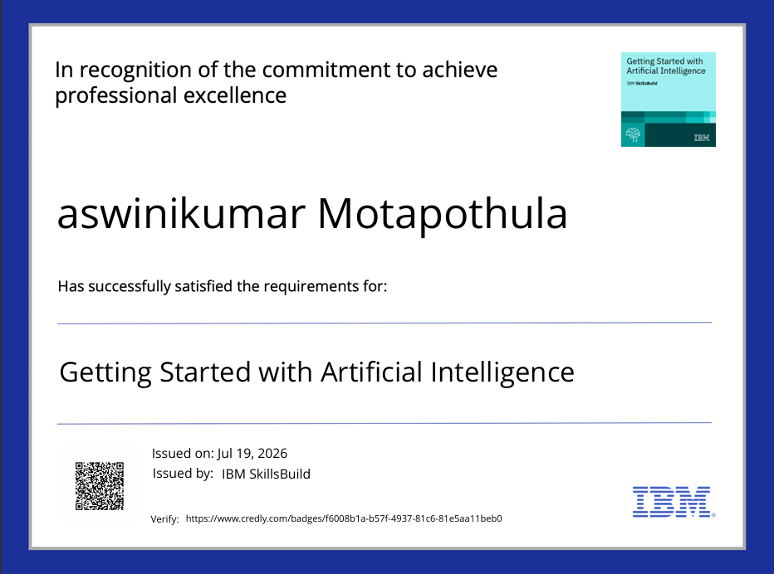
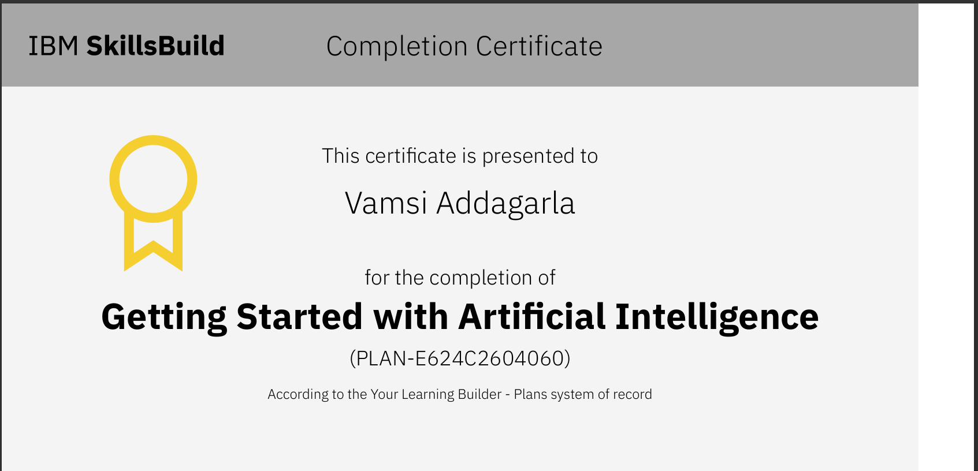
Certificates Earned:
Please add your credly certificate(Getting Started with Artificial Intelligence)

Slide 27


