Slide 1
CS512: Data Structures and Algorithms Final Project Image Similarity Search
Team Members: -
Mansi Rajesh Borole (mb2208) 218002227
Naga Vamsi Krishna Bulusu (nb847) 214005263
Anjali Menghwani (am3370) 218007930

Slide 2
Project Description
We have implemented an Image Similarity Search.
Used a pretrained Convolutional Neural Network (CNN) model to generate features for the training images
Then used a KNN classifier to find similar images for a test image
We have used the Imagenette dataset from Tensorflow catalogue (https://www.tensorflow.org/datasets/catalog/imagenette)

Slide 3
Data Description
Imagenette is a small subset of the ImageNet dataset
Imagenette contains a total of 10 classes of images, with each class containing approximately 500 images.
The classes in Imagenette : Tench fish, dog, Cassette player, Chain saw, Church, French horn, Garbage truck, Gas pump, Golf ball, Parasol
The images are 256x256 pixels in size and are in JPEG format

Slide 4
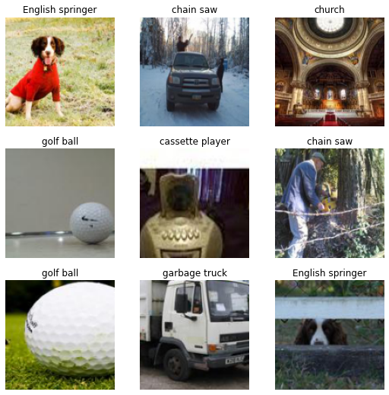

Slide 5
Implementation
Load Dataset and pre-processing
Load the Imagenette dataset from tensorflow_datasets.
Resizing the images into desired size (Height and Width) and normalize the pixel values to be between 0 and 1 in the preprocess_image function.
Then we create batches of the training dataset in the get_image_batches function.
Feature extraction for training images using CNN
The convolutions are performed by sliding the kernel over the image and computing the dot product of the entries in the kernel and the image at each position. The resulting feature map is then used further KNN
InceptionResNetV2

Slide 6
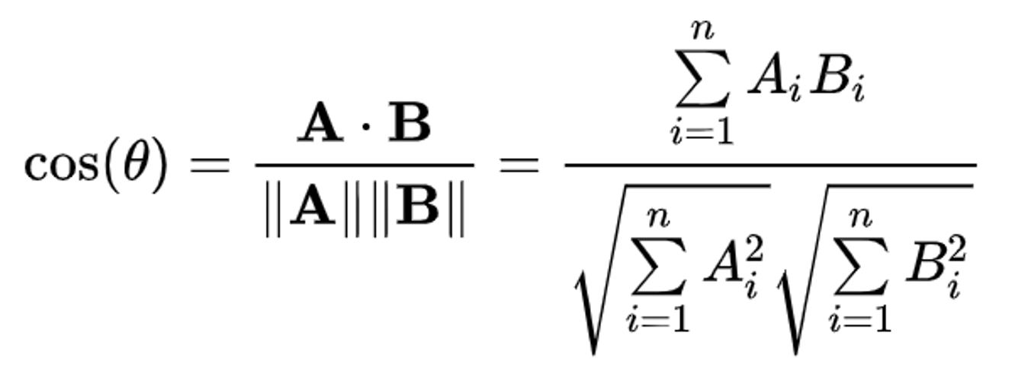
Implementation (.. Contd)
Using KNN model to Fit the features into clusters
Once the feature vectors have been extracted, the distance between feature vectors can be calculated using cosine similarity and form a cluster.
Testing: Finding similar images given test input
We generate a small batch of images from the testing dataset and then pick a few random input images from it.
Extract features of the test image and feed to the KNN model and find the top k-similar images.

Slide 7
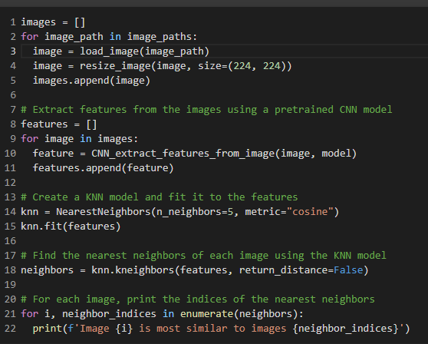
Pseudocode for the Implementation

Slide 8
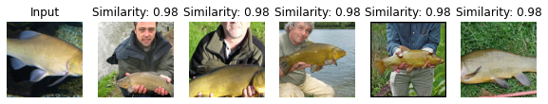
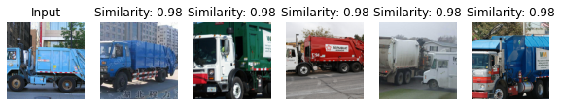
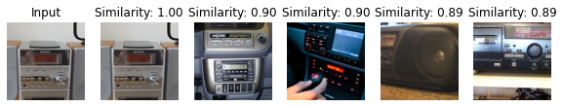
Outputs
Test case 1:
Test case 2:
Test case 3:

Slide 9
Thank you!

