Slide 1
Recommendation Systems
MovieLens
Team 10
Darshee Machhar (dm1639)
Pankti Nanavati (pn266)
Vamsi Krishna Bulusu (nb847)

Slide 2
Introduction
Recommendation systems are an essential part of many industries, including e-commerce, social media, and entertainment.
They help users discover new products, services, or content that they're likely to enjoy, improving their experience and engagement.
The Movielens dataset is a popular benchmark dataset for building recommendation systems, consisting of movie ratings from over 6000 users.
However, building an effective recommendation system is challenging, requiring a balance of accuracy, diversity, and scalability.
In this presentation, we'll explore how matrix factorization can be used to build a recommendation system for the Movielens dataset, including its performance and limitations.

Slide 3
Dataset Overview
The Movielens dataset is a popular dataset for building recommendation systems, consisting of movie ratings from over 6000 users.
We have used smaller dataset of 6 MB size.
It contains over 1 Million movie ratings, with each rating ranging from 1 to 5 stars.
The dataset also includes movie metadata, such as genre, year, and title.
Split the dataset into 60% training and 40% testing based on the User ID.

Slide 4
Collaborative Filtering
Collaborative filtering is a popular technique in recommendation systems that leverages the ratings of similar users or items to make personalized recommendations.
The basic idea is to find users or items that have similar preferences to the target user, and recommend items that they have rated highly but the target user hasn't seen yet.
User-based collaborative filtering computes the similarity between users based on their rating history, and recommends items that similar users have rated highly.
Item-based collaborative filtering computes the similarity between items based on the ratings they have received from users, and recommends similar items to the ones the target user has rated highly.
Collaborative filtering is a powerful technique for recommendation systems, as it can handle cold-start problems, where there is no prior information about the user or item, and can capture user-item interactions that are not captured by explicit features.
Notes:
Matrix factorization is used to build a recommendation system by factorizing the user-item rating matrix into two lower-dimensional matrices: a user factors matrix and an item factors matrix.
The factorization is optimized using the technique gradient descent to minimize the difference between the predicted and actual ratings.
The learned user and item factors capture the underlying preferences or characteristics of the users, respectively, and are used to predict ratings for new users.
To predict a rating for a user-item pair, we simply take the dot product of the corresponding user and item factors.
The predicted rating is then used to rank the items and recommend the top-rated ones to the user.

Slide 5
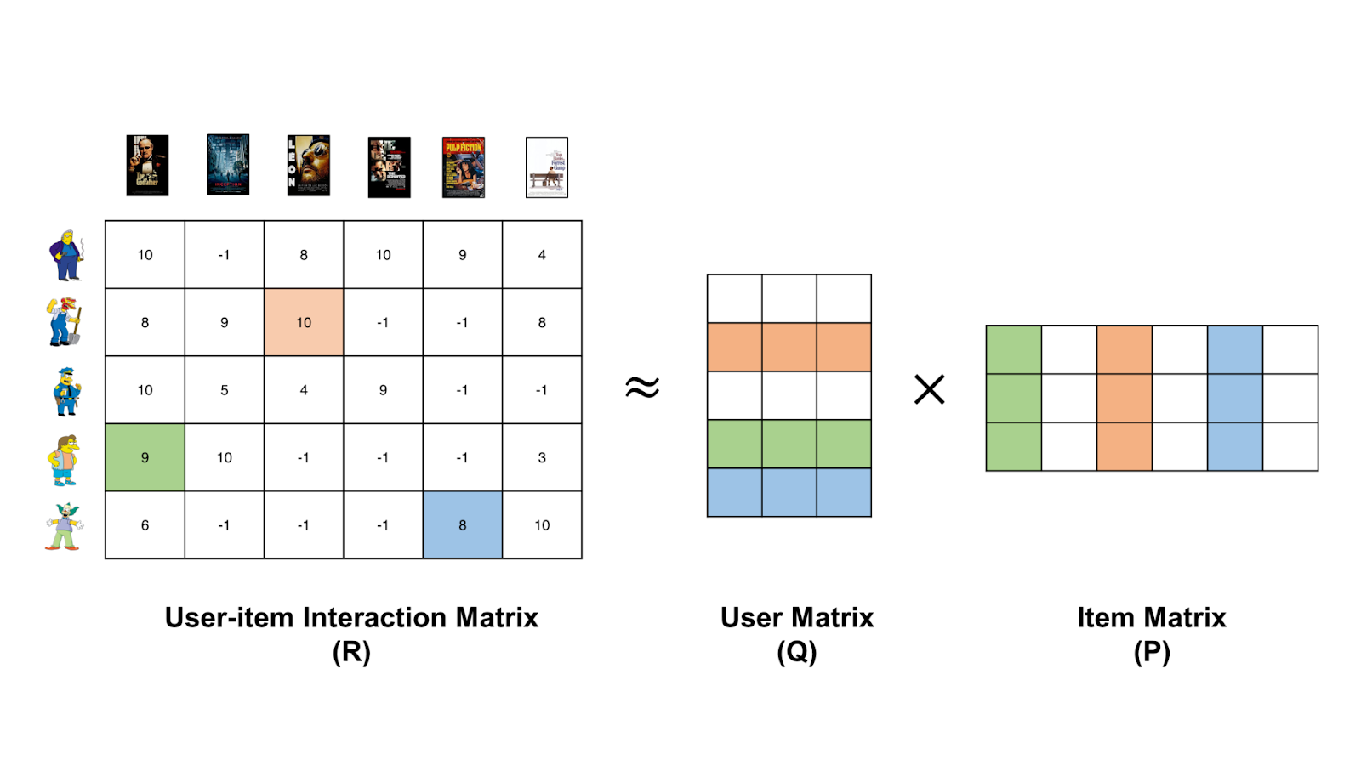
Matrix Factorization Overview
Matrix factorization is a technique used in recommendation systems to reduce the dimensionality of the user-item rating matrix.
The basic idea is to represent each user and item as a set of latent factors, or features, that capture their preferences or characteristics.

Slide 6
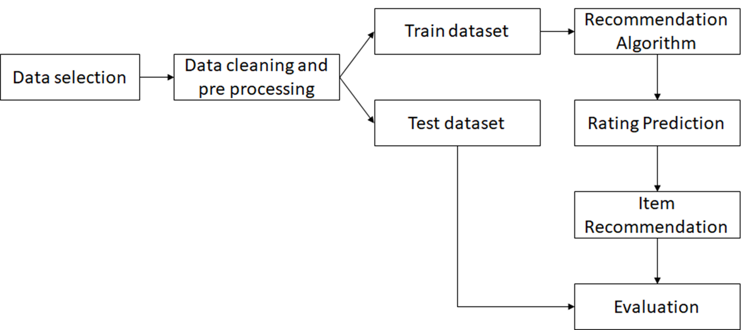
Flow chart

Slide 7

Objective Function
The model consists of user and movie embedding layers, bias terms for users and movies, and a global bias term. The forward function computes the dot product of the user and movie embeddings, adds the biases and the global bias, and returns the output.
The training loop performs backpropagation and updates the model's weights using an optimizer.
The Matrix Factorization model learns to predict the ratings of unseen user-movie pairs by factoring a user-movie rating matrix into two lower-dimensional matrices.

Slide 8
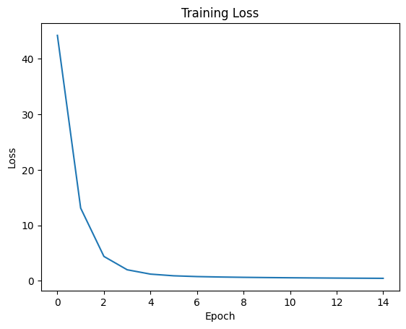
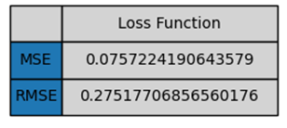
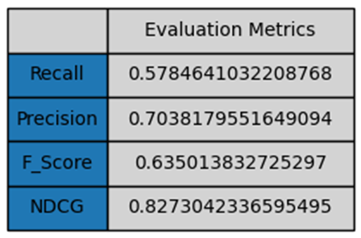
Evaluation

Slide 9
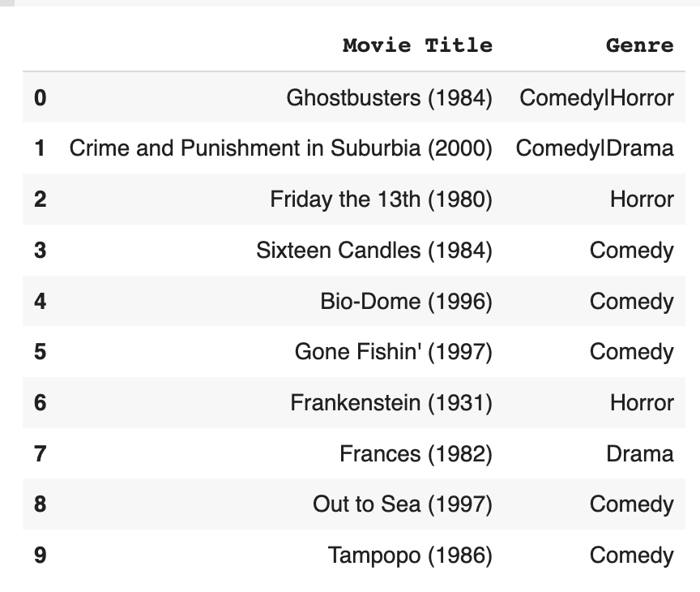
Results

Slide 10
Fairness and Unbiases of Recommender Systems
Bias is a pervasive issue in recommendation systems that can lead to unfair or discriminatory recommendations. Biases can arise due to various factors such as historical data, user preferences, and algorithmic design.
Data pre-processing: This is done by removing outliers, normalizing the data, and balancing the distribution of user-item interactions.
Regularization: Regularization methods such as L1 and L2 regularization helped prevent the algorithm from focusing too much on individual users or items and instead promoted a more balanced and diverse set of recommendations.
Reduce over-generalization: Biases are introduced into the recommendation algorithm to capture specific characteristics or preferences of the users and items. By incorporating these biases, the algorithm better captures the nuances of the data and makes more accurate recommendations.

Slide 11
Conclusion & Future Work
In conclusion, collaborative filtering using matrix factorization approach has been shown to effectively handle sparse and high-dimensional data, and can provide accurate recommendations even for new or unseen items.
One area for future work is to explore more advanced models that can incorporate additional features such as temporal dynamics or user demographics, which could further improve the accuracy of recommendations.

Slide 12
References
https://towardsdatascience.com/movie-recommendation-system-based-on-movielens-ef0df580cd0e
https://www.scaler.com/topics/machine-learning/recommender-system-using-movielens/
https://en.wikipedia.org/wiki/Recommender_system
https://towardsdatascience.com/introduction-to-recommender-systems-6c66cf15ada
https://towardsdatascience.com/recommendation-system-matrix-factorization-d61978660b4b

Slide 13
THANK YOU

