Slide 1
Astro Sage Excel Data Analysis
By
M.V.S. Vamsi krishna

Slide 2
Problem statement
AstroSage has received a 1 crore investment and aims to optimize its call center operations. The goal is to determine how to allocate this investment to maximize operational efficiency, customer satisfaction, and profitability.
The analysis will consider historical call data, performance metrics, and market trends to make informed decisions.

Slide 3
Data description:
Columns like “ _id, user, guru, guruName, gid, uid “ gives us Unique identifiers for the record, user, guru, and their IDs.
“chatStatus, consultationType, website, refundStatus, isWhiteListUser, queue, FreeCall, FreeChat ” are Information about chat status, consultation type, source, refund eligibility, whitelist status, and session type.
“chatSeconds, createdAt, updatedAt, __v, statementEntryId “are about the Duration of the chat in seconds, timestamps for creation and updates, versioning key, and statement entry_ID.

Slide 4
Data description:
“ chatStartTime, chatEndTime, timeDuration, callChannel, callIvrType, callStatus and CallSid” gives details of chat timing, duration, call channel, IVR type, call status, and call session ID.
“amount, astrologerCallStatus, astrologerOnCallDuration, astrologersEarnings, netAmount “ says about Amount charged, astrologer’s call status, duration, earnings, and net earnings after deductions.
“region, userCallStatus, userOnCallDuration, rating“ are about User’s region, call status, call duration, and session rating.

Slide 5
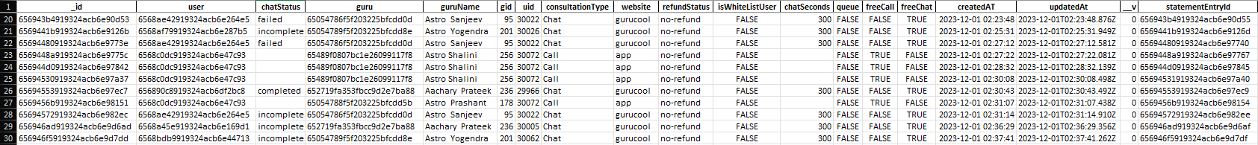
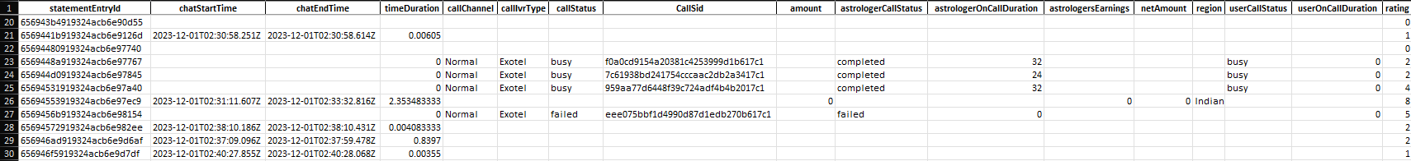
Data description:
A small Glimpse of the data

Slide 6
Key Performance Indicators
The table contains data over a time period of 34 days
With total Active Guru’s of 131 providing consultation through app and gurucool website
And total of 10344 customers were consulted.
Average calls per day per Agent is 2 (approx..)
The total number of calls recorded is 8,513, out of which 6,160 calls (72.36%) are from repeat callers.
The total number of repeat callers is 1,278, while there are 2,353 one-time callers.
The total operational cost includes a net amount/fees collected of ₹213,987.32 and astrologer earnings totaling ₹99,146.57.
Days with Maximum and Minimum Traffic from both Call and Chat are on December 12, 2023 and on January 1, 2024 respectively.

Slide 7
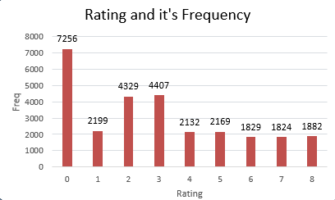
Key insights and Observations
Customer Satisfication Rating Analysis
First Bar graph shows how many users gave a particular rating to the consultation they had with a Guru.
A high proportion of low ratings (like 0,2,3) suggest dissatisfaction with services, either due to agent quality or system inefficiencies
Fewer gurus in the higher rating brackets (5 to 8), indicating room for improvement means small number of gurus have achieved top ratings
It’s netter to introduce performance-based incentives to motivate gurus to aim for higher ratings.

Slide 8
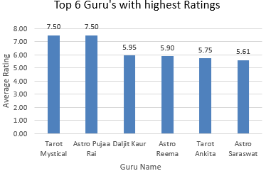
Top Guru’s with highest Ratings
We can see the Top 6 Guru's with highest Ratings here and the ratings range from 0 to 8.
"Tarot Mystical" and "Astro Pujaa Rai" have the highest rating of 7.50.
And they are followed by Daljit Kaur, Astro Reema, Tarot Ankita and Astro Saraswat with ratings 5.95,5.90,5.75 and 5.61 respectively.

Slide 9
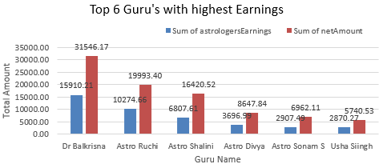
Top Guru’s with highest Earnings and netAmount
We can see the Top 6 Guru's with highest Earnings and highest Net amount generated.
Dr. Balkrisna leads the chart with astrologer earnings of ₹15,910.21 and a net amount of ₹31,546.17.
Astro Ruchi follows, earning ₹10,274.66 with a net amount of ₹19,993.40.
And at last is Usha Siingh earns ₹2,870.27 with a net amount of ₹5,740.53.
And they are decreasing steeply after first 2 guru’s Balkrisna and Ruchi.

Slide 10
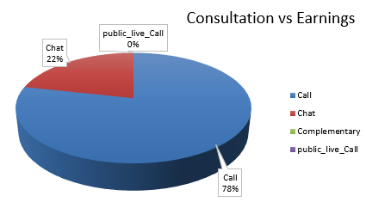
Consultation_type VS Astrologer’s Earnings
Calls are giving 78% of the Astrologer’s Earnings compared to chats which is at 22%.
And there is a very very little constribution from public_live_call
This data underscores the dominance of call consultations in driving revenue and suggests a focus on enhancing this channel for further growth.
Enhance chat interface with features like instant horoscopes, follow-up sessions to boost user satisfaction and retention.

Slide 11
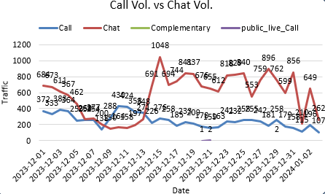
Daily Total Consultaions Analysis
Chat consistently outpaces call volumes, indicating users prefer chat over calls except in the 2nd week of December.
However, the call volume is still significant. But the Chat volume got to peak in mid December and it started decreasing.
But as we have seen earlier Astrologer’s Earnings are more in calls rather than in chats.

Slide 12
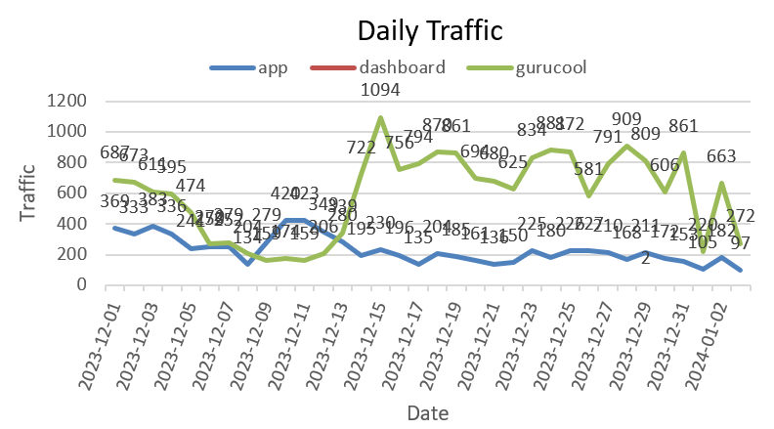
Daily website Traffic Analysis
We can see that chats are happening in gurucool website and calls are happening through app.
Gurucool consistently outpaces app traffic, except in the 2nd week of December.
And it indicates that users prefer website over app.
However, the app traffic is little constant. But the gurucool traffic got to peak in mid December, and it started decreasing

Slide 13
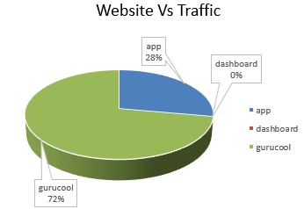
Website Traffic Distribution
Gurucool has more traffic than app and it indicates that users prefer gurucool over app.
App represents a moderate user base. Whereas Gurucool demonstrates strong popularity and adoption.
There is a major gap in user engagement across the platforms.
By introducing unique features, the app can stand out.
Gurucool's popularity can be used to cross-promote the other platforms.

Slide 14
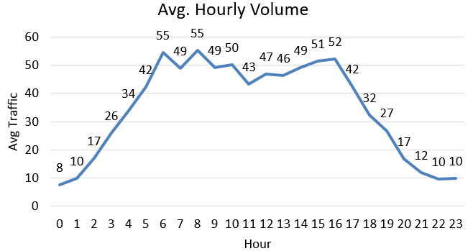
Hourly Average Traffic Analysis
In this Hourly Trafffic line chart, we can be see peak call volumes occuring primarily between 6 AM and 4 PM.
The highest count of consultations is in 6:00 AM – 7:00 AM and it is gradually declining after 16:00 ( 4:00 PM).
And after after 4 PM, taffic is gradually declining.
Late-night hours (22:00 – 23:00 ) have minimal call volume.

Slide 15
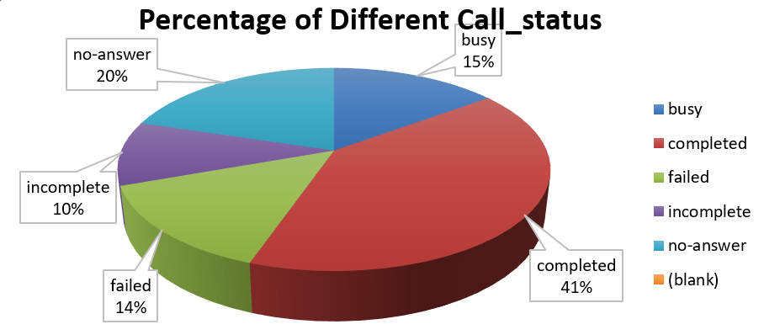
Chat Status Analysis
We can see 40% of calls are completed. But there is huge proportion of "No Answer," "Busy," and "Failed" categories too.
Must minimize the incomplete and failed percentage value as much as possible.
And these busy and no-answer users must be re contacted again in a short duration.
And Enhance infrastructure along with agent training. Expand agent availability or improve call distribution.

Slide 16
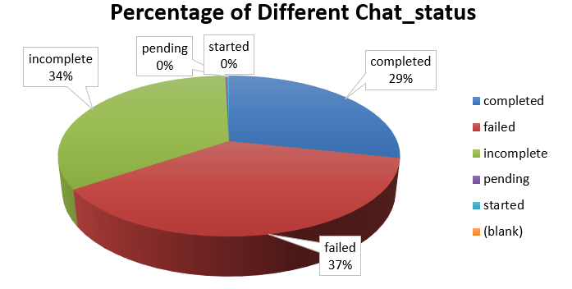
Call Status Analysis
The largest portion, accounting for 37%, represents "failed" chats.
"Incomplete" and "completed" chats make up to 34% and 29% respectively.
The "pending" and "started" statuses each represent 0% of the total, indicating negligible or no activity in these categories.
This data emphasizes the need to focus on reducing the percentage of failed and incomplete chats while improving the proportion of completed interactions.

Slide 17
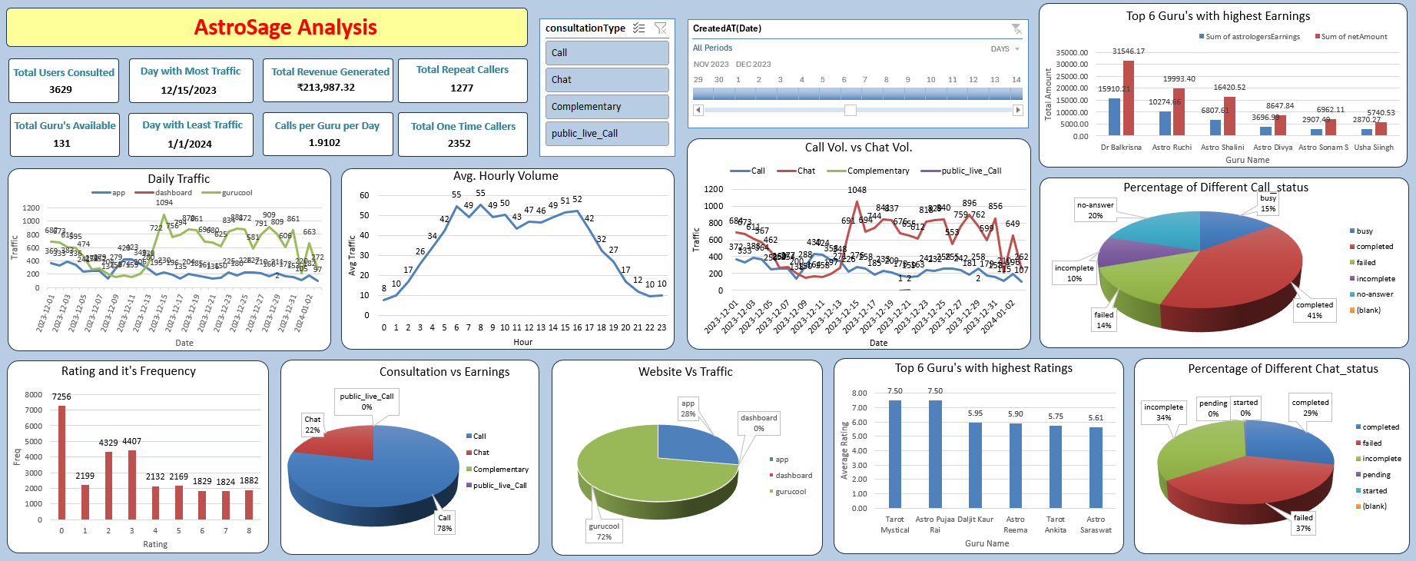
Final Dashboard:

Slide 18
Strategies to Maximize Customers and Revenue
Implement advanced call center technology. And start utilizing predictive algorithms for peak traffic management.
Which gives Increased efficiency, faster response times and enhanced customer satisfaction during peak and off-peak hours.
Upgrade call center technology for real-time solutions. And integrate AI-powered chatbots for initial connect with customers.
This will help in increased market share through improved service scalability.

Slide 19
Strategies to Maximize Customers and Revenue
Invest in targeted training programs for the Agents and Gurus to get higher revenue through improved conversions.
Incorporate real-time feedback tools to increase customer loyalty through personalized and empathetic interactions.
Optimize CRM tools for efficient query management to give enhanced customer experience with faster issue resolution and smoother service delivery.

Slide 20
Conclusion :
By implementing the above data-driven recommendations, AstroSage can enhance overall performance, achieve operational excellence, and elevate customer satisfaction.
This strategic approach will drive sustainable growth and establish a strong competitive advantage in the market.
With Invest in advanced technology and comprehensive training programs will leads to Customer satisfaction boost and Revenue growth.
And by focusing on technology enhancement and streamlining workload distribution will improve operational efficiency of employees.

Slide 21
- Thank You

