Slide 1
Name: Beverly Hills Businesses Lister App
Shashank Khanna Naomi Esserman Vamsi Mokkapati Dhruv Thakur

Slide 2
Abstract
This application finds and lists all the businesses in Beverly Hills
It also gives contact details about the businesses themselves
GOALS
Utilise wireless technology to create an application
Acquire contact details of a business in a certain area

Slide 3
Wireless LAN
Media Access Control is used.
If a base station such as a modem is connected to a wired network, it makes use of this communication, otherwise it uses an Ad Hoc system.
If there is a busy channel, interference is reduced through the CSMA/CA protocol that slows down transmission.
It uses DCF, which can cause it to falter in the presence of noise of the same frequency, such as microwaves. So frames are then sent in smaller packets fragmented with their own checksum to avoid damage.
It can also use PCF to control the frame sending, avoiding collisions altogether.

Slide 4
The Transport layer of WiFi consists of two main protocols:
Transmission Control Protocol (TCP) – It efficiently handles losses due to factors such as interference and fading. It is an expensive but reliable form of communication as it makes use of acknowledgements, congestion control and collision avoidance. Data is sent using byte streams.
User Datagram Protocol (UDP) – It is a connectionless protocol and doesn’t use a handshake. As a result, it is extremely fast insetting up connections. Since data is sent using datagram packets, there is a chance of losing datagrams or having overlaps. So it is not as reliable as TCP.

Slide 5
The Application
The City of LA has provided an API under the Open Data Initiative
It is a ReST API consisting of a Request and a Response
The Request parameters include city’s name, council district etc that are accessed using a GET request
The Response is a JSON object, which includes information on the businesses such as address, contact details etc

Slide 6
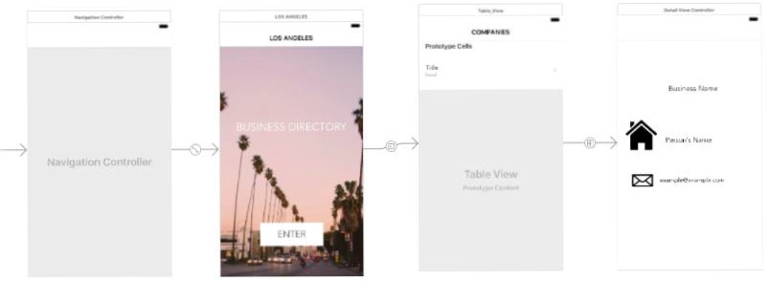
Views
Navigation Controller
Main View
Table View Controller
Detail View Controller

Slide 7
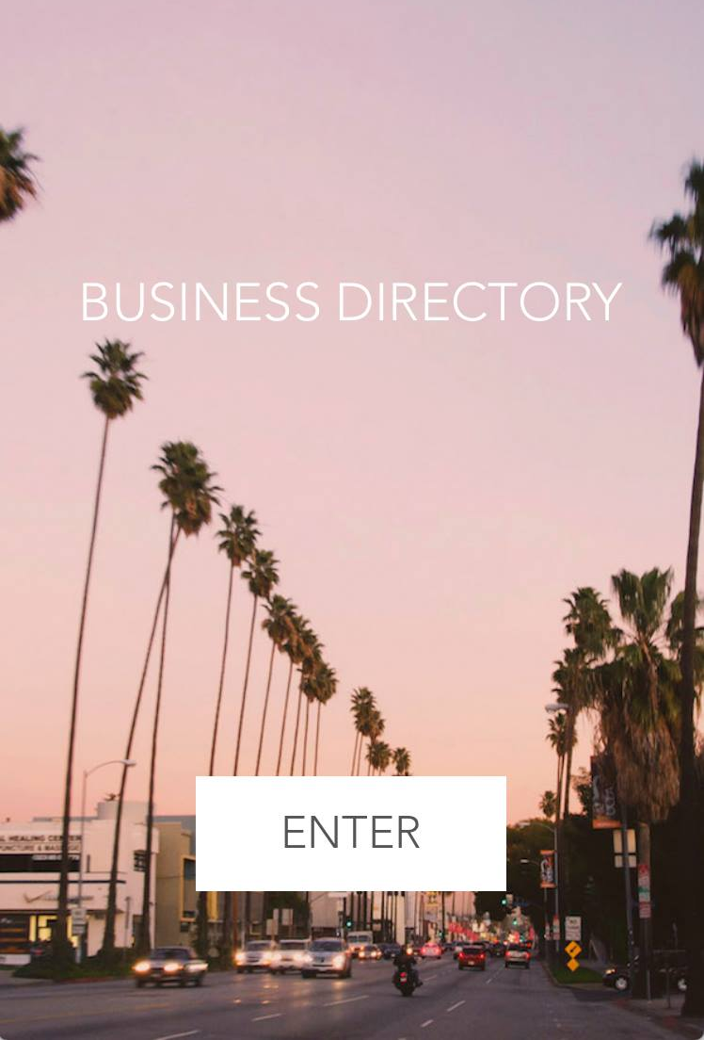
Main View
The first controller of the application
Allows entry to the main features of the app
Pressing the ‘Enter’ button segues into the next controller

Slide 8
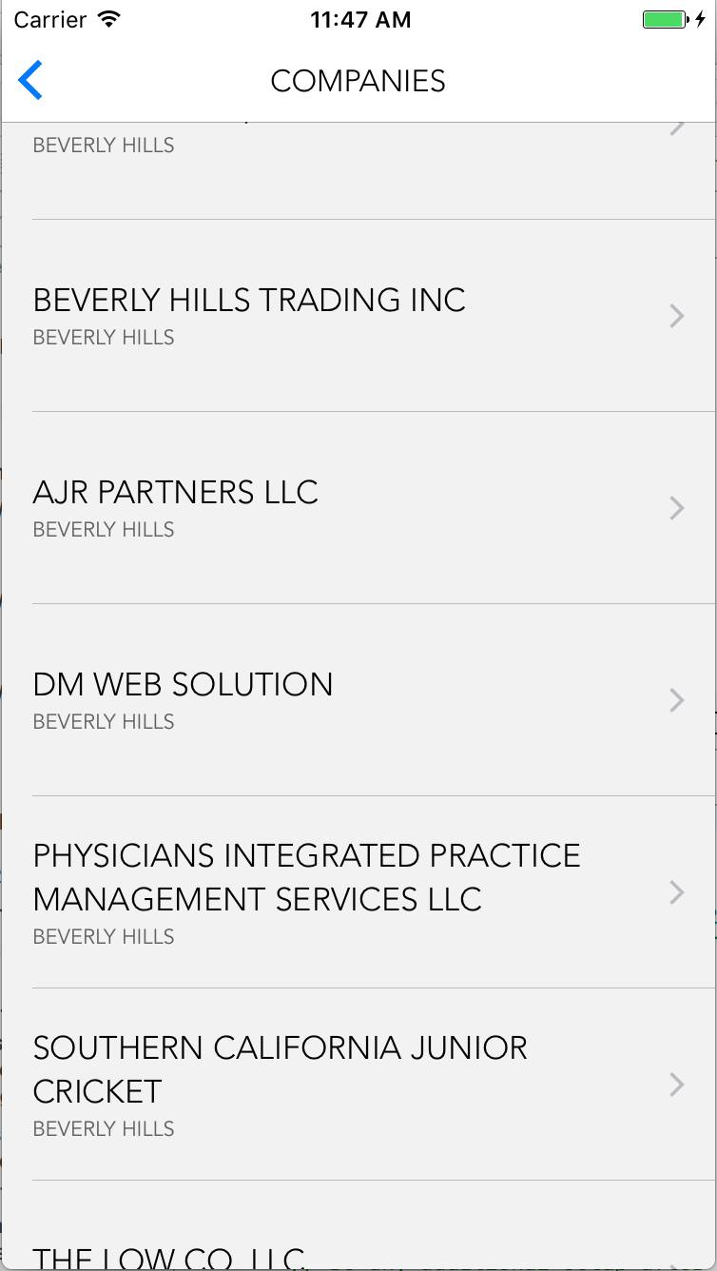
Table View Controller
Contains prototype cells
These prototype cells are set up as a list of companies by the backend development

Slide 9
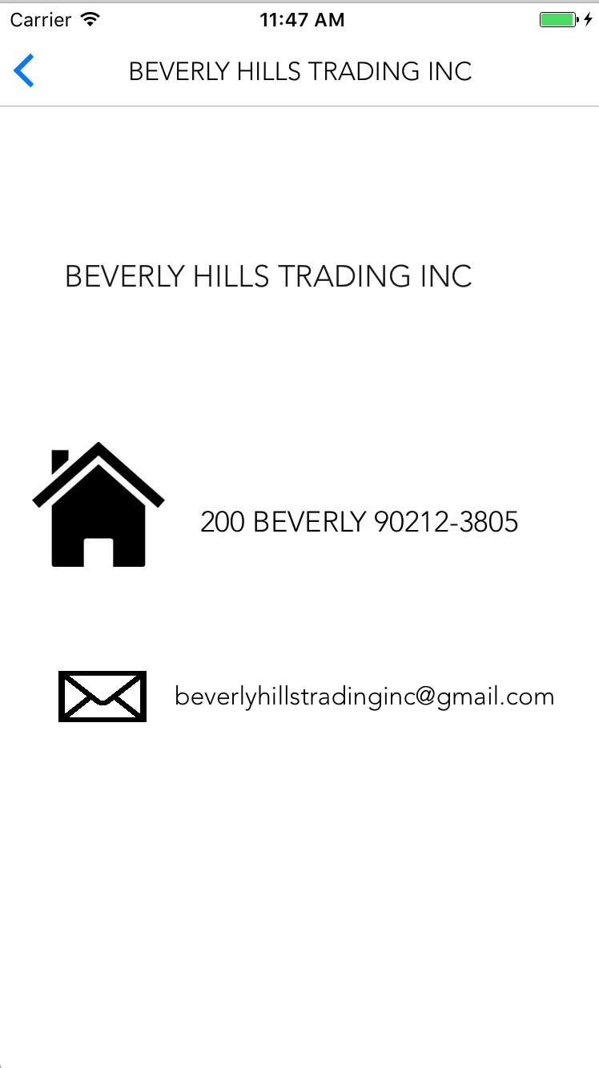
Detail View Controller
Selecting a company from the Table View Controller gives a more detailed outlook on that company
The Business Name, Address, Email and ZIP code fields of the business is displayed
These fields are filled in by the backend

Slide 10
Further Uses
This application can be programmed to use the APIs from every city in the US, and maybe even the world, and access the businesses list in those cities.
It could even involve tie-ups with jobs and hiring agencies, setting up meetings for potential job interviews with the businesses.
Features could be added to show vacancies whenever a business shuts down or relocates allowing new businesses to come in.

Slide 11
THANK YOU
QUESTIONS?

