Slide 1
Project Title :
CSphere – A College Club Management System
Project Guide :
K. Nageswara Rao sir

Slide 2
Batch Members :
CH. NAGA VAMSI 23608-CM-008
G. MANIKANTA 23608-CM-069
B. VINAY KUMAR 23608-CM-004
SK. MINAMPALLI JANI BASHA 23608-CM-052
P. BHARATH 23608-CM-046

Slide 3
Abstract
CSphere, a College Club Management System is a centralized web-based platform designed to streamline the management of college clubs. It addresses the inefficiencies of traditional systems that rely on fragmented tools like WhatsApp and Excel.
The application facilitates seamless communication, event scheduling, and member engagement through role-based access, notifications, and an intuitive dashboard.
By integrating modern web technologies (MERN stack), CSphere empowers student communities to manage activities efficiently, enhances visibility of club initiatives, and lays the groundwork for a scalable campus-wide digital ecosystem.

Slide 4
Requirements and Tech Stack
Hardware Requirements
CPU: i5 or better
RAM: 8 GB or above
Storage: ~500 GB+
Internet: Required for full functionality

Slide 5




Software Requirements
Frontend: React.js, Tailwind CSS
Backend: Node.js, Express.js
Database: MongoDB
Auth: JWT
Real-Time Features : Socket.IO

Slide 6
Existing System
Manual club management through tools like WhatsApp and Excel makes coordination tedious and error-prone.
No centralized system for tracking members, events, or participation records.
Communication gaps between organizers and students result in missed updates and low engagement.
Limited visibility of club activities reduces awareness and overall participation.

Slide 7
Proposed System
Provides a single platform for event creation, announcements, and member management.
Real-time communication via notifications and group chat to bridge the gap between organizers and students.
Transparent activity tracking with improved visibility of upcoming events, participation, and club updates.
User-friendly interface that enhances engagement and encourages more student involvement.

Slide 8
Core Features
User Profile & Auth: secured sign‑in/up
Club Management: create, view, manage clubs
Real-Time Chat: separate chat room per club
Real-Time Announcements & Notifications: push events
Explore Page: discover new clubs
Dashboards for analytics

Slide 9
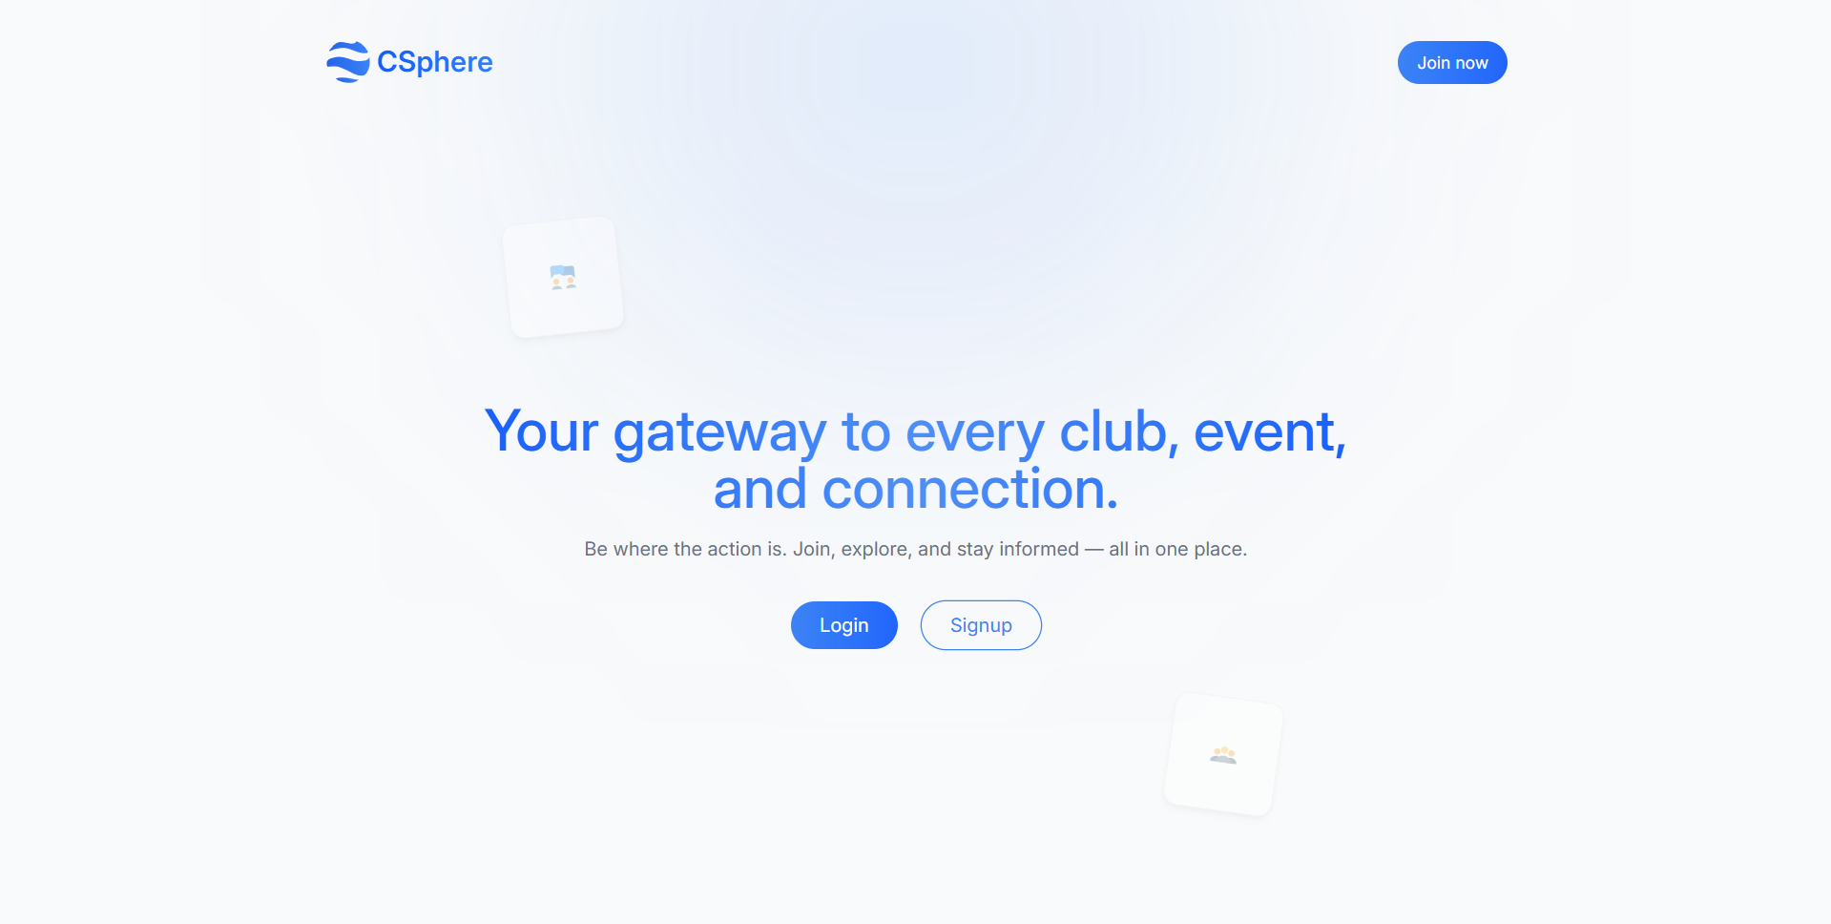

Slide 10
User Routes Screenshots →

Slide 11
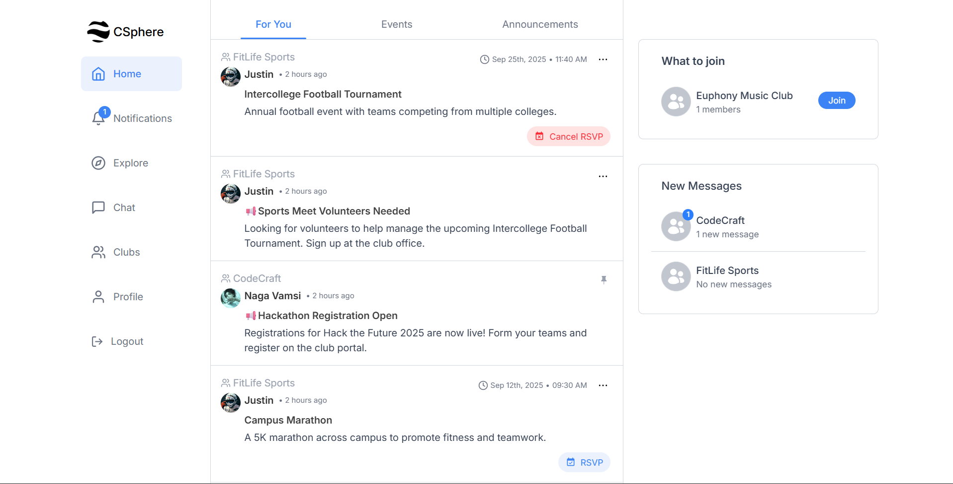

Slide 12
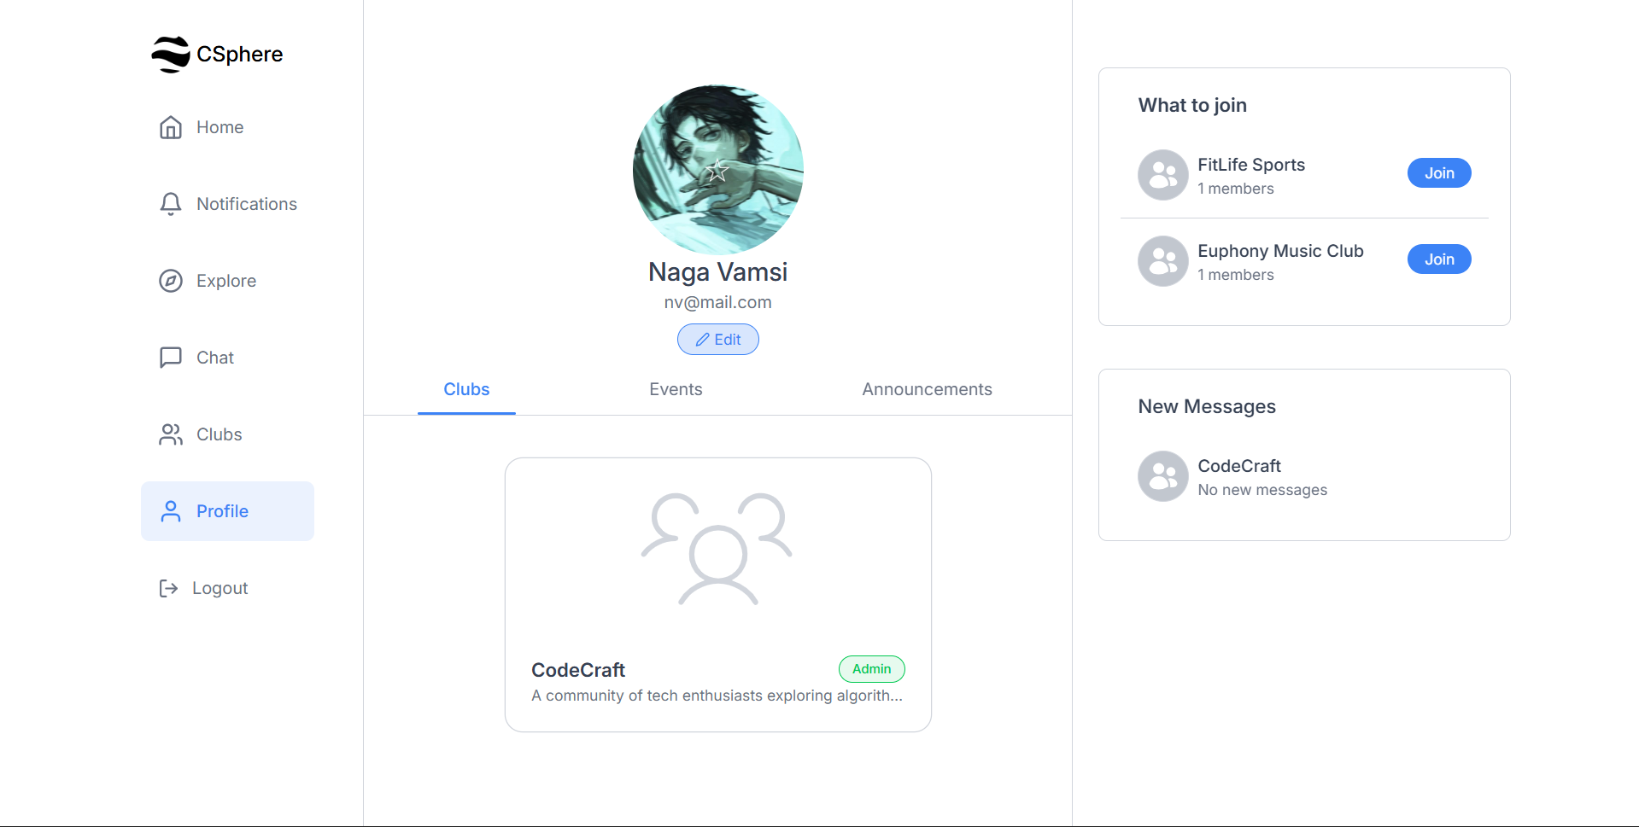

Slide 13
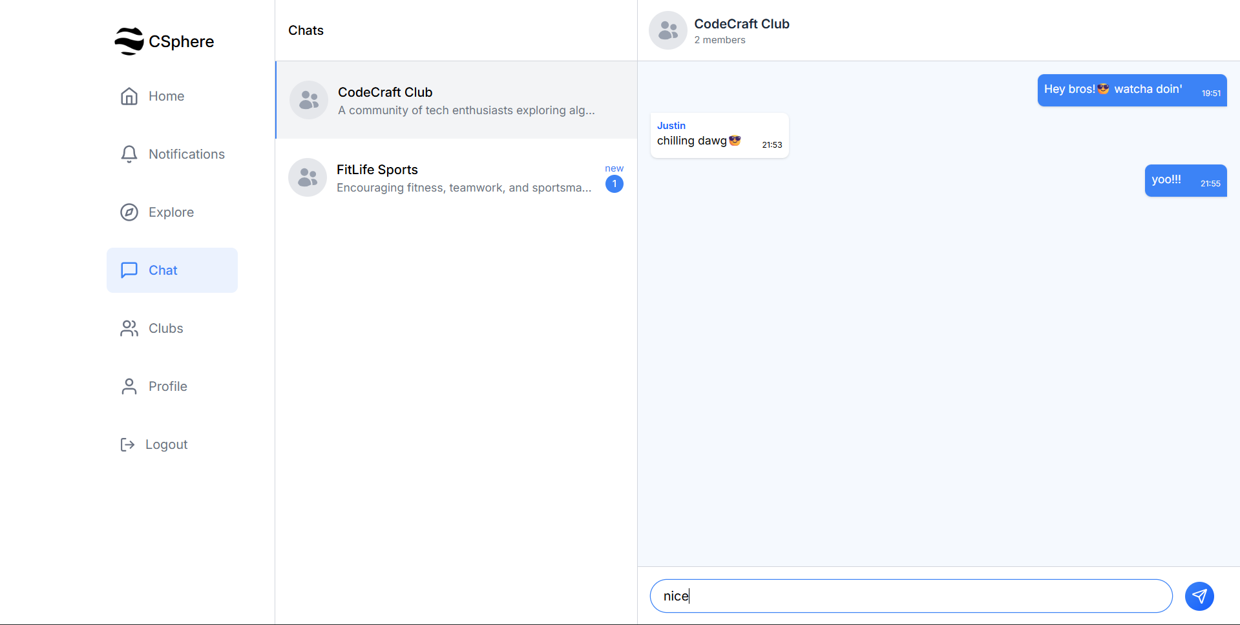

Slide 14
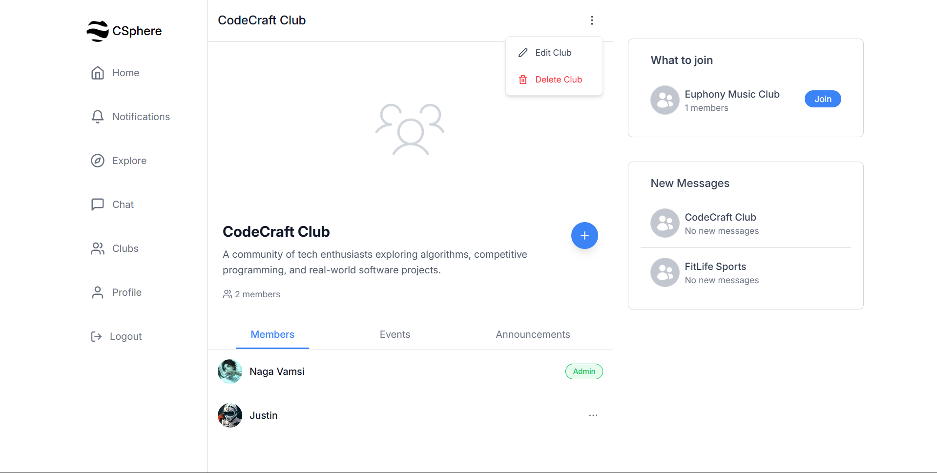

Slide 15
Super Admin Routes Screenshots →

Slide 16
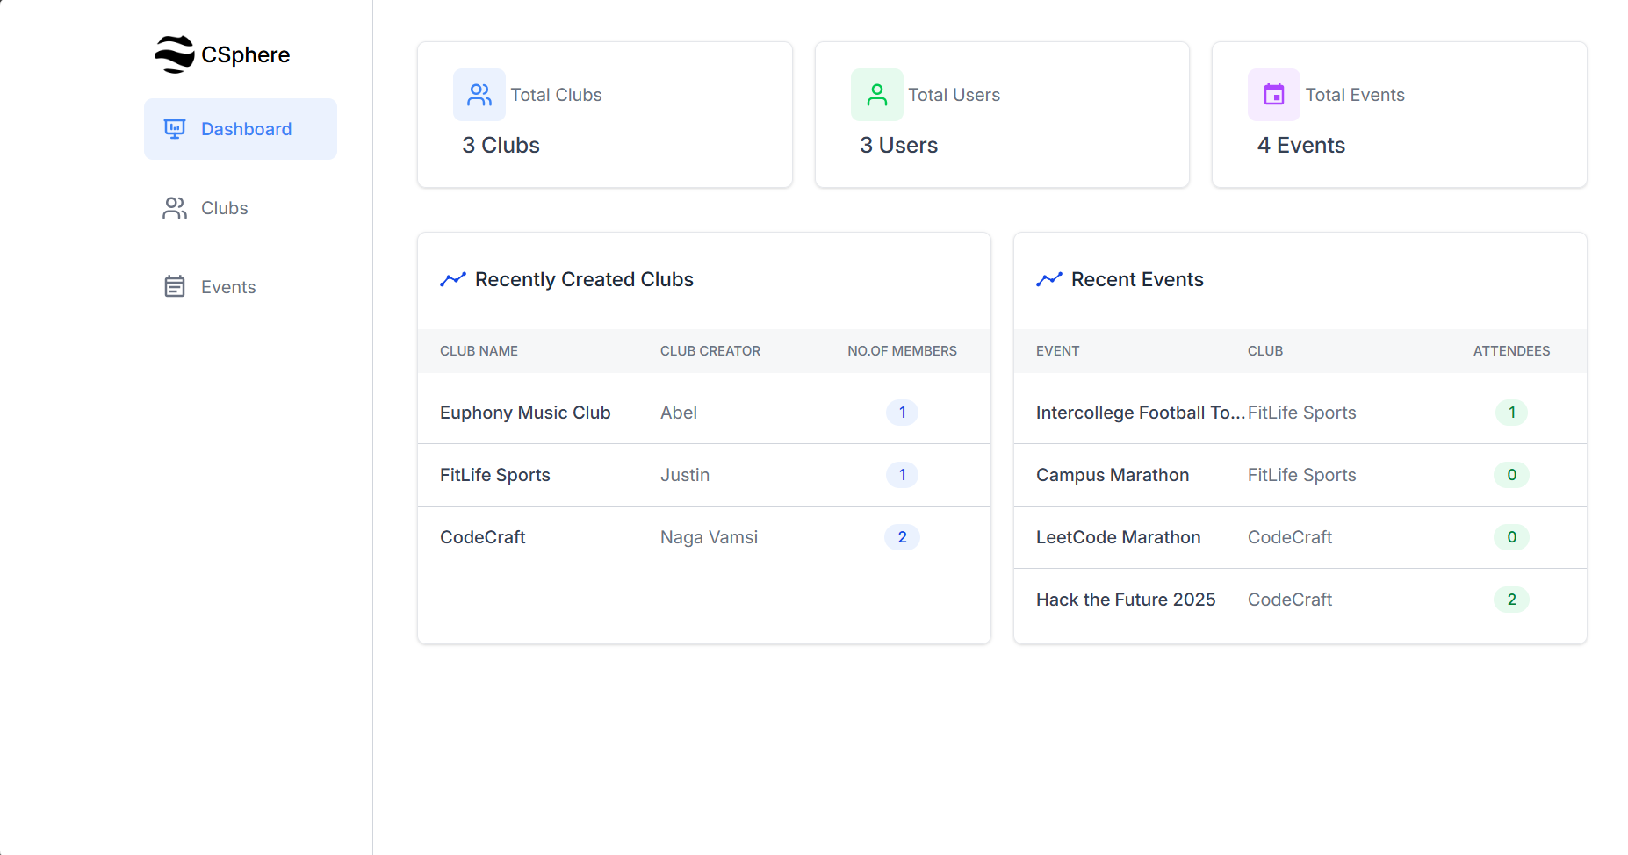

Slide 17
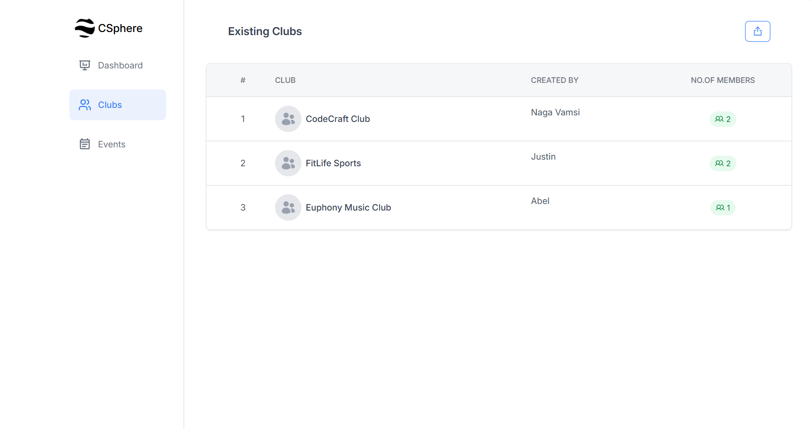

Slide 18
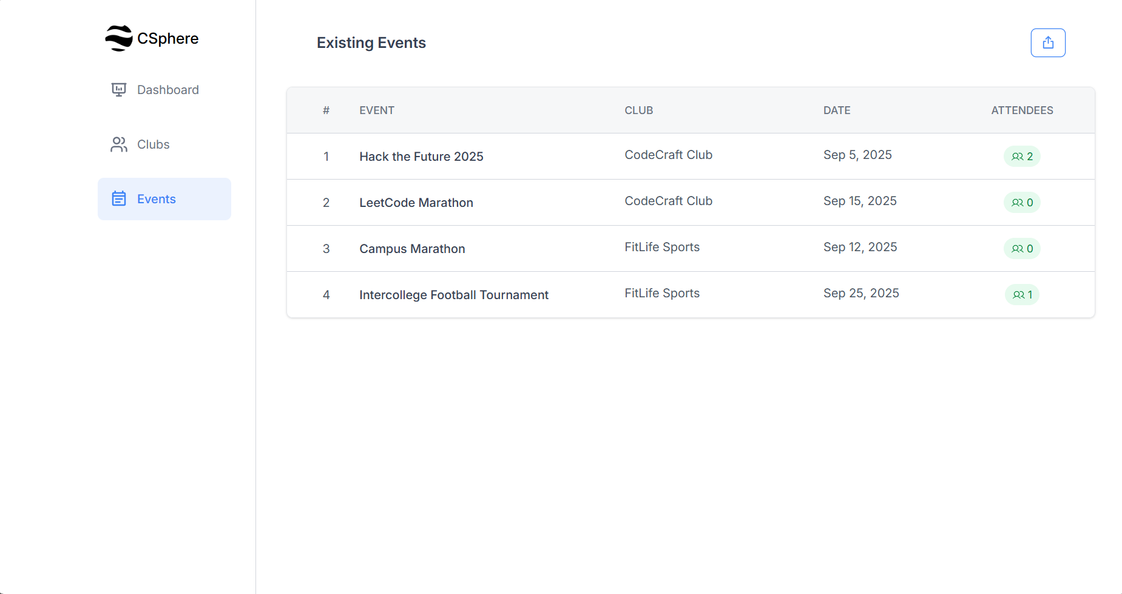

Slide 19
Future Scope
Mobile App: Launching Android and iOS apps for better accessibility and real-time engagement.
AI Powered Recommendations: Suggesting clubs and events to students based on their interests and past activities.
Cross-Club Collaborations: Facilitating joint events and shared resources between multiple clubs.
Calendar & Reminder System: Integrating with personal calendars (Google/Outlook) for event reminders.

Slide 20
THANK YOU

