Slide 1
STOCK MARKET ANALYSIS
GROUP MEMBERS: VAMSI KRISHNA
PREKSHA
AKASH GANDHI

Slide 2


MOTIVATION
Everybody wishes to make money in a short span of time
People invest in stocks so that they can reap benefits from a trending stock in a short time
However the stock prices are highly volatile and not easy to predict

Slide 3
INTRODUCTION
Investors and traders need to take decisions about buying and selling a particular stock based on technical analysis
Stock analysis is one such method to evaluate the past and current trend of a stock
Two types of stock analysis are fundamental analysis and technical analysis

Slide 4
STOCK ANALYSIS
FUNDAMENTAL ANALYSIS
TECHNICAL ANALYSIS
BUSINESS PERFORMANCE
FINANCIAL STATEMENTS
GOOD PRODUCTS
RESPONSIBLE MANAGEMENT
PRICE MOVEMENT
HISTORICAL TRENDS
STOCK PRICE
VOLUME OF STOCKS
So an investor should incorporate both fundamental and technical analysis before investing in a stock

Slide 5
EXTERNAL FACTORS THAT INFLUENCE STOCK PRICES
News releases on earnings and profits, and future projections
Securing a new or large contract
Accounting errors or scandals
Anticipated takeover or merger
A change in management or leadership

Slide 6
OUR AREA OF FOCUS-EFX

Slide 7
WHY EQUIFAX??
Equifax is a credit reporting agency and based on the credit report of the consumer, they come up with a credit score
Equifax owns millions of sensitive records of consumers before they evaluate and report a credit score
There was a data breach in Equifax servers which resulted in hackers gaining information to almost 40% of US population
This data breach was publicly announced on Sept 7th 2017
Notes:
Other competetitors:
Equifax, Experian, and TransUnion
Not major impact because the competitors are minor players.

Slide 8
Analysis on Equifax Stock Data
Data Source : https://finance.yahoo.com
Period: 2 years with daily frequency
Technical Analysis : Performed analysis using Exponential moving averages(EMA) and Average Directional Index.(ADX)
Notes:
What is an 'Exponential Moving Average - EMA'An exponential moving average (EMA) is a type of moving average that is similar to a simple moving average, except that more weight is given to the latest data. It's also known as the exponentially weighted moving average. This type of moving average reacts faster to recent price changes than a simple moving average.
Formula:
The average directional index (ADX) is an indicator used in technical analysis as an objective value for the strength of a trend. ADX is non-directional, so it quantifies a trend's strength regardless of whether it is up or down. It is usually plotted in a chart window along with two lines known as the DMI (Directional Movement Indicators).
The ADX indicator measures the strength of a trend and can be useful to determine if a trend is strong or weak. High readings indicate a strong trend and low readings indicate a weak trend. When this indicator is showing a low reading then a trading range is likely to develop. Avoid stocks with low readings!

Slide 9





Bullish Bearish
Notes:
Bullish:
Investors who believe that a stock price will increase over time are said to be bullish. Investors who buy calls are bullish on the underlying stock.
Bearish:
Investors who believe that a stock price will decline are said to be bearish. The seller of a call has an obligation to sell the stock to the purchaser at a specified price and believes that the stock price will fall and is therefore bearish. Read more: Bullish Vs. Bearish - Series 4 | Investopedia https://www.investopedia.com/study-guide/series-4/introduction/bullish-vs-bearish/#ixzz4yQ4s81kw Follow us: Investopedia on Facebook Read more: Bullish Vs. Bearish - Series 4 | Investopedia https://www.investopedia.com/study-guide/series-4/introduction/bullish-vs-bearish/#ixzz4yQ4iXu7C Follow us: Investopedia on Facebook

Slide 10
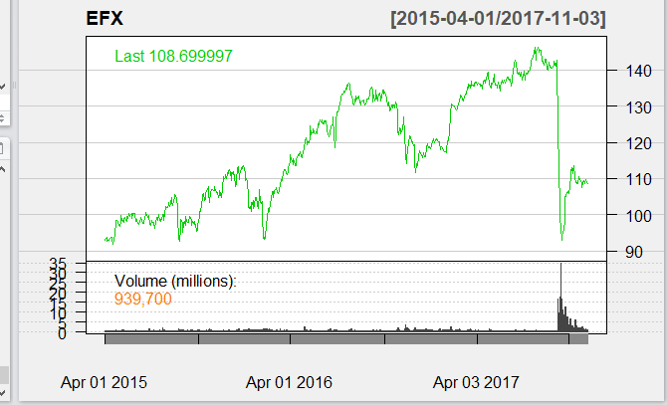
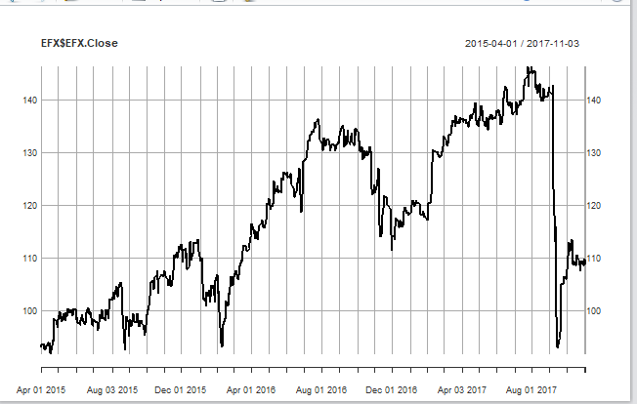
Trends of Equifax
Notes:
The columns in the data Open High, Low, Close, Adjusted close and Volume.

Slide 11
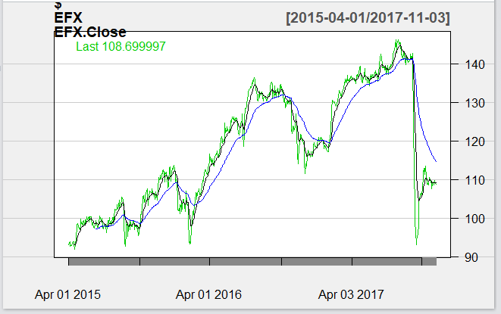
EMA
It is used for smoothening of the curve.
An exponential average gives more weight to the latest data and reacts faster to price fluctuations than a simple moving average.

Slide 12
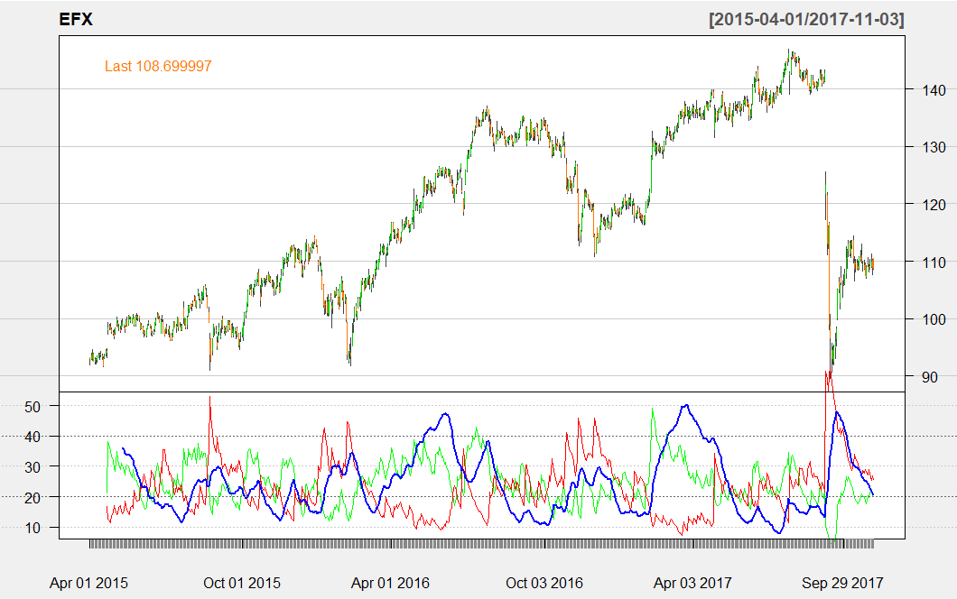
ADX
It is used to find the strength of the trend
It is non-directional by nature

Slide 13
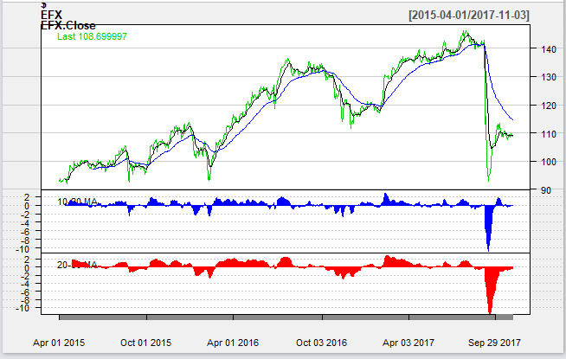
Notes:
The predicted value for this is around 110. The price as of today is 108.79 .

Slide 14
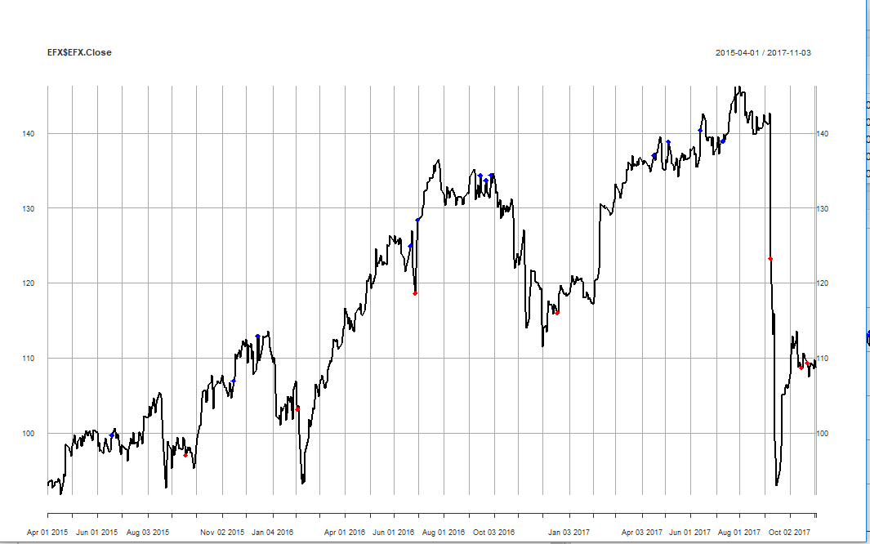
Short and Long
Notes:
The terms long and short refer to whether a trade was entered by buying first or selling first. A long trade is initiated by buying, with the expectation to sell at a higher price in the future and realize a profit. A short trade is initiated by selling first (before buying), with the expectation to buy the stock back at a lower price and realize a profit

Slide 15
Forecasting of Time Series Data
Forecasting involves predicting the values using historical data.
One method of forecasting the time series data is using Auto Regressive Moving Average Model (ARMA).
Prerequisite for ARIMA model is that the data has to be stationary.
The model combines three basic methods:
Auto Regressive models(p) : No of lagged values.
Differencing (d): Degree of differencing.
Moving Averages models(q): It refers to the random errors in previous period.
The representation of ARIMA (p,d,q).

Slide 16
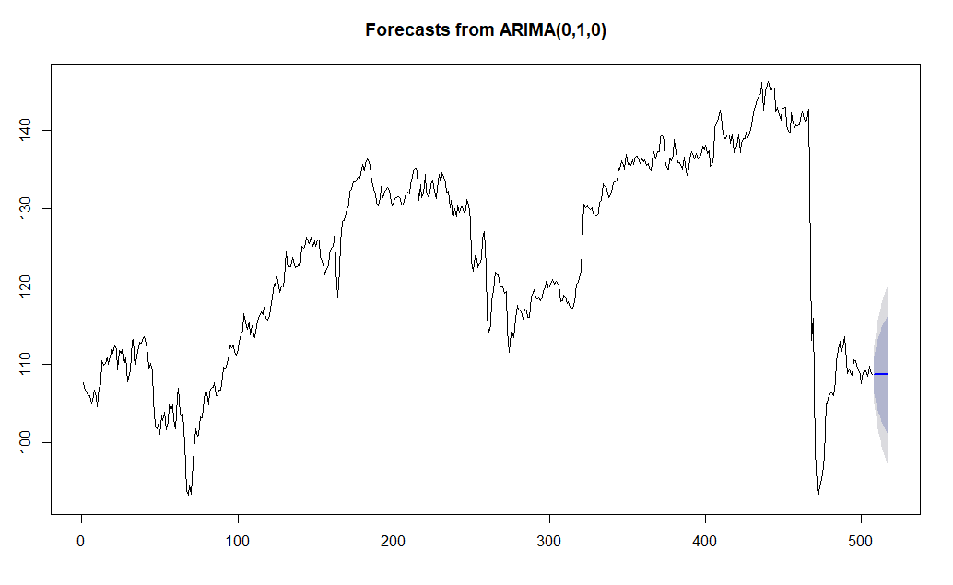
Predicted Value for next time period | Actual Value for next time period
109.31 | 108.79
Notes:
The predicted value for this is around 110. The price as of today is 108.79 .

Slide 17
Conclusion
As per the case study we can observe an unpredictable trend because of the data breach which affected their price.
The analysis helps us to understand when an investor and a trader can invest in stocks.
An understanding on how to forecast the time series data ?

Slide 18
References
https://www.investopedia.com
https://www.fidelity.com
http://stockcharts.com/

Slide 19
Thank You

