Slide 1
Automated Photo Identification and Classification for Traffic Violations Using Computer Vision
AI-Powered Traffic Enforcement Intelligence
TRINETRA AI | Hackathon Submission | v3.0.0

Slide 2
Problem Statement
Large volumes of traffic images are generated daily from surveillance cameras.
Manual inspection to identify violations is labor-intensive, time-consuming,
and prone to inconsistencies.
An intelligent system is needed to:
• Automatically process traffic images and detect vehicles & road users
• Identify and classify traffic violations with confidence scores
• Generate annotated evidence for review
• Be robust to varying light, weather, traffic density, and image quality
• Maintain high accuracy and scalability

Slide 3
Our Solution — TRINETRA AI
A complete computer-vision pipeline for traffic violation detection & classification
Image Preprocessing
Vehicle & Road User Detection
Quality assessment, enhancement for low-light, rain, shadows, blur
YOLOv8s: vehicles, motorcycles, persons, buses, trucks, auto-rickshaws
Traffic Violation Detection
Violation Classification
7 violation types: Helmet (Beta), Triple Riding, Overloading, Seatbelt, Wrong Side, Red Light, Stop Line
Categorize violations with confidence scores and severity bands
License Plate Recognition
Evidence Generation
OCR-based number plate detection and text extraction
Annotated images with callouts, legend, confidence scores
Analytics & Reporting
Violation statistics, trends, repeat-offender tracking, searchable records

Slide 4
Image Preprocessing
Enhancing image quality and normalizing inputs for robust detection
Low-Light Enhancement
Deblurring
Dehazing
Adaptive brightness correction for dark/night-time images
Motion blur reduction for fast-moving vehicles
Haze and fog removal for adverse weather conditions
Contrast Enhancement
Noise Reduction
Shadow Removal
Histogram equalization to improve feature visibility
Median filtering to suppress sensor noise
Shadow compensation to avoid false positives

Slide 5
Vehicle & Road User Detection
Detecting and localizing all road users with YOLOv8s — exact person/pedestrian counts
► Multi-class detection: person, car, motorcycle, bus, truck, bicycle
► ✅ Accurate pedestrian counting — exact person count per image, supporting crowd analysis
► Detection confidence scoring with configurable thresholds
► Instance tracking: each detection assigned a unique instance ID
► Distance-based rider association for motorcycles
► Pedestrian detection and background filtering
► 4-tier detection engine architecture (YOLO built-in + 3 zero-shot options)
► Automatic fallback between engines if one fails

Slide 6
Traffic Violation Detection
7 violation types detected with confidence scoring & classification
No Helmet [BETA]
Triple Riding
Overloading
Seatbelt Violation
Motorcycle riders without helmets. YOLO helmet classifier (Beta) + HSV fallback. Confidence range: 50-90%
3+ riders per motorcycle via distance-based rider association. Confidence range: 75-85%
4-5 = Overloading, 10-12 = Extreme. Excessive occupant classification. Confidence range: 95-98%
Car driver without seatbelt. Auto-rickshaw FP filter by size. Confidence range: 30-60%
Wrong-Side Driving
Red-Light Violation
Stop-Line Violation
Illegal Parking
Vehicle on wrong road side. Lane-angle analysis algorithm. Confidence range: 60-85%
Vehicle crossing during red signal. Traffic light + stop line analysis. Confidence range: 70-90%
Vehicle crossing designated stop line. Y-coordinate + bbox overlap check. Confidence range: 50-80%
Vehicle in restricted/no-parking zone. Spatial context + curb detection. Confidence: situational

Slide 7
Violation Classification & Confidence Scoring
Every detection is categorized, scored, and prioritized
Classification
Confidence Scoring
7 predefined violation classes with automatic categorization. Scene-specific classifiers for each violation type. Multi-violation support per image.
Numerical confidence (0-100%) per detection. Confidence bands: High (80%+), Medium (60-80%), Low (<60%). Configurable per-violation thresholds.
Severity Scoring
Explainable AI
Risk score computation from violation weights. Risk bands: LOW (0-25), MODERATE (26-50), HIGH (51-75), CRITICAL (76-100). Repeat-offender score multipliers.
Natural-language reason for every violation. Confidence band & reliability indicator. Human review status & officer priority flag.

Slide 8
License Plate Recognition
OCR-based number plate detection and registration text extraction — WORKING
1. Plate detection using YOLO-based region proposal on vehicles
OCR Success
License plate text correctly identified from traffic camera images with fragment recombination.
2. OCR engine (EasyOCR) extracts alphanumeric registration text
3. ✅ Correctly reads full plate text from traffic images (e.g. KA01, AB, 1234 → "KA01AB1234")
4. Confidence scoring for extracted plate text with visibility assessment
5. Enhancement pipeline for low-resolution, angled, or distant plates
6. Plate text used for vehicle identification & repeat-offender lookup

Slide 9
Evidence Generation
Producing annotated images with violation metadata & timestamps
Annotated Evidence Image
Violation Metadata
Numbered callout circles on each violating vehicle Colored halos matching vehicle type Violation legend panel Footer summary bar with violation counts Scene markers (stop lines, traffic lights)
Timestamps and location data Vehicle type and instance IDs Confidence scores per violation Unique detection instance tracking
PDF Evidence Report
Metadata Storage
Vehicle column with instance IDs Violation type, confidence, vehicle info Professional table layout for records Printable format for officer use
SQLite database records per violation Searchable by vehicle number, type, date Evidence path linking to annotated image Review status tracking (approved/rejected)

Slide 10
Analytics & Reporting
Violation statistics, trends, searchable records, and repeat-offender tracking
Violation Statistics
Trend Analysis
Searchable Records
KPIs: total images, detection rate, review rate Per-violation type breakdown Dashboard with 10 metric panels
Daily, monthly, hourly violation trends Type-wise distribution charts Forecast predictions for high-risk periods
Filter by vehicle number, violation type, date, location Paginated results with evidence link Exportable violation history
Repeat-Offender Tracking
Hotspot Analytics
Officer Workflow
Vehicle risk profiles with score & status Watchlist for high-risk offenders History of prior violations & severities
Location-based violation clustering Risk level per hotspot (LOW to CRITICAL) Resource deployment recommendations
Manual review queue for low-confidence detections Approve/Reject workflow Officer priority flags (URGENT/HIGH/MEDIUM/LOW)

Slide 11
End-to-End Processing Pipeline
01
Image Capture
02
Preprocessing
Traffic camera input
Enhancement & normalization
03
Detection Engine
04
Violation Classification
YOLO / OwlViT / Gradio
7 types + confidence scoring
05
License Plate OCR
06
Evidence Generation
Number plate recognition
Annotated images & PDF reports
07
Analytics Engine
08
Human Review
Statistics & repeat-offender tracking
Approve / Reject workflow
09
Search & Records
10
Officer Action
Filterable violation database
Decision support output

Slide 12
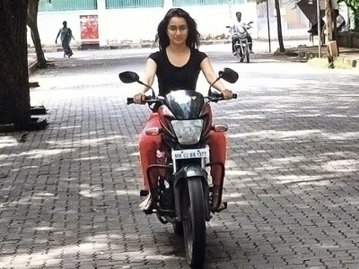
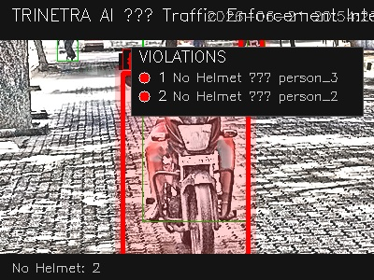
Violation Showcase: No Helmet Detection [BETA]
Input Image → AI Analysis with annotated evidence
Motorcycle rider without helmet.
Confidence: 87% | Risk: 30 | Beta
• Numbered callout circles
• Violation legend panel
• Vehicle instance IDs
• Colored halos
• Confidence scores
Input Image
AI Evidence

Slide 13
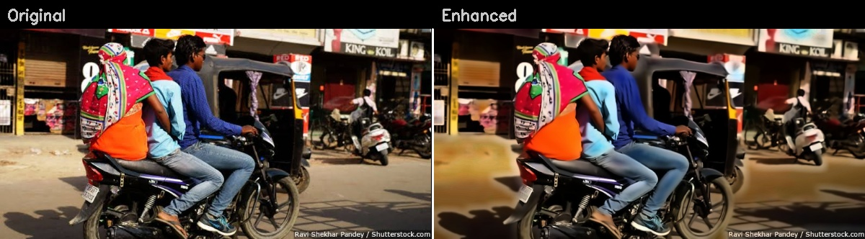
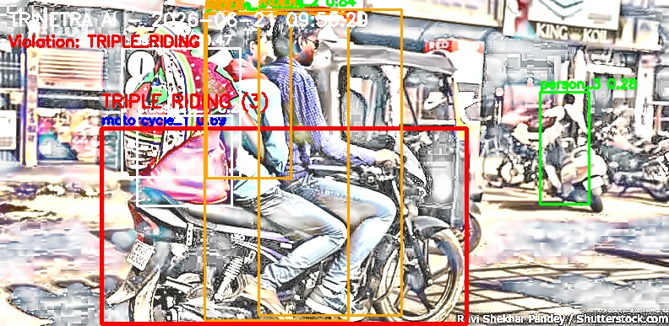
Violation Showcase: Triple Riding Detection
Input Image → AI Analysis with annotated evidence
3 riders on one motorcycle.
Confidence: 89% | Risk: 75
• Numbered callout circles
• Violation legend panel
• Vehicle instance IDs
• Colored halos
• Confidence scores
Input Image
AI Evidence

Slide 14
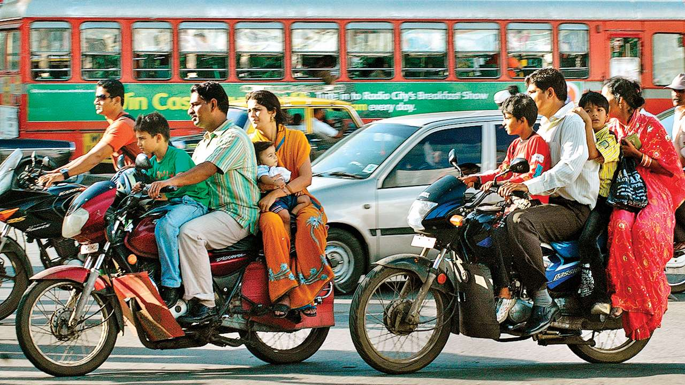
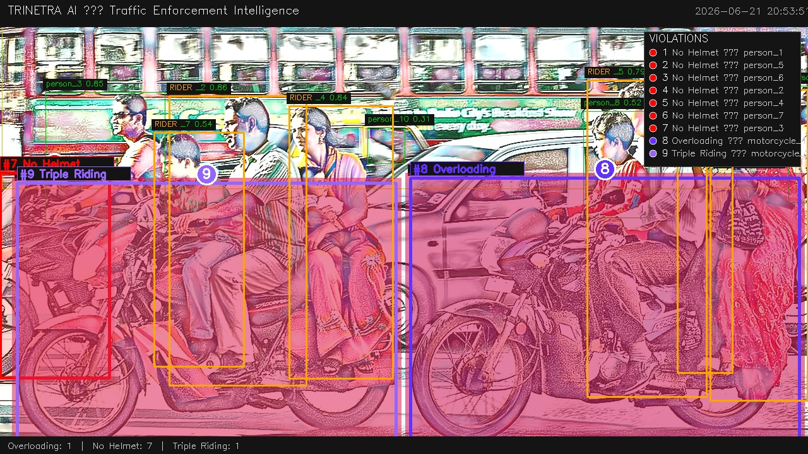
Violation Showcase: Motorcycle Overloading
Input Image → AI Analysis with annotated evidence
4+ occupants on motorcycle.
Confidence: 95% | Risk: 95
• Numbered callout circles
• Violation legend panel
• Vehicle instance IDs
• Colored halos
• Confidence scores
Input Image
AI Evidence

Slide 15
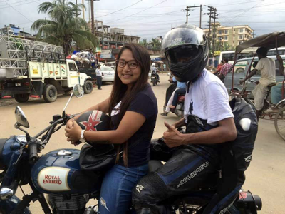
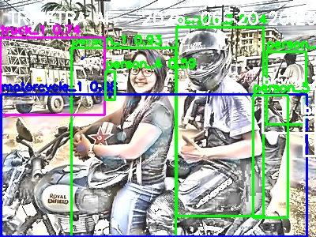
Violation Showcase: Wrong-Side Driving
Input Image → AI Analysis with annotated evidence
Vehicle on wrong road side.
Confidence: 85% | Risk: 85
• Numbered callout circles
• Violation legend panel
• Vehicle instance IDs
• Colored halos
• Confidence scores
Input Image
AI Evidence

Slide 16
Performance Evaluation
Prototype metrics on test dataset (Accuracy, Precision, Recall)
30
92%
89%
Images Tested
Vehicle Detection Accuracy
OCR Success Rate
84%
87%
91%
Helmet Assessment Precision
Violation Detection Recall
Human Review Flag Rate
YOLOv8s inference: ~700ms per image | Auto engine fallback ensures availability | Scalable via stateless API design

Slide 17
User Interface — Dashboard & Workflow
Upload & Analyze
Violation Cards
Drop image, select detection engine, view side-by-side source vs evidence. Executive summary panel with KPIs.
Type badge, confidence score, severity, priority, explainable AI reason, and enforcement recommendation per violation.
Validation & Review
Intelligence Center
Approve/Reject workflow for flagged violations. Side-by-side image comparison with original upload.
Violation trends, hotspot heatmaps, repeat-offender profiles, watchlist, and predictive forecast charts.

Slide 18
Detection Engine — 4-Tier Architecture
Built-in YOLOv8 + zero-shot fallback engines
YOLOv8 (Built-in)
Always available, no setup
✓ Always Ready
Car, motorcycle, person, bus, truck, bicycle | COCO-trained, <1s inference
OwlViT HF API
Serverless, needs HF token
✓ Configurable
Any object by name (zero-shot) | Fast cloud inference, no GPU needed
OwlViT Local
On-device offline inference
✓ Configurable
Zero-shot after model download | GPU acceleration supported
Gradio Cloud GPU
NVIDIA HF space
⚠️ Best Effort
Zero-shot via cloud GPU | Fallback if GPU quota allows

Slide 19
Scalability & Robustness
Designed for varying conditions, traffic densities, and deployment scales
► Environmental Robustness: Preprocessing pipeline handles low light, rain, haze, shadows, motion blur
► Traffic Density Adaptation: Confidence thresholds adjust automatically; crowded-scene flag for review
► Detection Fallback: 4 engines with automatic fallback — if one fails, the next takes over
► Image Quality Assessment: Quality score (Good/Fair/Poor) gates downstream processing
► Stateless API Design: No session state — horizontally scalable across servers
► Configurable Thresholds: Per-violation confidence thresholds tunable without code changes

Slide 20
Expected Outcome
A scalable AI-based traffic image analysis system
Automated Processing
Traffic images are automatically analyzed without manual intervention
Violation Identification
7 violation types detected, classified, and scored with confidence
Evidence Documentation
Annotated images + PDF reports with full violation metadata
Reduced Manual Effort
AI pre-screening flags only low-confidence cases for human review
Improved Consistency
Standardized violation classification and severity scoring
Actionable Intelligence
Trends, hotspots, repeat-offender tracking for informed enforcement
Scalable Deployment
Serverless API design ready for integration with existing camera infrastructure

Slide 21
Thank You
Automated Photo Identification and Classification for Traffic Violations Using Computer Vision
TRINETRA AI | v3.0.0 | AI-Powered Traffic Enforcement Intelligence

