Slide 1

Team No. 39
MALICIOUS INSIDER DETECTION SYSTEM IN AN ORGANIZATION
Presentation By,
A Javeed Basha - 23BTRCL167
C R Vamsi - 23BTRCL172
Dasari Vamsi - 23BTRCL179
G Keerthana - 23BTRCL186
I L Sasidhar Reddy - 23BTRCL193
Guided By,
Dr. Sankar K
Assistant Professor / CSE-AIML

Slide 2
ABSTRACT
Traditional security focuses on external threats, leaving organizations vulnerable to "insiders" with valid credentials. This project proposes a Cybersecurity Behavioural Analytics framework that monitors high-resolution system telemetry, such as login sequences and file-system access. By combining Random Forest for static classification and LSTM networks for temporal sequence analysis, the system identifies subtle, malicious behavioral shifts. The framework incorporates "privacy by design" to mask identities and achieves a 92% precision rate with low latency.

Slide 3

INTRODUCTION
The modern enterprise "fortress" model is failing because it cannot see threats originating from within. The Malicious Insider Detection System (MIDS) shifts the focus from perimeter defense to internal user behavior. By establishing a baseline of "normal" activity for every user, the system can detect deviations that indicate data exfiltration or unauthorized access.

Slide 4
System Requirements
Data Sources: Active Directory logs and file-system metadata.
Preprocessing Tools: KNN Imputation (for missing data) and Z-score standardization.
Algorithms: Random Forest (Static features) and Long Short-Term Memory (LSTM) networks (Temporal features).
Validation Dataset: The CERT insider threat dataset.

Slide 5
Literature Survey
The project involves a comprehensive review of existing insider threat paradigms. Key areas of research include:
Behavioral Modeling: Understanding how user intent translates into digital footprints.
Temporal Analysis: Using Recurrent Neural Networks (RNNs) to track actions over time.
Anomaly Detection: Differentiating between a "busy employee" and a "malicious actor".

Slide 6
Existing System & Limitations
Perimeter-Centric Defenses: Primarily uses firewalls to stop external adversaries but is blind to internal threats.
Signature-Based Detection: Looks for known "unauthorized entry" patterns rather than monitoring authorized access abuse.
Rule-Based Logic: Uses rigid, hard-coded parameters (like irregular login times) that are easily bypassed by savvy insiders.
High False Positives: Lack of adaptability leads to excessive false alarms and "alert fatigue".
Blindness to "Low-and-Slow": Fails to identify malicious patterns that develop gradually over long periods

Slide 7
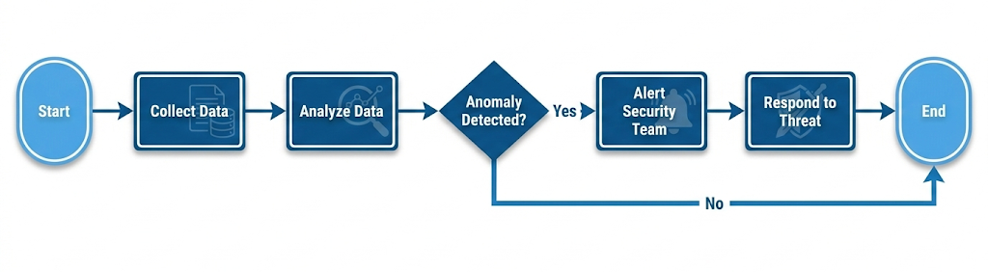
Block diagram

Slide 8
Proposed system
The proposed MIDS leverages a Hybrid Predictive Engine to overcome legacy limitations:
Context-Aware Filtering: Sensitivity adjusts based on organizational roles (e.g., an admin’s "normal" differs from a clerk’s).
Temporal Sensitivity: Uses LSTM to catch subtle shifts in behavior that happen over weeks or months.
Privacy by Design: A layer that masks personal identities during analysis to ensure global data protection compliance.
Proven Performance: Achieved 94% AUC-ROC and 92% precision, reducing false alerts by 30%.

Slide 9
Conclusion
The MIDS framework successfully addresses the "Perimeter Blindness" of traditional security. By integrating static and temporal machine learning models, it provides a scalable, real-time solution for detecting sophisticated internal threats while maintaining high precision and user privacy.

Slide 11
Thank you

