Slide 1
HematoVision:-
Advanced Blood Cell Classification Using Transfer Learning
Presented by: LTVIP2025TMID59856
Rayachoti Vamsi
Yerrakkagari Chaithra
Boilla Vishnu Vardhan Reddy
Asapuram Lakshmi
Annamacharya Institute Of Technology And Sciences,Kadapa

Slide 2
Introduction:-
HematoVision aims to develop an accurate and efficient model for classifying blood cells by employing transfer learning techniques.
Utilizing a dataset of 12,000 annotated blood cell images, categorized into distinct classes such as eosinophils, lymphocytes, monocytes, and neutrophils, the project leverages pre-trained convolutional neural networks (CNNs) to expedite training and improve classification accuracy.
Transfer learning allows the model to benefit from pre-existing knowledge of image features, significantly enhancing its performance and reducing computational costs.
This approach provides a reliable and scalable tool for pathologists and healthcare professionals, ensuring precise and efficient blood cell classification.

Slide 3
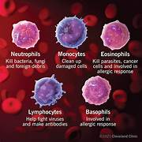
Problem Statement:-
The manual classification of blood cells (BCs) in peripheral blood smear images is a critical but labor-intensive task commonly performed by trained hematologists or laboratory technicians.
This process involves visually inspecting stained blood cells under a microscope to identify different types of BCs such as neutrophils, lymphocytes, monocytes, and eosinophils.
It is time-consuming, especially when processing large volumes of patient samples.
It is subjective and inconsistent, with results often varying between observers based on their experience and expertise.

Slide 4
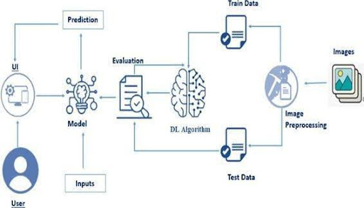
Project Overview:-
HematoVision is a deep learning-based web application designed to automate the classification of blood cells (BCs) from microscopic blood smear images. The primary objective of the project is to assist medical professionals in identifying and classifying different types of BCs—neutrophils, lymphocytes, monocytes, and eosinophils—quickly and accurately, reducing reliance on manual microscopy.
To achieve this, the system leverages a Convolutional Neural Network (CNN) trained on a labeled dataset of BloodCell images. The trained model is integrated into a Flask-based web application that allows users to upload cell images and receive instant predictions.

Slide 5
Dataset:-
Here are several high-quality, publicly available blood cell datasets:-
1. Raabin‑blood cells Dataset:-
Size & classes: Over 14,500 images, across 5 WBC types (Basophil, Monocyte, Eosinophil, Neutrophil, Lymphocyte)
Extras: Includes double-labeled cropped cells and ground truth masks for nucleus/cytoplasm.
2.Human Blood Cells:-
Content: Includes fluorescent, brightfield, and darkfield images of WBCs (e.g., B-/T-lymphocytes, eosinophils, monocytes, neutrophils)
Size: Hundreds to thousands of cells; useful for segmentation and classification.
3.PBC Peripheral Blood Cells Dataset:-
Overview: ~17,000 individual WBC images across 8 types (including immature granulocytes, erythroblasts, and platelets)
Ideal for classification tasks with a broader set of cell types.

Slide 6
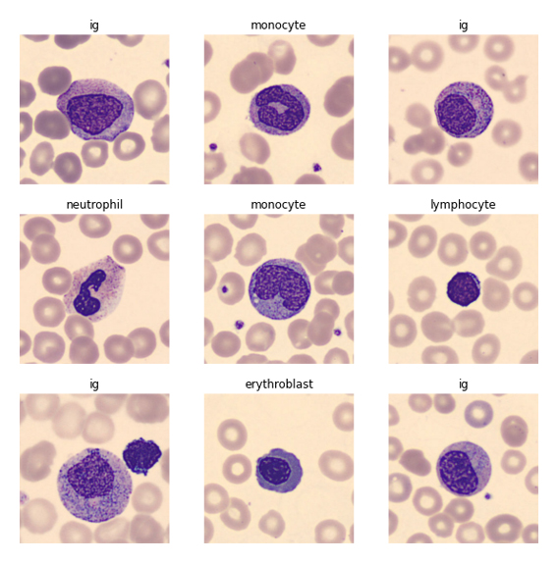
Model Architecture:-
The architecture begins with three convolutional layers that extract hierarchical spatial features from the input image. Each convolutional layer is followed by a ReLU activation and MaxPooling to reduce spatial dimensions and computational complexity. To avoid overfitting, dropout layers add after the convolutional blocks and dense layer.

Slide 7
Training Results:-
Accuracy :0.8705
Loss :0.4657
Test Accuracy:0.8219
Test Loss : 0.5832

Slide 8
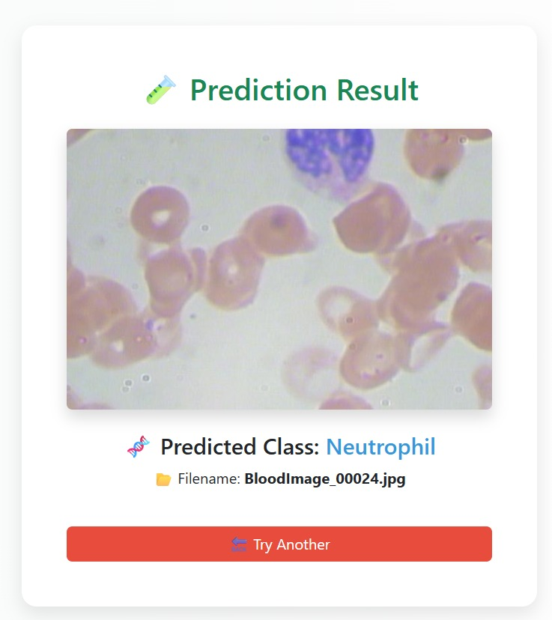
Web Application:-
The HematoVision web application was developed to make the white blood cell classification model accessible through a simple, user-friendly interface. The application is built using Python and Flask, a lightweight web framework suitable for quick deployment of machine learning models.

Slide 9
Sample Predictions:-

Slide 10
Challenges Faced:-
Despite the successful development and deployment of the HematoVision system, several challenges were encountered during the project:
1.Limited and Imbalanced Dataset:-
Solution: Applied data augmentation (rotation, flipping, zoom) and class balancing techniques during training.
Impact: The model initially overfitted to majority classes, resulting in lower accuracy for minority cell types.
2. Overfitting:-
Impact: Reduced model accuracy and robustness.
Solution: Normalized image data and included diverse image conditions during trainings
3. Integration with Web Interface:-
Solution: Used pre-trained .h5 model format and carefully mapped input/output layers with Flask routes.
Impact: Increased development time for front-end and back-end integration

Slide 11
Future Work:-
To enhance the capabilities and reach of the HematoVision system, several future improvements are planned:
1. Expand to Other Blood Cell Types:-
Include Red Blood Cells (RBCs) and Platelets for complete blood analysis.
Help detect anemia, thrombocytopenia, and related disorders.
2. Real-Time Microscope Integration:-
Connect directly with a digital microscope or smartphone adapter.
3. Mobile Application Development:-
Build a lightweight Android/iOS app.
Allow healthcare workers in rural areas to classify cells using a mobile camera.
blood sample analysis without manual upload.
4. Explainable AI (XAI):-
Add visualization tools (e.g., Grad-CAM) to explain model predictions.
Increase trust among medical professionals using the system.

Slide 12
Conclusion:-
The HematoVision project successfully demonstrates how deep learning and computer vision can be applied to automate the classification of white blood cells from microscopic images. By using a custom-trained Convolutional Neural Network (CNN) and integrating it into a Flask-based web application, the system provides a fast, accurate, and user-friendly solution to a traditionally manual and time-consuming diagnostic task.
The model achieved high accuracy in classifying four key types of white blood cells — neutrophils, lymphocytes, monocytes, and eosinophils — and offers consistent performance across varied inputs. The use of image augmentation, regularization techniques, and a simple but effective model architecture ensured strong generalization to unseen data.

Slide 13

Thank you

