Slide 1

Agentic RAG Chatbots: Elevating Q&A with MCP
Explore a multi-agent Retrieval-Augmented Generation (RAG) chatbot designed to answer questions across diverse document formats.

Slide 2
ARCHITECTURE
Modular Agentic Design
Our RAG chatbot utilizes a sophisticated modular architecture, breaking down complex tasks into specialized, intelligent agents. This design ensures scalability, maintainability, and efficient processing of information.
LLMResponseAgent
Builds LLM queries and generates final responses.
IngestionAgent
CoordinatorAgent
Parses and preprocesses uploaded documents.
Orchestrates the flow among other agents.
These agents communicate seamlessly through a structured Model Context Protocol (MCP), ensuring precise message passing and coordinated task execution.
RetrievalAgent
Generates embeddings and retrieves top-k context chunks.

Slide 3

SYSTEM FLOW
Coordinated Information Flow via MCP
The agents in our RAG chatbot interact dynamically, with the CoordinatorAgent at the helm, managing the entire question-answering process. This diagram illustrates a sample workflow for a user query.
User Input
User uploads documents and asks a question, initiating the workflow.
Ingestion & Retrieval
Documents are parsed, chunked, and embeddings are generated for relevant context.
LLM Response
LLM queries are built using retrieved chunks to generate accurate answers.
Output
Final answer displayed to the user with traceable source references.

Slide 4
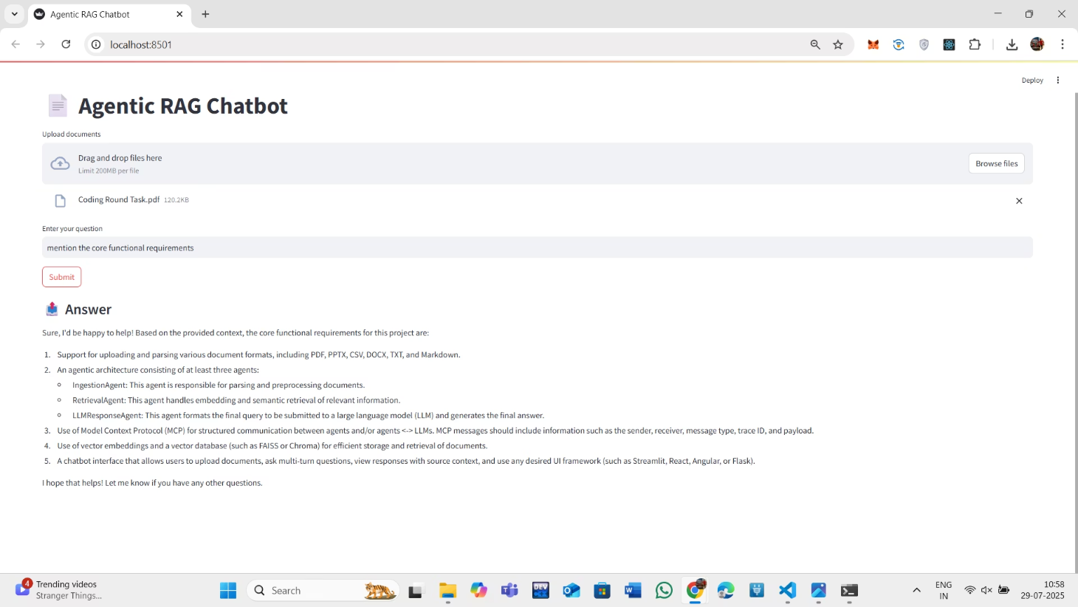
CAPABILITIES
Versatile Document Handling & UI
Our Agentic RAG Chatbot is designed for broad compatibility, allowing users to upload and query a wide array of document formats.
Document Formats: PDF, DOCX, PPTX, CSV, TXT, Markdown.
User Interface: A Streamlit-powered UI facilitates seamless file uploads, multi-turn question answering, and provides answers linked directly to source documents.
This ensures comprehensive document coverage and a user-friendly experience, making information retrieval efficient and transparent.

Slide 5




TECHNOLOGY
Key Technologies Driving the Chatbot
The Agentic RAG Chatbot leverages a robust stack of modern AI and data processing technologies to deliver accurate and efficient responses.
Language Models
Embeddings
Together.ai (Mixtral, Mistral) for advanced LLM responses.
HuggingFace SentenceTransformers (all-MiniLM-L6-v2) for efficient vector generation.
Vector Storage
Custom Protocol
FAISS for high-performance similarity search and retrieval.
In-memory Model Context Protocol (MCP) for structured messaging.
This combination ensures powerful language understanding, rapid information retrieval, and seamless inter-agent communication.

Slide 6
CHALLENGES & FUTURE
Navigating Complexities in Development
Developing a multi-agent RAG system presents unique challenges that require careful design and optimization.
Document Encoding Inconsistency
MCP Schema Adherence
Ensuring consistent handling of diverse document encodings and internal structures (e.g., tables, images within text) across all formats.
Maintaining strict adherence to the MCP message schema for all agents to prevent communication errors and ensure data integrity.
Context Chunking Optimization
API Token Budget Management
Optimizing the chunking strategy for large documents to balance context retention with token limits, especially for LLMs.
Integrating Together.ai within strict token budgets, requiring efficient prompt engineering and response generation.
Future iterations will focus on addressing these challenges for enhanced robustness and performance.

