Slide 1
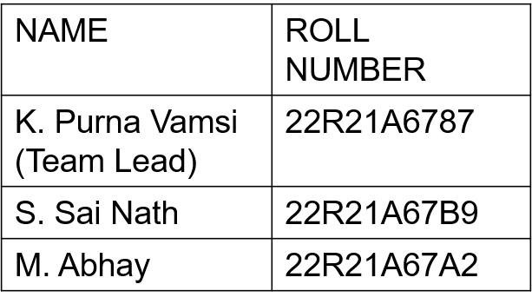
Department of Data Science
II B.Tech II Semester MiniProject-2024
Submitted by
Batch -03
REAL-TIME GENDER AND AGE CLASSIFICATION USING DEEP LEARNING AND OPENCV
GUIDE:
Mrs.Y. Anjali, M.Tech,
Assistant Professor, Department of Data Science.

Slide 2
Contents
Abstract
Introduction
Existing System
Draw backs
Proposed System
Advantages
Requirements
Conclusion
References

Slide 3
Abstract
This project aims to automatically determine the gender and age of a person using deep learning and OpenCV on real-time video frames. The challenge lies in predicting age accurately from a single frame due to factors like facial expressions, lighting, and makeup. To address this, the model categorizes predicted ages into ranges. The Adience dataset, known for its diverse real-world conditions, is employed for training and testing. The output of the system is the predicted gender and age range based on the input frame, making it a valuable tool for applications on social media platforms.

Slide 4
Introduction
Using deep learning and OpenCV for real-time gender and age classification based on frames of individuals.
It predicts gender and age from frames, considering challenges like facial expressions, lighting, and makeup.
The Adience dataset, known for diverse imaging conditions, is employed for training and evaluation. Rather than exact age estimation, age is categorized into ranges.
The aim of this research is to enhance social media platforms by providing efficient and accurate gender and age predictions.

Slide 5
Existing System
The existing system for gender and age classification in social media platforms relies on traditional methods such as handcrafted features, machine learning algorithms, and statistical models.
These approaches often suffer from limitations in capturing complex patterns and variations in facial images accurately.
They can be sensitive to factors like lighting, pose, and facial expressions, and may not provide robust results in diverse real-world scenarios.

Slide 6
Disadvantages
Inaccuracy: Age detection algorithms are not always accurate and may produce false positives or false negatives, which could lead to discrimination or other negative consequences.
Privacy concerns: Age detection technology may raise privacy concerns if it is used to collect personal information without the individual's consent.
Bias: Age detection algorithms may also be biased against certain ethnic or racial groups, as they may be trained on datasets that are not representative of the entire population.

Slide 7
Proposed System
We propose a novel approach for gender and age classification using deep learning and OpenCV.
It targets to overcome the limitations of the existing methods by utilizing deep learning techniques to capture complex patterns and variations in facial images more accurately.
To train and evaluate the system, we utilize the Adience dataset, it includes variations in noise, lighting, occlusions, and covers subjects from different age groups, ethnicities, and genders, making it well-suited for our purposes.
We categorize the predicted age into various age ranges, providing valuable insights about the approximate age group of the person.

Slide 8
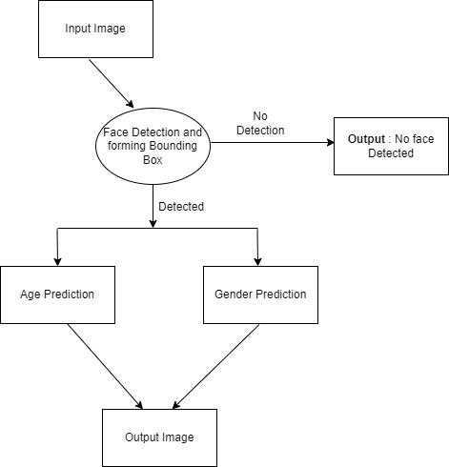
Working

Slide 9
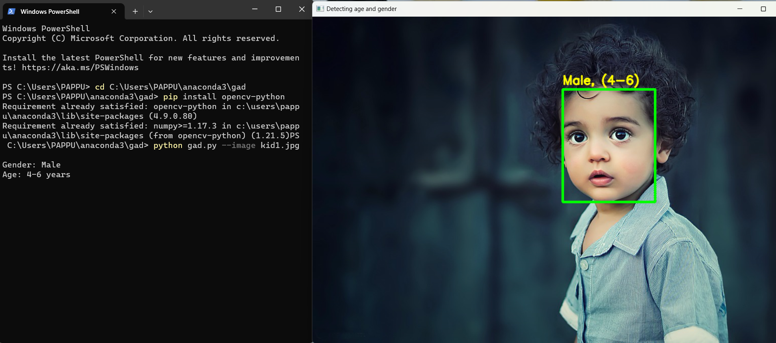

Slide 11
Advantages
Security: Age detection can be used for security purposes such as identifying underage individuals who may be attempting to purchase alcohol or tobacco products.
Marketing: Age detection can help marketers target their ads to specific age groups, making their marketing campaigns more effective.
Personalization: Age detection can also be used to personalize content and services for different age groups.

Slide 12
Requirements
Hardware Requirements:
System : Pentium IV 2.4 GHz.
Hard Disk : 40 GB.
Monitor : 15 VGA Color.
Mouse : Logitech.
Ram : 512 Mb
Software Requirements:
IDE: Google Collab
Coding Language: Python
Operating System: Window 10

Slide 13
Conclusion
Developed real-time gender and age classification system using deep learning and OpenCV.
Achieved high accuracy in predicting gender and age range from facial images.
Integrated system for seamless processing of frames from social media platforms.
Provides potential for targeted content delivery and enhanced user profiling.
Future improvements can include expanding dataset and refining the model for better performance.

Slide 14
References
Mohd Rafey and Gurubasava, “Age and Gender Detection using Python”, International Journal of Interdisciplinary Innovative Research &Development (IJIIRD) ISSN: 2456-236X Vol. 05 Issue 01 | 2020.
Akash. B. N, Akshay. K Kulkarni, Deekshith. A and Gowtham Gowda4, “Age and Gender Recognition using Convolution Neural Network”, IJESC, ISSN 2321 3361 Volume 10 Issue No.6.

Slide 15


