Slide 1
Guide : Mrs. Arshiya Begum Assistant Professor Department of CS/DS.
Department of DataScience and CyberSecurity
III B.Tech II Semester Industrial Oriented Mini Project-2025
Submitted by
Team - 7
Real Time Age and Gender Classification
TEAM MEMBERS | ROLL NUMBERS
K. PURNA VAMSI (Team Lead) | 22R21A6787
G. SAI TEJA | 22R21A6782
B. CHANDRA SHEKHAR | 23R25A6710

Slide 2
ABSTRACT
This project aims to develop a real-time age and gender classification system using deep learning and computer vision techniques. By leveraging pre-trained convolutional neural networks (CNNs) and fine-tuning them for age and gender prediction, the system can analyze live video streams or static images. The process involves detecting faces from input frames using OpenCV, followed by cropping and preprocessing the detected faces for model inference. The model classifies age as a continuous value (age prediction) and gender as a binary label (male or female). The system is designed to run efficiently in real time, making it suitable for applications like security systems, user personalization, and demographic analysis. Optimizations such as model quantization and transfer learning are employed to ensure high accuracy and fast processing speed.

Slide 3
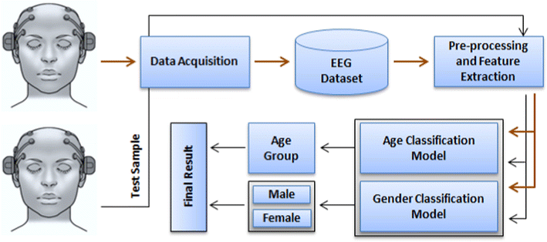
ARCHITECTURE

Slide 4
MODULES
Face Detection Module
Face Preprocessing Module
Age and Gender Classification Module
Real-Time Processing and Display Module

Slide 5
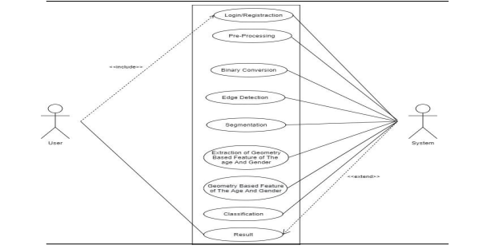
UML DIAGRAMS
Use case

Slide 6
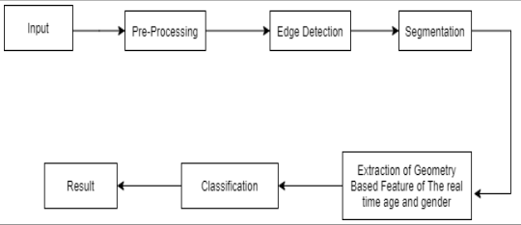
UML DIAGRAMS
Class Diagram

Slide 7
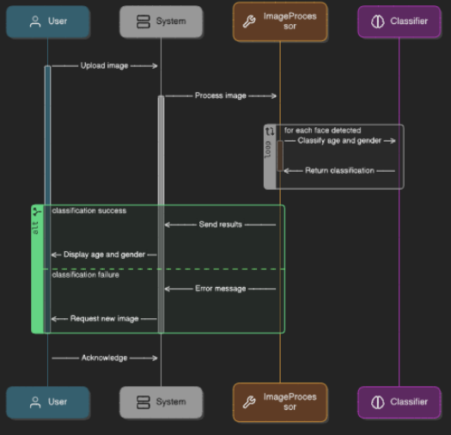
UML DIAGRAMS
sequence case

Slide 8
THANK YOU

