Slide 1
Guide : Mrs. Arshiya Begum Assistant Professor Department of CS/DS.
Department of DataScience and CyberSecurity
III B.Tech II Semester Industrial Oriented Mini Project-2025
Submitted by
Team - 7
Real Time Age and Gender Classification
TEAM MEMBERS | ROLL NUMBERS
K. PURNA VAMSI (Team Lead) | 22R21A6787
G. SAI TEJA | 22R21A6782
B. CHANDRA SHEKHAR | 23R25A6710

Slide 2
ABSTRACT
This project aims to develop a real-time age and gender classification system using deep learning and computer vision techniques. By leveraging pre-trained convolutional neural networks (CNNs) and fine-tuning them for age and gender prediction, the system can analyze live video streams or static images. The process involves detecting faces from input frames using OpenCV, followed by cropping and preprocessing the detected faces for model inference. The model classifies age as a continuous value (age prediction) and gender as a binary label (male or female). The system is designed to run efficiently in real time, making it suitable for applications like security systems, user personalization, and demographic analysis. Optimizations such as model quantization and transfer learning are employed to ensure high accuracy and fast processing speed.

Slide 3
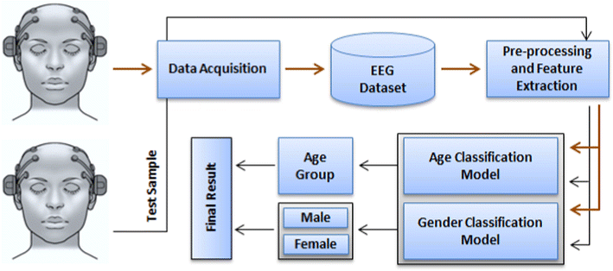
ARCHITECTURE

Slide 4
TECHNOLOGIES
OpenCV (cv2): Core computer vision library for capturing video, detecting faces, preprocessing images, and displaying outputs.
Python: The main programming language used to glue everything together.
Pretrained DNN Models (.pb and .pbtxt): TensorFlow or Caffe models trained on age and gender datasets; loaded using OpenCV’s dnn module.
NumPy: For efficient numerical operations and image data manipulation.

Slide 5
TECHNOLOGIES
OpenCV (cv2): Core computer vision library for capturing video, detecting faces, preprocessing images, and displaying outputs.
Python: The main programming language used to glue everything together.
Pretrained DNN Models (.pb and .pbtxt): TensorFlow or Caffe models trained on age and gender datasets; loaded using OpenCV’s dnn module.
NumPy: For efficient numerical operations and image data manipulation.

Slide 6
Algorithms
Convolutional Neural Networks (CNNs): Used for both age and gender classification tasks, typically pretrained on large datasets (like IMDB-WIKI or Adience).
Face Detection – Haar Cascades / DNN (Deep Neural Networks): Detects faces from webcam input using OpenCV’s pre-trained Caffe-based DNN model or Haar Cascade classifier.
Softmax Activation: Used at the final layer of age and gender models to output a probability distribution over classes.

Slide 7
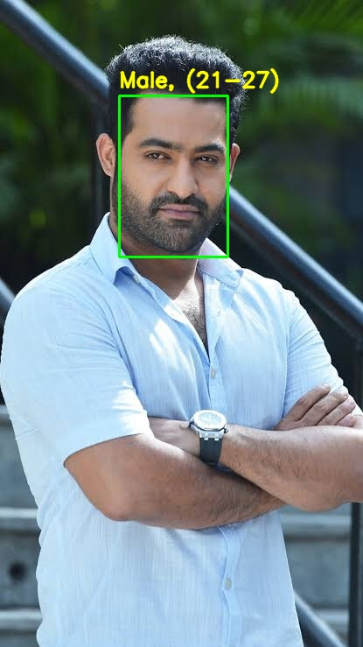
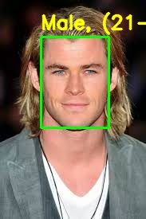
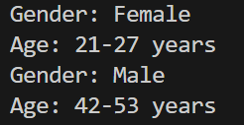
RESULTS

Slide 8
CONCLUSION
Developed real-time gender and age classification system using deep learning and OpenCV.
Achieved high accuracy in predicting gender and age range from facial images.
Integrated system for seamless processing of frames from social media platforms.
Provides potential for targeted content delivery and enhanced user profiling.
Future improvements can include expanding dataset and refining the model for better performance.

Slide 9
THANK YOU

