Slide 1

Predicting Mental Health Status in Clinical Patients Using NLP Techniques
Vaishnavi Tamilvanan (G38942246)
Vamsidhar Boddu (G40705113)

Slide 2

INTRODUCTION:
Mental health is a puzzle, with emotions shifting and evolving in ways even we struggle to understand.
This project explores how NLP models can predict a person's mental state through their own words.
We chose this dataset for its rich collection of statements and diverse mental health labels, offering valuable insights.

Slide 3
PROJECT OBJECTIVE:
Building an NLP-based solution to predict mental health statuses using patient statements.
Creating a user-friendly interface with Streamlit to help patients understand their mental state and access actionable resources.
Enabling therapists/psychiatrists to upload multiple patients' statements, prioritize critical cases (e.g., suicidal), and make informed decisions.
Providing analytics of prediction results, offering insights into trends and priorities for mental health management.

Slide 4
DATASET:
This dataset compiles mental health statuses from statements collected across various sources, including social media and Reddit
It integrates data from several Kaggle datasets and classifies entries into seven categories: Normal, Depression, Suicidal, Anxiety, Stress, Bi-Polar, and Personality Disorder
The dataset contains 53,043 records across 3 columns (`Unnamed: 0`, `statement`, `status`), refined to 51,060 after cleaning. Text characteristics include a maximum length of 1,089 characters, with misspellings, punctuation errors, and varying verbosity. Preprocessing involved text cleaning (lowercasing, punctuation removal, tokenization, stopword removal, lemmatization), class imbalance handling, label encoding, feature extraction, and preparation for transformer-based models.

Slide 5
Project Flow:
Model Selection and Training
Validation and Metrics
Streamlit App
Data Preprocessing
Data Loading and Cleaning

Slide 6
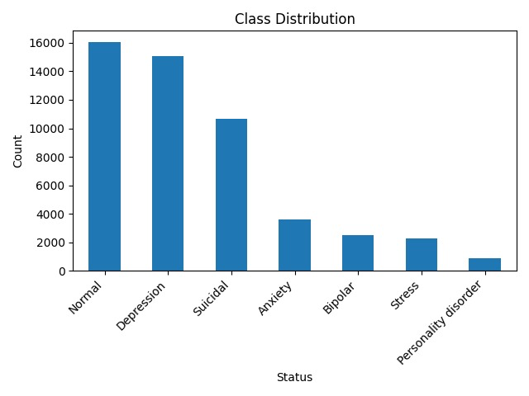
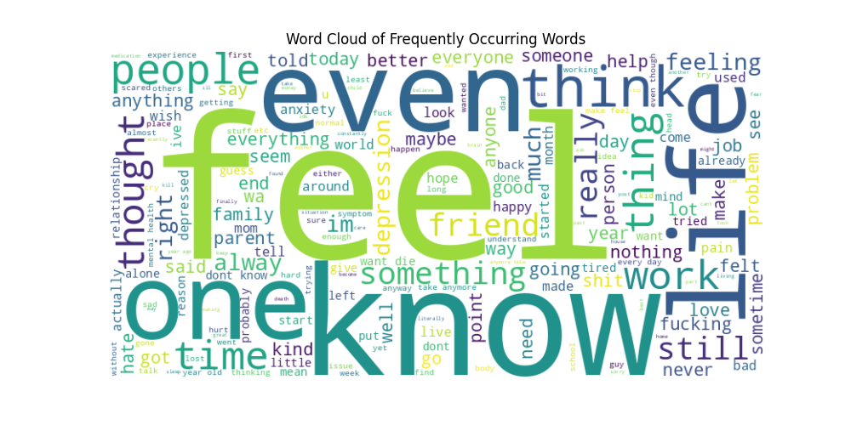
Exploratory Data Analysis

Slide 7
Models Performance Summary:
Model | Features & Adjustments | Performance Metrics | Key Findings
LSTM | - Used GloVe word embeddings to capture sequential text dependencies. - Basic text preprocessing included stopword removal and lemmatization. | Accuracy: ~70% | Faced challenges with minority classes due to limited ability to capture complex dependencies and lack of contextual understanding.
BERT-base | - Transitioned to BERT-base to leverage transformer architecture for better contextual understanding. - Fine-tuned on dataset with class weights integrated into loss functions. | Accuracy: 79%, Macro F1: ~76% | Despite improvements, still struggled with recall for minority classes; encountered signs of overfitting.
BERT-large | - Employed BERT-large for deeper learning capacity (more layers, more parameters). - Aimed to enhance representation and handling of contextual nuances. | Accuracy: 80%, Macro F1: ~77% | Slight improvements in handling "Stress" and "Personality Disorder".
RoBERTa-base | - Upgraded to RoBERTa-base for optimized pretraining and better tokenization. - Introduced focal loss to prioritize harder-to-classify examples. | Accuracy: 80%, Macro F1: ~77% | Minor gains in overall metrics; better handling of minority classes but not transformative.
RoBERTa-large (before class weights) | - Advanced to RoBERTa-large with robust representation capabilities. - Adjusted learning rates, added dropout layers, and extended training epochs for balance. | Accuracy: 81%, Macro F1: ~78%, Weighted F1: ~82% | Achieved the best balance across classes; substantial improvements in minority class performance.
RoBERTa-large (after class weights) | - Focused on refining performance for minority classes using weighted focal loss to address class imbalances. | Accuracy: 73%, Significant recall improvements for minority classes | Reduced overall accuracy to improve minority class recall significantly for classes like "Bipolar", "Personality Disorder", and "Stress". Precision trade-offs were noted, impacting majority class performance.

Slide 8
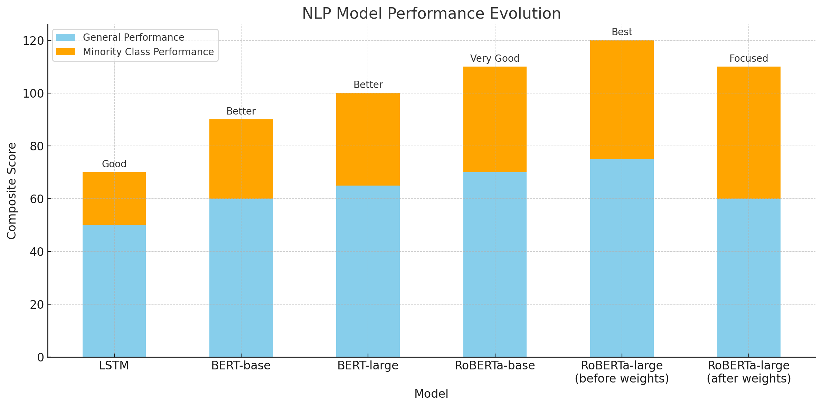
Model Performance Evolution
This stacked bar chart compares NLP model evolution using combined metrics of overall accuracy and minority class F1 scores, highlighting progressive improvements in handling class imbalances.

Slide 9
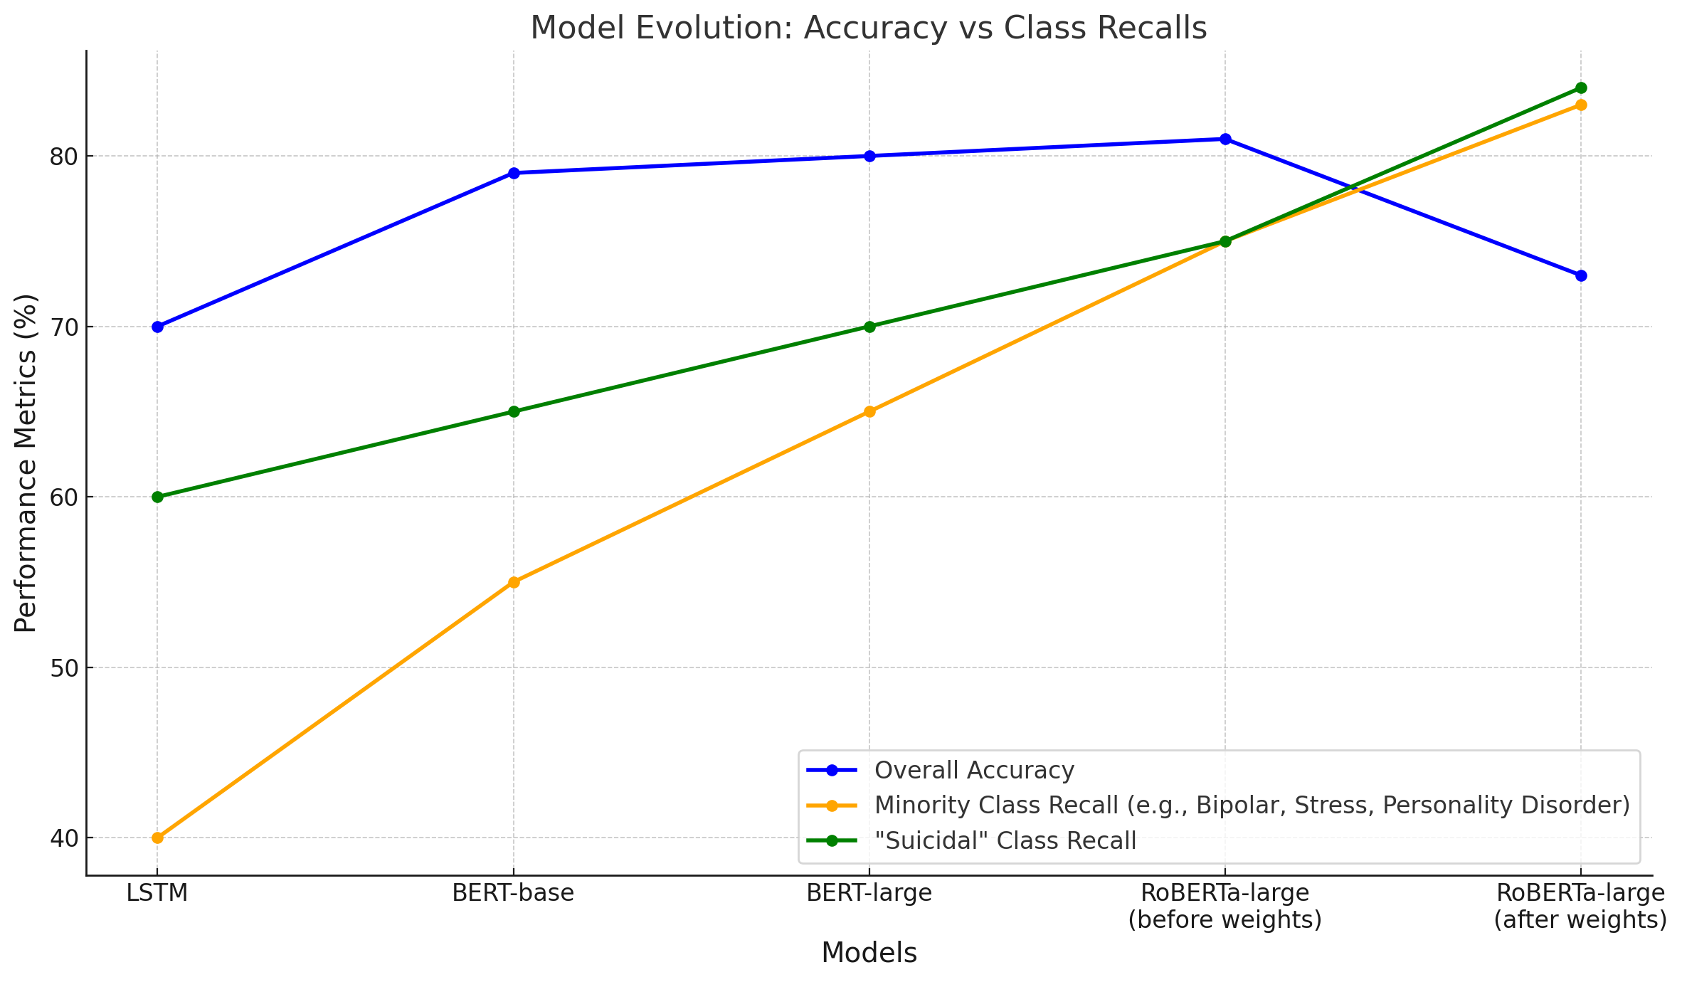
Accuracy vs Recall:
The chart demonstrates steady improvements in minority class recall (e.g., Bipolar, Stress, Personality Disorder) and mid-sized class recall ("Suicidal") as the models evolved, highlighting the impact of advanced techniques like class weights and focal loss.
While overall accuracy declined from 81% to 73%, significant gains in minority class recall (e.g., Bipolar: 78% → 87%, Personality Disorder: 66% → 79%) and "Suicidal" recall (71% → 84%) showcase the model's balanced approach to inclusivity and fairness.

Slide 10
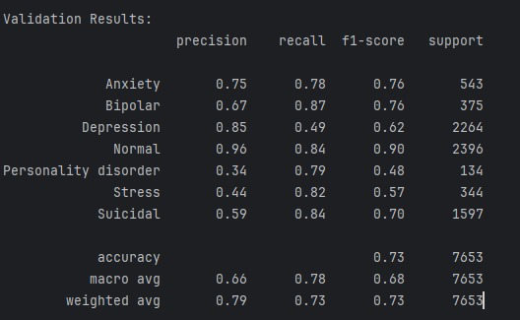
Final Model: RoBERTa-large
The final model with class weights achieved 73% accuracy, prioritizing inclusivity and minority class recall over overall performance.
Significant recall improvements for Bipolar (87%), Personality Disorder (79%), and Stress (82%) ensured fairness in predictions.
Maintained strong recall for mid-sized (Suicidal: 84%) and majority classes (Normal: 84%), achieving a well-rounded performance.

Slide 11
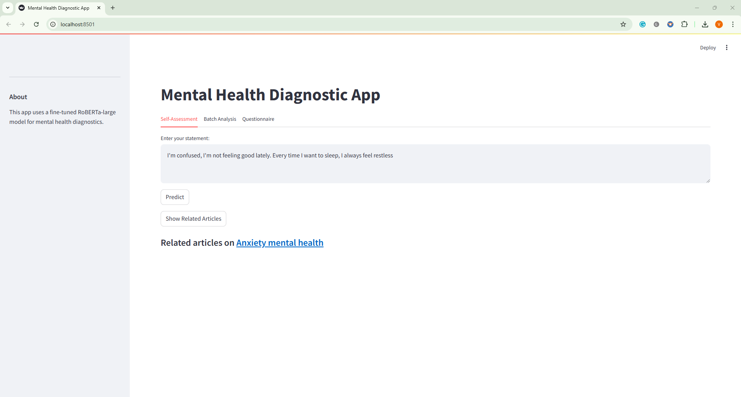
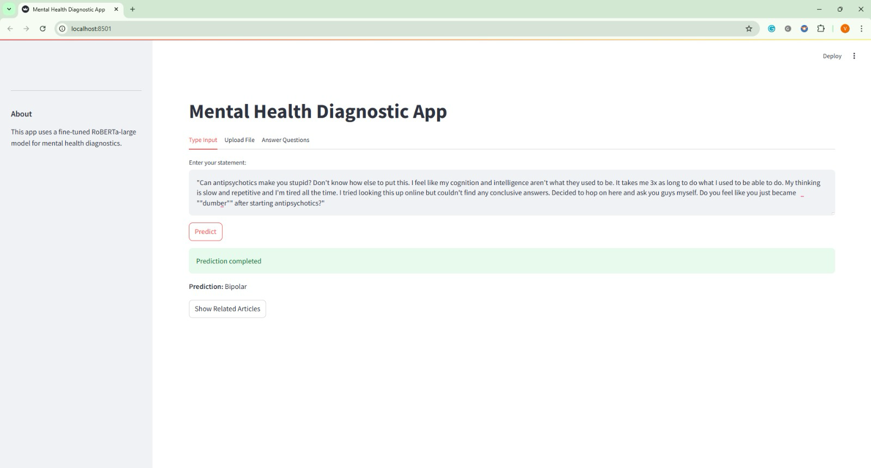
User-friendly interface with Streamlit:

Slide 13
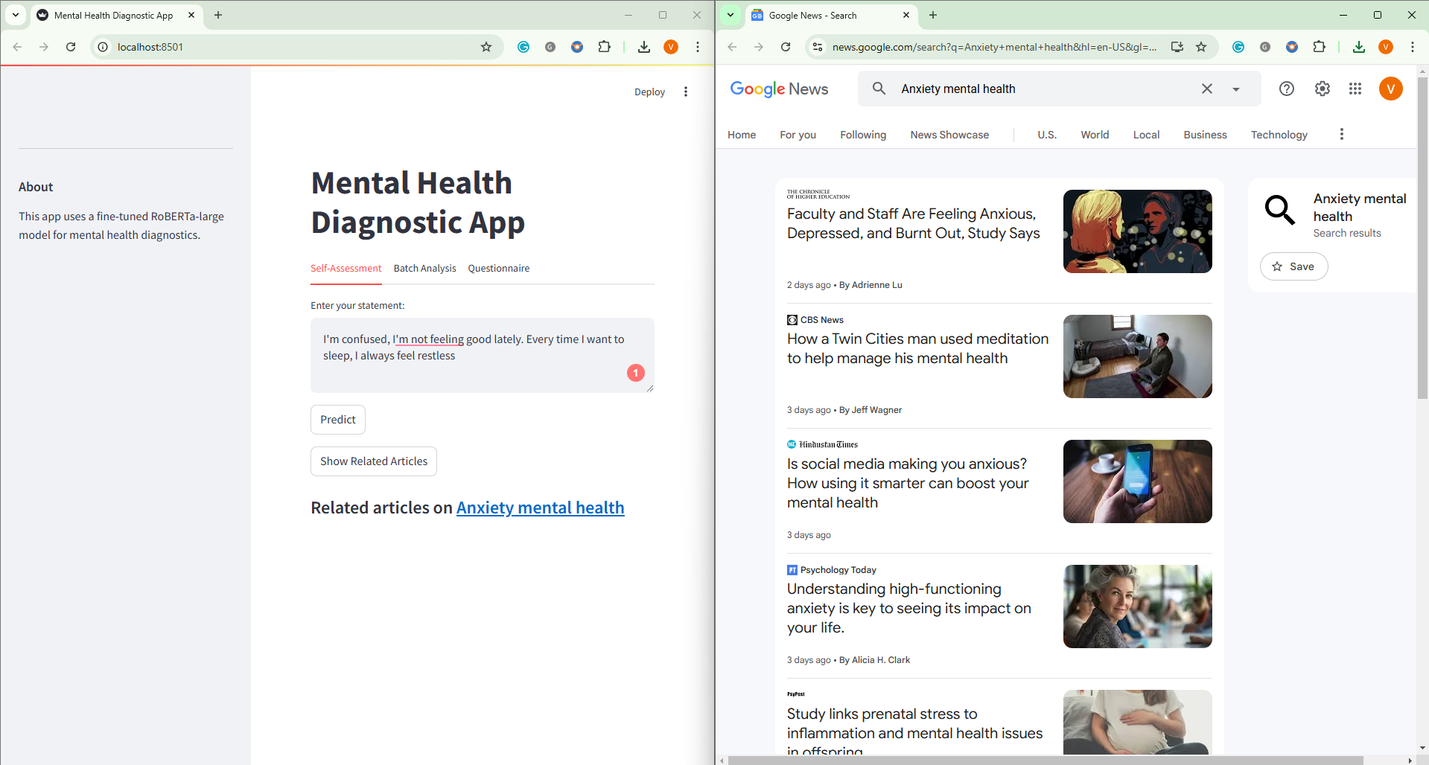

Slide 14

What intrigues you? What challenges do you see? Let’s discuss!!

