Slide 1



Water Quality Prediction Using AI & ML
Water Quality Prediction
Name : B.Venkata Vamsi Krishna Reddy

Slide 2

Learning Objectives:
Understand water quality indicators and their significance.
Preprocess water quality data including handling nulls and outliers.
Apply classification algorithms like Random Forest, SVM, and Logistic Regression.
Evaluate model accuracy to predict water potability.
GOAL
Source :
www.freepik.com/

Slide 3
Tools and Technology Used:
Python
Jupyter Notebook
Pandas
Numpy
Matplotlib
Seaborn
Scikit-learn (RandomForest, SVM, Logistic Regression)

Slide 4
Methodology:
Data preprocessing (handling missing values, scaling)
Feature engineering and correlation analysis
Splitting data into training and testing sets
Model training and comparison (RandomForest, SVM, Logistic Regression)
Accuracy and performance evaluation

Slide 5
Problem Statement:
The goal is to build a machine learning model that predicts whether water is potable (safe for drinking) based on various chemical attributes such as:
pH
Hardness
Solids
Chloramines
Sulphate
Conductivity
Organic Carbon
Trihalomethanes
Trubidity

Slide 6
Solution:
Data Loading and Initial Analysis
Handling Missing values
Exploratory Data Analysis
Feature Engineering and Preprocessing
Model building and training
Model Evalution
Prediction

Slide 7
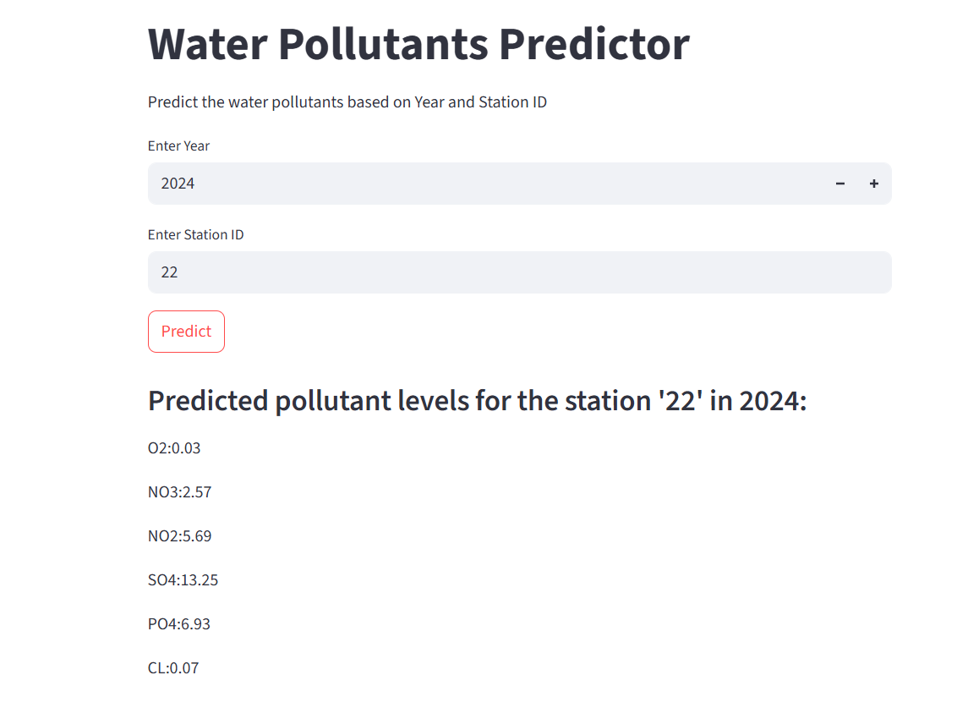
Screenshots:
Screenshot of output:

Slide 8
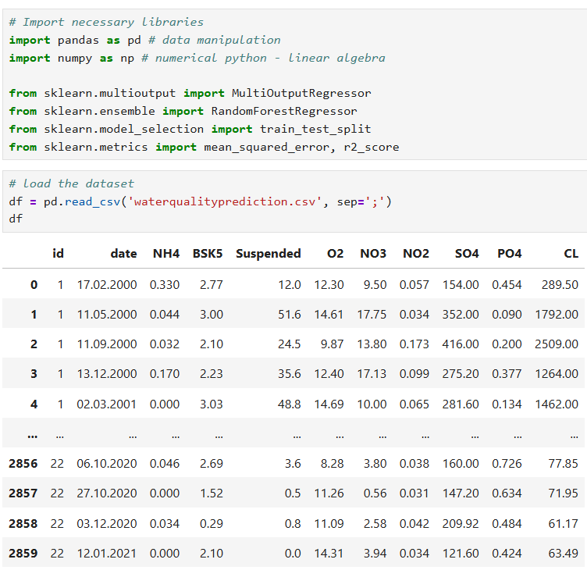
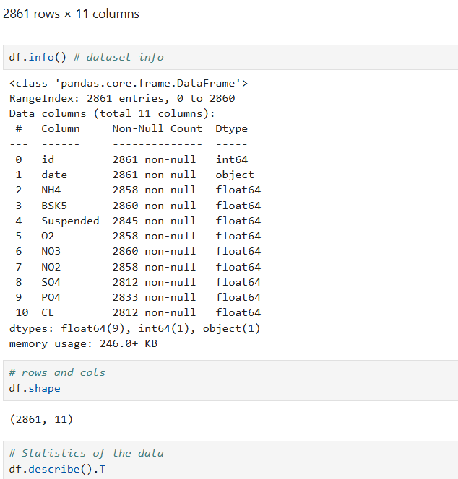
Screenshots:
Screenshot of code:

Slide 9
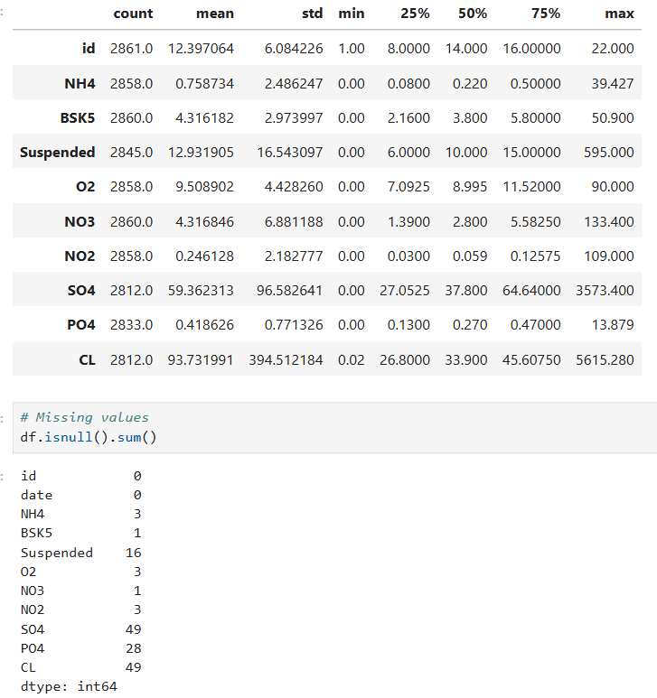
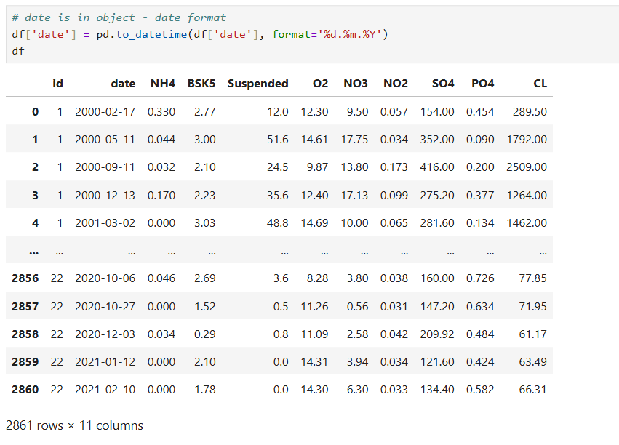
Screenshots:
Screenshot of code:

Slide 10
Conclusion:
This project successfully demonstrates how machine learning can be applied to solve real-world environmental problems like water quality assessment. By preprocessing real-world data, handling missing values, and applying robust classification algorithms, we were able to predict whether water is potable (Safe to drink) with a high degree of accuracy.
Among the models tested, the Random Forest Classifier consistently outperformed others, achieving the best accuracy due to its ability to handle non-linearity and complex interactions between features.
Key Takeaways:
Data preprocessing and visualization help uncover valuable insights about water quality parameters.
Feature scaling and cleaning significantly improve model performance.
ML models can provide accurate and scalable solutions for environmental monitoring and public health support.

