Slide 1
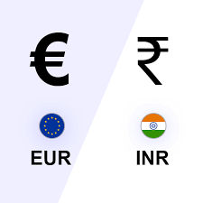
Finance-Flash Assignment
Analyzing trends of Currency EUR/INR
- By Vamsi Krishna Adatra

Slide 2
Contents
EUR/INR Forex Market Overview
Technical Indicators
Decision making process
Individual Indicator Analysis
Combined Analysis

Slide 3


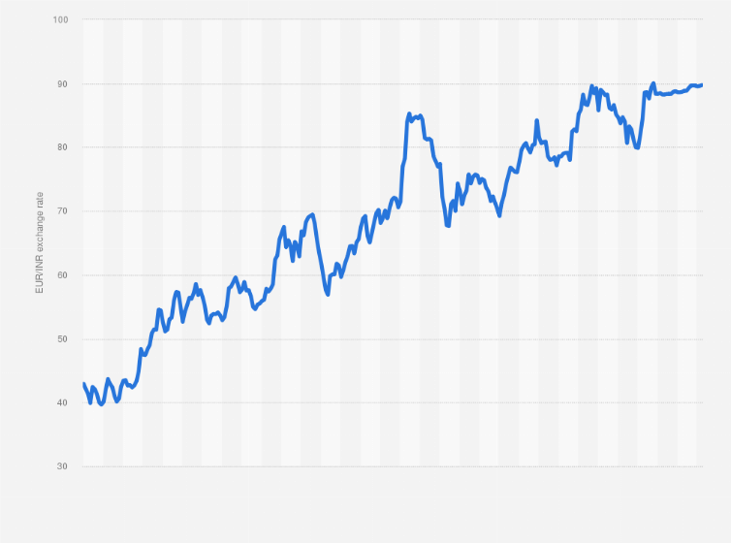









EUR/INR Forex Market Overview:
The EUR/INR currency pair represents the exchange rate between the Euro (EUR) and the Indian Rupee (INR). It reflects how many Indian Rupees are required to purchase one Euro.
The trading of EUR/INR occurs primarily in the foreign exchange market, and fluctuations in this pair are influenced by various factors such as economic indicators, geopolitical events, monetary policies of the European Central Bank (ECB) and the Reserve Bank of India (RBI), trade balances, and market sentiment towards both currencies.

Slide 4
yfinance Library for Data Collection:
“yfinance” is a Python library that provides a convenient interface for accessing financial data from Yahoo Finance. It allows users to fetch historical market data, stock prices, trading volumes, dividend and split information, and other relevant financial information for analysis and research purposes using simple and intuitive commands within Python.
start_date = "2023-01-01"
end_date = "2023-12-07"
Process of downloading EUR/INR data for analysis using Python:
eurinr_data = yf.download("EURINR=X", start=start_date, end=end_date)["Close"]

Slide 5

Technical Indicators:
Moving Average (MA): Average price over a set period.
Standard Deviation (Std): Measure of price volatility around the average.
Bollinger Bands: Two lines set at standard deviations above and below a moving average to identify overbought/oversold conditions.
Commodity Channel Index (CCI): Oscillator measuring how much price deviates from its historical average, identifying overbought/oversold areas and potential trend reversals.

Slide 6
Importance of these indicators in analyzing market trends
MA, CCI, BB in Market Analysis:
Moving Averages show trend directions, CCI spots extreme conditions, and Bollinger Bands reveal potential breakout areas.
Their Role: These indicators help traders identify trends, find good times to enter or exit trades, and confirm possible market changes, guiding smarter trading decisions.
Bullish and Bearish Counts Calculation Method:
Tallying specific patterns or formations in historical data, such as higher highs or bullish candlestick patterns for bullish counts, and lower highs or bearish candlestick patterns for bearish counts.

Slide 7
bullish_threshold = 0
bearish_threshold = 0 bullish_count = len(all_data_metrics[all_data_metrics['CCI'] > bullish_threshold])
bearish_count = len(all_data_metrics[all_data_metrics['CCI'] < bearish_threshold])
Purpose:
This method aims to quantify and track occurrences of certain market indicators in historical data to anticipate potential upward or downward trends in the market.

Slide 8
Decision-Making Process
Conditions Alignment:
The program integrates various technical indicators such as Moving Averages (MA), Commodity Channel Index (CCI), and additional indicator values into separate sets of conditions for "BUY" and "SELL" decisions.
For a "BUY" decision, conditions involving MA, CCI, weekly CCI mean, additional indicator value, and historical bullish sentiment are aligned to collectively indicate a potential uptrend or bullish market sentiment.
Similarly, for a "SELL" decision, conditions related to MA, CCI, weekly CCI mean, additional indicator value, and historical bearish sentiment align to suggest a potential downtrend or bearish market sentiment.

Slide 9
In the program, the consideration for risk management in the decision-making process is:
Adjusting Position Size Based on Risk Tolerance:
The program decides the size of the investment (position size) by considering how much risk an investor is comfortable taking. It calculates this based on a defined level of risk tolerance.
For example, if an investor is willing to risk only a certain percentage (like 2%) of their total portfolio value on a trade, the program adjusts the investment size to match this risk limit. This helps control the potential loss if the trade doesn't go as expected.

Slide 10
Individual indicator analysis:
1. MA
Moving Average(MA):
MA's contribution to decisions:
BUY: If Upcoming Day's MA > Historical MA.
SELL: If Upcoming Day's MA < Historical MA.
NEUTRAL: If conditions aren't met.
Date | Historical MA | UpcomingDay’s MA (predicted) | Decision
2023-12-10 | 75.20 | 76.40 | Buy
2023-12-11 | 74.80 | 73.20 | Sell
2023-12-12 | 76.00 | 77.80 | Buy
2023-12-13 | 75.90 | 76.20 | Buy
2023-12-14 | 76.30 | 75.00 | Sell

Slide 11
CCI:
Date | CCI values | Decision
2023-12-10 | 15 | Buy
2023-12-11 | 18 | Sell
2023-12-12 | -5 | Buy
2023-12-13 | 20 | Buy
2023-12-14 | -10 | Sell
CCI's role in decisions:
BUY: If CCI for the upcoming day > 0 (indicating positive momentum).
SELL: If CCI for the upcoming day < 0 (indicating negative momentum).
NEUTRAL: If conditions aren't met.

Slide 12
Weekly CCI Mean:
Week Start Date | Week End Date | Mean CCI for the week
2023-12-10 | 2023-12-16 | 12
2023-12-17 | 2023-12-23 | -5
2023-12-24 | 2023-12-30 | 8
2023-12-31 | 2024-01-06 | 18
2024-01-07 | 2024-01-13 | -10
Weekly CCI Mean's influence on decisions:
BUY: If Mean CCI for the upcoming week > 0.
SELL: If Mean CCI for the upcoming week < 0.
NEUTRAL: If conditions aren't met.

Slide 13
Additional Indicator: (Hypothetical)
Additional indicator's role in decisions:
BUY/SELL/NEUTRAL:
Based on predefined threshold comparisons or directional influence.

Slide 14
Combined Analysis:
Date | MA Condition | CCI Condition | Weekly CCI Mean Condition | Additional Indicator | Final Decision
2023-12-10 | BUY | BUY | BUY | BUY | BUY
2023-12-11 | SELL | SELL | NEUTRAL | NEUTRAL | NEUTRAL
2023-12-12 | BUY | BUY | BUY | NEUTRAL | BUY
2023-12-13 | BUY | SELL | SELL | SELL | SELL
2023-12-14 | SELL | SELL | NEUTRAL | BUY | NEUTRAL

Slide 15
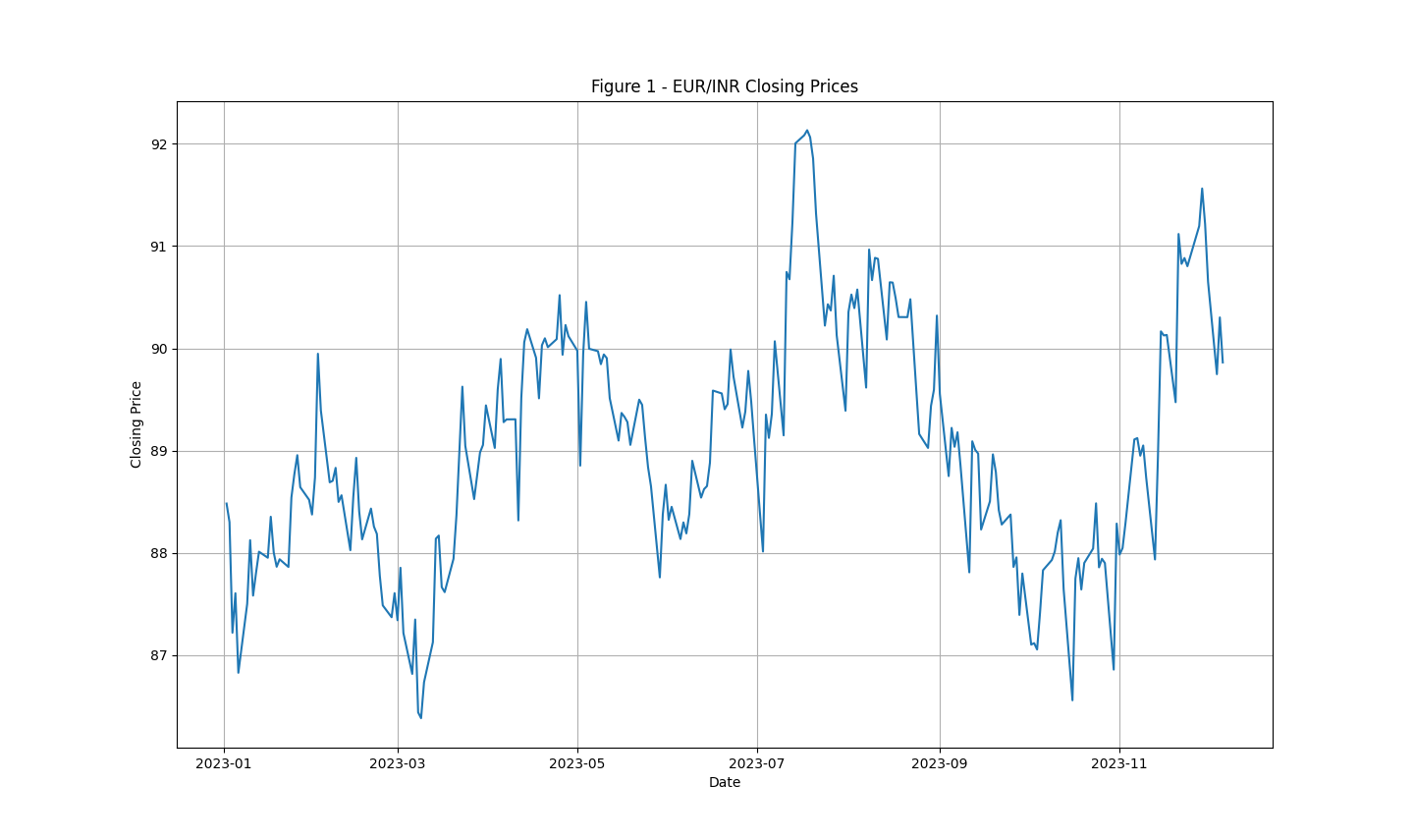
Graph of EUR/INR closing prices from 2023-01-01 to 2023-12-07

Slide 16
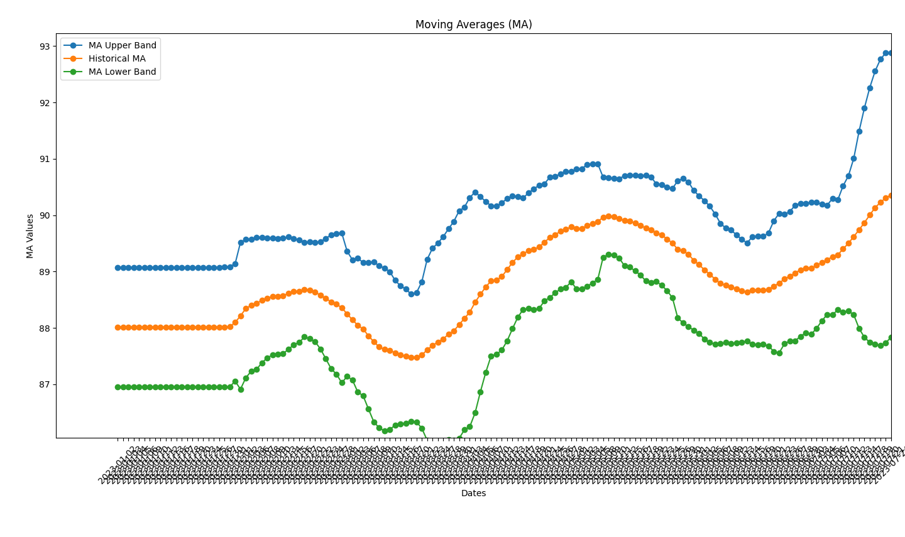
Overall Moving averages along with BB

Slide 17
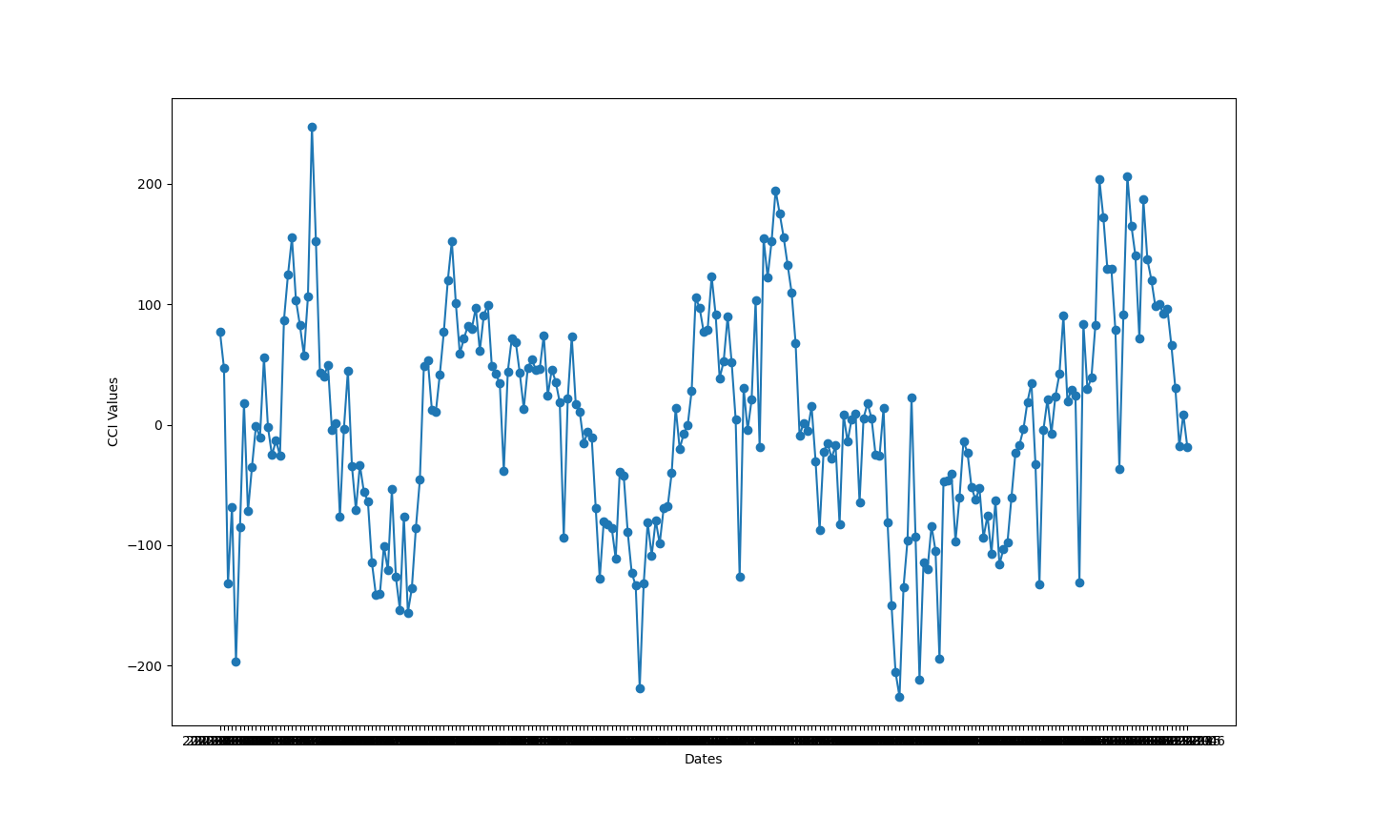
CCI

Slide 18
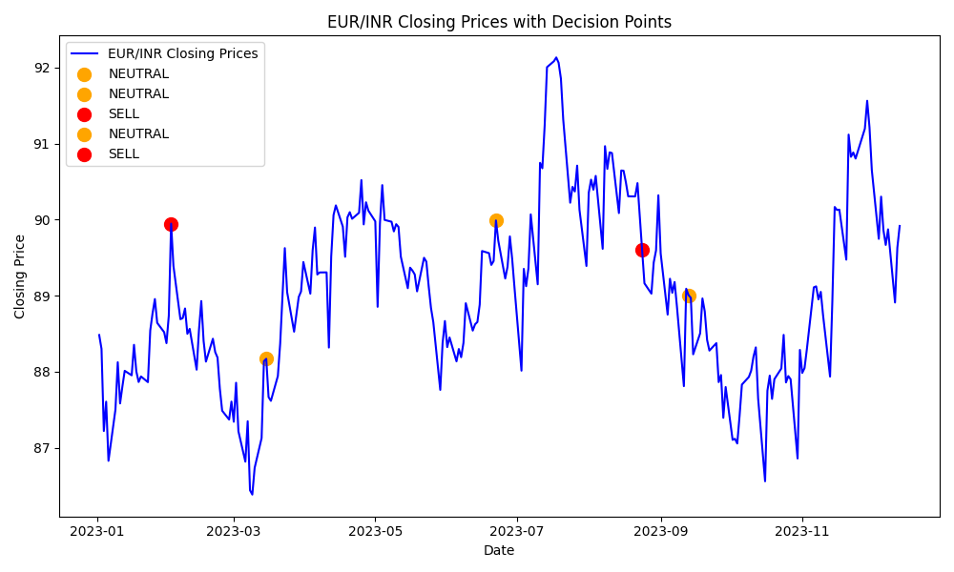
Combined Analysis:

Slide 19
Thank you

