Slide 1

Student Management System
A Java Swing-based GUI Application by Andavarapu Vamsi
Data Science Email: vamsiandavarapu83096@gmail.com Mobile no: 8309639943

Slide 2
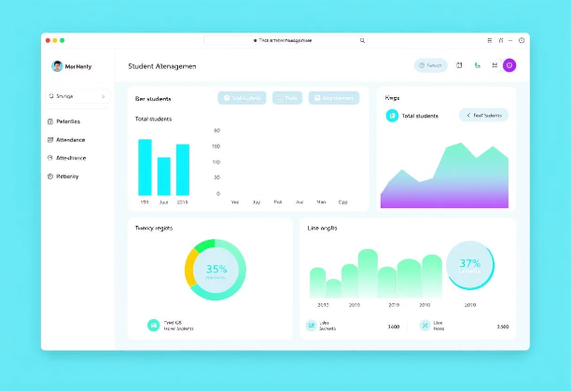
Introduction
Our Student Management System is a desktop application. It's built with Java Swing for efficient data handling. The user-friendly interface simplifies daily tasks. This includes managing records, marksheets, and attendance. It significantly boosts administrative efficiency. And helps in easily retrieving of students data.

Slide 3

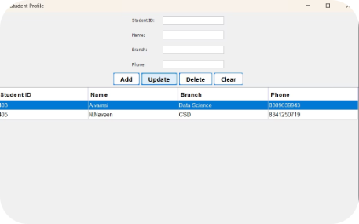
Core Features
Student Record Management
Grades and Marksheet Generation
Attendance Tracking
Comprehensive tools for student data.
Real-time monitoring of student presence.
Automated grade processing and reporting.
Reporting and Analytics
Actionable insights from student data.

Slide 4

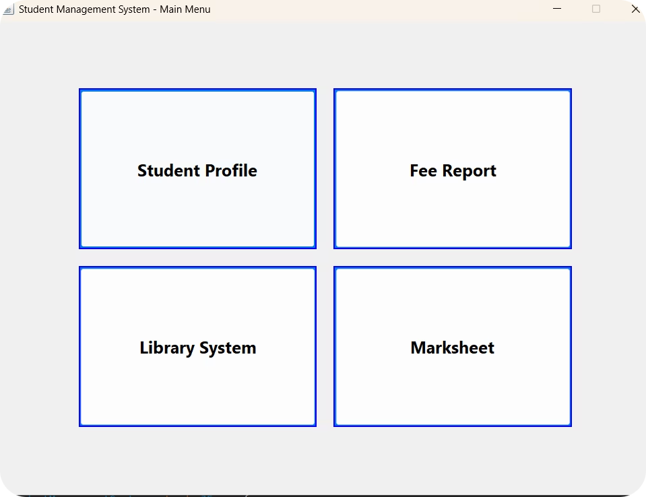




Student Record Management
CRUD Operations
Add, View, Update, Delete student records easily.
Detailed Information
Store comprehensive contact and enrollment data.
Search and Filter
Quickly find students using various attributes.
Data Integrity
Ensure consistency and accuracy of all records.

Slide 5


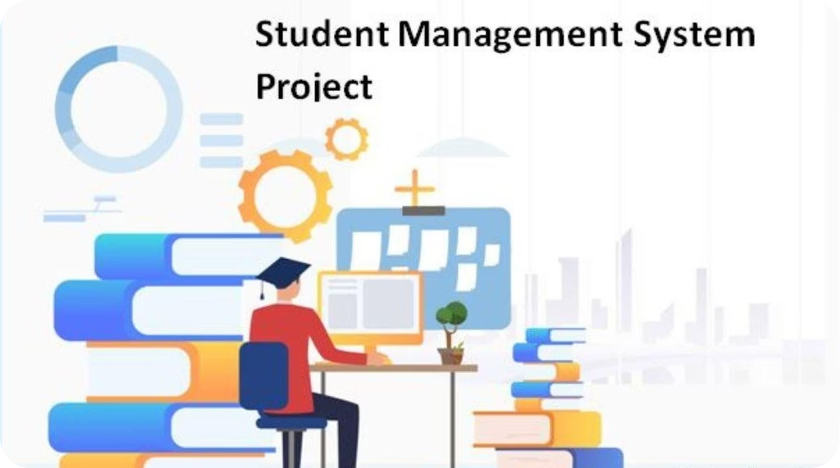



Grades and Marksheet Generation
Enter Grades
Input and manage student course grades.
Auto-Calculate
System automatically generates marksheets.
Export Options
Grades can be exported to Excel or PDF.
Accuracy
Significantly reduces manual data entry errors.

Slide 6


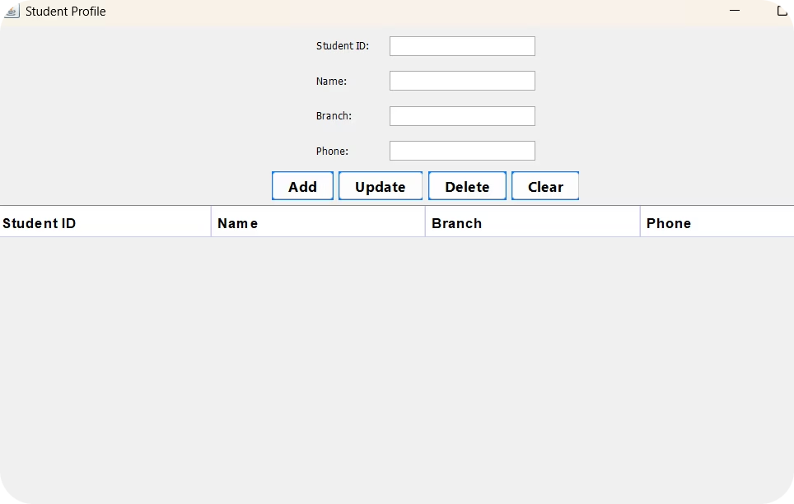



Attendance Tracking
Real-Time Monitoring
Record and track attendance instantly.
Generate Reports
Create reports on attendance patterns.
Low Attendance Alerts
Automated notifications for concerns.
Improved Accuracy
Ensures precise and reliable tracking.

Slide 7








Reporting and Analytics
Data-Driven Insights
Customize Reports
Identify areas for improvement effectively.
Tailor reports to specific needs.
Generate Reports
Better Decisions
Performance and attendance trends.
Enhances strategic decision-making.

Slide 8
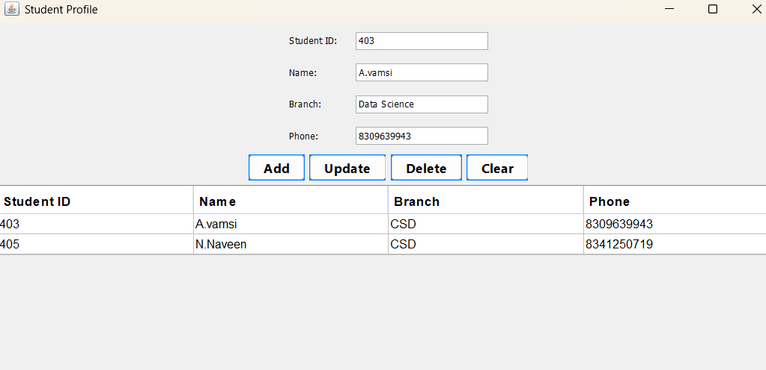
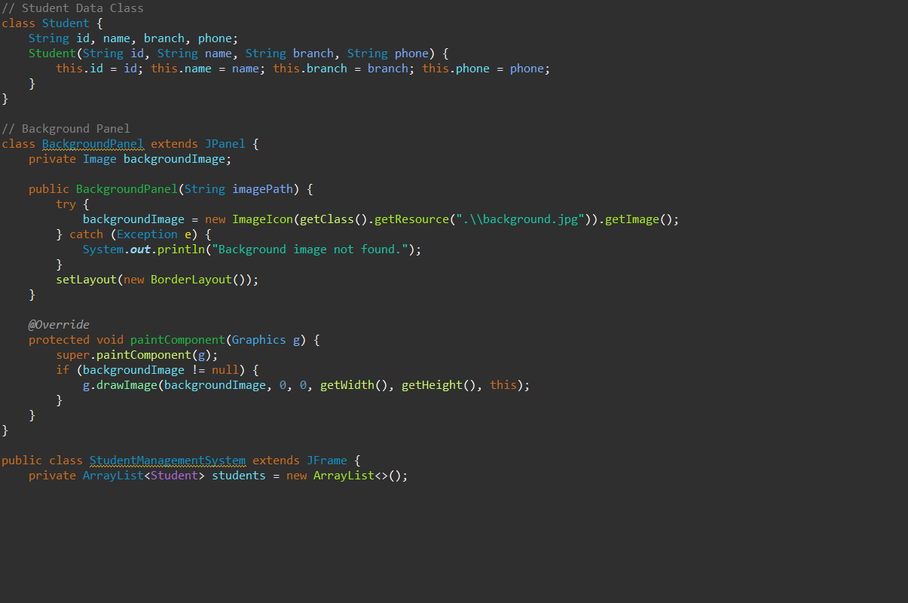
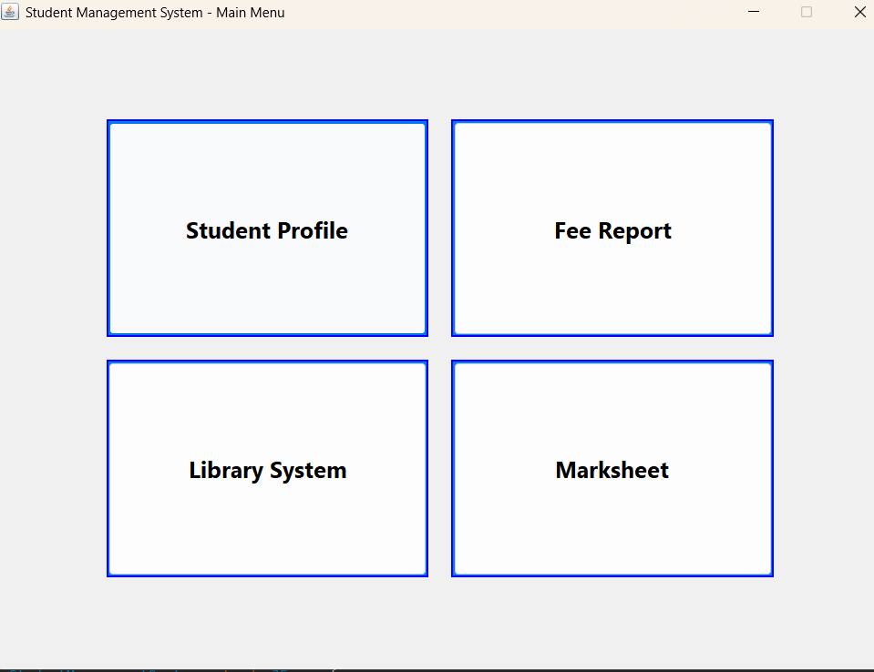
Screenshots

Slide 9

Conclusion
Streamlined Management
Effortlessly handles all student data.
Enhanced Efficiency
Boosts administrative productivity significantly.
Better Insights
Provides accurate reporting for informed choices.
A.Vamsi

