Slide 1
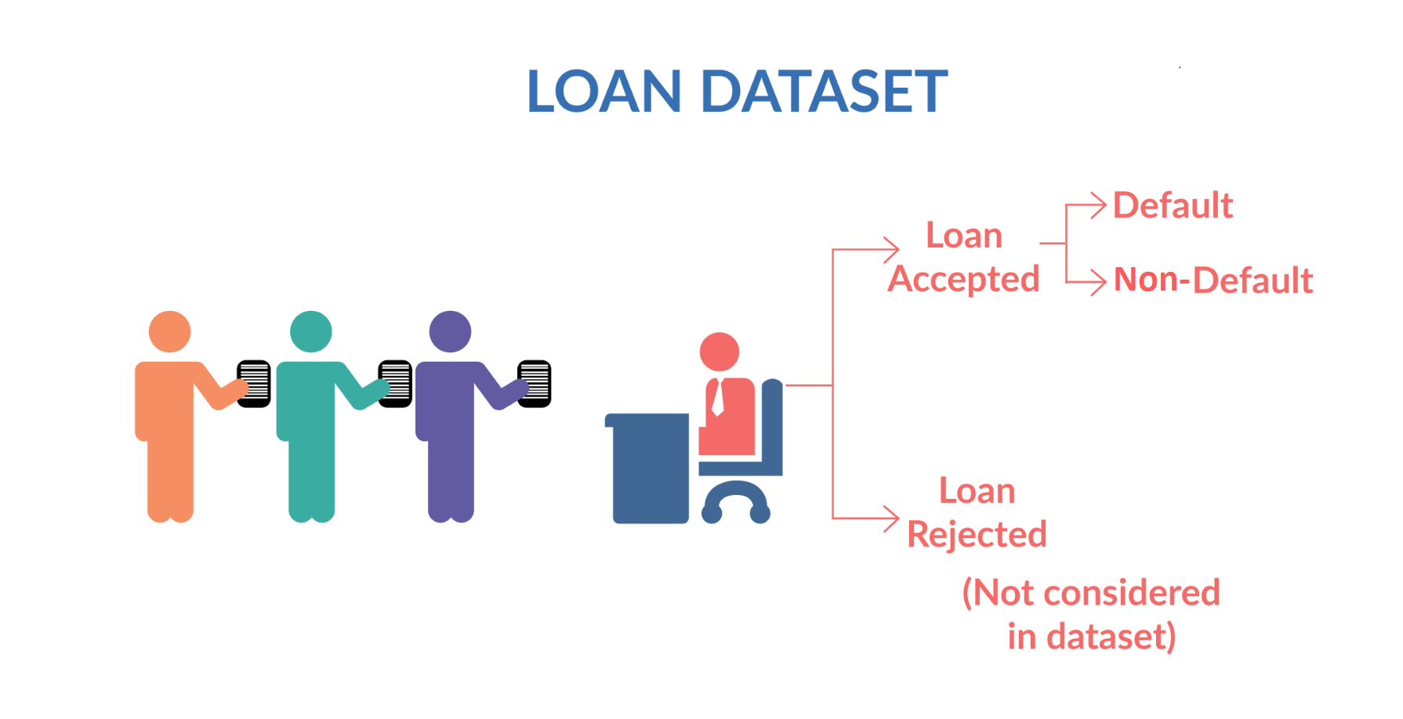
Problem Statement
Risk analytics in banking and financial services and understand how data is used to minimize the risk of losing money while lending to customers.
Business Understanding
When the company receives a loan application, the company has to make a decision for loan approval based on the applicant’s profile. Two types of risks are associated with the bank’s decision:
If the applicant is likely to repay the loan, then not approving the loan results in a loss of business to the company
If the applicant is not likely to repay the loan, i.e. he/she is likely to default, then approving the loan may lead to a financial loss for the company.
The data given below contains information about past loan applicants and whether they ‘defaulted’ or not. The aim is to identify patterns which indicate if a person is likely to default, which may be used for taking actions such as denying the loan, reducing the amount of loan, lending (to risky applicants) at a higher interest rate, etc.
In this case study, you will use EDA to understand how consumer attributes and loan attributes influence the tendency of default.
When a person applies for a loan, there are two types of decisions that could be taken by the company:
Loan accepted: If the company approves the loan, there are 3 possible scenarios described below:
Fully paid: Applicant has fully paid the loan (the principal and the interest rate)
Current: Applicant is in the process of paying the instalments, i.e. the tenure of the loan is not yet completed. These candidates are not labelled as 'defaulted'.
Charged-off: Applicant has not paid the instalments in due time for a long period of time, i.e. he/she has defaulted on the loan
Loan rejected: The company had rejected the loan (because the candidate does not meet their requirements etc.). Since the loan was rejected, there is no transactional history of those applicants with the company and so this data is not available with the company (and thus in this dataset)

Slide 2
Business Objectives:
Like most other lending companies, lending loans to ‘risky’ applicants is the largest source of financial loss (called credit loss). Credit loss is the amount of money lost by the lender when the borrower refuses to pay or runs away with the money owed. In other words, borrowers who default cause the largest amount of loss to the lenders. In this case, the customers labelled as 'charged-off' are the 'defaulters'.
If one is able to identify these risky loan applicants, then such loans can be reduced thereby cutting down the amount of credit loss. Identification of such applicants using EDA is the aim of this case study.
In other words, the company wants to understand the driving factors (or driver variables) behind loan default, i.e. the variables which are strong indicators of default. The company can utilize this knowledge for its portfolio and risk assessment.

Slide 3
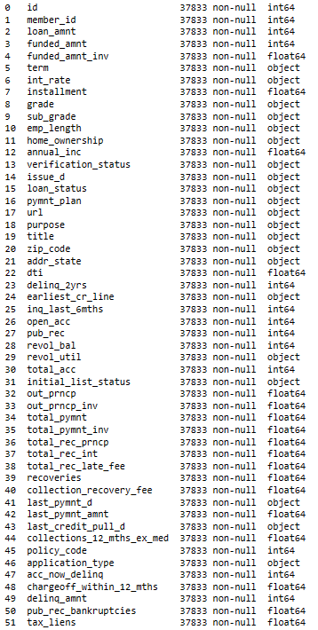
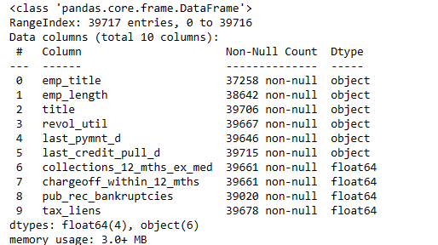
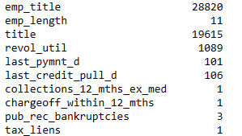
Data Understanding
Data received having no of rows =39717,columns =111
Fixing missing values
we remove 58 columns from 111 columns
In 58 columns data is missing is >10%
Columns having missing values less than 10%
After dropping all columns and rows which have missing values. Final list is
No of rows :37833
Columns : 52
% of Data removed from the origin data is around 4.74%
Find the unique value of columns having missing values
From above list we are dropping “emp_title” column

Slide 4
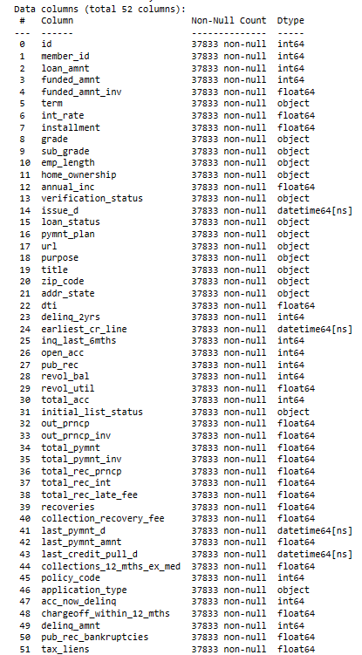
Data Standardise
Droping following columns based on stat summary :
collections_12_mths_ex_med
policy_code,acc_now_delinq
chargeoff_within_12_mths
delinq_amnt
tax_liens
Id
Member_id
Types:
Datetime64[ns] : 4
Float64: 20
Int64: 13
Object: 15

Slide 5
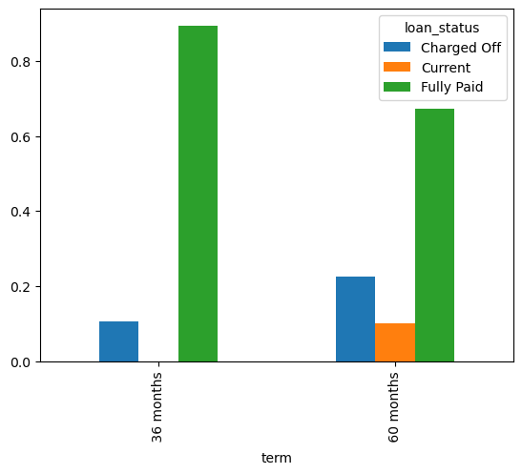
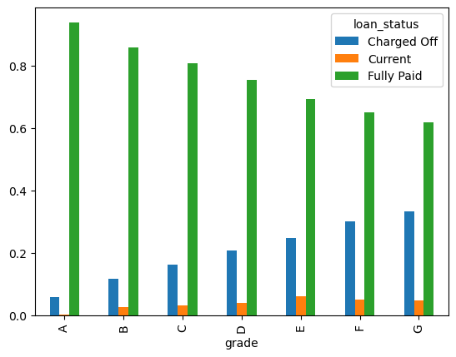
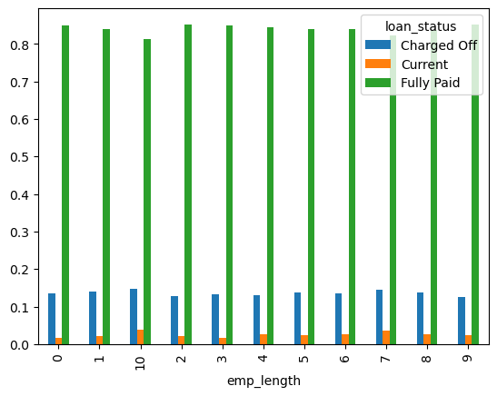
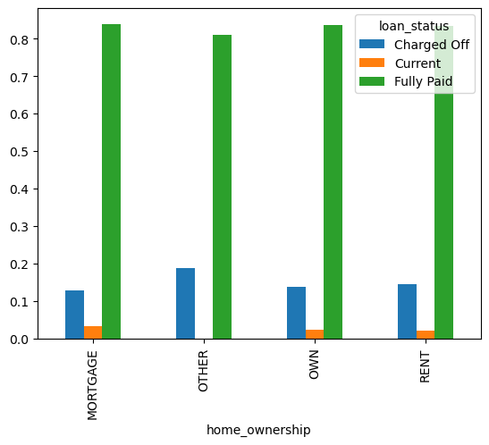
Bivariate Analysis :Categorical vs Categorical Variables
Loan Status vs loan term
Higher the loan term-> higher default
Loan Status vs loan grade
lower the loan grade> higher default
A : High
G: low
Loan Status vs Employment
No impact on loan status
Loan Status vs home ownership
Higher Default for other Categorical variable

Slide 6
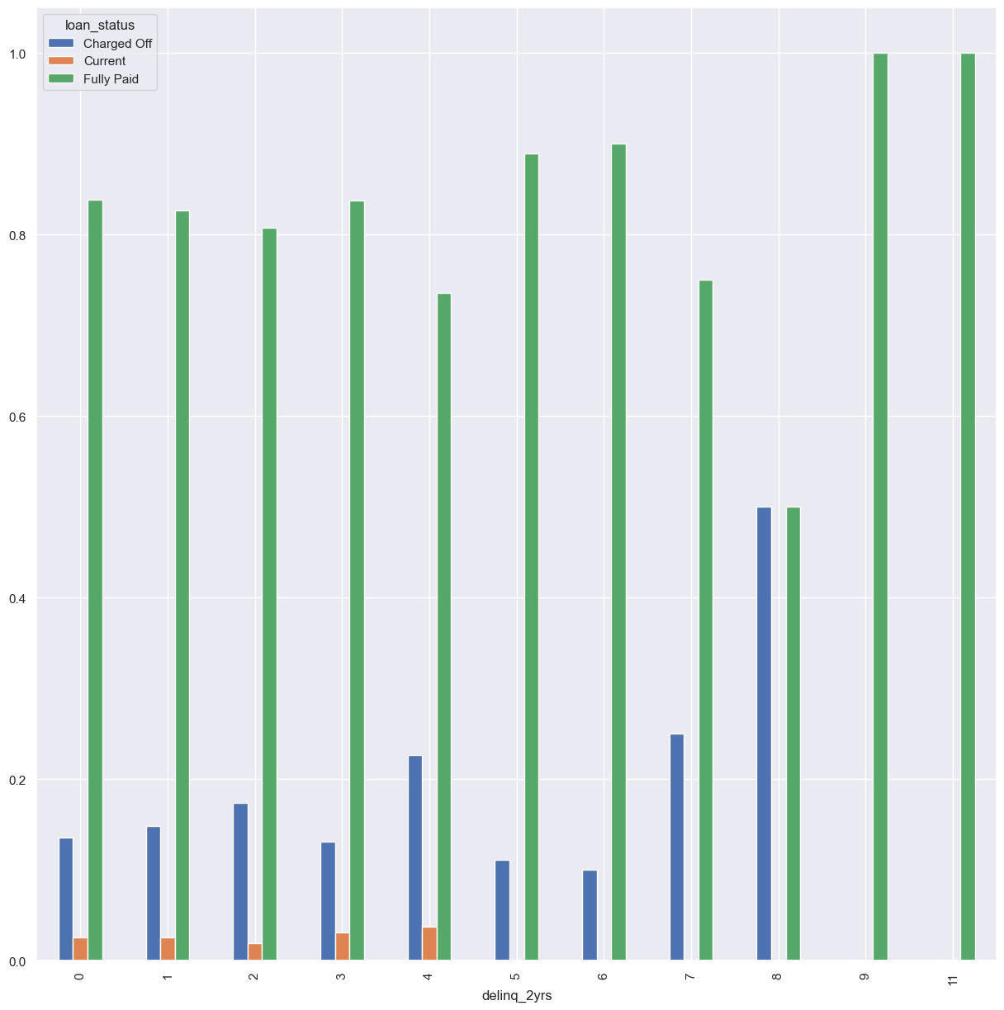
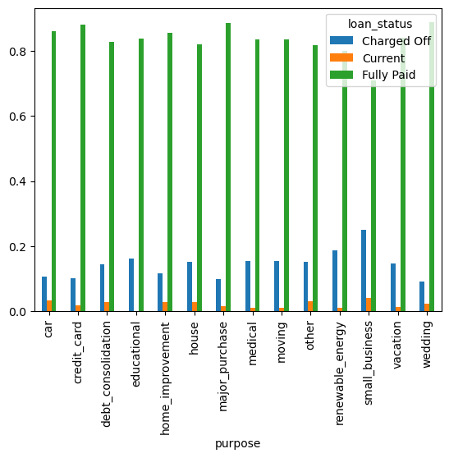
Bivariate Analysis :Categorical vs Categorical Variables
Loan Status vs Loan Purpose
Higher Default has seen for below Category
Small business
Renewable energy
education
Loan Status vs Borrower's credit file for the past 2 years:
Higher Default seen for credit file for 8

Slide 7
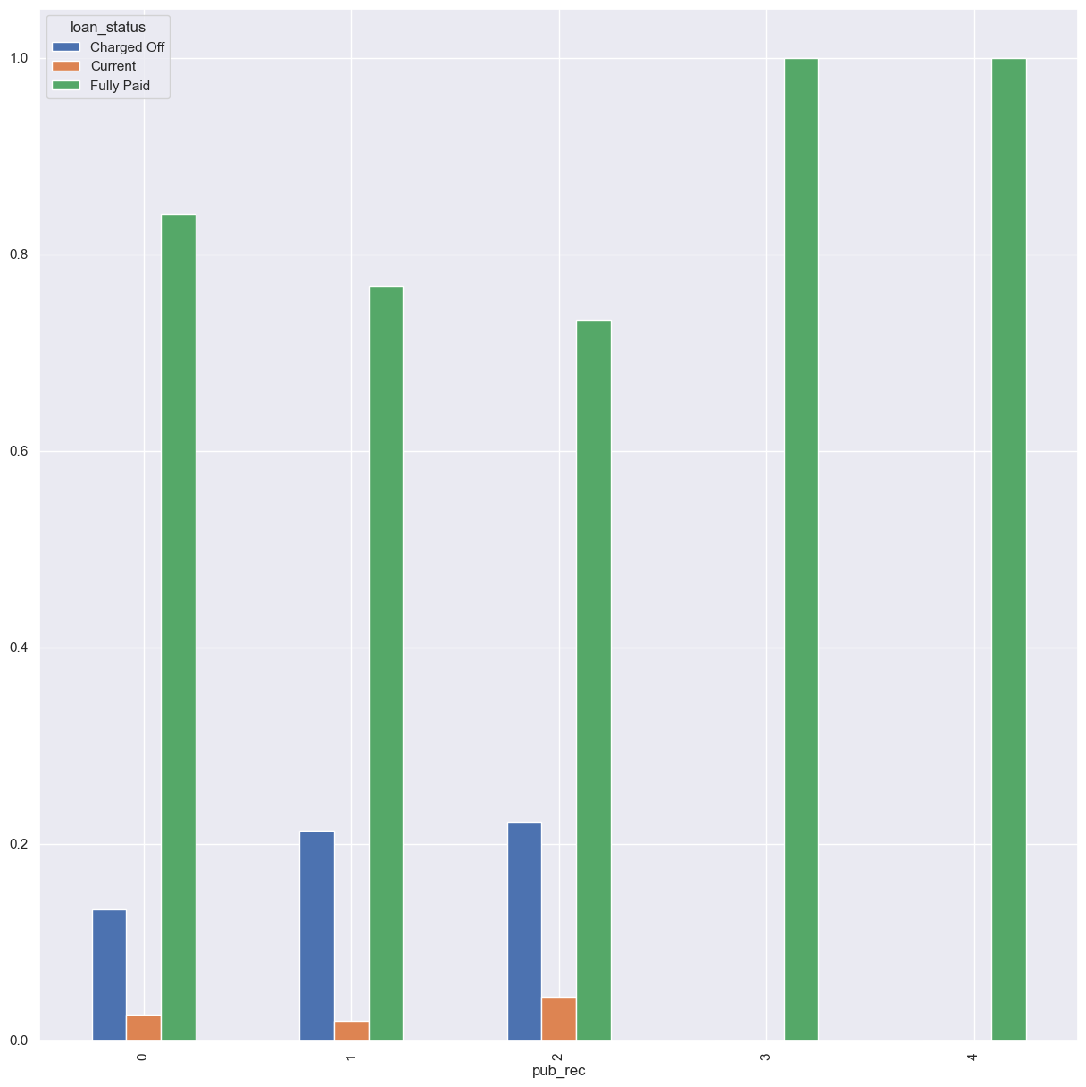
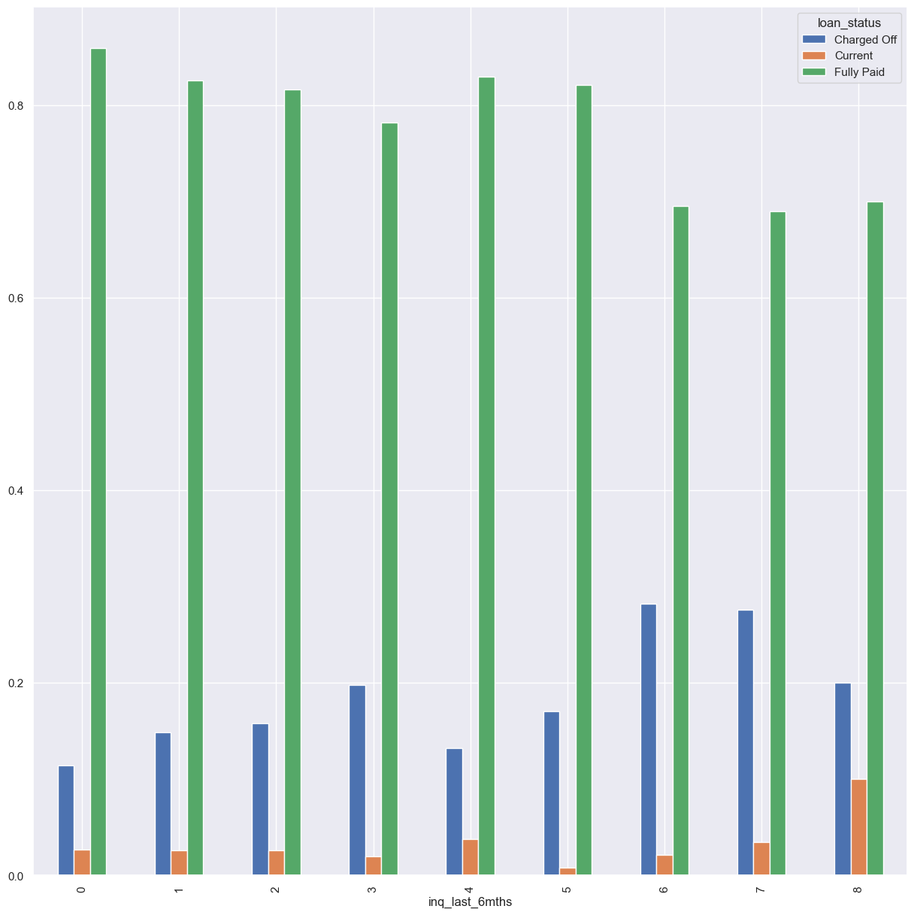
Loan Status vs Number of derogatory public records:
Higher Default seen for Number of derogatory public records having 2
Loan Status vs The number of inquiries in past 6 months :
Higher Default seen for if inquiries having more than 6

Slide 8
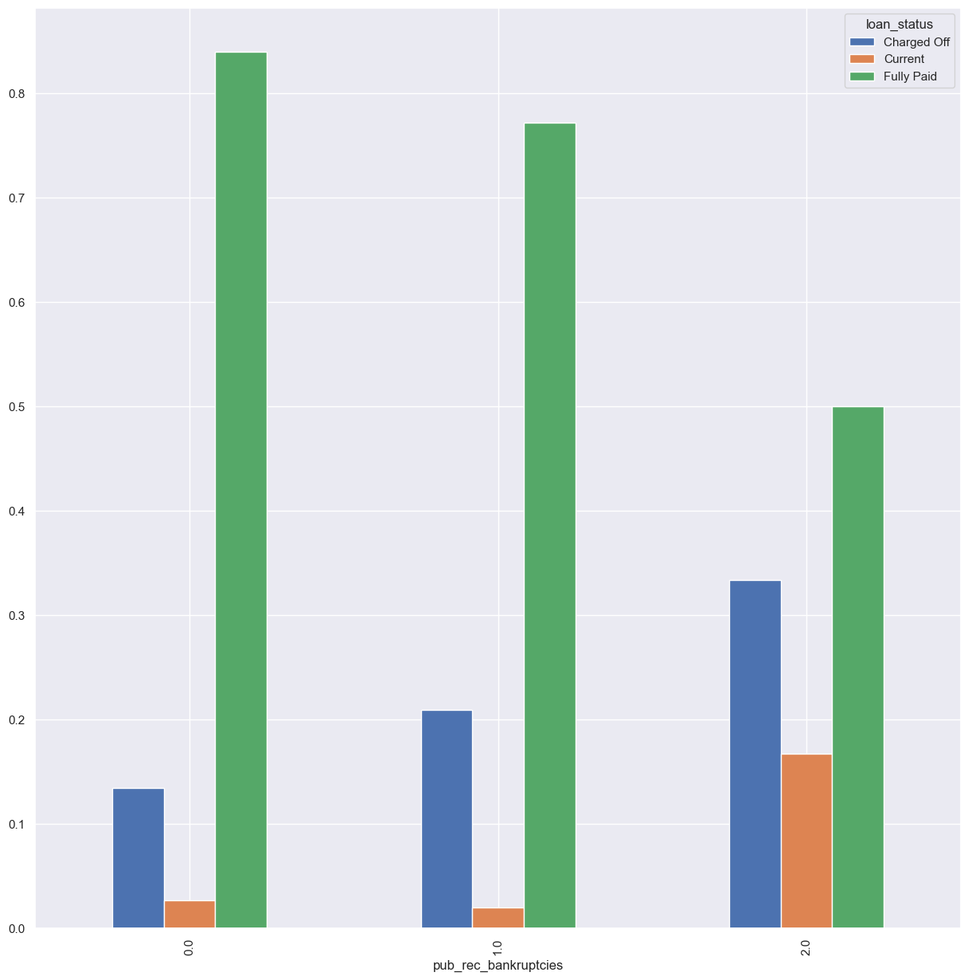
Loan Status vs Number of public record bankruptcies:
Higher Default for higher public record related to bankruptcies

Slide 9
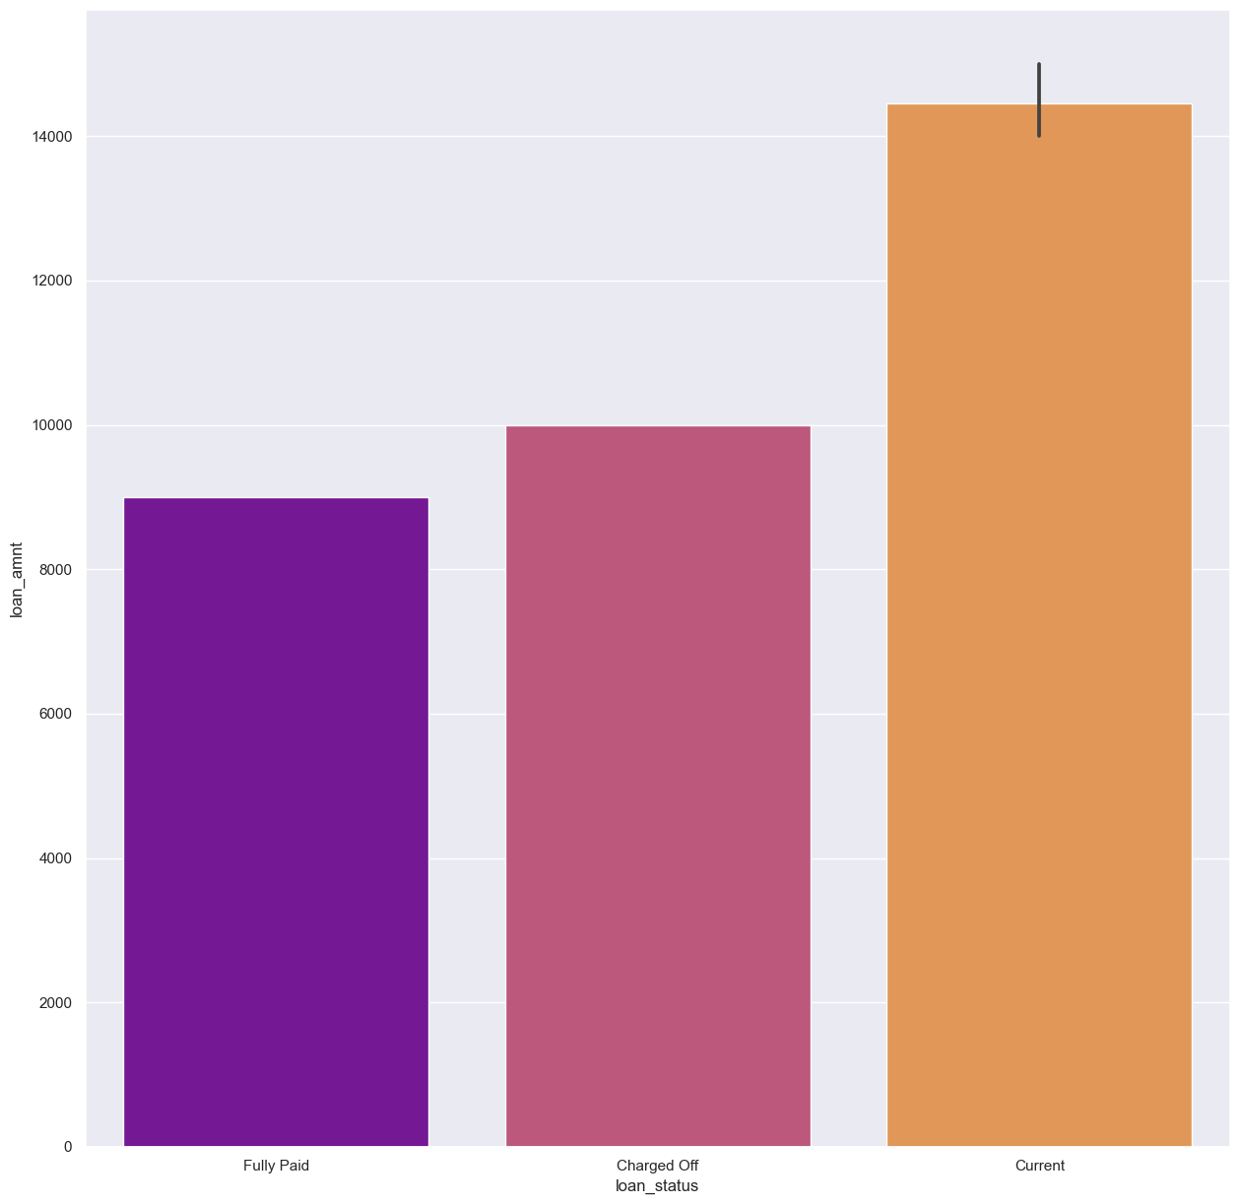
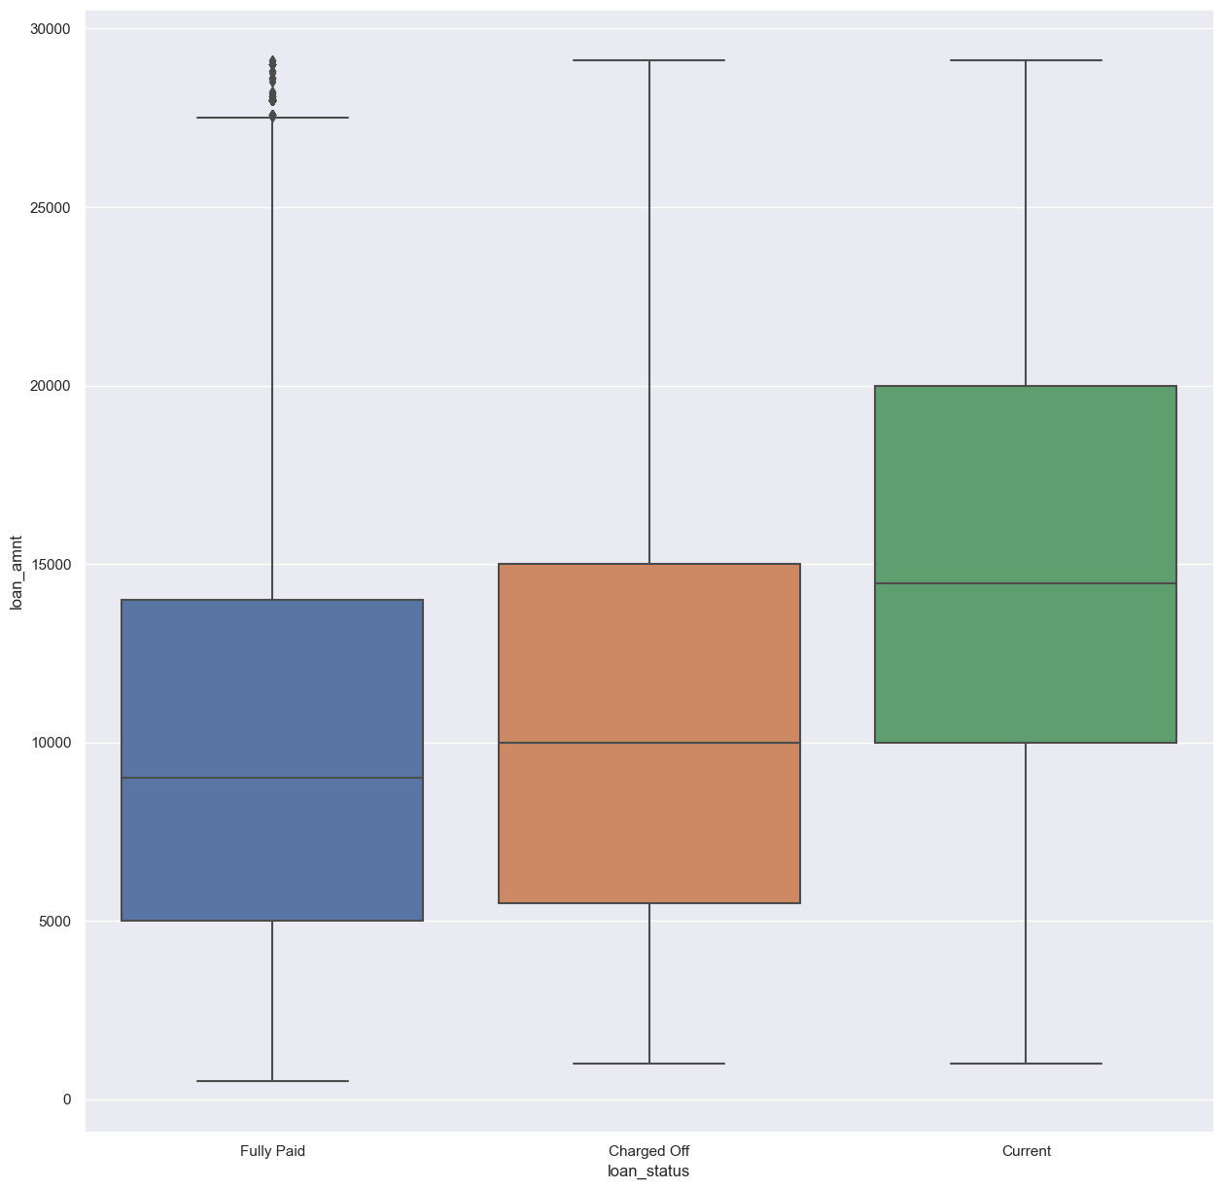
Bivariate Analysis :Categorical vs Numerical Variables
Loan Status vs loan amount:
No conclusion on loan amount

Slide 10
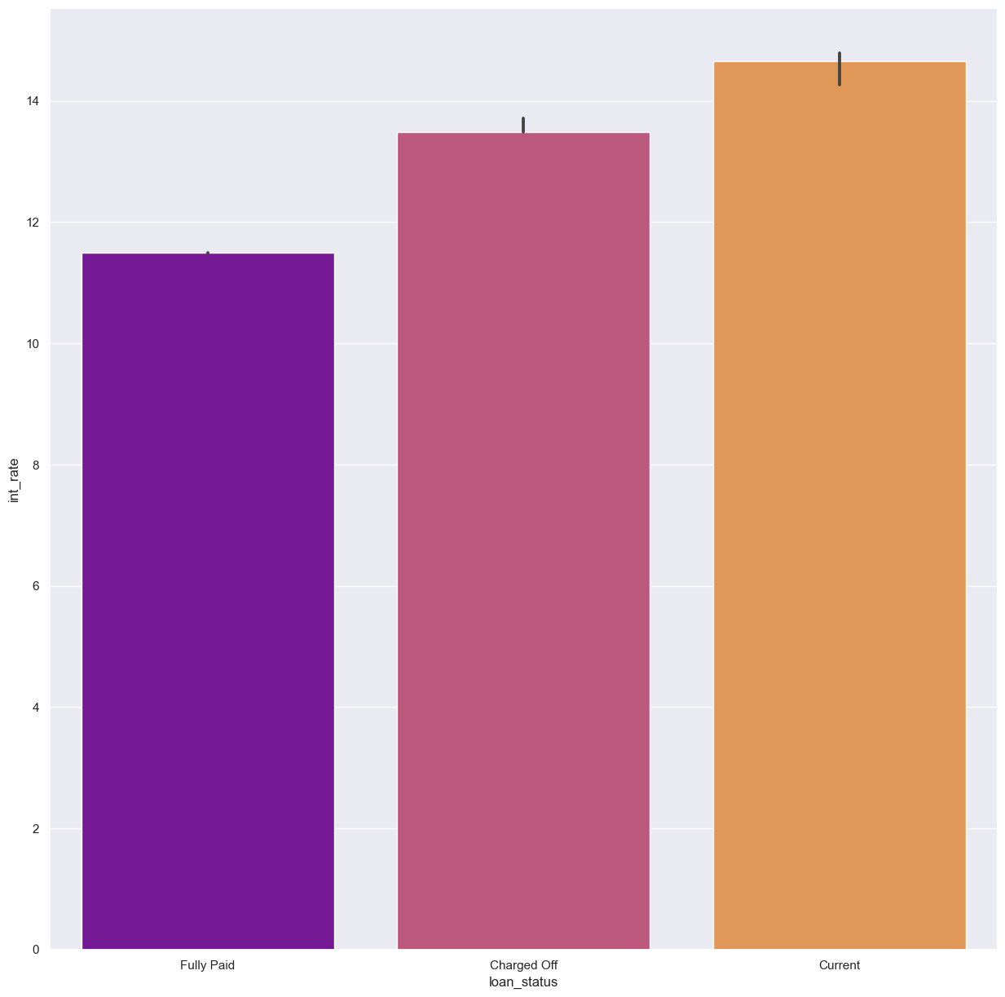
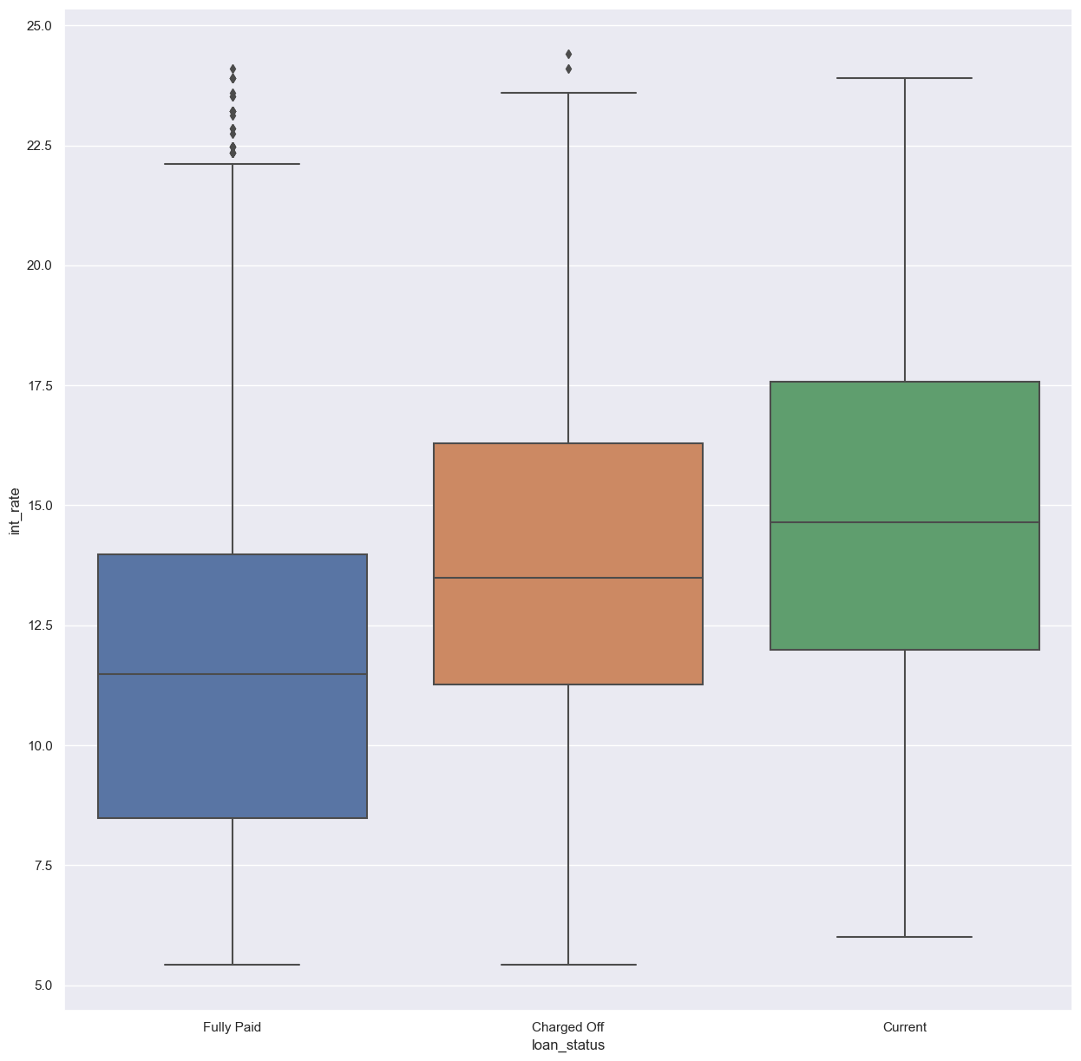
Loan Status vs loan amount:
No conclusion on loan amount

Slide 11
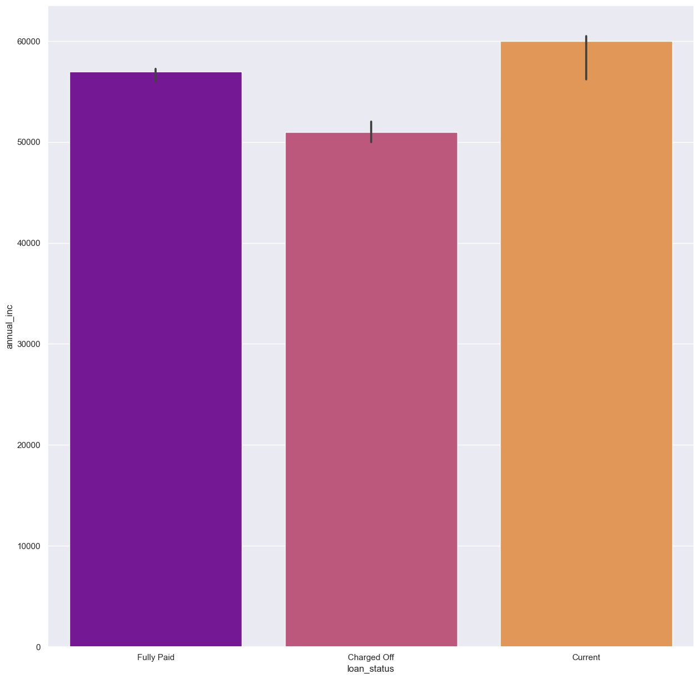
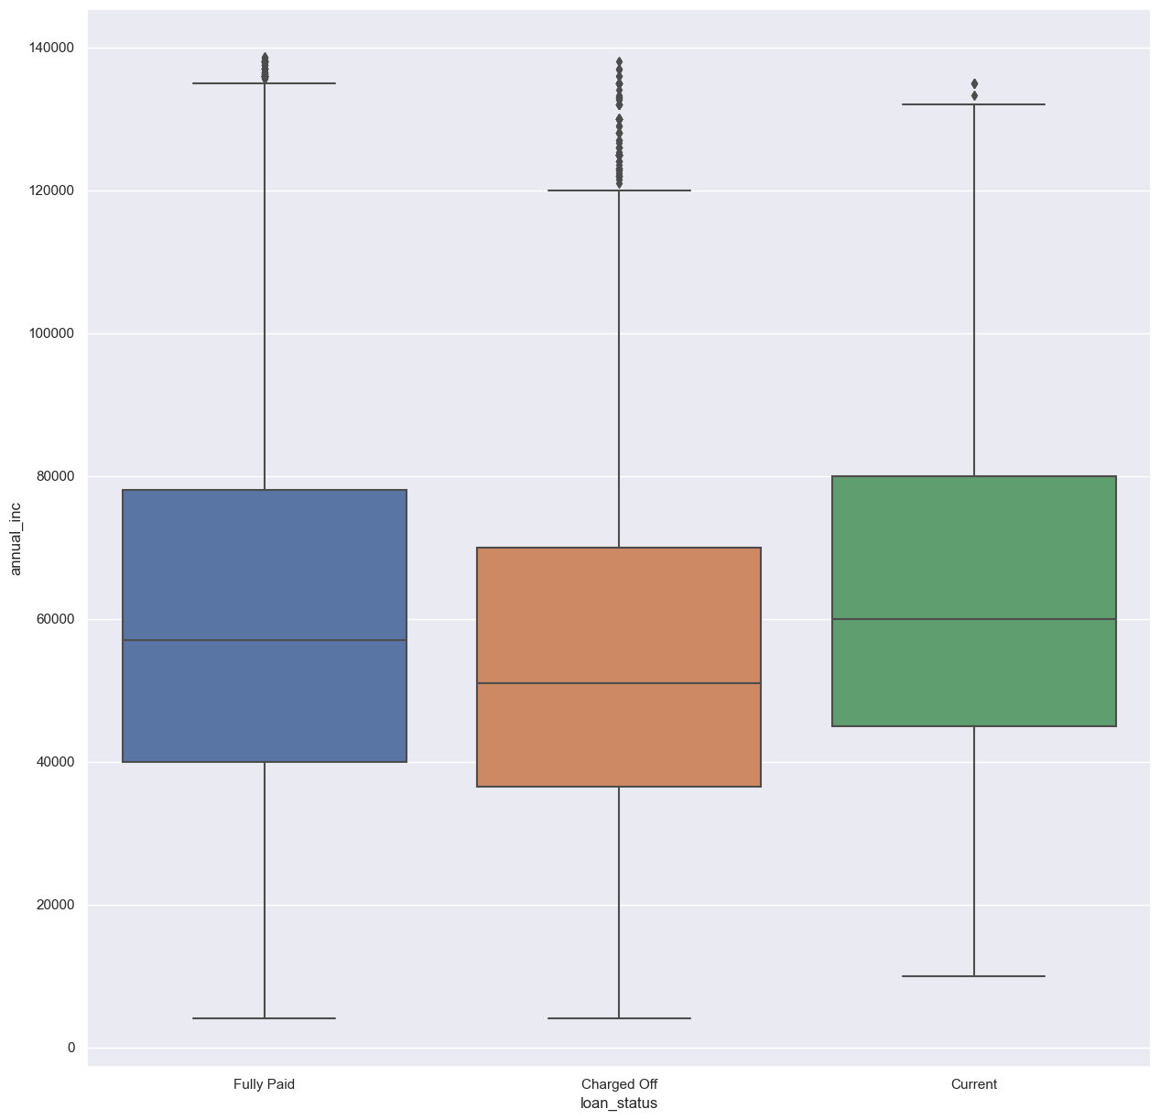
Loan Status vs annual income
If annual income is less (51k) then Default is higher

Slide 12
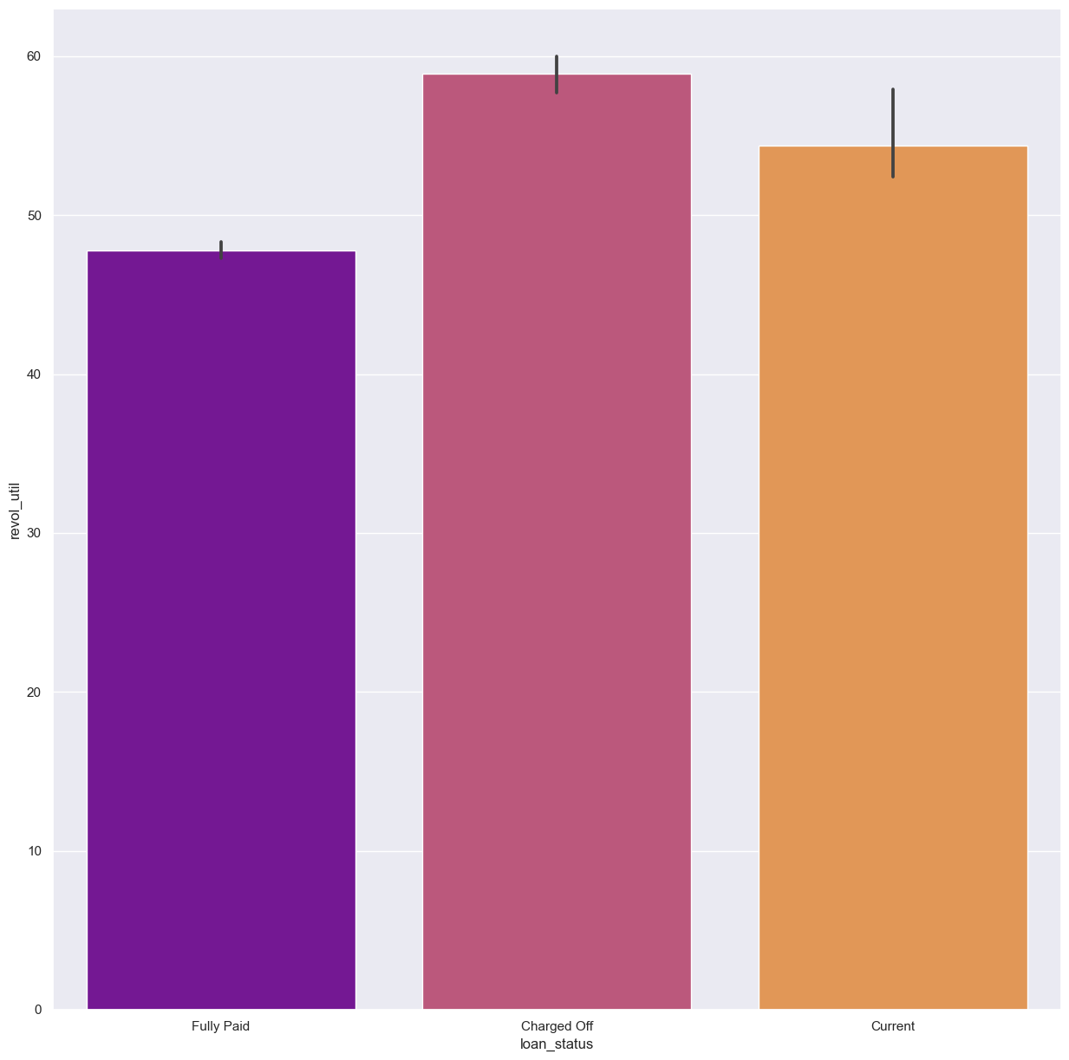
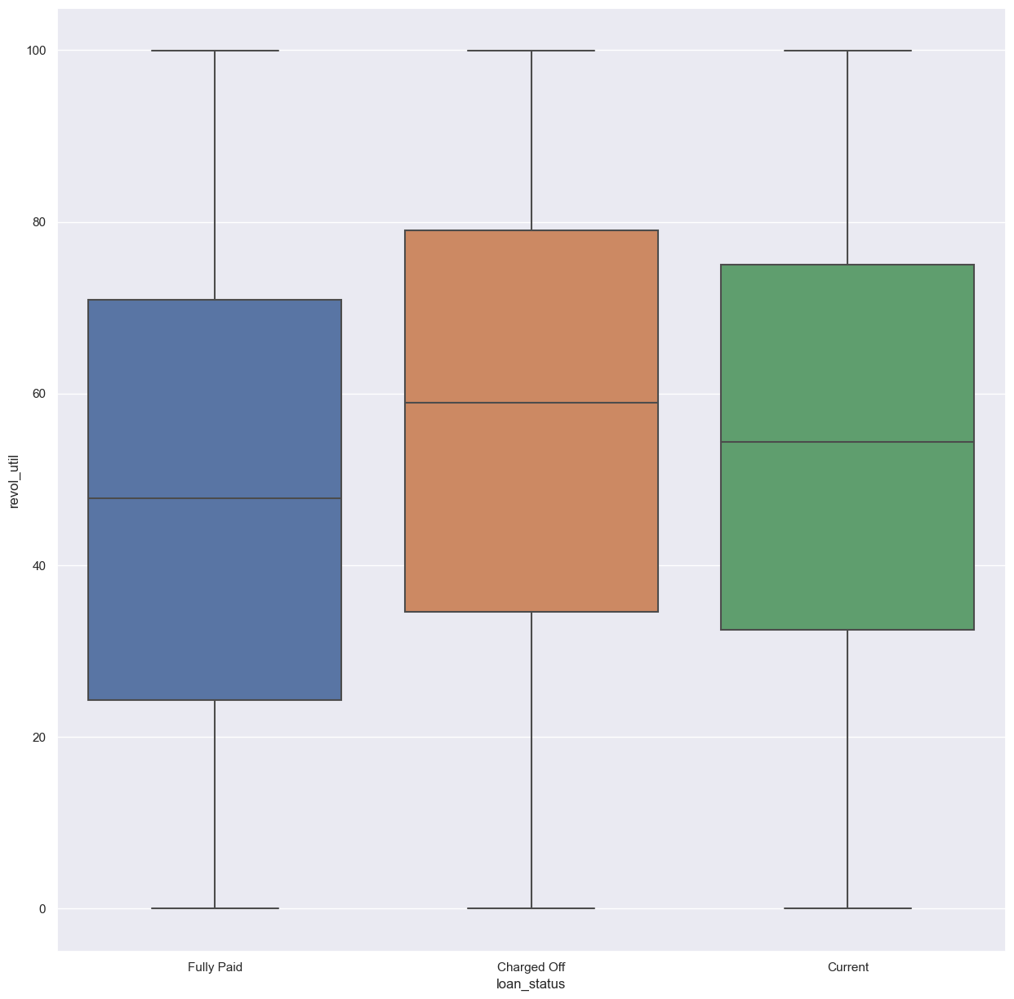
Loan Status vs Revolving line utilization rate
If Revolving line utilization rate is higher (51k) then Default is higher

