Slide 1
Predicting Rising Future Stars in Research
Vamsi Chunduri – Z1833668
Vamsi Krishna Simma – z1809589

Slide 2
Who are Rising Stars?
Finding rising stars is a challenging and interesting task which is being investigated recently in co-author networks.
Rising stars are authors who have a low research profile in the start of their career but may become experts in the future.

Slide 3
Why find Rising Stars?
large volumes of publications every year – continuing
research community, e.g., offering competitive candidates to university.
Finding such Rising starts within the organizational domains.

Slide 4
Author Timeline

Slide 5
The main contribution of our work
1.It is the first attempt to consider author’s citations, co- author’s order of appearance and author’s influence and weight. 2. Mathematical formulations for the computation of weighted mutual weight and influence. 3. Performance evaluation of proposed and baseline methods in terms of average number of papers and average number of citations. 4. Qualitative analysis of top ranked 10 authors in terms of their achievements.

Slide 6
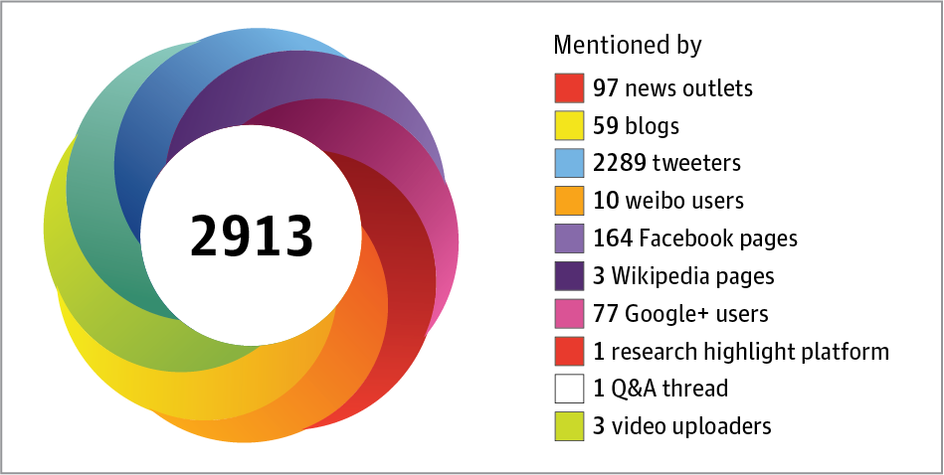
Data- AltMetrics
Altmetrics include a wide variety of counts, from coverage in mainstream news and social media (tweets,shares, likes, etc), author Details, score, blogs , readers and demographics to citations on Wikipedia.

Slide 7
Dataset
Altmetrics dataset -big data course at NIU.
9 million JSON files in the dataset. Each JSON file represented a tuple in the Altmetric data, which we processed to create the final dataset.
We extracted 50,000 tuples using random.
Dataset after cleaning 33,125 tuples.
*Dont use your laptops unless they have 32 gb ram and 1 tb ssd

Slide 8
Altmetric data cons
The altmetric data no venue details– The data set does not mention any refrence to venues but only the geographical demographics.
Rely on 3rd Party data sources .

Slide 9
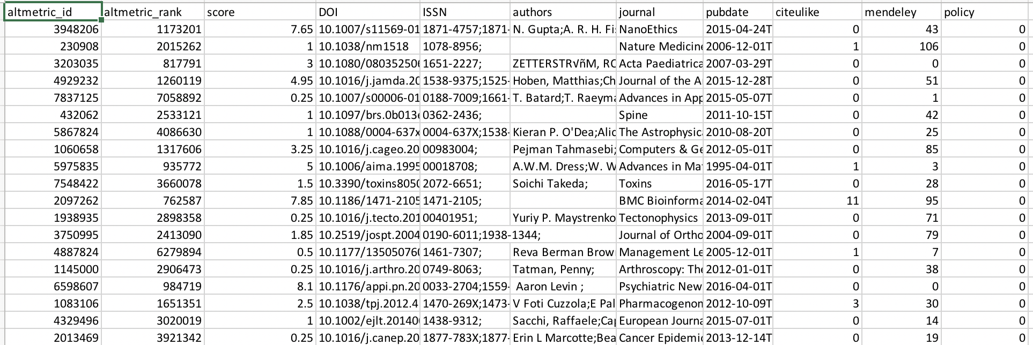
Attributes from Altmetic Data
Using Python – Data extraction for the following attributes was done
Altmetric_ID
Altmetric Rank
Score
DOI
ISSN
Authors
Journal
Pubdate
Citelike
Mendeley
Policy
They played a key role in modeling the feature.
*Not all attributes used

Slide 10

Feature Selection
Information Gain
information gain is the change in information entropy H from a prior state to a state that takes some information as given:

Slide 11
Features used
No of publictions for each author
Author publication from 2005 to 2010
Author publications from 2010 to 2015
Mutual weight
Author Influence
Simpton Diversity
Co-author influence

Slide 12
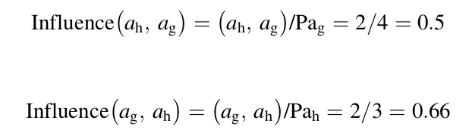
Author Influence
If a junior researcher is able to work together with an expert or capable to perform numerous contributions in team work then he/she has bright chances to be a future expert. Consider two authors g and h with 4 and 3 publications respectively. Both are coauthors in 2 publications, the influence of an author to other author can be calculated as
where Pag and Pah are total number of publications for authors ag and ah. Hence author ah influences to ag with 0.5 score and ag to ah with 0.66 score.

Slide 13

Simpson’s Diversity Index
Simpson's Diversity Index is a measure of diversity which takes into account the number of species present, as well as the relative abundance of each species. As species richness and evenness increase, so diversity increases.
The value of D ranges between 0 and 1. With this index, 1 represents infinite diversity and 0, no diversity.

Slide 14

Co-Author citations
If a junior researcher has initially few citations collaborates with senior scholar, then there are more chances for junior scholar to get more citations in collaboration. The co-author citations can be computed as
where CC (ag) is the co-author citations for author ag, and (Rab , Rac , Rad) is the sum of total papers’ citations of the co-authors (ab, ac and ad) of author ag.

Slide 15
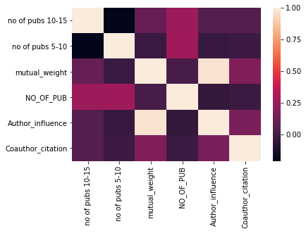
Corelation matrix

Slide 16
Methods used
Generative and Discriminative methods
Discriminative: A generative classifier tries to learn the model that generates the data behind the scenes by **estimating the assumptions and distributions of the model.
SVM
Classification and Regression Tree ( CART )
Generative: A discriminative classifier tries to model by just depending on the observed data. It makes fewer assumptions on the distributions but depends heavily on the quality of the data
Naïve Bayers

Slide 17
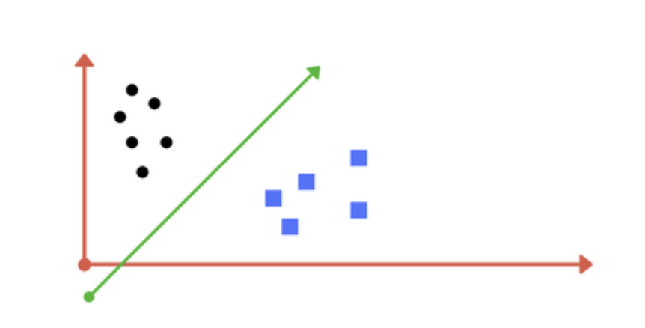
Support Vector machines(SVM)
Support vector machines (SVMs) are a type of learning model used for classification and regression analysis. In an SVM data points are represented as points in space in such a way that points from different categories are separated by a plane. You can think of this like a line through data points that separates data of different classes.
accuracy: 0.893
Precision: 0.797
Recall: 0.893
F-measure: 0.842

Slide 18
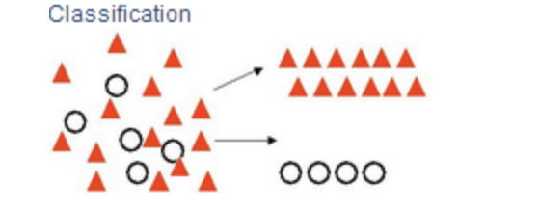
CART
CART is basically a non parametric learning approach that results in either regression or classification tree depending variables (features) are either categorical or numeric
accuracy: 0.829
Precision: 0.831
Recall: 0.829
F-measure: 0.764

Slide 19
Naïve Bayers
The NB is a probabilistic classification method that applies naive hypothesis with Bayes algorithm for every pair of features. It can handle both continuous and categorical independent variables and assumes that features are statistically independent.
accuracy: 0.793
Precision: 0.727
Recall: 0.713
F-measure: 0.752

Slide 20
Evaluation Metrics
The performance of applied classifiers is analyzed by Precision, Recall and F1 evaluation metrics. We mainly used F1 score to examine the effects of different features for rising star classification accuracy and prediction. The mathematical definition for these metrics are described as
Precision=TP/TP+FP
Recall=sensitivity=TP(TP+FN)
F1=2×precision×recallprecision+recall

Slide 21
Rising Star Score
Ranking of top rising stars are presented for the list of predicted future rising stars for both data sets. The authors are ranked by sorting score in decreasing order.
Rising Star score= (sum of all features)

Slide 22
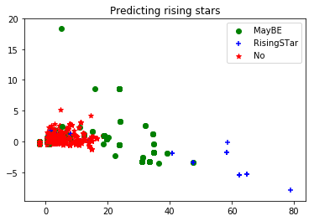
Predicting Rising Stars

Slide 23
Results

Slide 24
Top Authors on our model
Top Authors
Pham, L.D. | Bang Wool Eom
Do, D.N. | Hong Man Yoon
Nam, L.Q. | Ji Yoon Rho
Van Ba, N. | Il Ju Choi
Minh, L.T.A. | Young-Woo Kim
Hoan, T.X. | Greenwood S
Ji Yeon Park | Chen JC
Keun Won Ryu | Chen CT
Daniel Reim | Jump AS

Slide 25
Conclusion
Discriminative and generative machine learning techniques
Two classes of features are explored i.e. Author, Co-author.
SVM, CART and Naive Bayes are chosen for experiment and results analysis
SVM performs better compared to other models

Slide 26
Future Scope
Implement the Venue centric features
predicts more accuracy
weight of author is precise
Apply concept to other domains

Slide 27
Questions?

Slide 28
Thank You

