Slide 1
LANE
Commercial auto intake that shows its work
An agent's email of fifteen files becomes one page for the underwriter: what each document is, what it says, where documents disagree, what is missing, how the guideline lands rule by rule, and what to ask next. Every number opens the line it came from.
The model reads and explains. Code decides. A person signs.
24 of 24
102 of 102
13 of 13
29 of 29
0
documents classified
fields read correctly
conflicts found, none false
rules with the right outcome
facts invented
Scored by make eval against hand-written gold for the sample packet. Live at laneunder.online
Notes:
Lane reads every document an agent sends, applies Knight's guideline as code, and gives the underwriter one page where every number opens its source. The design rests on one rule: the model reads and explains, code decides, a person signs. It runs end to end on AWS today, with real email.

Slide 2
Their sample contains every trap the brief describes
THE PROBLEM, IN THEIR OWN PACKET
What arrived: one email, 15 files and a zip of all 15
What Lane finds, in the brief's own terms
Files | Format | Becomes
Application workbook | XLSX | Application, schedules
Quote form | PDF | Quote form
Driver, vehicle lists | XLSX | Two schedules
MVR report | PDF, scans, photos | 8 MVRs
AL and MTC, 3 terms | PDF | Loss runs, a letter
Q3 2025 to Q2 2026 | PDF, partly scanned | 4 IFTA returns
The zip | ZIP of all 15 | Read once, by hash
One loss history is a letter, not a loss run; typed by its content and flagged
Incorrectly named
Duplicate
The zip repeats all fifteen files; recognised by sha256 and read once
Conflicting
The owner is on the driver schedule with a Class C license; the application says the owner does not drive. Power units: 4 scheduled, 5 stated
Missing
A 2021 Peterbilt and a driver, Kevin Brandt, appear in a claim and on no schedule; no MVR for him
Prohibited risk
IFTA puts 56% of miles in states outside the program; the farthest state is New Jersey, not the declared Texas
24 documents
732 facts
Coverage history
A 308-day gap in prior coverage
found in 15 files plus the zip; 13 scanned pages read by OCR
each tied to its page, box or cell; 99.2% found on the source
Lane's result: Refer to Small Fleet underwriting, potential decline for a person to confirm, and a draft asking the agent for what is needed before a quote.
evals/report/sample_packet.md, data/packet_cobalt_mesa/
Notes:
The packet they sent contains every problem the brief lists. Fifteen files plus a zip of all fifteen become twenty-four documents, because the MVR report holds eight MVRs and the workbook holds several forms. Lane finds the misnamed letter, the duplicate zip, the owner who appears as a driver, a truck and a driver that appear only in a claim, and operations outside the program. The result is a refer to Small Fleet with a potential decline, and a request for exactly what is needed before a quote.

Slide 3
Seven versioned steps; the model works in four, and none of them decides
THE PIPELINE
Orchestration, Intelligence, Verification gate, Decision
LAYERS
# | Step | What it does | Writes | Model | If the model is down
1 | Triage | Text layer or OCR per page; quality band; photo flattening; hidden text and injection scan | pages, page and OCR caches | none (RapidOCR, local) | unaffected
2 | Classify | Type every page: code, then learned layouts, then the model; split and supersede documents | documents, page_classifications | Haiku 5.5 | keywords carry text pages; images to review
3 | Extract | Catalog fields with evidence; decision fields read twice; validators, recall and arithmetic | facts, document_extractions | Haiku 5.5; Sonnet 5.5 to escalate | documents marked failed; step degraded
4 | Resolve | One value per field from verified facts, or a conflict with every candidate; missing items | resolved_fields, conflicts, missing_info | none | unaffected
5 | Rules | 29 predicates from the guideline; safeguards; the route and team | rule_results, decisions | none | unaffected
6 | Review | Expert summary and findings, every sentence cited and checked by code | analyses, findings | Opus 5.5, after approval | last good review kept, marked degraded
7 | Actions | What to ask the agent; the draft email | agent_request_items, email_drafts | Sonnet 5.5, wording only | template with the same items
Fingerprint input hash of every file, every step, prompt and ruleset version, and an output hash
Cache model calls keyed by model, effort, prompt sha256, schema and input: a replay costs $0
Versions triage 5, classifier 4, extractor 2, ruleset 1.1.0 with its sha256 on every decision
backend/src/lane/pipeline/registry.py, runner.py, fingerprint.py
Notes:
Seven steps run in order for every email, each versioned. The model works in four of them, and none of the four decides anything. Resolve and rules are pure code. Each step has a defined state when a model is unavailable, so a model failure is visible and the deterministic results still render. Every run is fingerprinted: input hash, every version, output hash.

Slide 4
Documents are identified by their bytes and content, never their names
INTAKE, CLASSIFICATION, POOR-QUALITY DOCUMENTS
Orchestration, Intelligence
LAYERS
1 Intake
2 Triage and poor quality
3 Classification
Four ways in: upload, CLI, Mailpit (local), SES into S3 (AWS)
SES gate: virus and spam verdicts pass, DMARC or DKIM pass, sender allowlisted; else held, never read
Magic bytes, not extensions: PDF, images, XLSX inside zips, EML by its headers
Zip limits: depth 3, 500 members, 100 MB per file, 500 MB expanded, ratio 200; no paths, links or encryption
Duplicates, three levels: same email by Message-ID, same bytes by sha256, same files as another submission
Per page: text layer if at least 40 characters; otherwise prepare and OCR
Prepare: flatten a photographed page, turn by the best OCR read, deskew, even out light
OCR: RapidOCR PP-OCRv6 on ONNX, local; words with boxes and scores
Quality: sharpness under 40 poor, under 120 degraded; poor pages cap confidence and go to the stronger model
Hidden text (invisible, transparent, under 2 pt, white on white) removed and audited; injection phrases audited
Tier 1, code: worksheet headers and known signals settle the page; no model call
Tier 2, learned layouts: from documents a person confirmed; 10% still read by the model, and a disagreement retires the layout
Tier 3, the model: Haiku, fused with keyword votes; disagreement goes to review
Then: split files that hold several documents; a newer copy supersedes an older one
Name check: a filename that disagrees with the content is flagged, never trusted
IN THE SAMPLE
24 of 24
8 MVRs
28 to 12
224.6 s to 0.3 s
documents typed correctly
split out of one PDF
model calls per run once layouts are learned
triage of a resent packet, from the page cache
backend/src/lane/intake/, documents/triage.py, prep.py, tier1.py, layouts.py, classify.py
Notes:
Lane never trusts a file name. Bytes are sniffed, archives are opened with limits, and the same bytes are never read twice. Every page is triaged: a usable text layer, or preparation and local OCR, with a measured quality band that later caps confidence. Classification is code first, learned layouts second, and the model last, checked by keyword votes. That is how the letter filed as a loss run is caught, and how a photographed MVR still gets read.

Slide 5
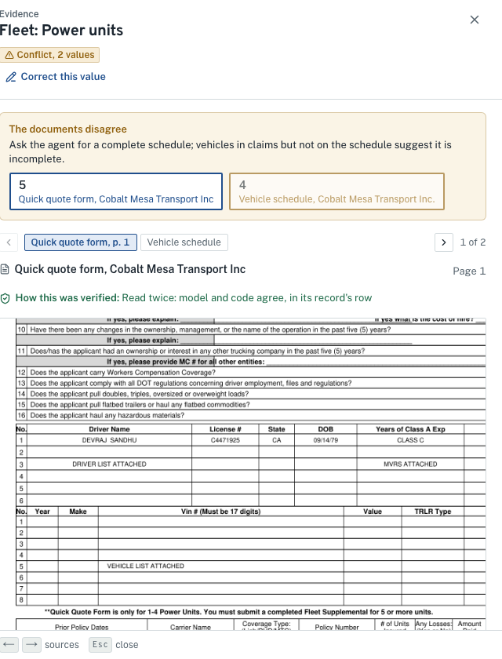
A value may decide only after code finds it again on the page
EXTRACTION AND CONFIDENCE
Intelligence, Verification gate
LAYERS
Two independent reads of every decision field
Page | First read: the model | Second read: code, at the same place
Worksheet | Names the cell (CellRef) | Reads the stored cell itself
Text layer | Copies the value with a quote | Finds the label in the page words, reads beside it
Scan or photo | Reads the image | OCR words at the same anchor, scored 0.85 or more
Compared by type: identifiers after folding look-alikes (O and 0, I and 1, S and 5), money to the cent, dates as dates. A value that does not verify is re-read from a 2.5x crop, then by the stronger model.
Confidence is computed, then capped
resolve/service.py (the gate)
High: verified by code
Medium: on the page, not verified (context fields)
Low: a decision field not verified, or not found
Caps: failed validator, failed recall check, poor page, ambiguous day and month
def decides(f: Fact) -> bool:
if f.tier == "decision":
return f.verified
return f.grounding not in (
"none", "mismatch", "ocr_mismatch")
Checks code runs: VIN check digit and year, DOT and MC formats, license format by state, dates in order, paid plus reserved equals incurred; IFTA columns sum to totals, tax equals gallons times rate.
The evidence lens: the value, outlined on its page
backend/src/lane/extract/engine_v2.py, verify.py, ocr_check.py; resolve/service.py
Notes:
Extraction follows a field catalog: only fields the guideline, a conflict check or a screen needs. Every field that can change a decision is read twice by different means: the model, then code at the same place on the page. Confidence is computed from that verification, never asked of the model, and capped by failed validators, poor pages and ambiguous dates. The gate is one function: a decision value that did not verify cannot decide anything, and a rule that needs it says can't check yet.

Slide 6
The guideline runs as code: 29 rules, each quoting the line it enforces
RULES AND WORKFLOW
Decision, Policy as data
LAYERS
backend/rules/knight_trucking.v1.yaml
Every rule, in this order, before it may decline
- id: DRV-01
title: Every driver holds a valid CDL
section: Safe driver criteria
quote: "Valid U.S. driver license and CDL"
predicate: drivers_hold_cdl
assumptions: [A06, A10]
decline: true
request: Confirm who drives; a driver without
a CDL must be excluded by name
Step | What it does
Predicate | Reads resolved fields only; every read is recorded as evidence
Unread sources | A refer resting on a file Lane could not read becomes can't check yet
Unverified reads | A pass on a value read once, never verified, becomes can't check yet
Sensitivity | Re-run once per candidate of each conflict; a conflict that changes the outcome blocks the rule
Certainty | A decline on a blocking conflict becomes a refer, marked potential decline
Readings | Ambiguous guideline lines are evaluated both ways (A03)
Other anchor | Re-run from the effective date; any change is noted
backend/src/lane/rules/predicates.py
def drivers_hold_cdl(ctx: RuleContext) -> Verdict:
drivers = _drivers(ctx, only_driving=True,
judges_owner=True)
for d in drivers:
if d.value("commercial_license") is False:
failing.append(f"{d.label} holds a non-commercial")
...
return Verdict(Outcome.DECLINE, reason, failing)
Route: team by every power-unit count the documents support (4 and 5: Small Fleet; a count on each side of 10 goes to Fleet). External checks (SAFER, premium per unit) are listed for quote. The worst remaining outcome decides.
Outcomes: pass, flag, refer, decline, can't check yet, not applicable. Changing a threshold is a reviewed YAML edit; the ruleset's sha256 is stored on every decision.
The model never writes a rule outcome.
backend/rules/knight_trucking.v1.yaml, backend/src/lane/rules/engine.py, predicates.py
Notes:
The guideline is a versioned YAML file: 29 rules, each with the exact line it enforces, its assumptions and its request wording, and one predicate in Python. Predicates read resolved fields only, never model output. Before a rule may decline it passes the safeguards: unread sources, unverified reads, sensitivity to every conflicting value, decline needs certainty, alternative readings of ambiguous lines, and a check from the other anchor date. In the sample, DRV-01 depends on the owner conflict, so it becomes a potential decline for a person to confirm.

Slide 7
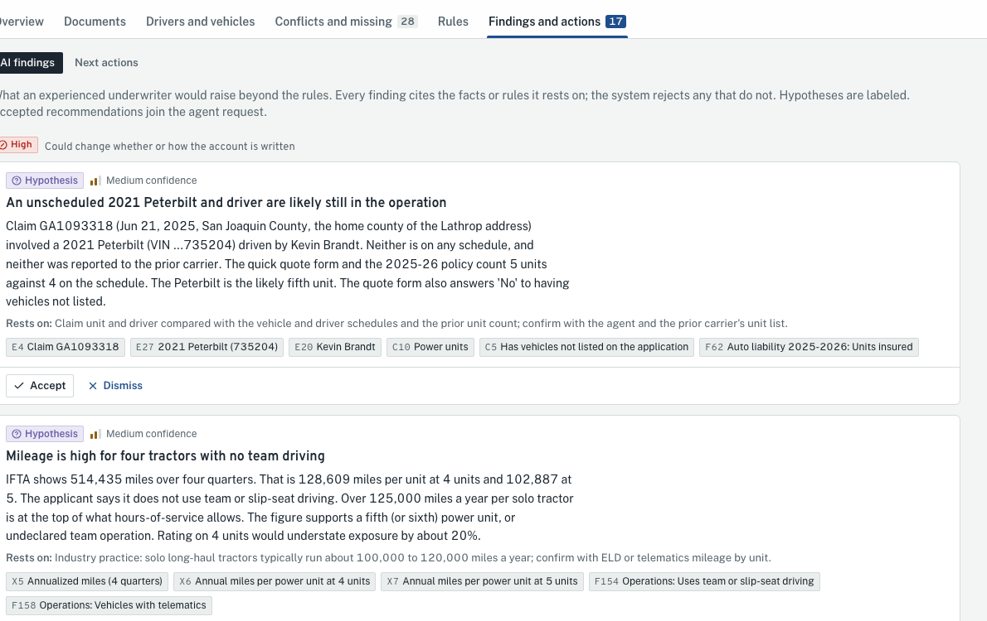
The model writes the review; code rejects anything it cannot cite
AI ANALYSIS AND RECOMMENDATIONS
Intelligence
LAYERS
1 What the model is given
Purpose | Model
Classify a page | Haiku 5.5
Extract fields | Haiku 5.5
Re-read, escalate | Sonnet 5.5
Expert review | Opus 5.5
Draft wording | Sonnet 5.5
A brief, not documents: resolved fields F1, entities E1, conflicts C1, missing items M1, rules R:DRV-01, figures X1 computed by code
Minimized: addresses withheld; license numbers and FEIN tokenized; dates of birth become ages; no page text
Purpose: summarize, find patterns an expert would, raise hypotheses with their basis
2 What code checks
Opus runs only after a person approves its estimated cost
Failures are states: refused, invalid, error; the step degrades visibly
Replay is cache-only: a call not cached is never sent
analyze/engine.py
CITATION = r"^(?:[FECMX]\d+|R:[A-Z]+-\d+)$"
# every sentence: at least one valid citation
# a hypothesis: needs a basis
# approve, bind, accept, decline, reject: rejected
# summary: 5 to 7 sentences; one retry
Findings: each with its basis, citations and accept or dismiss
3 One gateway for every model call
Cached by model, effort, prompt sha256, schema and input
Fenced: document text wrapped with a content nonce, as data
Priced: cost per call logged; a daily spend alarm
Rejected findings are stored, not shown. 18 of 18 findings an expert underwriter wrote down were also raised.
backend/src/lane/analyze/context.py, engine.py; llm/gateway.py
Notes:
The expert review uses the model's industry knowledge, but it never sees a document. It gets a brief built by code: resolved fields, conflicts, missing items, rule results and figures computed by code, each with a citation id, with personal data withheld or tokenized and dates of birth as ages. Code checks the output: every sentence needs a valid citation, a hypothesis needs a basis, and any finding that tells the underwriter to approve or decline is rejected. All model calls go through one gateway that caches, prices and fences them.

Slide 8
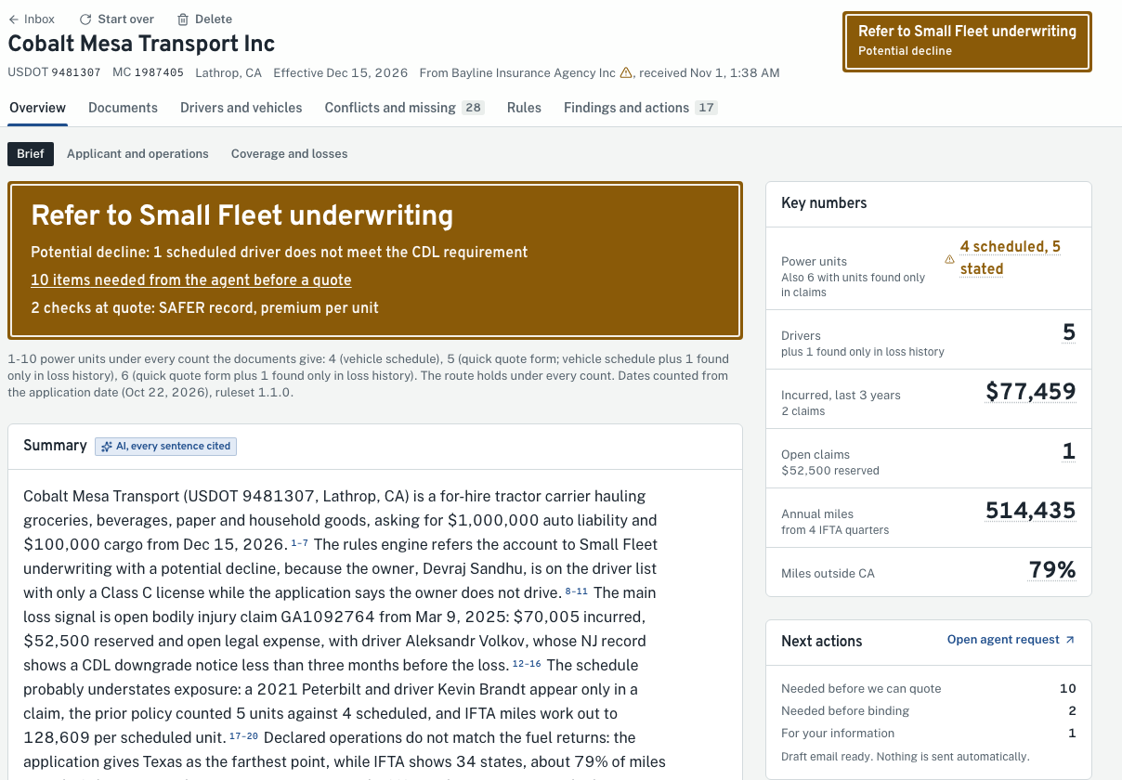
One page for the underwriter; every disagreement goes to a person
RESULTS AND HUMAN REVIEW
Experience, API, Evidence
LAYERS
1
Resolve a conflict
Both candidates side by side with their sources; a person picks or overrides, with a reason; rules rerun at once
2
Review findings
Accept or dismiss each, with a reason; accepted findings become requests to the agent
3
Send the request
Lane drafts with [Ref LN-...] in the subject; a person sends it and marks it sent
4
Measure the reply
Linked by reference, thread or DOT; in the demo: 3 of 24 points answered, DRV-01 to can't check yet
5
Clear a decline
A rule leaving decline waits for a senior underwriter to confirm; enforced by the API
6
Audit
The Brief: route, key numbers, cited summary, next actions
Every action hash-chained (sha256 of the previous event); the chain is verified on screen
frontend/src/components/submission/; backend/src/lane/review/, actions/, audit/chain.py
Notes:
Everything lands on one page, the Brief: the recommendation and route, the key numbers, a summary where every sentence is footnoted, and what to ask the agent. People stay in charge at each point: a conflict is resolved with a reason and the rules rerun; findings are accepted or dismissed; the request is sent by a person and marked sent; the reply is linked and measured point by point; and clearing a decline needs a senior underwriter. Every action is in a hash-chained audit trail.

Slide 9
Exceptions are states, never silent; operations sees every one
EXCEPTIONS AND THE OPERATIONS TEAM
Orchestration, Verification gate, Decision
LAYERS
Exception | What Lane does | Who acts
Mail fails a scan, authentication or the allowlist | Held in S3 held/, logged, never read | Operations
Oversized, encrypted or unsafe archive member | That file rejected with its reason; the rest is read | Underwriter asks
Unreadable or damaged file | Surviving pages kept; rules that need it say can't check yet | Underwriter asks
Poor page quality | Confidence capped; the stronger model reads first | Automatic
Model and keywords disagree on a page | Page sent to review; a person's label holds on every rerun | Underwriter labels
A deciding value does not verify | Re-read from a crop, then by Sonnet; else in review, rules can't check yet | Underwriter confirms
Totals do not add up | Escalation waits with its estimated cost | Underwriter approves
Model down, refused or invalid | Step degraded to a named state; code results still render | Operations
Worker dies mid job | Lease expires; another worker takes it; up to 3 attempts | Automatic
Reply matches by name only | Suggested as a follow-up, never merged | Underwriter decides
The Ops screen
for the Operations role
Services: database, file storage, email intake
Workers by heartbeat: working, idle or quiet; jobs done
Queue: jobs by status, the oldest queued, each lease and attempt, jobs taken over
Runs: by status; failed runs with the step and the error
Steps: p50 and p95 time, failures per step
Models: calls, cache hits, errors; cost per submission, today's cost and cache rate
Runs the system without reading it: Operations holds the process and ops permissions, not view_content.
On AWS: 7 alarms by email, a CloudWatch dashboard, JSON logs with personal data masked.
intake/ses.py, archive.py; pipeline/runner.py, queue.py; extract/engine_v2.py; api/ops.py
Notes:
Every exception has a named state, a place on screen, and an owner. Mail that fails a check is held, never read. A file that cannot be read keeps what survived, and the rules that need it say can't check yet. A value that does not verify is re-read, then goes to a person. A model that is down degrades its step visibly while code results still render. A worker that dies loses nothing: its lease expires and another takes the job. The operations team watches all of it on the Ops screen, without reading the documents.

Slide 10
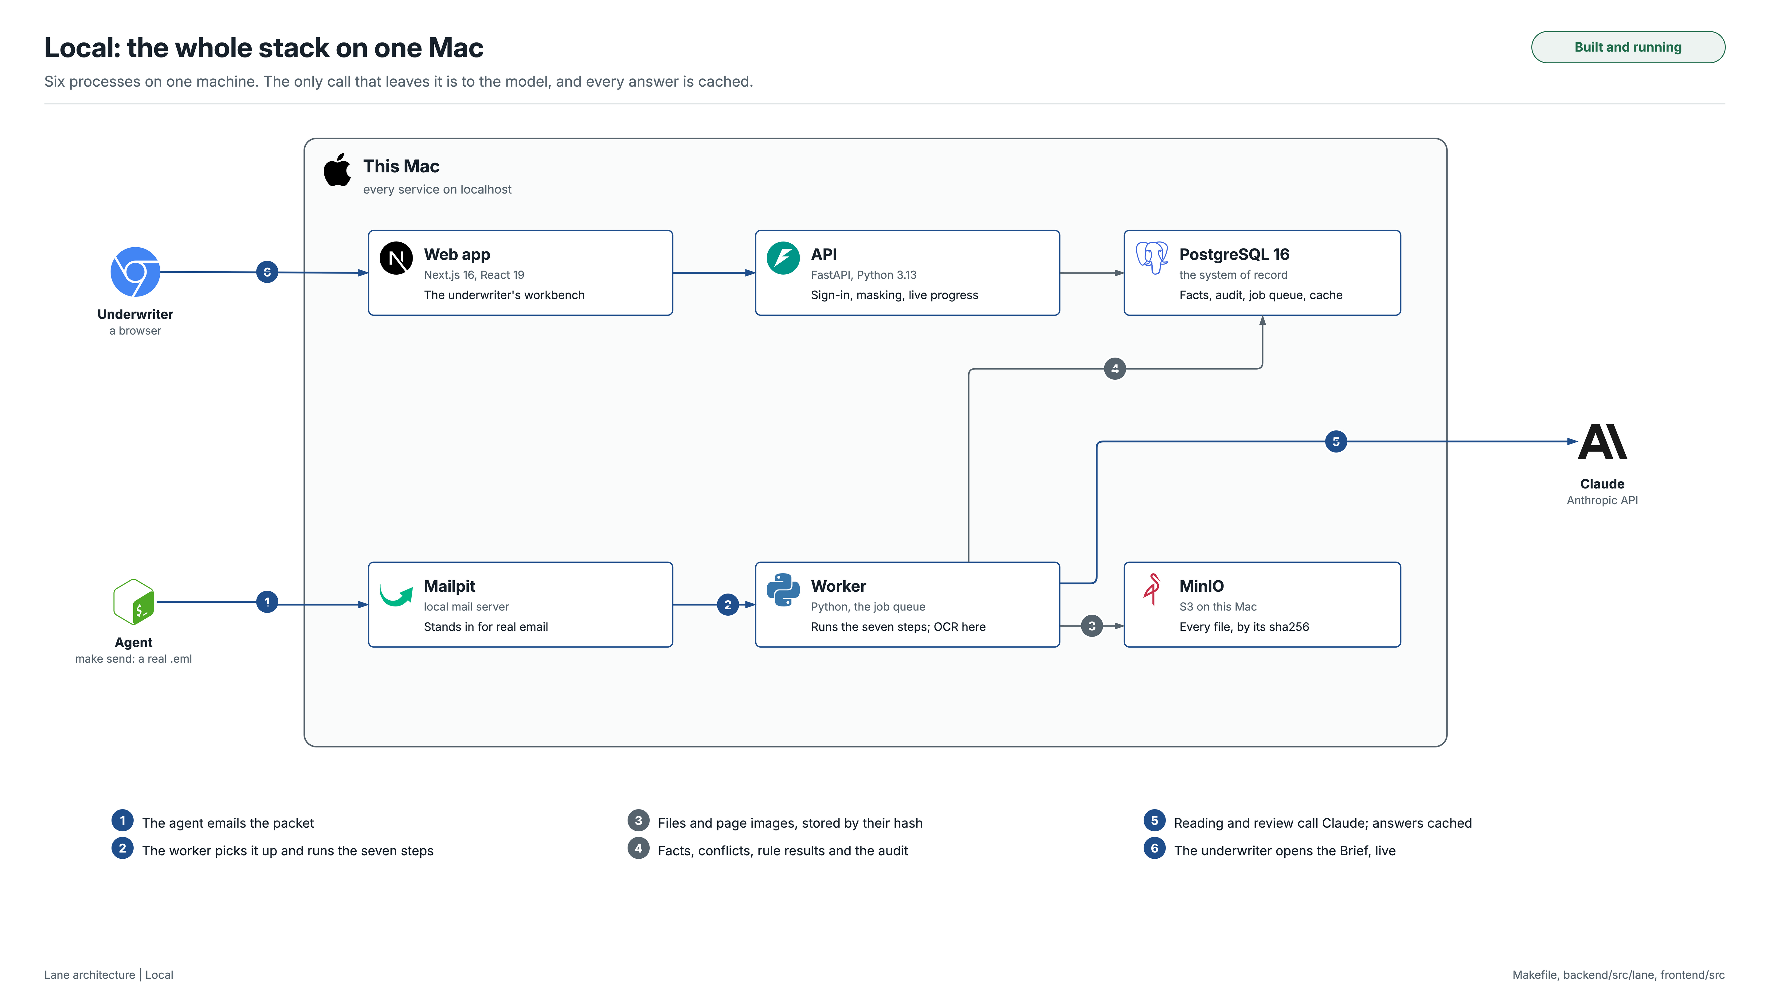
Notes:
Locally: a Next.js workbench, a FastAPI API, a queue worker that runs the seven steps, Postgres, MinIO for files and Mailpit for email. Only model calls leave the machine. Flows 1 to 8 follow one email to the Brief.

Slide 11
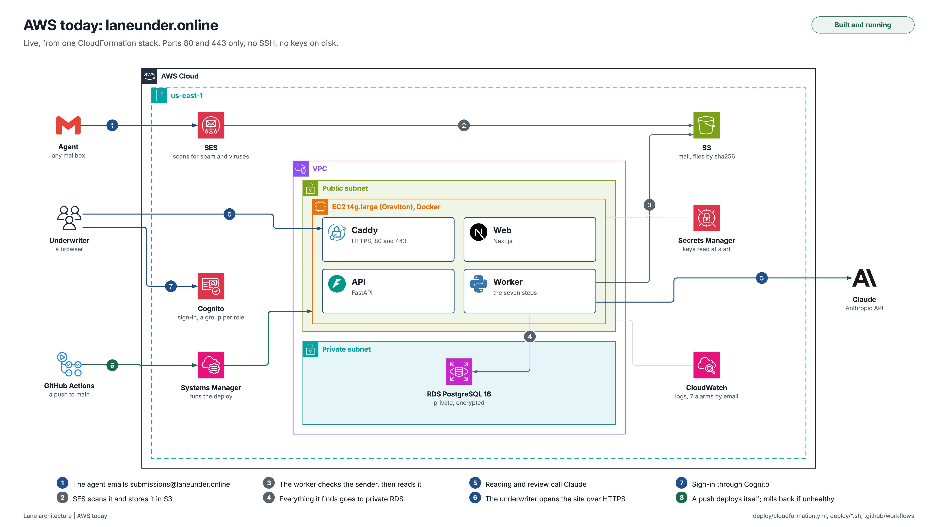
Notes:
Running now at laneunder.online, from one CloudFormation stack. Real email arrives through SES, which scans it; the worker processes only authenticated, allowlisted senders. Private RDS, S3, Cognito sign-in with PKCE, Secrets Manager, seven alarms. Ports 80 and 443 only, no SSH; a push to main deploys through OIDC and Systems Manager and rolls back if unhealthy.

Slide 12
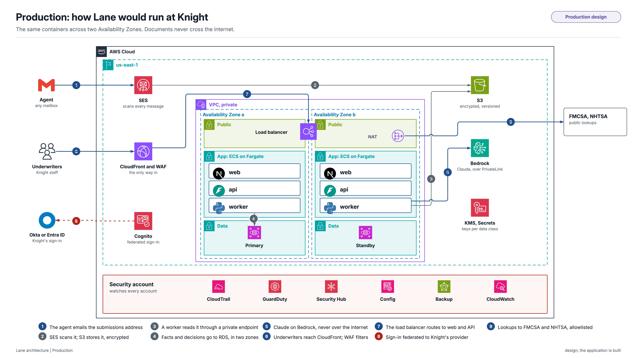
Notes:
For Knight: the same images on ECS Fargate across two Availability Zones, behind CloudFront, WAF and a load balancer; RDS Multi-AZ with a proxy and a replica; Claude on Bedrock over PrivateLink, so documents never cross the internet; sign-in federated to Knight's Okta or Entra ID; security services from a separate account. The VIN check and IFTA arithmetic are built; the FMCSA lookup by USDOT is the next step.

Slide 13
Repeatable, recoverable, and private by default
SCALABILITY, RELIABILITY, SECURITY
Orchestration, Evidence
LAYERS
Repeatable
Recoverable and scalable
Private and controlled
Fingerprint per run: input hash, every version, output hash
Replay: the whole pipeline in a scratch database, cache only; the output hash must match
Visible failures: each step degrades to a named state; deterministic results still render
Audit: sha256 chain; a Postgres advisory lock keeps writers in order; verified on screen
Queue: Postgres jobs, claimed FOR UPDATE SKIP LOCKED; 30 s lease renewed every 10 s; 3 attempts
Workers: heartbeat every 5 s; a dead worker's job is reclaimed; add workers for volume
Live progress: pg_notify to the API, then Server-Sent Events, resumable by Last-Event-ID
Production: workers on Fargate scaled on queue depth; RDS Multi-AZ; Bedrock
Masked by default: license numbers, dates of birth, home addresses, in values, free text, every response and the logs
Access: 5 roles; quoting at risk or clearing a decline needs a senior underwriter
Encrypted: TLS; RDS with SSL forced; S3 and RDS encrypted; secrets in Secrets Manager
Inbound mail: held unless scanned clean, authenticated and allowlisted
Measured on AWS: send to finished Brief
Gmail to SES | SES to ingest | Triage | Classify | Extract | Resolve, rules, review, actions | Model calls
15 s | 3 s | 2 s | 11 s | 25 to 32 s | under 1 s | 54, all from the cache, $0
Postgres 16 35 tables: emails, pages, documents, facts with evidence, conflicts, rule results, decisions, the audit chain, the job queue, the model cache
S3 (MinIO locally) every email, file, page render and word layout, stored by sha256 and never overwritten
Retention today inbound mail and logs 30 days; documents and the database have no policy yet
pipeline/fingerprint.py, queue.py; review/replay.py; api/privacy.py; audit/chain.py
Notes:
Same inputs and versions give the same outputs, and the system can prove it: every run is fingerprinted, and a replay reruns the whole pipeline in a scratch database from the model cache. The queue is Postgres with leases, so a dead worker's job is picked up by the next, and scale is adding workers. Personal data is masked in three layers and in the logs; roles and decision authority are enforced by the API; every action is in a hash chain. On AWS today, an email becomes a finished Brief in about a minute.

Slide 14
Compliance: what is built today, what production adds
SECURITY AND COMPLIANCE
API, Evidence
LAYERS
To confirm with Knight's compliance team: NAIC Insurance Data Security Model Law (state versions), NYDFS Part 500 where it applies, GLBA safeguards, DPPA for MVR data, FCRA where reports come from a consumer reporting agency, CCPA for California drivers, the NAIC model bulletin on insurers' use of AI, state record retention.
Area | Today, built | Production adds
AI governance | Model never decides; every finding cited; prompt version and hash on every call; ruleset hash on every decision; runs replayable; evals include injection | Model inventory; owner sign-off on prompt and rule changes; bias and drift testing; vendor review
Fair treatment | Legal presence and immigration signals never stored, shown or scored | Outcome testing for unfair discrimination, documented
Data to the model | Review gets a minimized brief (no addresses, tokenized IDs, ages). Gap: classify and extract send page text and images to the Anthropic API | Claude on Bedrock in-region over PrivateLink; no training, no retention
Personal data | Masked in UI, API and logs; reveal one field at a time, audited; license photos blurred | Macie on S3; access and deletion request handling
Access control | 5 roles; operations cannot read content; four eyes to clear a decline. Gap: some read endpoints check sign-in, not a role | Every endpoint checks its permission; SSO with MFA; access reviews
Encryption | TLS; S3 and RDS encrypted with AWS keys; RDS SSL forced. Gap: the database certificate is not verified | Customer-managed KMS keys per data class; verified TLS
Audit logging | Hash-chained audit, kept after a deletion; logs 30 days, personal data masked | CloudTrail to a log-archive account; write-once storage
Retention | Inbound mail and logs 30 days. Gap: documents and the database kept indefinitely | A schedule per state rules; legal hold; provable deletion
Adverse action | Lane recommends; a person decides. No notice step | A notice when a decline rests on a consumer report (FCRA)
Security operations | 7 alarms; inbound mail authenticated and allowlisted; no SSH; secrets in Secrets Manager | GuardDuty, Security Hub, Config; incident response with notification deadlines; pen tests
docs/SECURITY.md; api/privacy.py, auth.py; audit/chain.py; deploy/cloudformation.yml
Notes:
Which regulations apply is for Knight's compliance team to confirm; this is my reading. Lane is strongest where AI regulation is heading: the model never decides, every finding cites its evidence, and every prompt, rule and output is versioned and replayable. The gaps are named in red. The largest: document text and images reach the Anthropic API over the internet today, documents have no retention schedule, and some read endpoints check sign-in rather than a role. Production closes each one.

Slide 15
Measured against hand-written gold, then against damage
EVALUATION
The sample, against gold
Damaged copies: 11 of 11 pass
Extraction v1 to v2
Measure | Result
Documents recognised | 24 of 24
Fields read correctly | 102 of 102
Conflicts found, none false | 13 of 13
Missing items found | 15 of 15
Rules with the right outcome | 29 of 29
Expert findings also raised | 18 of 18
Facts tied to their source | 732, 99.2% found
Facts invented | 0
Perturbation | Checks
Blurred low-quality scan | 7 of 7
Photographed pages | 7 of 7
Rotated pages | 6 of 6
Corrupt file | 5 of 5
Renamed files | 6 of 6
Duplicated attachments | 5 of 5
Loss run removed | 7 of 7
Claim deleted | 6 of 6
Prompt injection | 5 of 5
FEIN only in the email | 5 of 5
A synthetic packet | 6 of 6
 | v1 | v2
Facts | 2,110 | 718
Decision facts read twice | none | 481 of 481
Gold fields correct | 82 of 82 | 82 of 82
Recall checks | 7 of 7 | 10 of 10
Follow-ups: 5 of 5
Same email twice; same packet resent; reply with the reference; reply by DOT; name only, suggested not merged.
In CI on every push
Each: same route, no outcome less careful, poor pages flagged, the run completes.
584 backend and 57 frontend tests, warnings as errors; ruff and pyright strict; a guard against packet-specific code.
evals/report/sample_packet.md, perturbations.md, follow_ups.md, extraction_v1_vs_v2.md
Notes:
Lane is measured, not asserted. make eval scores the sample against gold written by hand: documents, fields, conflicts, missing items, rules and an expert's findings. The perturbation suite damages the sample eleven ways and checks the route never becomes less careful. Follow-up cases test reply linking. Extraction v2 against v1: a third of the facts, and every decision fact verified by a second read.

Slide 16
Where the guideline is silent, the assumption is written down
ASSUMPTIONS, QUESTIONS, TRADE-OFFS
Question I would ask Knight | Assumption used in its place
Does "non-listed states" mean where the account is based, or where its trucks operate? Measured how? | Both readings evaluated; either declining makes a potential decline; 5% tolerance on IFTA miles (A03)
Does a "no paid losses" letter satisfy losses reported for every prior term? | No: a carrier loss run is required (A08)
Do the 60-day loss run and 90-day MVR windows count from the application or the effective date? | The application date, with the effective date checked too (A02)
An owner listed as a driver says the owner does not drive: refer, or is an exclusion enough? | A potential decline until a person confirms (A06)
When documents disagree on power units, which governs routing? | Every count considered; straddling 10 goes to Fleet (A15)
Trade-off
Risk
Not built yet
Two reads of every deciding value cost model time and money; they buy values that can be trusted to decide.
Scores rest on one real packet and one synthetic one; a wider gold set is the first next step.
FMCSA and NHTSA lookups; SSO federation; scaling OCR beyond one instance.
docs/QUESTIONS.md, docs/ASSUMPTIONS.md, docs/DECISIONS.md
Notes:
The guideline is one page; real decisions need more. Each gap became a written assumption with an id, and each assumption is a question I would ask Knight. Changing one is an edit in one place. The risks: one real packet in the gold set, the outside lookups are not built yet, and two reads cost model time to buy values that can be trusted to decide.

