Slide 1
RETAIL ANALYTICS REPORT
BigBasket
Customer Purchase & Market Basket Analysis
Analysis of 62,141 transaction records across 106 customers and 8,387 orders · March 2011 – December 2014

Slide 2
01 · OVERVIEW
Executive Summary
A loyal, high-frequency customer base.
Every one of the 106 customers placed multiple orders — a 100% repeat rate, averaging 79 orders each. This is a recurring-order grocery base, not one-off shoppers.
Fresh produce drives demand.
Vegetables and dals dominate the catalog; the top 10 categories account for 52.8% of all purchase records.
Clear cross-sell & retention plays.
Strong product affinities (Almonds↔Cashews, the dal family) and a 21-customer at-risk group define the next actions.
100%
79.1
Repeat customer rate
Avg orders / customer
7.41
52.8%
Items per order
Top-10 category share
BigBasket Analytics · 2/10

Slide 3

02 · METHOD
Scope, Data & Method
Three datasets
Five columns
bigBasket.csv — primary, 62,141 rows
IMB575-XLS-ENG.csv — customer-category support
Memberdata.csv — single-customer (M09736) case study
Member · Order · SKU · Created On · Description
106 customers, 8,387 orders, 1,732 SKUs
216 distinct product categories
Cleaning performed
Key constraint
Mixed dates fixed: 36,569 Excel serials + 25,572 strings
All standardized — zero unparseable
Zero missing values, zero exact duplicates
No price, quantity, or cost fields
Revenue / AOV / margin / CLV not computable
This is a descriptive behavioral analysis
BigBasket Analytics · 3/10

Slide 4
03 · KPIs
Key Performance Indicators
8,387
106
1,732
216
Total orders
Total customers
Total SKUs
Product categories
62,141
7.41
79.12
100%
Product records
Items per order
Orders per customer
Repeat customer rate
Revenue-based KPIs (AOV, margin, CLV) are not computable — the dataset has no price or quantity fields.
BigBasket Analytics · 4/10

Slide 5
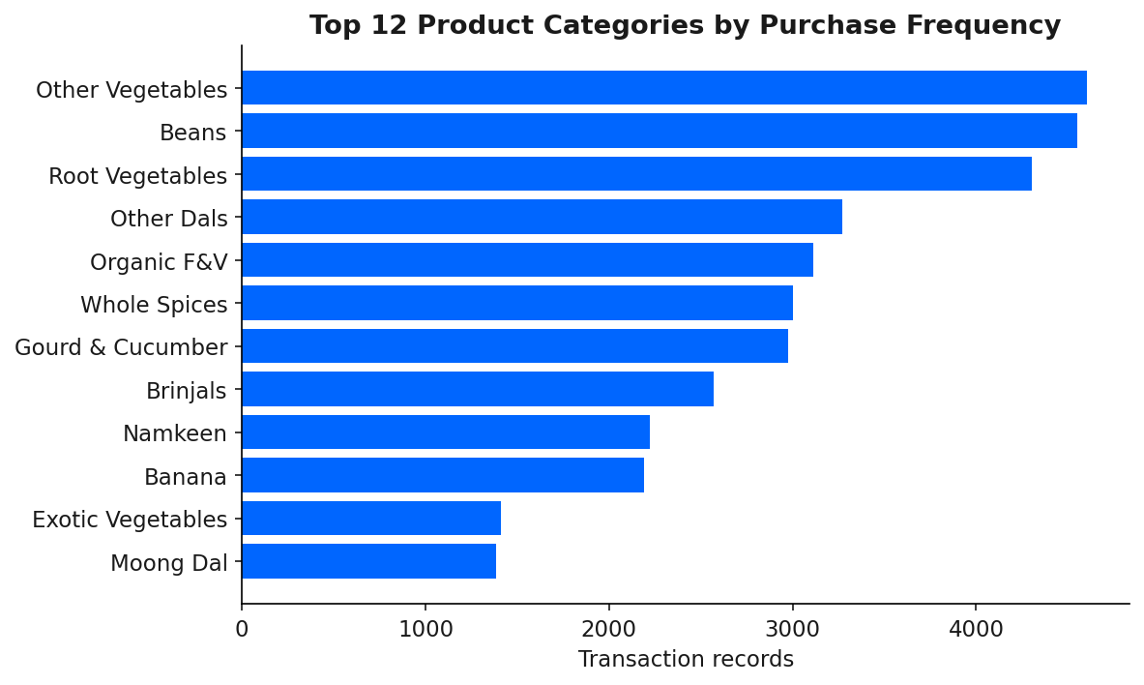
04 · CATEGORIES
Most Popular Product Categories
Fresh produce leads.
Other Vegetables (4,606), Beans (4,549) and Root Vegetables (4,303) are the three most-purchased categories.
The top 10 categories make up 52.8% of all purchase records — demand is concentrated in vegetables, dals and staples.
BigBasket Analytics · 5/10

Slide 6
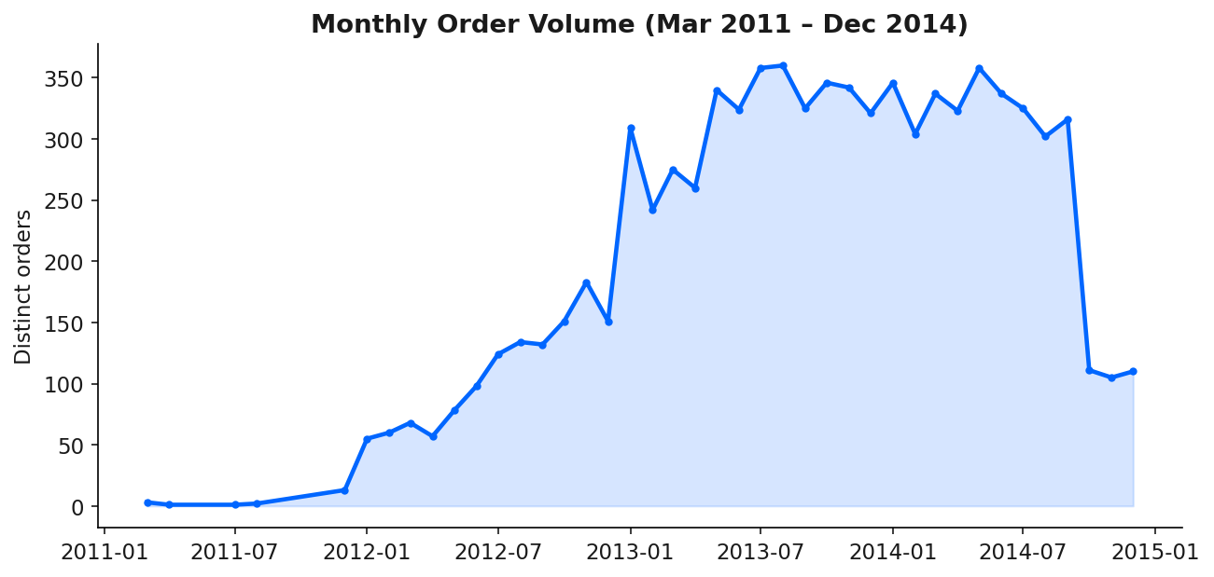
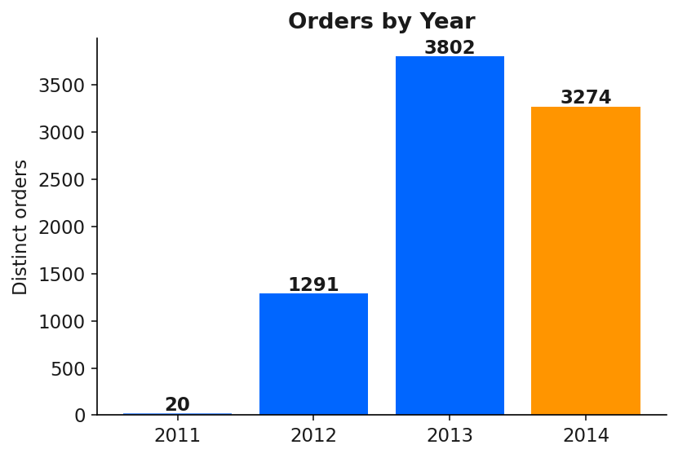
05 · TRENDS
Purchasing Trends Over Time
Orders ramped sharply from 1,291 (2012) to 3,802 (2013) as the base matured, then held at 3,274 in 2014. 41 months of activity, March 2011 – December 2014.
BigBasket Analytics · 6/10

Slide 7
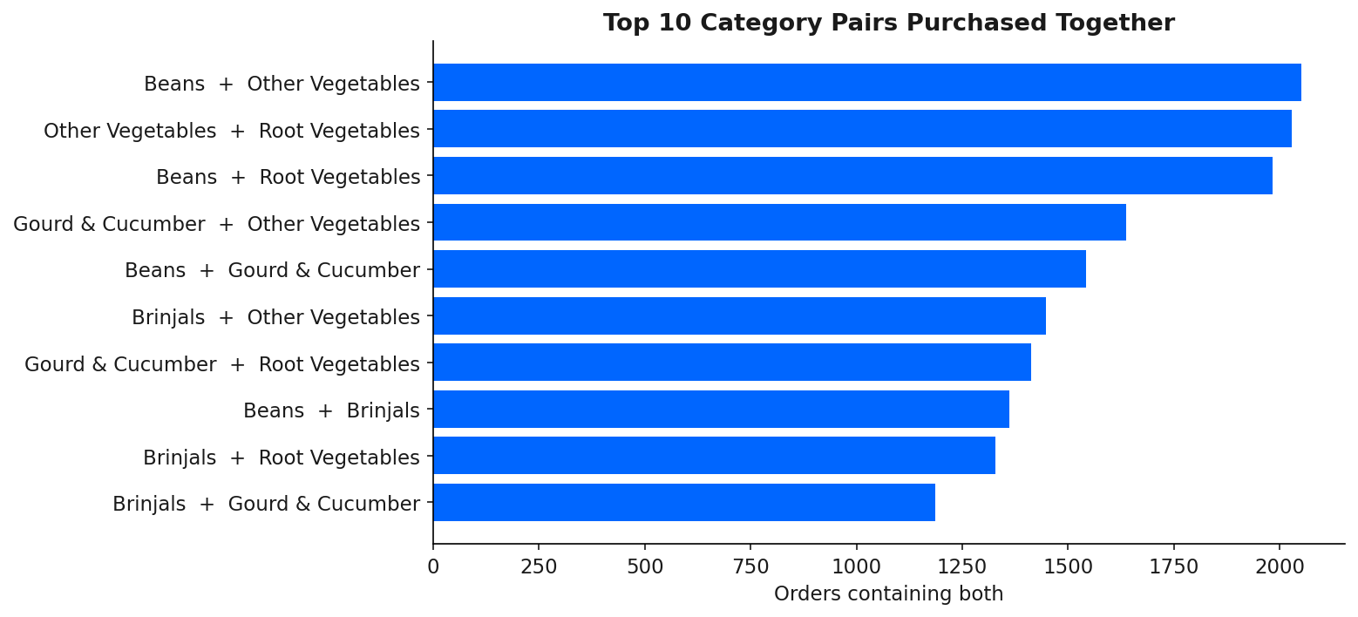
06 · MARKET BASKET
Market Basket Analysis — What Sells Together
Highest-lift affinities
Pair | Lift | Conf.
Almonds ↔ Cashews | 5.63 | 35%
Snacky Nuts → Namkeen | 3.67 | 54%
Urad Dal ↔ Boiled Rice | 3.24 | 33%
Urad Dal ↔ Toor Dal | 3.12 | 48%
Moong Dal ↔ Other Dals | 2.46 | 57%
Two cross-sell layers: high-lift niche bundles (nuts, dals) and high-volume staple pairs (vegetables co-occur in ~24% of orders).
BigBasket Analytics · 7/10

Slide 8
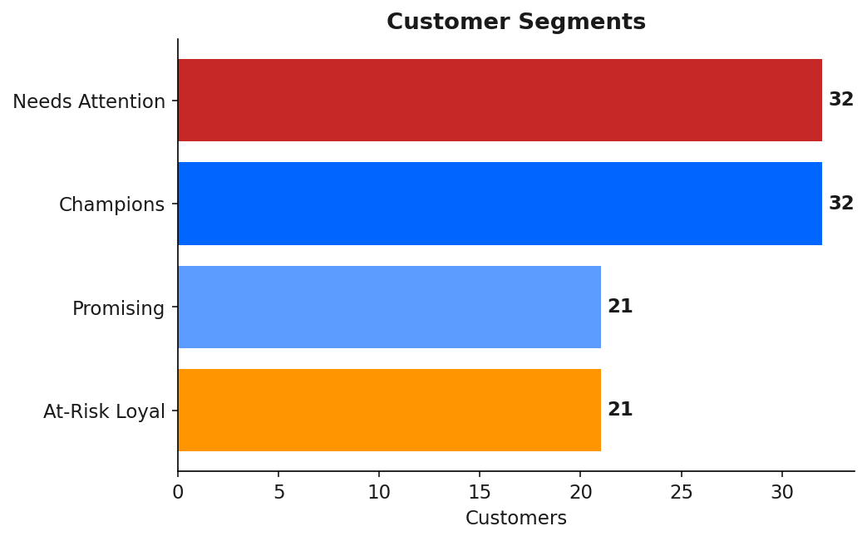
07 · SEGMENTS
Customer Segmentation
32 · Champions
Avg 107 orders, 3.6 days since last order. Reward & retain.
21 · At-Risk Loyal
Avg 97 orders but ~52 days lapsed. Highest win-back priority.
21 · Promising
Recent but lower frequency. Nurture to grow order count.
32 · Needs Attention
Low frequency and lapsing. Re-engage with targeted offers.
BigBasket Analytics · 8/10

Slide 9
08 · ACTIONS
Recommendations
Cross-sell bundles
Win-back campaign
Inventory focus
Bundle high-lift pairs: Almonds+Cashews, dal combos (Urad+Toor+Moong), Snacky Nuts+Namkeen.
Target the 21 At-Risk Loyal customers — historically frequent, now lapsing ~52 days.
Prioritize always-on stock for fresh produce — it anchors ~24% of all baskets.
Grow Promising
Category promos
Collect price & qty
Nurture the Promising segment with frequency incentives and reorder nudges.
Run promotions across vegetables & dals where demand is concentrated.
Capture price, quantity and cost to unlock revenue, AOV, margin and CLV analysis.
BigBasket Analytics · 9/10

Slide 10
09 · APPENDIX
Deliverables & Limitations
Deliverables produced
Limitations
Cleaned, standardized transaction dataset (CSV)
Excel analytics workbook — 8 sheets, ready for Power BI / Tableau
KPIs · Categories · Monthly & Yearly Trends
Customers · Segments · MBA Rules · Top Pairs
This insights report (PowerPoint)
No pricing or quantity data — revenue, profit and margin cannot be measured.
Only 106 customers — results may not generalize to the full business.
Repeat-order behavior is a retention proxy, not a cohort-based retention rate.
Associations are descriptive correlations — they do not prove causation.
BigBasket Analytics · 10/10

