Slide 1
Predictive Modelling Bankruptcy Data
Cute 03 Presentation – Group 05
KC Vamsi Krishna, Dinesh Kumar V, Kamalesh K K
02 September 2017

Slide 2
“Logistic Regression –Financial Data"
Objective : The goal of this activity is to predict bankruptcy status based on financial data of multiple business entities
Analysis Steps:
Data Import ,Study – Descriptive Statistics
Data Pre-processing – Feature Engineering
Model Building – Choosing appropriate ML Algorithm
Prediction with test results
Visualisation and Report

Slide 3
“Logistic Regression –Banks Financial Data"
DATA Description
Attr1 net profit / total assets
Attr2 total liabilities / total assets
Attr3 working capital / total assets
Attr4 current assets / short-term liabilities
Attr5 [(cash + short-term securities + receivables - short-term liabilities) / (operating expenses - depreciation)] * 365
Attr6 retained earnings / total assets
Attr7 EBIT / total assets
Attr8 book value of equity / total liabilities
Attr9 sales / total assets
Attr10 equity / total assets
Attr11 (gross profit + extraordinary items + financial expenses) / total assets
Attr12 gross profit / short-term liabilities
Attr13 (gross profit + depreciation) / sales
Attr14 (gross profit + interest) / total assets
Attr15 (total liabilities * 365) / (gross profit + depreciation)
Attr16 (gross profit + depreciation) / total liabilities
Attr17 total assets / total liabilities
Attr18 gross profit / total assets
Attr19 gross profit / sales
Attr20 (inventory * 365) / sales

Slide 4
“Logistic Regression –Banks Financial Data"
DATA Description Contd…
Attr21 sales (n) / sales (n-1)
Attr22 profit on operating activities / total assets
Attr23 net profit / sales
Attr24 gross profit (in 3 years) / total assets
Attr25 (equity - share capital) / total assets
Attr26 (net profit + depreciation) / total liabilities
Attr27 profit on operating activities / financial expenses
Attr28 working capital / fixed assets
Attr29 logarithm of total assets
Attr30 (total liabilities - cash) / sales
Attr31 (gross profit + interest) / sales
Attr32 (current liabilities * 365) / cost of products sold
Attr33 operating expenses / short-term liabilities
Attr34 operating expenses / total liabilities
Attr35 profit on sales / total assets
Attr36 total sales / total assets
Attr37 (current assets - inventories) / long-term liabilities
Attr38 constant capital / total assets
Attr39 profit on sales / sales
Attr40 (current assets - inventory - receivables) / short-term liabilities
Attr41 total liabilities / ((profit on operating activities + depreciation) * (12/365))
Attr42 profit on operating activities / sales
Attr43 rotation receivables + inventory turnover in days

Slide 5
“Logistic Regression –Banks Financial Data"
DATA Description Contd…
Attr44 (receivables * 365) / sales
Attr45 net profit / inventory
Attr46 (current assets - inventory) / short-term liabilities
Attr47 (inventory * 365) / cost of products sold
Attr48 EBITDA (profit on operating activities - depreciation) / total assets
Attr49 EBITDA (profit on operating activities - depreciation) / sales
Attr50 current assets / total liabilities
Attr51 short-term liabilities / total assets
Attr52 (short-term liabilities * 365) / cost of products sold)
Attr53 equity / fixed assets
Attr54 constant capital / fixed assets
Attr55 working capital
Attr56 (sales - cost of products sold) / sales
Attr57 (current assets - inventory - short-term liabilities) / (sales - gross profit - depreciation)
Attr58 total costs /total sales
Attr59 long-term liabilities / equity
Attr60 sales / inventory
Attr61 sales / receivables
Attr62 (short-term liabilities *365) / sales
Attr63 sales / short-term liabilities
Attr64 sales / fixed assets
Target (Bankcruptcy Status) Yes or No

Slide 6
Analysis Steps
Modeling Techniques
Random Forest
Cross validation
Descriptive Analytics
Feature plots (bar, histogram, boxplot)
Outliers
Missing Values
Visualization
Summarize
Training and Testing prediction
Plots
01
03
05
02
04
Feature Engineering
Normalizing Numerical data
Factorization
Categorical data
Outlier removal
Imputation
Testing / Evaluation
Testing performance
Confusion Matrix

Slide 7
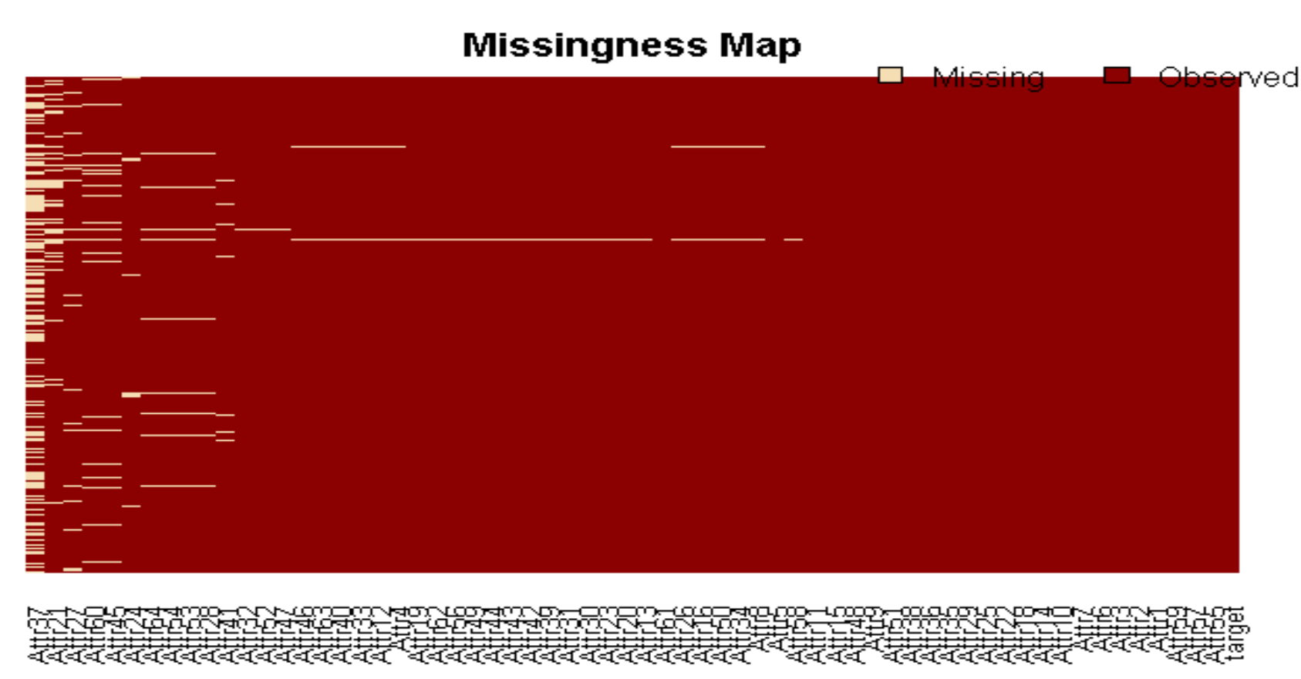
Descriptive Analytics – Missing values
Attributes missing value status Is indicated in descending order; # Attr17 has many zero values
Attribute "Attr37" and "Attr21" has 18836 and 5836 NAs respectively ; These attributes are dropped

Slide 8
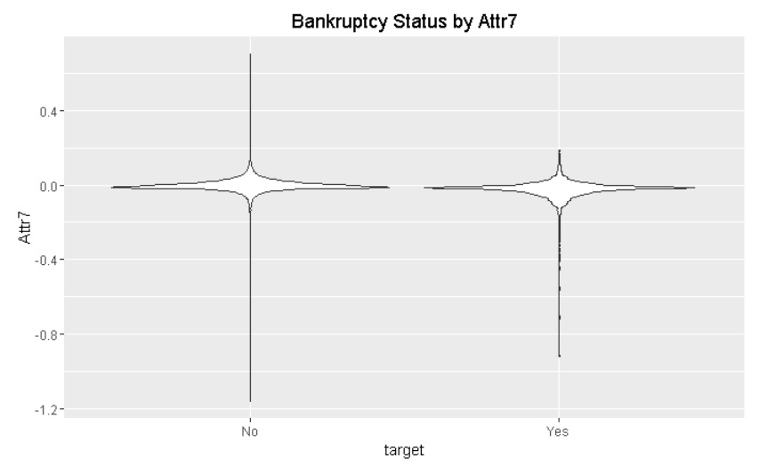
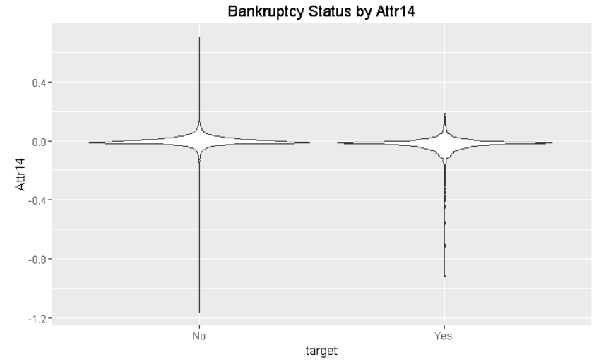
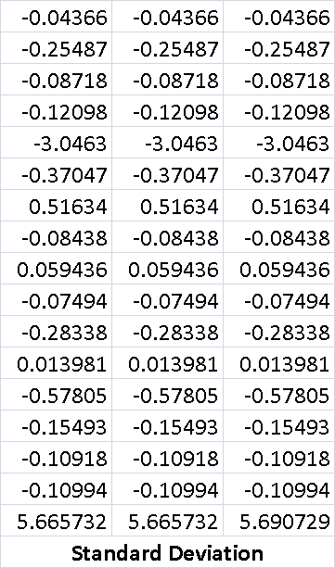
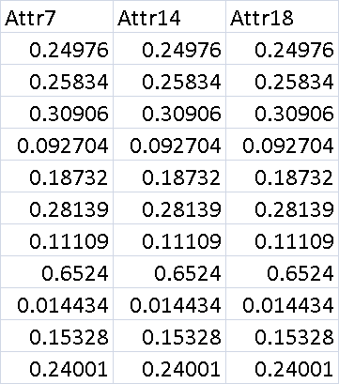
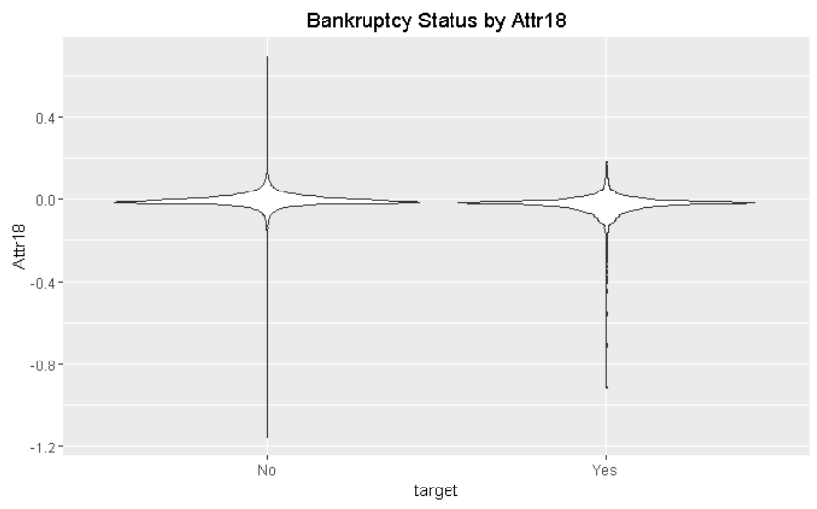
OBSERVATION
Descriptive Analytics –Feature Engineering
Removal of Features – Attr14,Attr18
Duplicates Features Attr7,Attr14 and Attr18

Slide 9
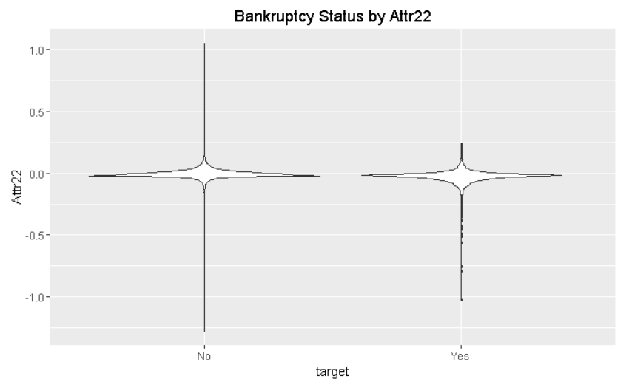
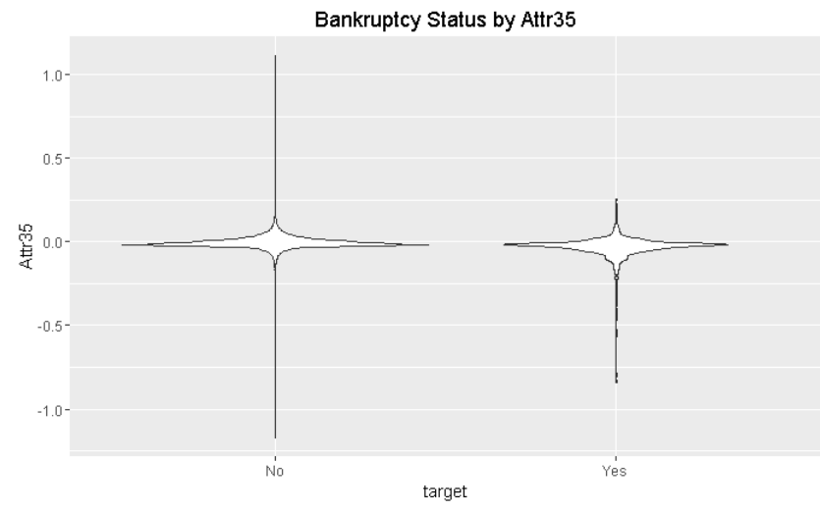
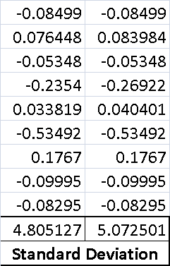
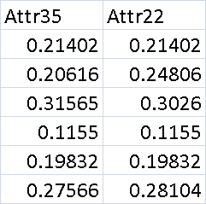
OBSERVATION
Descriptive Analytics –Feature Engineering
Removal of Features – Attr35
Duplicates Features between Attr22 and Attr35

Slide 10
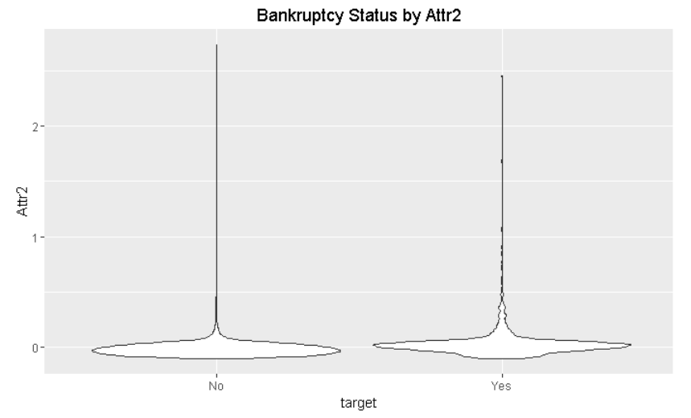
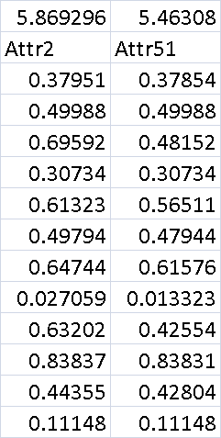
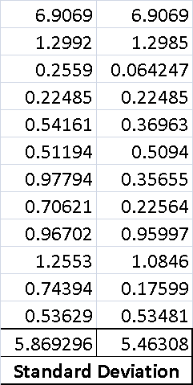
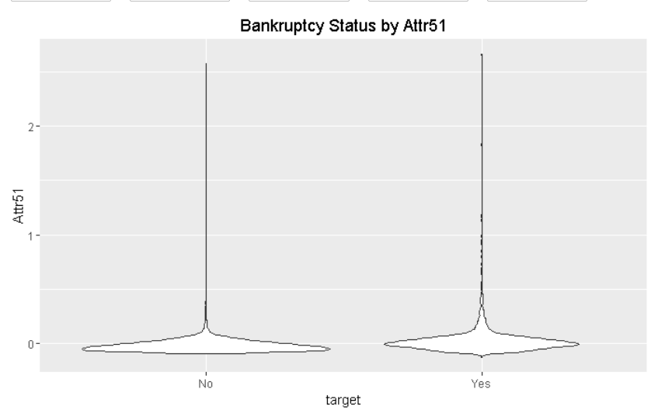
OBSERVATION
Descriptive Analytics –Feature Engineering
Removal of Features – Attr51
Duplicates Features between Attr2 and Attr51

Slide 11
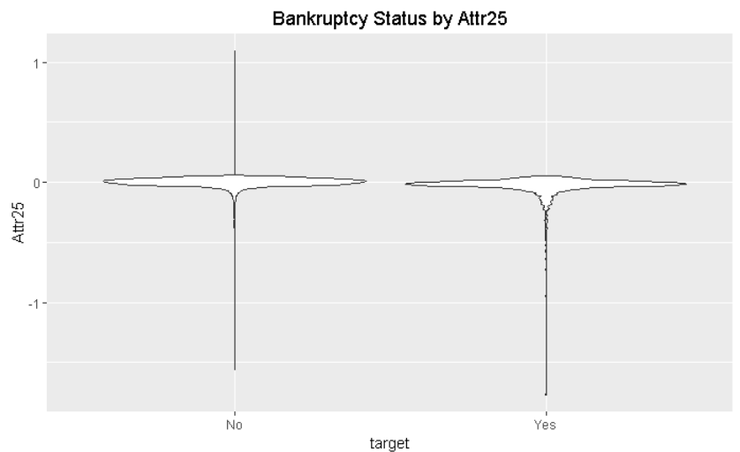
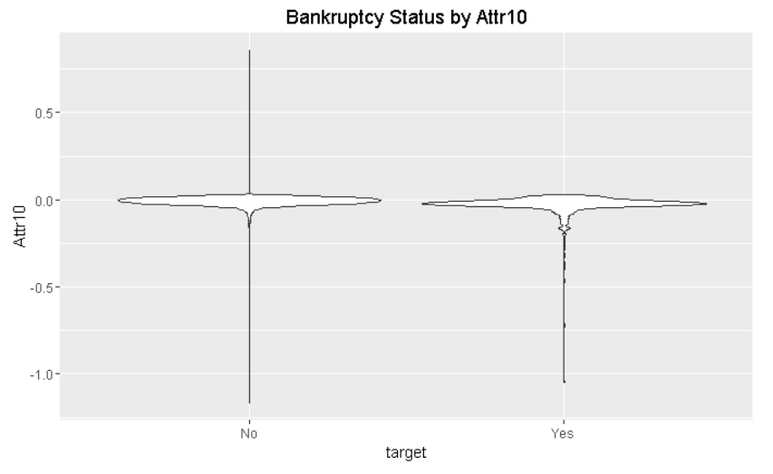
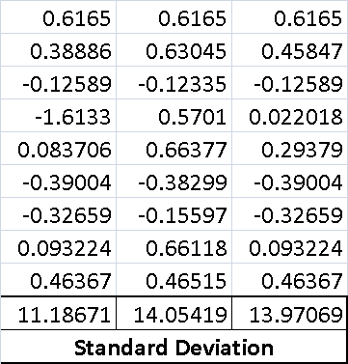
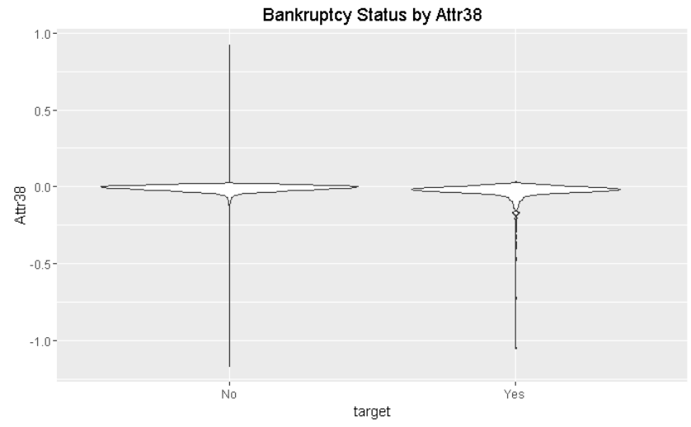
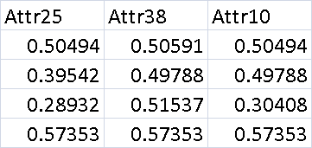
OBSERVATION
Descriptive Analytics –Feature Engineering
Removal of Features – Attr25, Attr38
Duplicates Features between Attr10, Attr25 and Attr38

Slide 12
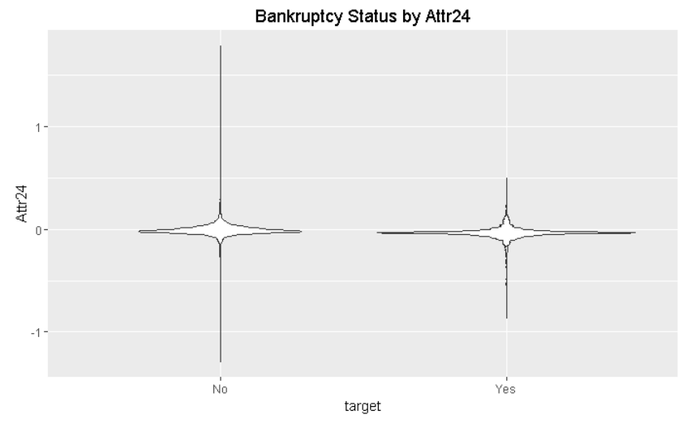
Descriptive Analytics –Relevant Featues
Bankruptcy No: Level ‘0’
Bankruptcy Yes: Level ‘1’

Slide 13
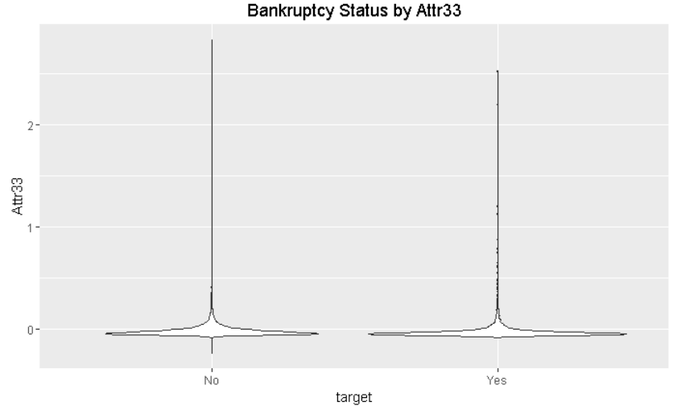
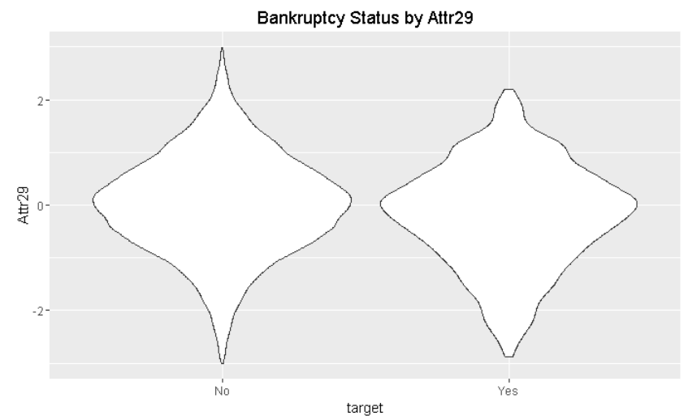
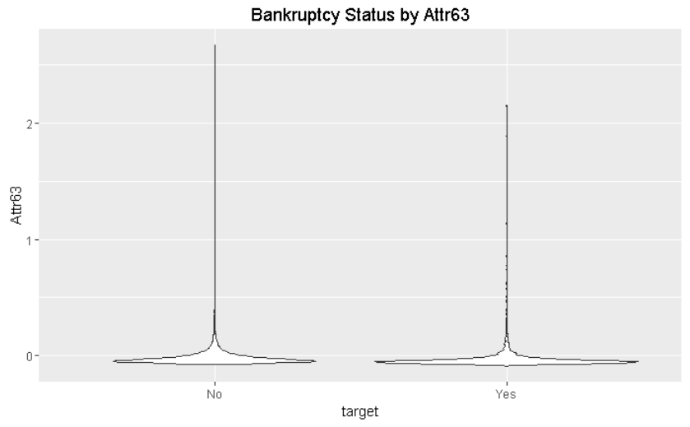
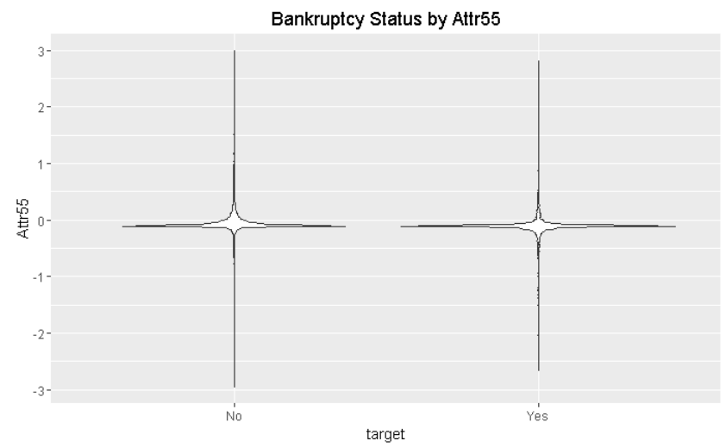
Descriptive Analytics –Relevant Featues
Bankruptcy No: Level ‘0’
Bankruptcy Yes: Level ‘1’

Slide 14
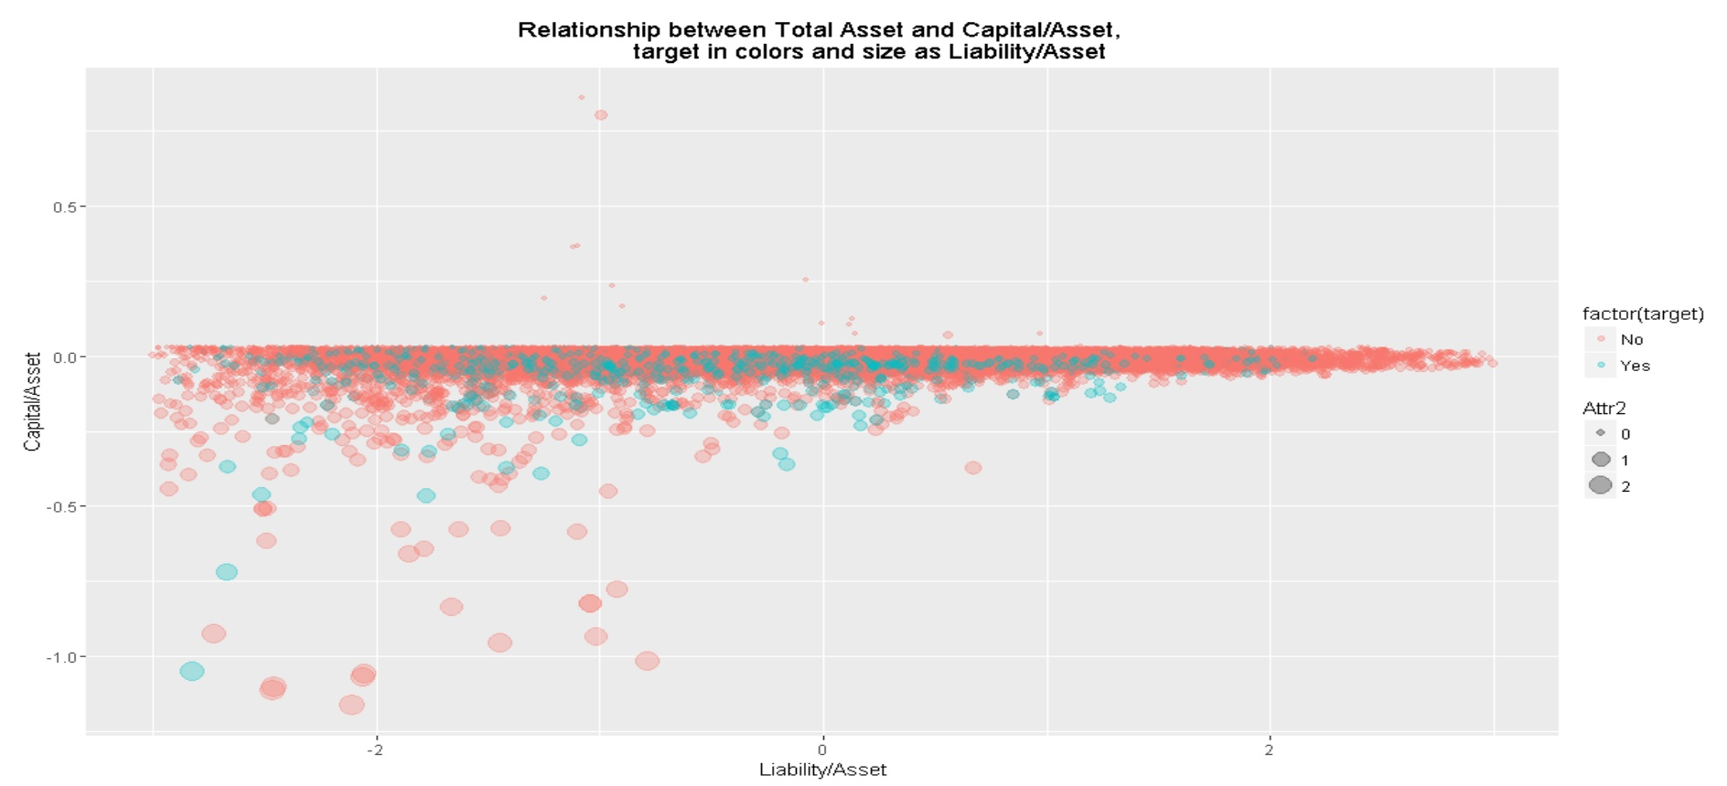
Descriptive Analytics –Relevant Featues
Plot between 2 numerical attributes ,another numerical attribute as bubble size ,targeting clusters

Slide 15
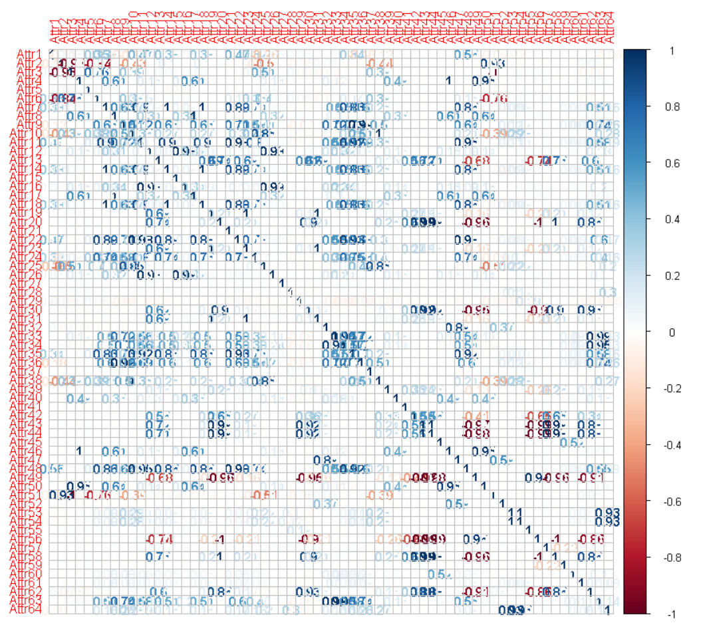
OBSERVATION
Descriptive Analytics –Correlation plot
Correlation is observed between many predictors
Random forest is best algorithm with cross-fold validation tuning considering Multi-collinearity and 50+ feature space
Bankruptcy No: Level ‘0’
Bankruptcy Yes: Level ‘1’

Slide 16
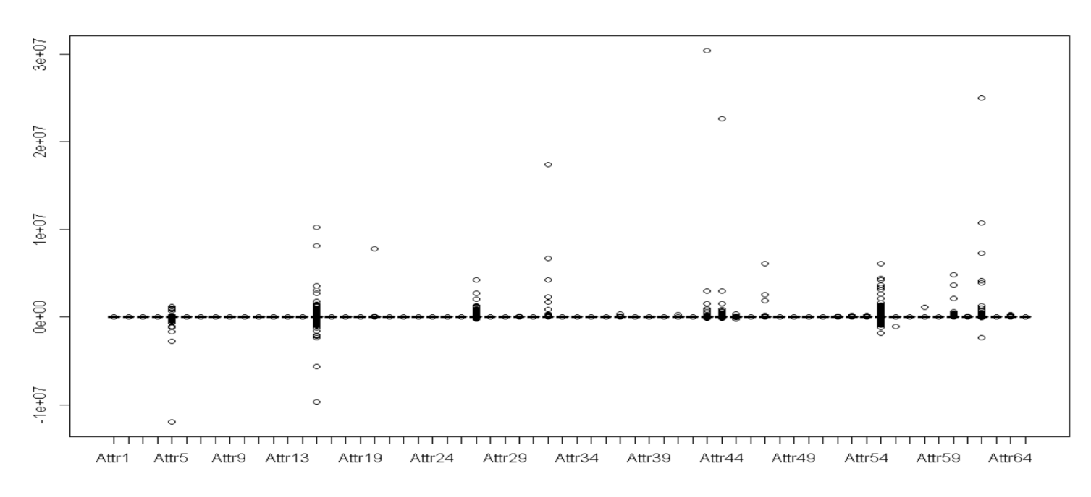
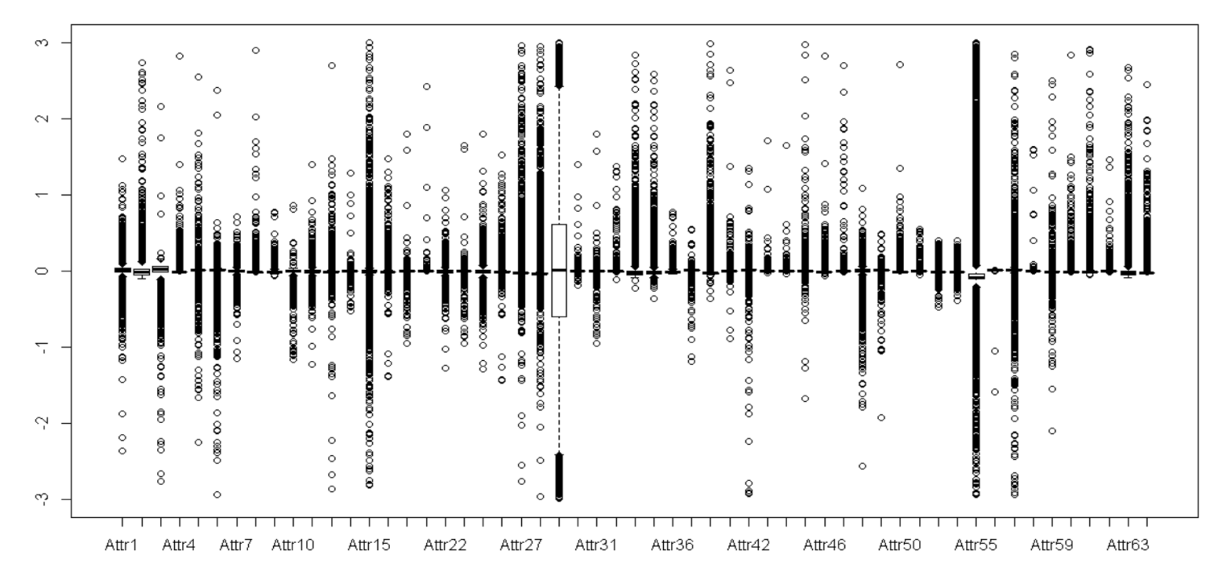
Descriptive Analysis Summary
OBSERVATION
Bank data received is sparse (top left image)
Box plot distribution of data after normalising and outlier removal
Duplicate features are removed
Data with in 3 Standard Deviation is considered for study across all attributes
2.5% data is ignored outside 3 standard deviation

Slide 17
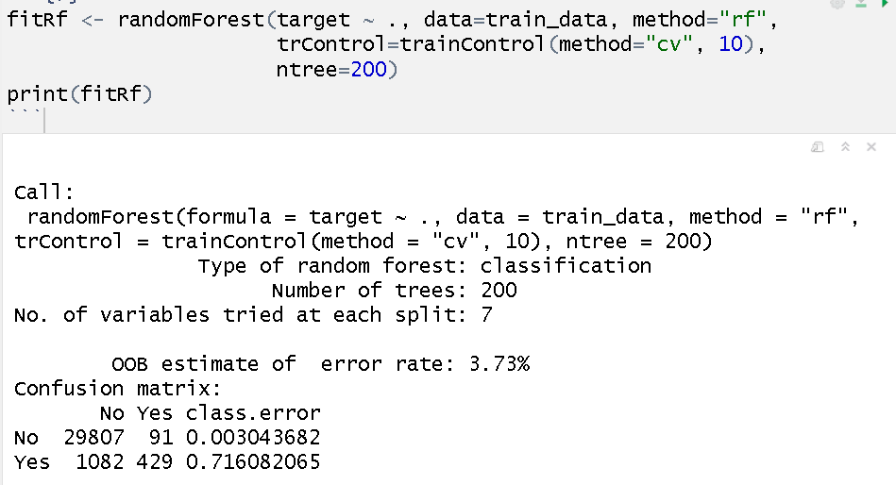
Modelling Random Forest
55 Attributes are considered out of 64 attributes
Random forest with cross fold validation is performed
No of trees 200 upon tuning with metrics
Mtry – 7 chosen by algorithm
(square root of 55)

Slide 18
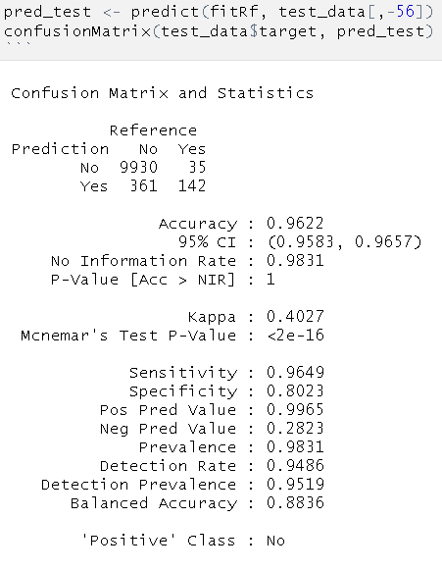
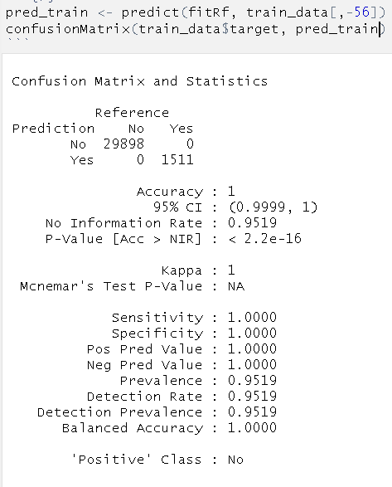
Results Random Forest – 55 features
 | Dataset
Metrics | Training | Testing
TP | 29898 | 9930
TN | 1511 | 142
FP | 0 | 35
FN | 0 | 361
Accuracy | 100.0 % | 96.2 %
Specificity | 100.0 % | 80.2 %
Sensitivity | 100.0 % | 96.5%
F1 score | 100 % | 98.0 %

Slide 19
Observation
Duplicate Features:
Multiple features are removed by observing relevant plots and actual values/Standard deviation
Outlier removal:
2.5 % of data points are removed to eliminate outliers
Feature space:
55 features are considered for final model

Slide 20
Challenges/Further Scope
Challenges
Unknown values (NA)
Few features have more than 1000 NA value
Data Imbalance
Data is more skewed towards class “Yes”
Further scope
More modelling techniques
Advanced prediction algorithm like en-sembling and bootstrap aggregation technique is to be implemented as further studies e.g Adaboost, XGB

