Slide 1
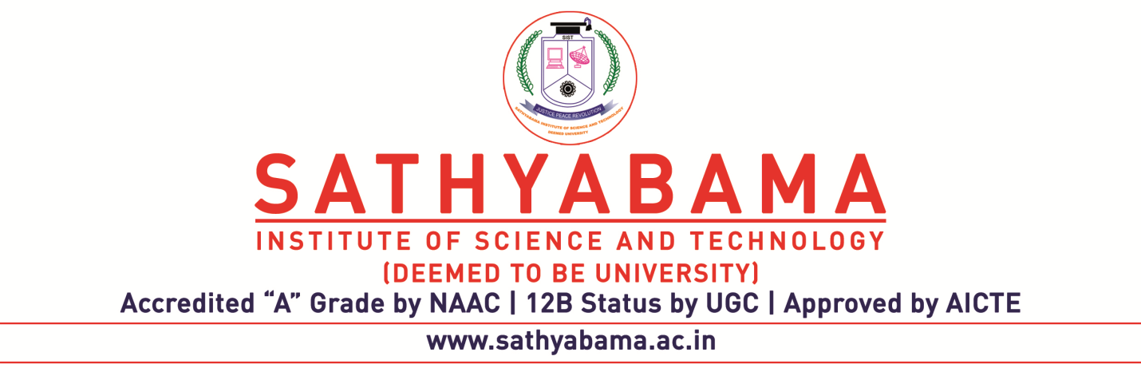
DIABETES RISK PREDICTION
Project Supervisor: Dr. J. Albert Mayan M.E.,Ph.D
Name of the Student: V. Vamsi Krishna
Register Number: 40111453

Slide 2
PRESENTATION OUTLINE
Course Certificate
Introduction
Objectives
Abstract
System Architecture
Project Implementation
Results and Discussions
Result Snapshots
Conclusion & Future work
References

Slide 3
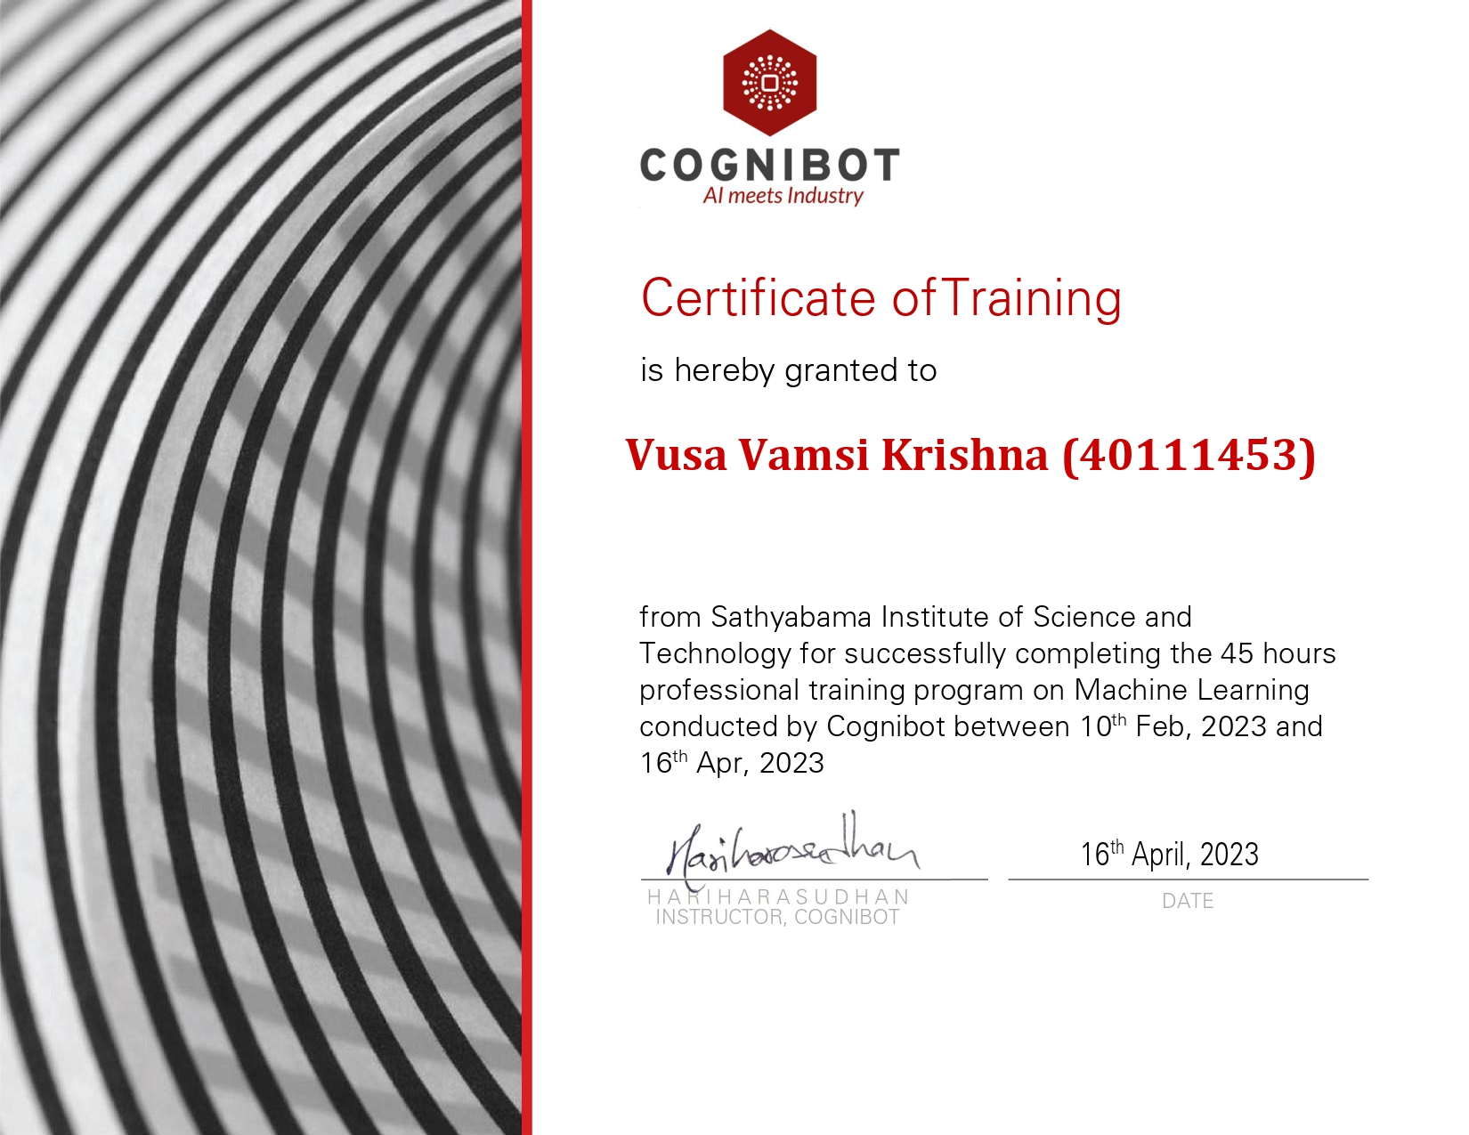
COURSE CERTIFICATE

Slide 4
INTRODUCTION
A diabetics risk prediction machine learning model which helps in early detection of diabetics with known attributes, which is demonstrating now.
For this project we used machine learning using python because ML provides better result for prediction by constructing different models from the datasets collected from various patients.
The main purpose of this project is to show how the machine learning can solve our real world problems and to showcase the different dimensions in machine learning.
So, we have taken diabetics problem and followed all the steps in this process to achieve the outcome with a good accuracy.

Slide 5
OBJECTIVES
The Objective of this project is to develop a system which can perform early prediction of diabetes for a patient with a higher accuracy by machine learning techniques.
To achieve this goal we gathered diagnostic dataset having 17 attributes of 520 patients.
Based on this attributes, we figured to use Random Forest Classifier Machine learning techniques to predict Diabetes with higher accuracy.
We also chosen python language for machine learning because in python there are various built in libraries which helps in building models easily .

Slide 6
ABSTRACT
Diabetes is a chronic disease or group of metabolic disease where a person suffers from an extended level of blood glucose in the body, which is either the insulin production is inadequate, or because the body’s cells do not respond properly to insulin.
Early prediction of such disease helpful for control over it. To achieve this goal we gathered diagnostic dataset having 17 attributes of 520 patients. Based on this attributes, we figured to use Random Forest Classifier Machine learning Algorithm to predict Diabetes.
Random forest classifier will handle the missing values and maintain the accuracy of a large proportion of data. If there are more trees, it won't allow over-fitting trees in the model.

Slide 7
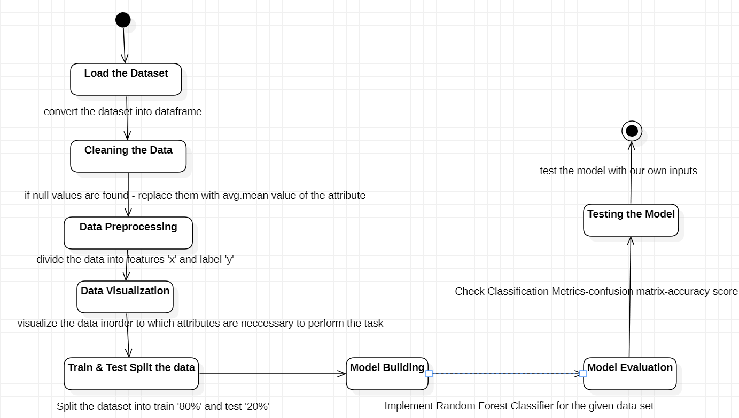
SYSTEM ARCHITECTURE

Slide 8
PROJECT IMPLEMENTATION
Software Requirements
Jupyter Notebook - Project environment
Numpy – Used to convert 1D arrays to 2D arrays
Pandas – Convert dataset into data-frame
Matplot , Seaborn – Used to visualize the dataset
SkLearn module – To import all types ML algorithms
Hardware Requirements
GPU
Any Operating System

Slide 9
PROJECT IMPLEMENTATION
To implement this project we need to follow the below steps
GetData :
Gather the diagnostic dataset of 520 patients.
DataCleaning :
Check for Null values and replace them with mean value of the column.
DataPreprocessing :
Divide the data into features(x) and label(y).

Slide 10
PROJECT IMPLEMENTATION
Train and Test:
Split the dataset into train(80%) and test(20%).
Model Selection :
Implement Random Forest Classifier for the given data set.
Model Evaluation :
Check Classification Metrics.

Slide 11
PROJECT IMPLEMENTATION
Here we choose random forest classifier model because our prediction feature is a discrete class label. Random forest classifier is a ensemble learning model that operates by constructing a multitude of decision trees at training time.
For classification tasks the output of the random forest is the class selected by most trees so that our accuracy will also be high.
From SkLearn.ensemble we import Randomforest classifier into our Model
Model.fit () is used for training model and Model.predict() is used for prediction.

Slide 12
RESULTS AND DISCUSSION
Confusion matrix and it’s related metrics given a good score ,So by this we can conclude that our model performed well.
Hence, we can say that our model is pretty good because by implementing all the steps above mentioned we got an accuracy equal to 99%.Therefore,it is a good model and our predictions will be effective .

Slide 13
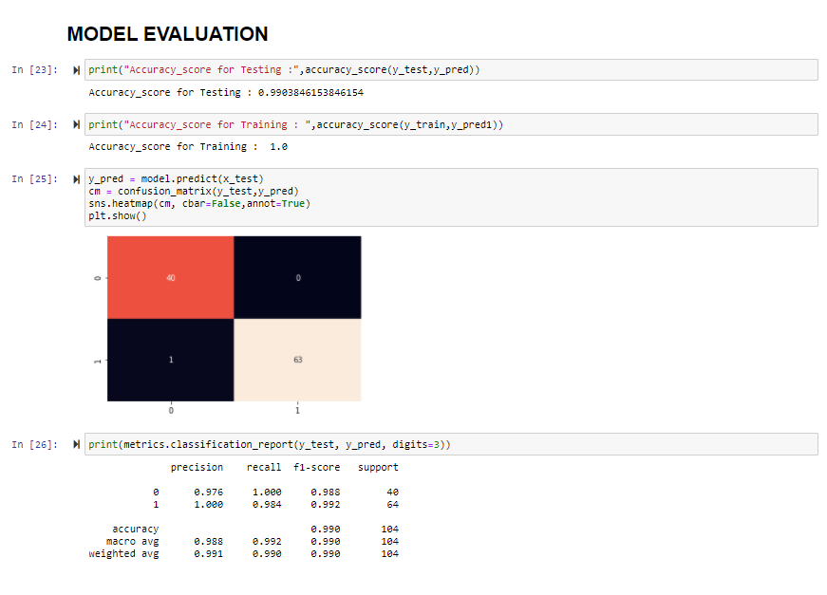
RESULT SNAPSHOTS

Slide 14
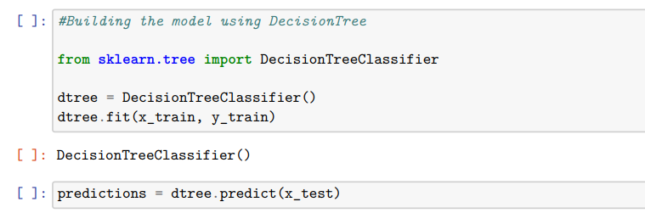
RESULT SNAPSHOTS

Slide 15
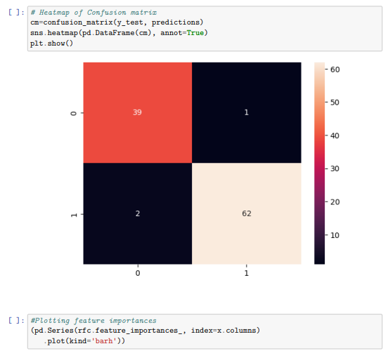
RESULT SNAPSHOTS

Slide 16
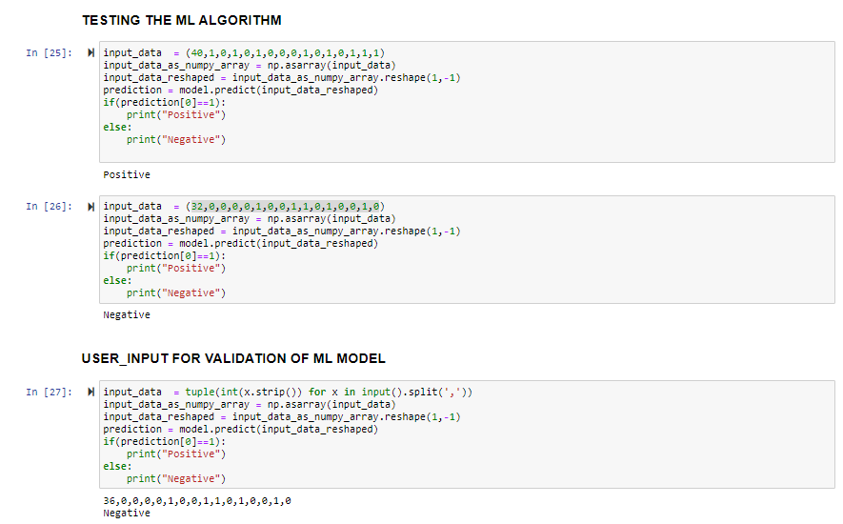
RESULT SNAPSHOTS

Slide 17
CONCLUSION & FUTURE WORK
Machine learning approaches work well for diagnosis of diabetes. It performs very well with medical datasets. Prediction of diabetes at early stage helps the patient in order to provide appropriate treatment.
I had taken a wide range of research about different ML Algorithms and finally choose random forest classifier approach to solve this problem.
In this project we implement random forest classifier approach and we observed that it given a good accuracy and performed well.
In the process of research, I came to know about the various ML techniques and it’s different algorithms which helps to solve real-world problems.

Slide 18
REFERENCES
[1]
[2]
[3]
[4]
[5]
https://archive.ics.uci.edu/ml/datasets/Early+stage+diabetes+risk+prediction+dataset.
https://www.healthline.com/health/diabetes.
https://www.python.org/doc/
https://scikit-learn.org/stable/.
https://towardsdatascience.com/understanding-random-forest-58381e0602d2.

Slide 19


