Slide 1
INTRUSION DETECTION SYSTEM USING MACHINE LEARNING TECHNIQUES

Slide 2
INTRUSION DETECTION SYSTEM USING MACHINE LEARNING TECHNIQUES
TEAM MEMBERS:
K.VAMSI MOHAN REDDY(19091A05H3)
A.SAI THANU SREE(19091A05C7)
L.VASAVI(19091A05H4)
Under the guidance of
Dr. N MADHUSUDHANA REDDY M.Tech , Ph.D.
PROFESSOR
COMPUTER SCIENCE AND ENGINEERING

Slide 3
CONTENTS
INTRODUCTION
EXISTING SYSTEM
DRAWBACKS OF EXISTING SYSTEM
PROPOSED SYSTEM
ADVANTAGES OF PROPOSED SYSTEM
SYSTEM REQUIREMENTS
MODULES
UML DIAGRAMS
RESULTS
CONCLUSION
REFERENCES

Slide 4

INTRODUCTION
The need to secure the data integrity & confidentiality has increased as the network attacks are increasing .
Intrusion Detection System monitors & analyzes the data to detect intrusions in the system.
Machine learning techniques provides the flexibility to the system i.e., if any new attack is developed the system can be trained for predicting the attack.

Slide 5
EXISTING SYSTEM
In real cyberspace, malicious cyber-attacks are resulting in a high imbalance of data.
Cyber-attacks can hide in a large amount of normal traffic.
The concept of Difficult Set Sampling Technique(DSSTE) algorithm is used to tackle the class imbalance problem in network traffic.
This method reduces the imbalance and makes the classification model learn difficult samples.

Slide 6
DRAWBACKS OF EXISTING SYSTEM
By using Difficult Set Sampling technique there is a chance of overfitting of data as like in random over sampling.
This technique balances the data by replicating the minority samples.
In this case dataset is prone to overfitting as same information is copied.

Slide 7
PROPOSED SYSTEM
It aims to classify the type of network attack using machine learning algorithms.
The dataset is Over Sampled using SMOTE (Synthetic Minority Over Sampling Technique) and the algorithms XG-Boost (Extreme Gradient Boosting) classifier, LSTM (Long Term Short Memory) are used for classification.

Slide 8
ADVANTAGES OF PROPOSED SYSTEM
High accuracy on detection rate.
Comparison of various algorithms can be done easily.

Slide 9
REQUIREMENTS
SOFTWARE REQUIREMENTS:
Software : Jupyter notebook or Google Colab
Programming language : Python
Operating System : Windows 7 and above (using windows 11)
HARDWARE REQUIREMNTS:
Hard Disk Drive : 512 GB or more
Processor : using core i5
RAM : using 8 GB

Slide 10
MODULES
MODULE 1 - Data Preprocessing:
The dataset is explored, the categorical attributes are converted into numeric attributes by Label Encoding.
The class label is explored, the attack types with negligible values are replaced with the label as ‘others’.
normal = 0 , neptune = 1 , others = 2

Slide 11
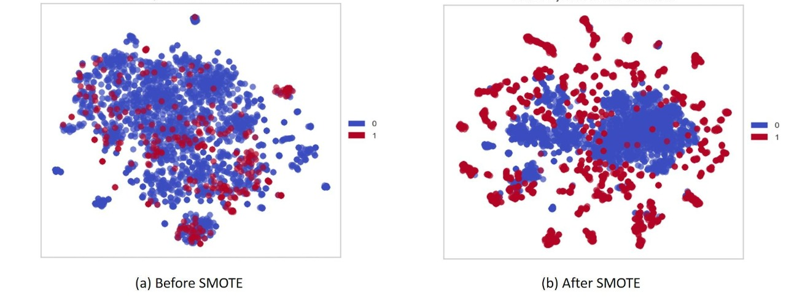
MODULE 2 - Sampling Technique:
SMOTE is an oversampling technique where the synthetic samples are generated for the minority class. This algorithm helps to overcome the overfitting problem posed by random oversampling.

Slide 12
MODULE 3 - Modelling :
XG-Boost:
XG-Boost is a scalable and highly accurate implementation of gradient boosting, being built largely for energizing machine learning model performance and computational speed.
It improves the accuracy of intrusion detection, the detection method becomes more effective and more accurate.
LSTM:
Long Short-Term Memory (LSTM) has the ability to remember values over arbitrary intervals. It is a suitable method to classify and predict known and unknown intrusions.
It is designed to avoid the long-term dependency issue, LSTM can remember data for long periods.

Slide 13
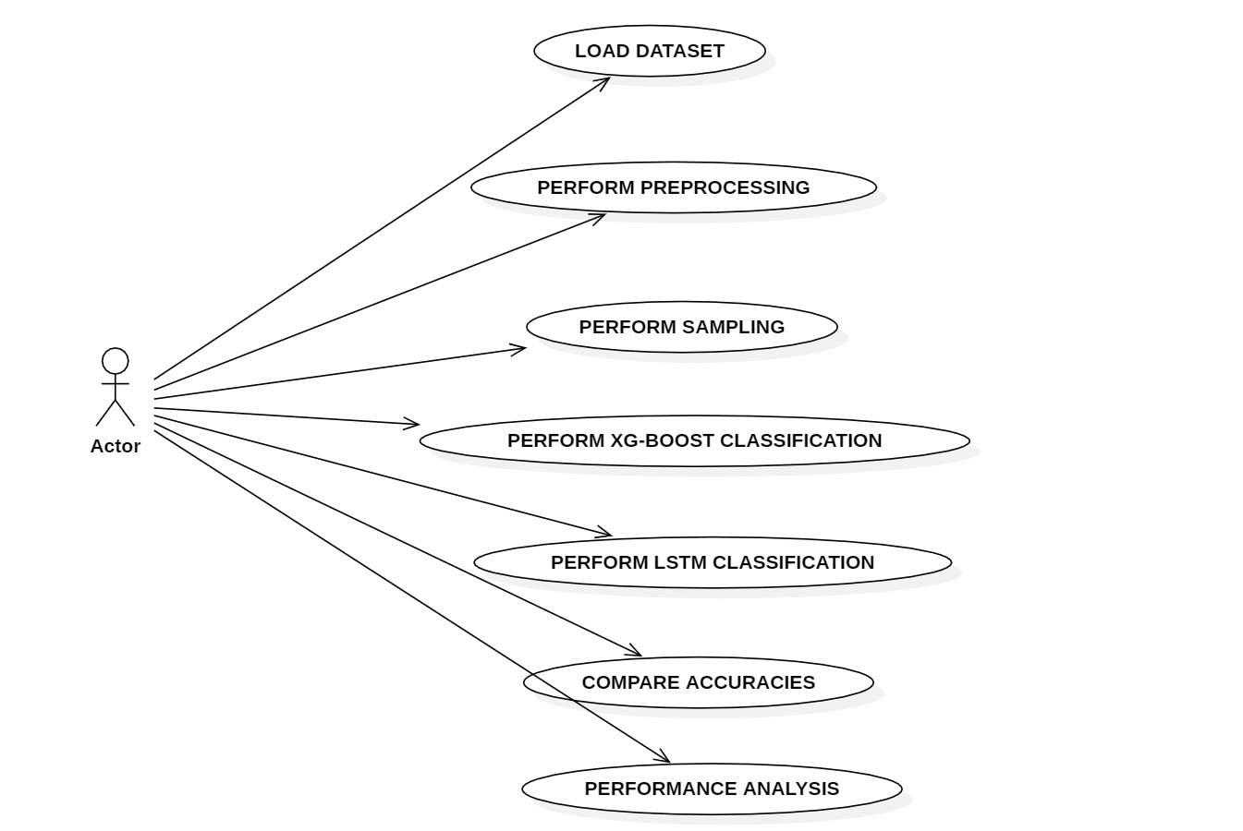
UML DIAGRAMS
USE CASE DIAGRAM

Slide 14
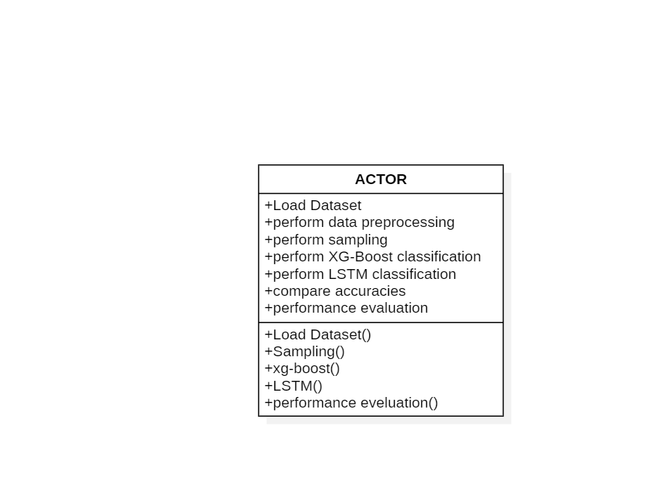
CLASS DIAGRAM

Slide 15
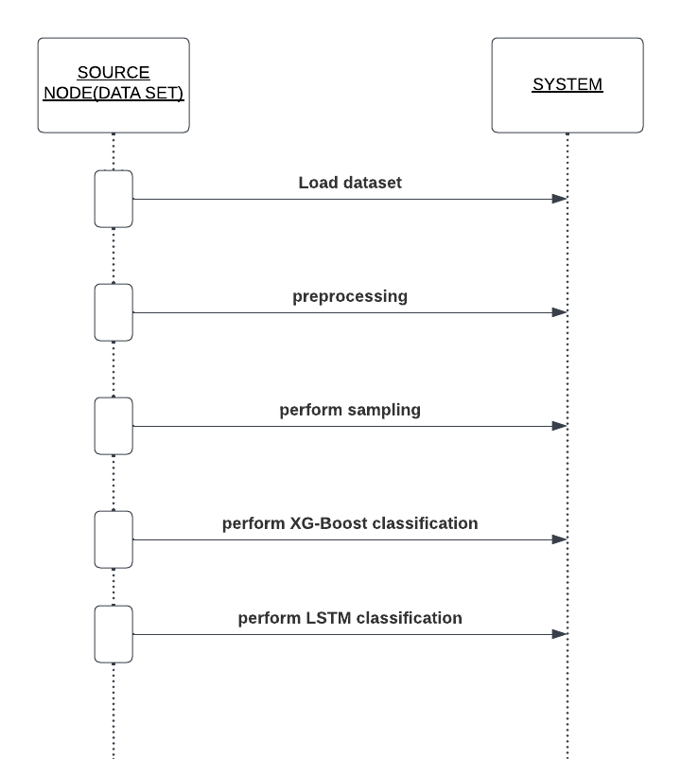
SEQUENCE DIAGRAM

Slide 16
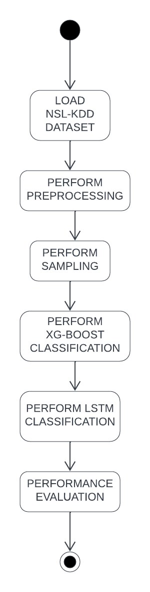
ACTIVITY DIAGRAM

Slide 17
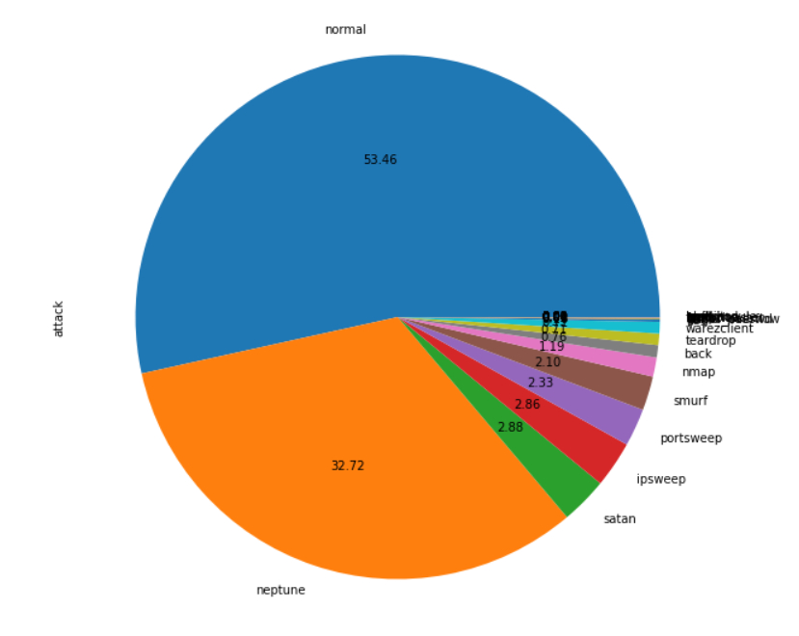
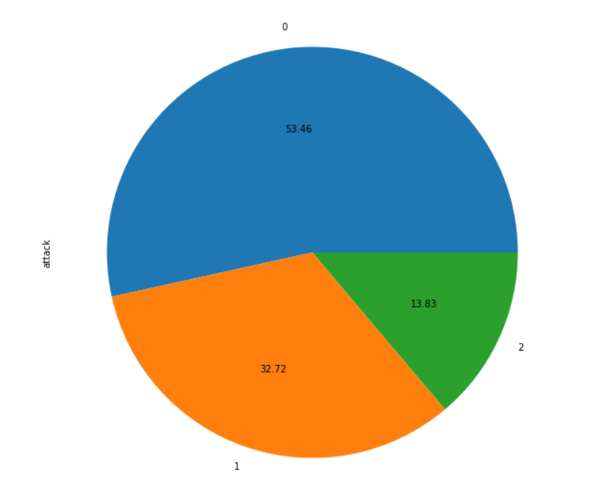
RESULTS
Preprocessing module is implemented and class labels are replaced as required i.e; normal=0, neptune=1, others=2
The representation of class labels after preprocessing is as below:

Slide 18
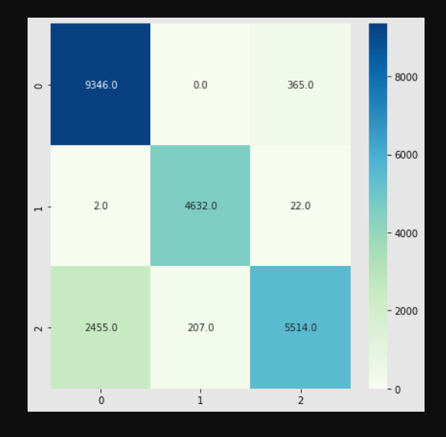
The confusion matrix representation of XG-Boost classification is resulted as below

Slide 19
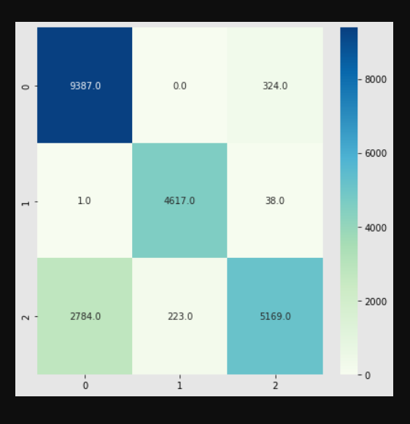
The confusion matrix of LSTM classifier is resulted as below

Slide 20
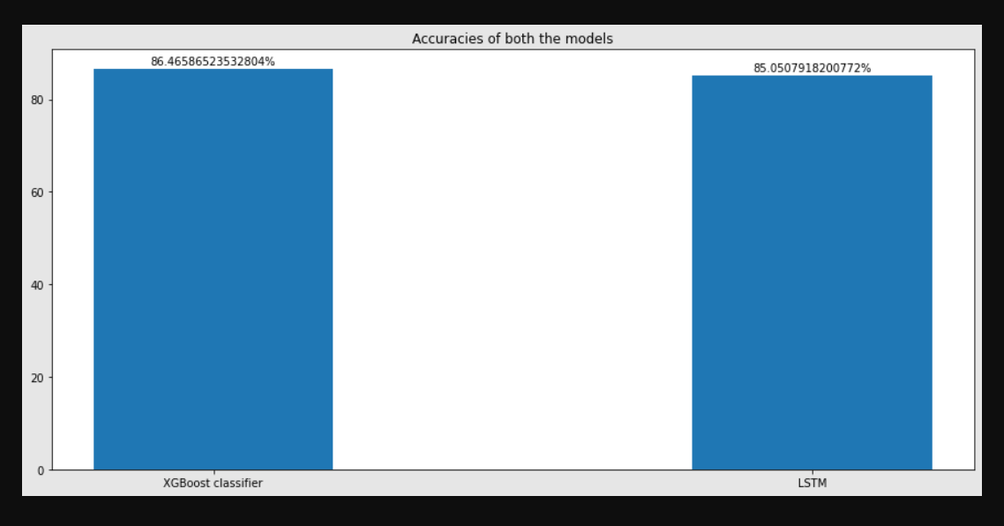
The accuracy comparision of both models are represented as below

Slide 21
CONCLUSION
The pressure on network intrusion detection increases as network intrusion continues to evolve. The proposed model is predictive and is capable of distinguishing between anomaly connections(intrusions) and normal connections.
The increased number of minority samples can reduce the imbalance of network traffic and improve the classification accuracy.
Two classification methods, XGBoost and LSTM are combined with SMOTE sampling technique.
Experiments are performed on NSL-KDD dataset, the results, and accuracies of XGBoost algorithm(Extreme Gradient Boosting) and LSTM algorithm(Long Short Term Memory) are compared. XGBoost algorithm classified better than LSTM algorithm with the accuracy of 87.15% .

Slide 22
REFERENCES
[1] Dhanabal, L. and Shantharajah, S.P. (2015) A Study of NSL-KDD Dataset for Intrusion Detection System Based on Classification Algorithms. International Journal of Advanced Research in Computer and Communication Engineering, 4, 446-452.
[2] D. A. Cieslak, N. V. Chawla, and A. Striegel, ‘‘Combating imbalance in network intrusion datasets,’’ in Proc. IEEE Int. Conf. Granular Comput., May 2006, pp. 732–737.
[3] M. S. Pervez and D. M. Farid, ‘‘Feature selection and intrusion classification in NSL-KDD cup 99 dataset employing SVMs,’’ in Proc. 8th Int. Conf. Softw., Knowl., Inf. Manage. Appl. (SKIMA), Dec. 2014, pp. 1–6.

Slide 23
THANK YOU

