Slide 1
PHISHING WEBSITE DETECTION
BY VAMSI

Slide 2
Overview
Introduction
Exploratory Analysis
The Model
Comparison of different Models
Conclusion

Slide 3
Introduction
Phishing is a form of identity theft that is usually made through emails or website in order to gain authorized access to user’s private information. Phishing websites are bogus sites, where a phishing attacker attracts victims to a spoofed website similar to a legitimate one, a so-called “phishing site”.
Once victims access the phishing site, then the attacker attempts to convince them to send their private information such as usernames, passwords and credit card resulting in stealing their information that might cost them over a billion dollars each year.

Slide 4
Exploratory Analysis
Exploratory analysis will help us to summarizing and visualizing the important characteristics and statistical properties of the data set.
By using ggplot2 bar charts the highly important features were plotted . This would give us a fair idea which feature plays a prominent role in phishing website detection.
By using the Bar charts, each feature was analyzed separately for detecting phishing and legitimate websites.

Slide 5
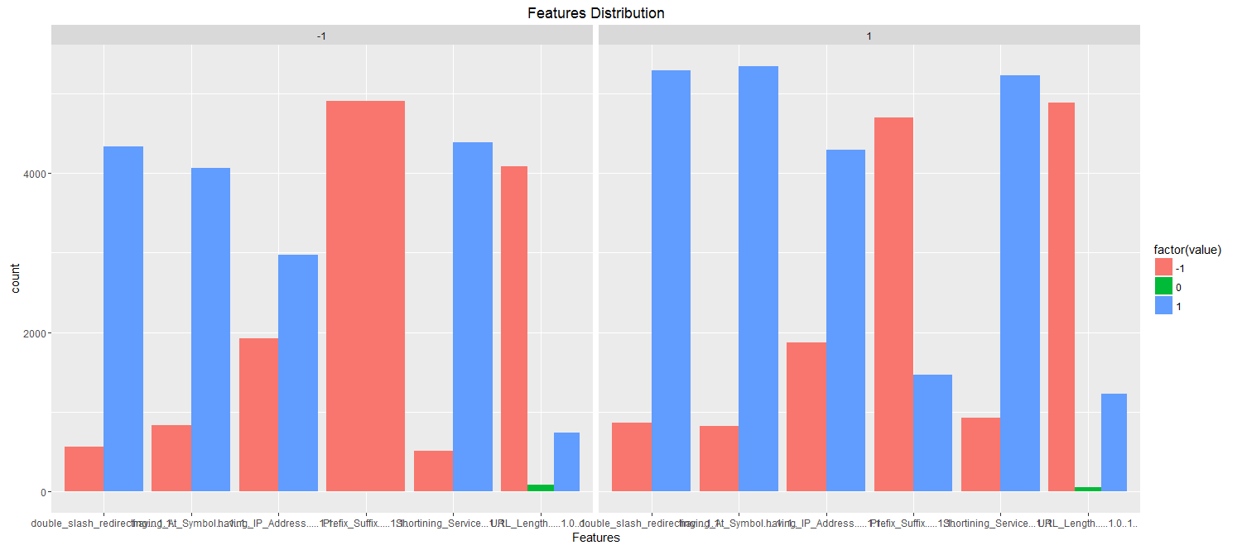
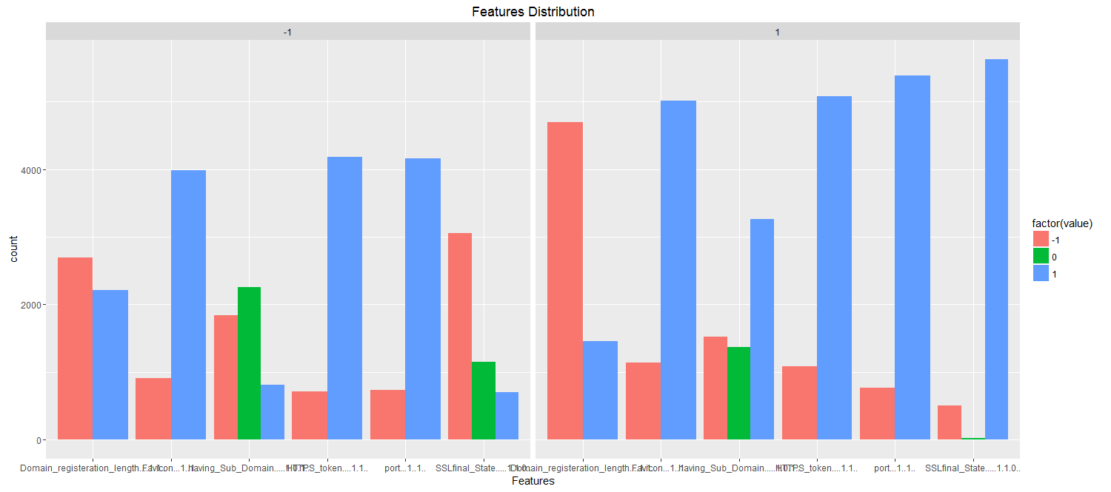
Exploratory Analysis for Address Bar Based Features:
Note: There is no significant correlation between the address bar based features and phishing websites.

Slide 6
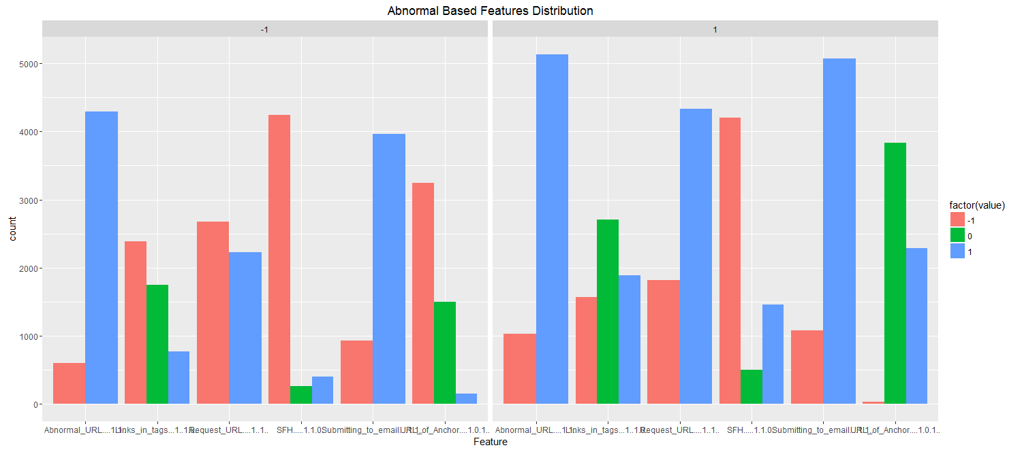
Exploratory Analysis for Abnormal Based Features :
Note: There is one feature which exhibits significant correlation phishing websites. “URL OF ANCHOR”

Slide 7
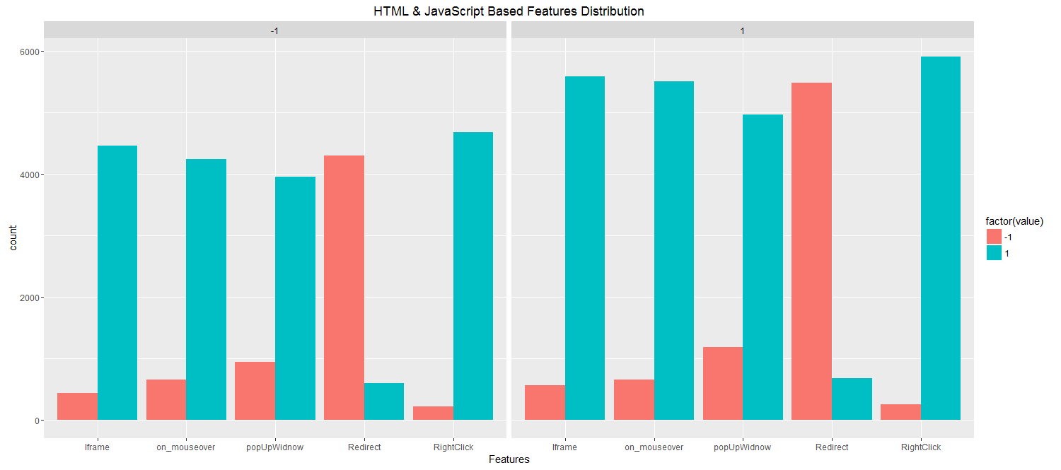
Exploratory Analysis for HTML and JavaScript based Features :
Note: There is no significant correlation between the address bar based features and phishing websites.

Slide 8
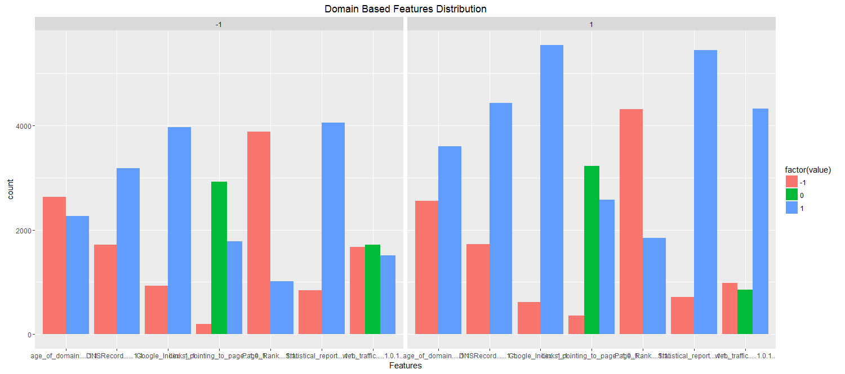
Exploratory Analysis for Domain based Features :
Note: There is one feature which exhibits significant correlation phishing websites. “SSL FINAL STATE”

Slide 9
The Model
A comparison study of three classification models:
Logistic Regression
Random Forest
Decision Trees
The “Train” data set was initially used to build up the models which was made up of 50% of the original data set, the other 50% for testing.
All attributes were initially included in the model.
The attributes were narrowed down based on their significance until the final model was achieved.

Slide 10
Model Accuracy
The accuracy of the model was determined using the following metrics:
1. Overall accuracy = (TN + TP)/N
2. Sensitivity = TP/(TP+FN)
3. Specificity = TN/(TN+FP)

Slide 11
Model Accuracy
 | Sensitivity | Specificity | Accuracy
Logistic Regression | 94.64% | 90.07% | 92.612%
Decision Trees | 91.13% | 89.75% | 90.521%
Random Forests | 97.11% | 94.37% | 95.894%

Slide 12
Threshold Value
In order to investigate the t value further, a good place to start is to determine the area under the ROC curve for the model. The resulting AUC value is an indicator of the discrimination ability of the model. The value ranges from 0.5 to 1 with a higher value representing a better discrimination ability and hence a better predictor.
For example, an ROC curve with an AUC of 0.5 will have a curve close to 45 degrees and will have little or no discrimination ability i.e. the prediction will be 50/50 - pure chance. Whereas a curve that tends towards the top left hand corner of the plot will have an AUC of closer to 1 which indicates perfect discrimination ability. Hence, a high AUC value is more desirable as it indicate a better predictor power for the model in question.

Slide 13
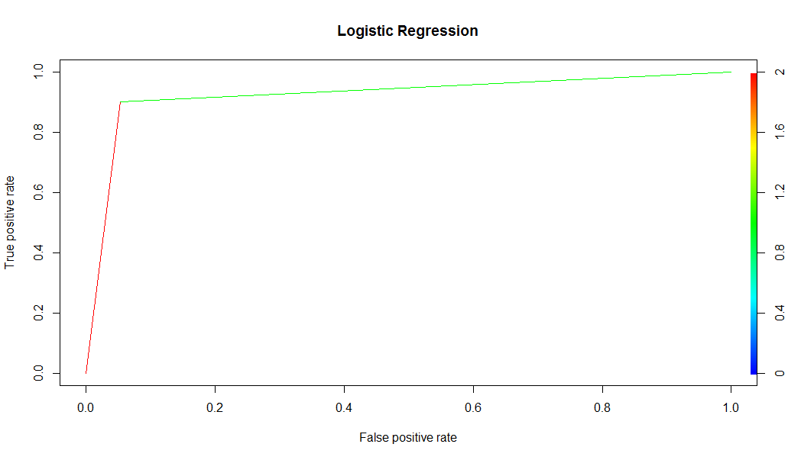


Threshold Value

Slide 14
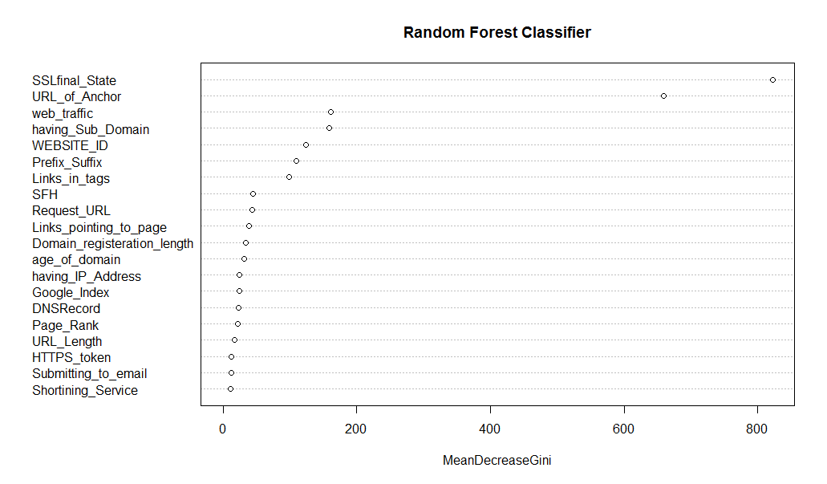
Conclusion
The models which have been built for predicting the phishing websites have been successfully applied to the data.
The Random Forest has outperformed the decision tree and logistic regression in terms of accuracy with an optimal sensitivity of 97.11% achieved.
As discussed in above section the t-value, the sensitivity of the model was very important and needed to be as high as possible. It is far more important for the model to keep False Negatives as low as possible rather than False Positives, while still keeping the accuracy high. Hence, there was a trade-off between the 3 main metrics: Accuracy, Sensitivity and Specificity.
We can also optimize the random forest model by setting the no of trees and depth of the trees, which plays a very important role in model accuracy.
From the above plot and from data exploration bar chats we can conclude that SSL final state and URL of Anchor features play very important role in predicting if a website is legitimate or suspicious.

