Slide 1
Data Warehousing Assignment
Vamsi Patibandla

Slide 2
Project Overview
• Consolidates HR, Finance, and Operations data
• ETL scripts to clean and transform raw Excel files
• Cleaned data is loaded into a MySQL-based star schema
• Simulate role-based access for different users
• Bonus features like SCD type 2 and incremental loading

Slide 3
Tools & Technologies
• Python (pandas for ETL)
• MySQL (Data warehouse simulation)
• SQL (Views, role-based access)
• GitHub (Version control)

Slide 4
Folder Structure
• /data: Raw Excel files
• /outputs: Cleaned CSV files
• /etl: ETL, SCD, incremental scripts
• /sql: SQL scripts and role-based views
• /notebooks: Scripts for KPIs and SCD

Slide 5
ETL Pipeline Overview
• Separate ETL script for each business area
• Outputs:
Fact Tables: fact_hr, fact_finance, fact_operations
Dimension Tables: dim_employee, dim_department, dim_expensetype, dim_process
• The cleaned CSVs are saved in the /outputs/ folder and loaded into the MySQL database using sql/load_to_mysql.py

Slide 6
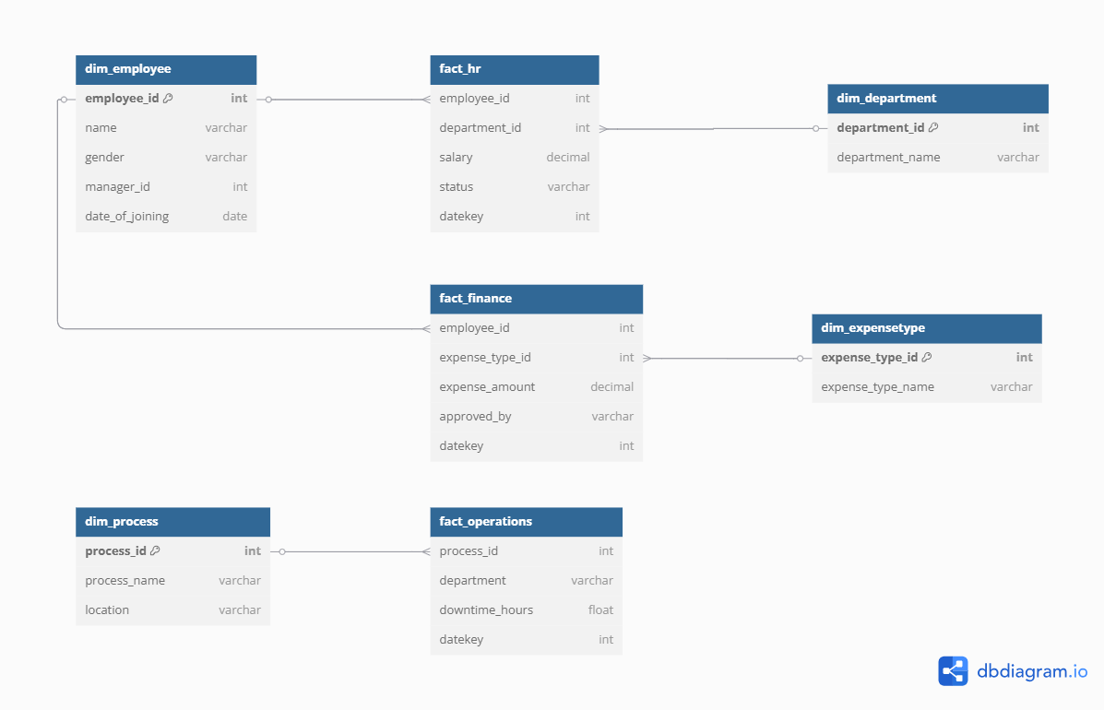
Star Schema Diagram

Slide 7
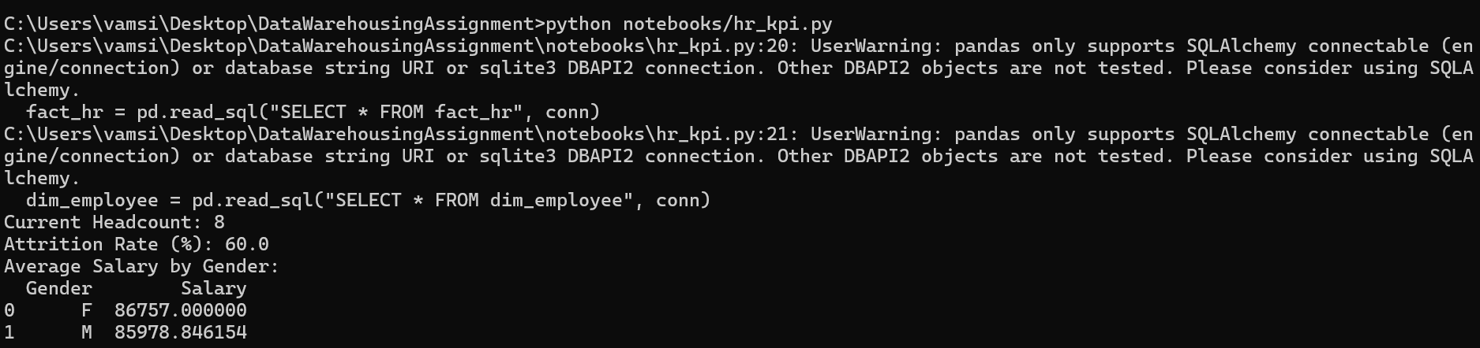
KPI Metrics Summary
• HR: Headcount, Attrition Rate, Avg Salary by Gender

Slide 8
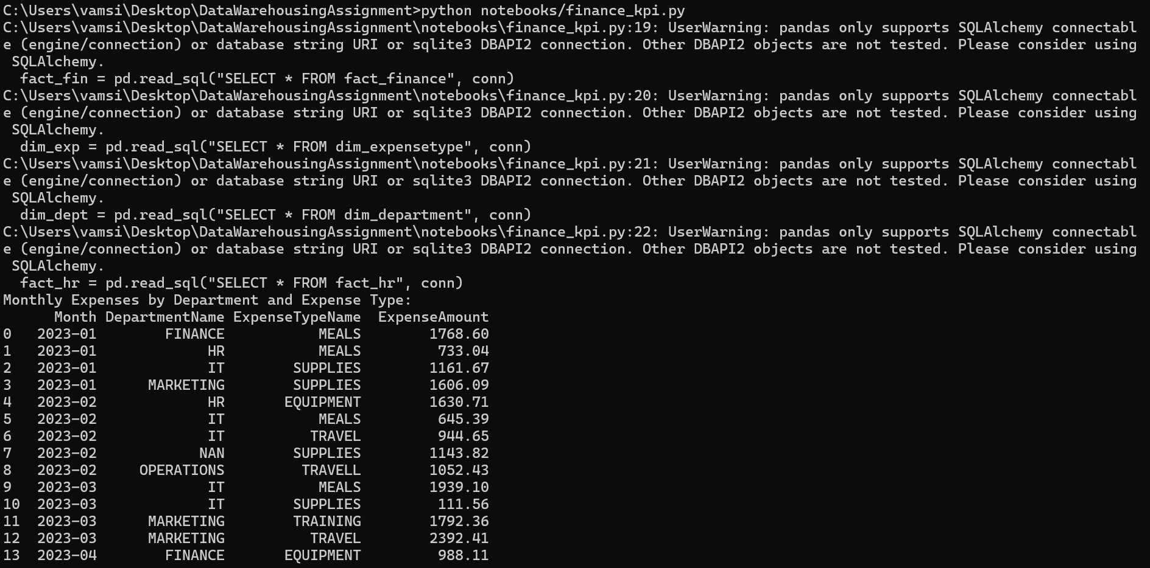
KPI Metrics Summary
• Finance: Monthly Expenses by Department and Expense Type

Slide 9
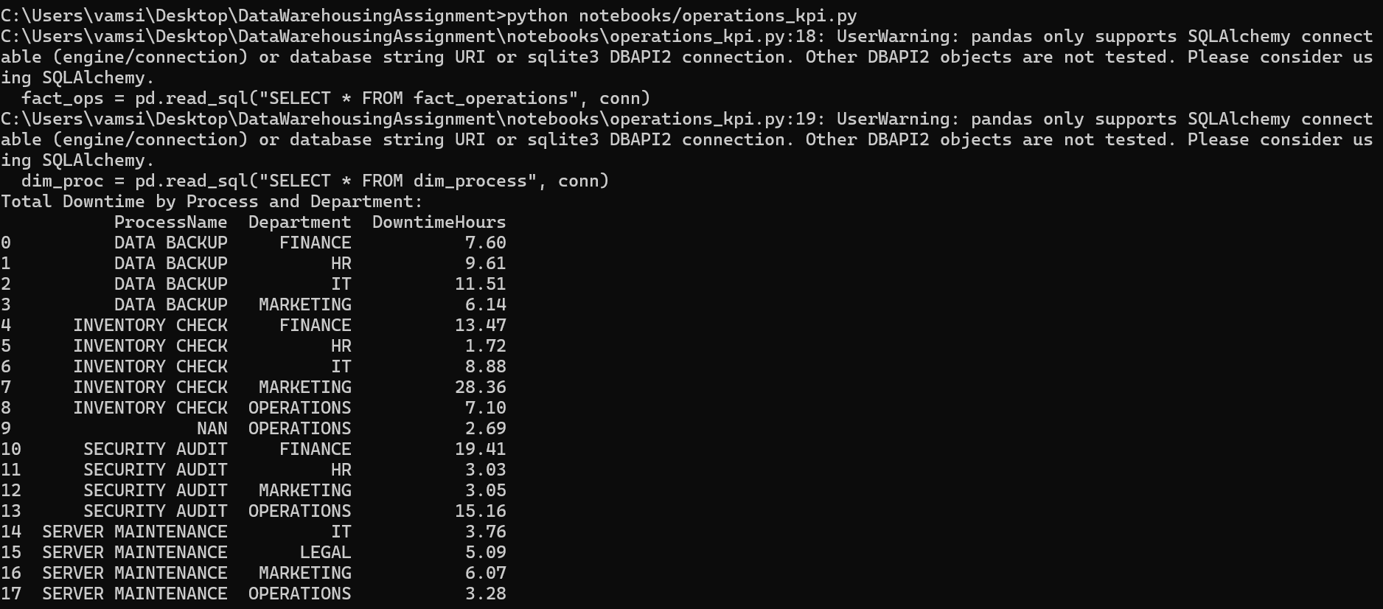
KPI Metrics Summary
• Operations: Total Downtime by Process & Department

Slide 10
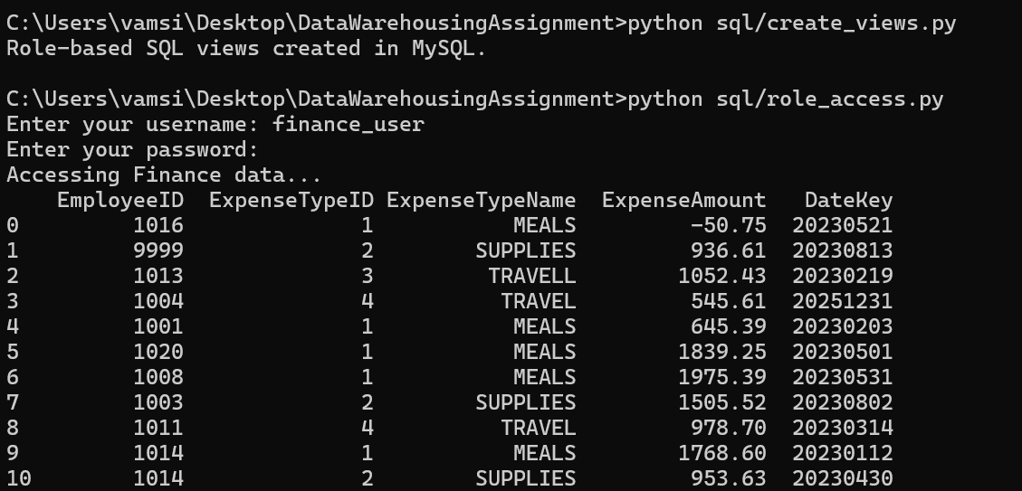
Role-Based Access
• HR User → access to employee and HR metrics
• Finance User → access to expenses and financial metrics
• Super User → access to all data
• The username and password is stored in the sql/roles_config.json file

Slide 11
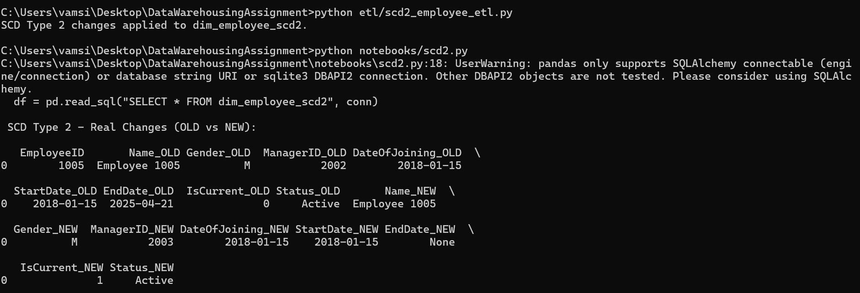
Bonus Features
• SCD Type 2: Historical tracking of employee data

Slide 12
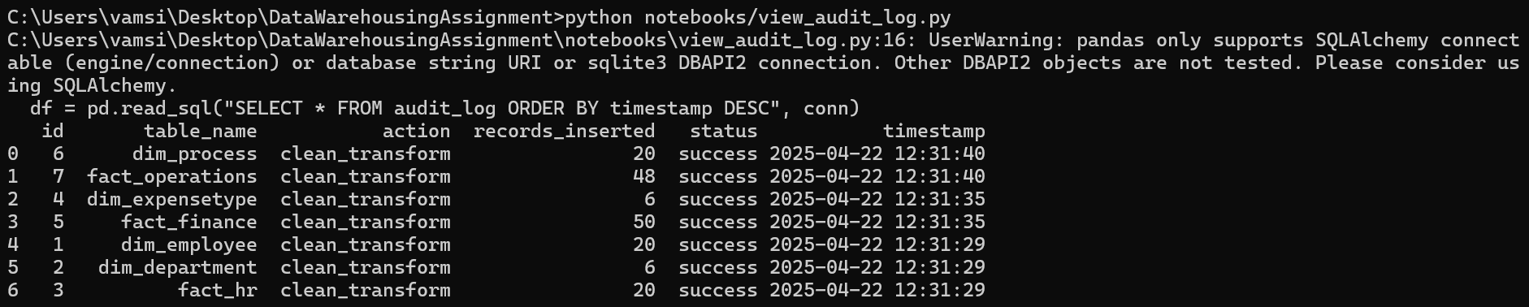
Bonus Features
• Audit log: Logs ETL and data load actions

Slide 13
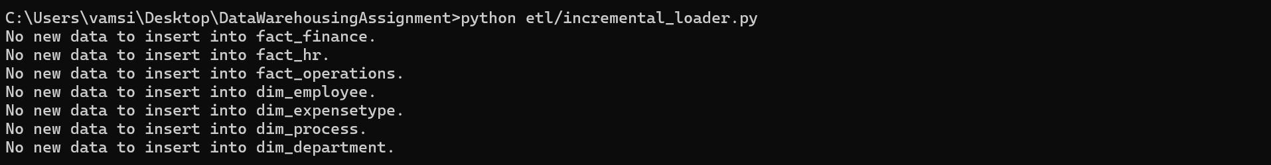
Bonus Features
• Incremental Loading: To load new data incrementally into all supported tables (fact/dimension tables).

Slide 14
Setup & Prerequisites
• Python 3.12 and MySQL Server
• pip install -r requirements.txt
• Update MySQL credentials in db_config.ini

Slide 15
Execution Workflow
1. Run ETL Scripts
2. Load cleaned Data into MySQL
3. Generate KPIs
4. Create SQL Views for Roles
5. Apply SCD Type 2 & Incremental Loading

