Slide 1
Composition gestures
atoms · axis 01
01 / 10
comp.centered
comp.split-50
comp.split-60
comp.golden
centered
split · 50/50
split · 60/40
golden ratio
title + lede axis-aligned
copy left, media right
narrative dominant
φ-anchor on the focal point
comp.thirds
comp.offcanvas
comp.edge-rotated
comp.bento
EDITION · 04 · 2026
rule of thirds
off-canvas bleed
edge-rotated caption
bento · asymmetric
subject on a third-grid intersection
media leaves the frame
vertical type on the frame
apple/linear tile grid
SLIDIFY · ATOMIC SEED
01 / 10 · COMPOSITION

Slide 2
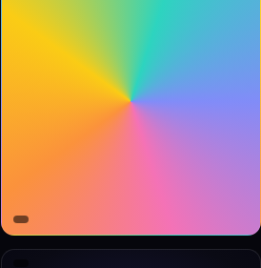
Background fields
atoms · axis 02
02 / 10
bg.mesh
bg.conic
bg.stripes
bg.scanline
mesh · 4-blob
conic · spectrum
stripes · 8/16
CRT scanline
bg.duotone
bg.vignette
bg.aurora-band
duotone · 2-stop
vignette · radial
aurora band · 5-stop
SLIDIFY · ATOMIC SEED
02 / 10 · BACKGROUND FIELDS

Slide 3
Surfaces
atoms · axis 03
03 / 10
surf.glass
surf.hero
surf.spotlight
surf.aurora
12.4M
+340%
99.8%
2.4s
glass
hero
spotlight
aurora
surf.polaroid
surf.tactile
surf.recessed
surf.sticker
$28
git diff
★ 4.9
tactile
recessed
sticker
— shipped 04 / 2026
SLIDIFY · ATOMIC SEED
03 / 10 · SURFACES

Slide 4
Type treatments
atoms · axis 04
04 / 10
type.gfill-2
type.gfill-4
VELOCITY.
VELOCITY.
type.stroke
type.stroke-thick
VELOCITY.
VELOCITY.
type.echo
type.longshadow
RUSH
SOLAR
RUSH
RUSH
RUSH
SOLAR
SOLAR
SOLAR
type.mixed
type.kinetic-baseline
R
I
S
we ship slides, and systems.
E
.
type.marquee
ITERATE
ITERATE
ITERATE
ITERATE
SLIDIFY · ATOMIC SEED
04 / 10 · TYPE TREATMENTS
type.dropcap
There is a moment in every render where the system stops behaving like a screenshot tool and starts behaving like a compiler — every pixel that stays editable compounds across every translation, theme swap, and revision your team will ever ship.

Slide 5
Media masks
atoms · axis 05
05 / 10
mask.disc
mask.arch
mask.hex
mask.parallelogram
mask.triangle
mask.diamond
mask.rounded
mask.mosaic
SLIDIFY · ATOMIC SEED
05 / 10 · MEDIA MASKS

Slide 6
Decorative tokens
atoms · axis 06
06 / 10
0
100
SHIPPED
2026 · Q2
SLIDIFY · ATOMIC SEED
06 / 10 · DECORATIVE TOKENS

Slide 7
Data primitives
atoms · axis 07
07 / 10
75
data.heatmap
data.kpi-delta
data.ticker
heatmap · 8×4
kpi · delta
ticker · live
2.4M
▲
+18.2%
28 dau
vs Q1
SHIP ▲ 2,184
STAR ▲ 14k
BUG ▼ 3
NET ▲ 99.8%
LAT ▲ 2.4s
ARR ▲ 14.2M
data.logo-cloud
logo cloud · trusted by
vercel
linear
stripe
notion
cursor
raycast
supabase
resend
SLIDIFY · ATOMIC SEED
07 / 10 · DATA PRIMITIVES

Slide 8
Motion implication
atoms · axis 08
08 / 10
motion.echo
motion.shutter
RUSH
RUSH
RUSH
RUSH
SHUTTER
echo · ghost-stack
shutter · stripes
motion.marquee
motion.kinetic
FAST
R
I
FAST
S
E
.
FAST
marquee · skewed
kinetic baseline
SLIDIFY · ATOMIC SEED
08 / 10 · MOTION IMPLICATION

Slide 9
UI mocks
atoms · axis 09
09 / 10
ui.browser-chrome
ui.tab-strip
slidify.sh / atoms
Atoms
Recipes
Fonts
Probe
slidify · atomic seed
ui.search
search atoms…
⌘ K
# compose a deck from atoms
from slidify import convert
deck = atoms.compose("hero", "bento", "cta")
convert(deck, "out.pptx")
ui.toolbar
ui.avatar-cluster
⊞
B
I
U
↶
↷
VR
JL
MK
TS
+12
16 collaborators
ui.toast
SLIDIFY · ATOMIC SEED
09 / 10 · UI MOCKS
Deck shipped
native_area_ratio · 0.97

Slide 10
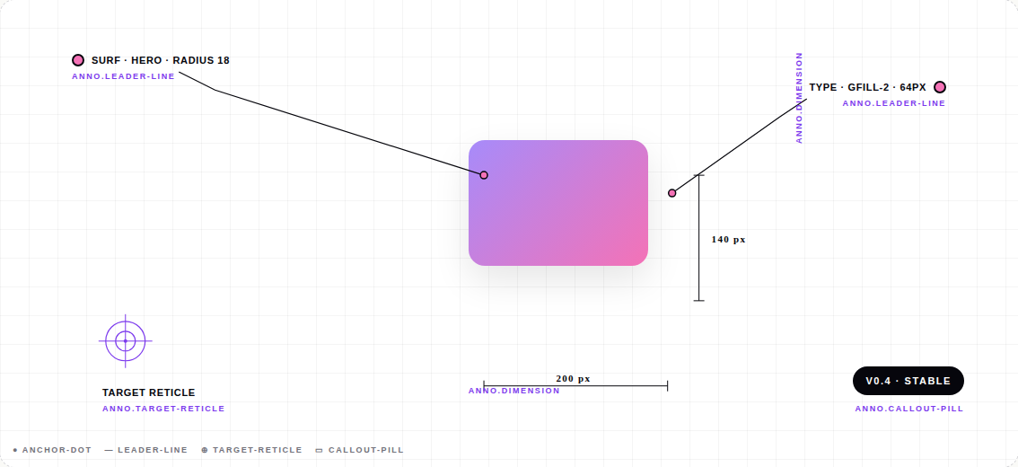
Annotation primitives
atoms · axis 10
10 / 10
anno.dimension
anno.leader-line
anno.leader-line
140 px
200 px
v0.4 · stable
target reticle
anno.dimension
anno.target-reticle
anno.callout-pill
● anchor-dot — leader-line ⊕ target-reticle ▭ callout-pill
SLIDIFY · ATOMIC SEED
10 / 10 · ANNOTATION PRIMITIVES

