Slide 1
ISSUE 04 · 2026 · A FILM ABOUT SHIPPING
FUTURE.
SLIDIFY · ATOMIC SEED · RECIPE 01
EDITORIAL · CHAPTER ONE

Slide 2
02
chapter two of four
CHAPTER · 02 / 04
A new render path that stays alive after the meeting.
Render in headless Chromium. Cluster into atomic visual units. Translate gradients, shadows, and shapes into native PPTX. Edit the result in PowerPoint as if a designer authored it by hand.
SLIDIFY · ATOMIC SEED
02 / 16 · CHAPTER DIVIDER

Slide 3
MANIFESTO · A LUXURY POSITION
Rasterization is the failure mode, not the goal — every pixel that stays editable compounds across every translation.
✱
Vamsi Ramakrishnan
Founder · Pixelpitch Labs · 2026
SLIDIFY · ATOMIC SEED
03 / 16 · MANIFESTO

Slide 4
atelier .
ISSUE 04 · MMXXVI
A FILM
ABOUT
SHIPPING.
How a small team in Brooklyn built a compiler that turns browsers into editable PowerPoint — and why every screenshot tool was the wrong abstraction.
04 / SUBJECT · STILL · 2026
Cover The render pipeline, photographed in long exposure. By Pixelpitch Labs.

Slide 5
PRODUCT · OVERVIEW
A bento of every primitive a deck needs.
05 / 16 · BENTO
FEATURED · NATIVE-AREA RATIO
▲ ARR
UPTIME · 90D
$12.4M
99.98%
+18.2% Q-o-Q
5,182 of 5,184 deploys passed SSIM ≥ 0.95.
▲ DECKS / WEEK
$ slidify --quiet
95%
# compose from atoms
deck.compose(
"hero", "bento")
→ out.pptx ✓
1,184
of slide area emits as native, editable PPTX shapes — gradients, shadows, text frames, real preset shapes.
Across 318 teams in production.
SLIDIFY · ATOMIC SEED
05 / 16 · BENTO

Slide 6
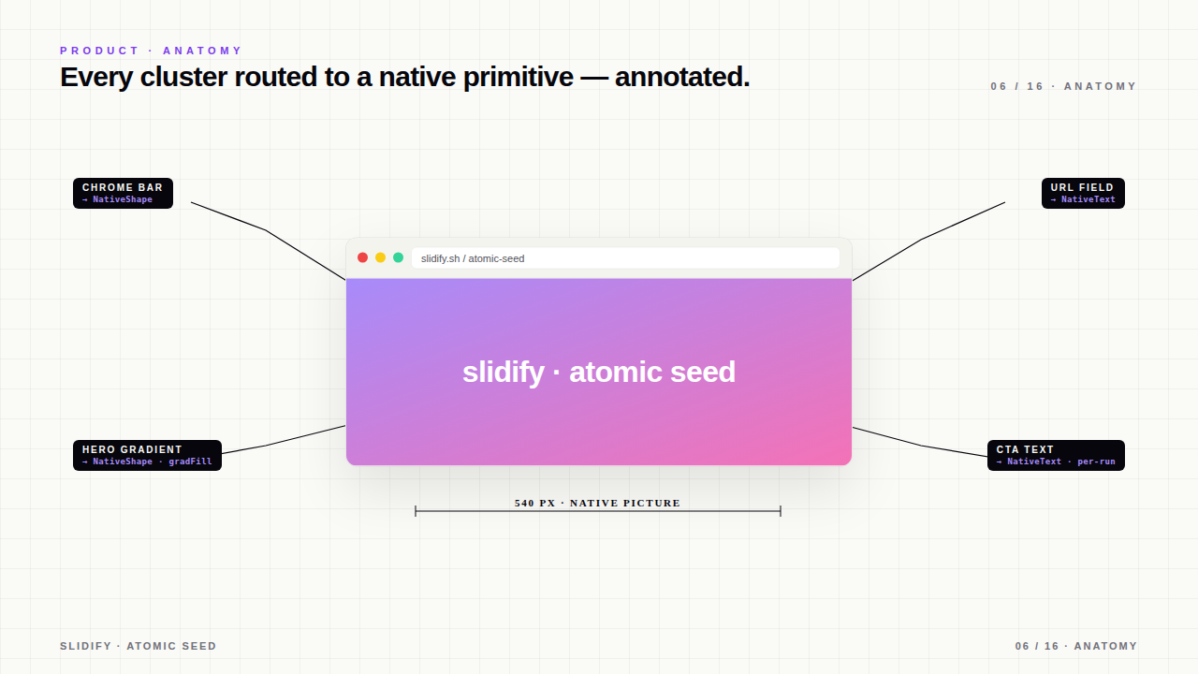
PRODUCT · ANATOMY
Every cluster routed to a native primitive — annotated.
06 / 16 · ANATOMY
CHROME BAR
URL FIELD
→ NativeShape
→ NativeText
slidify.sh / atomic-seed
slidify · atomic seed
HERO GRADIENT
CTA TEXT
→ NativeShape · gradFill
→ NativeText · per-run
540 PX · NATIVE PICTURE
SLIDIFY · ATOMIC SEED
06 / 16 · ANATOMY

Slide 7
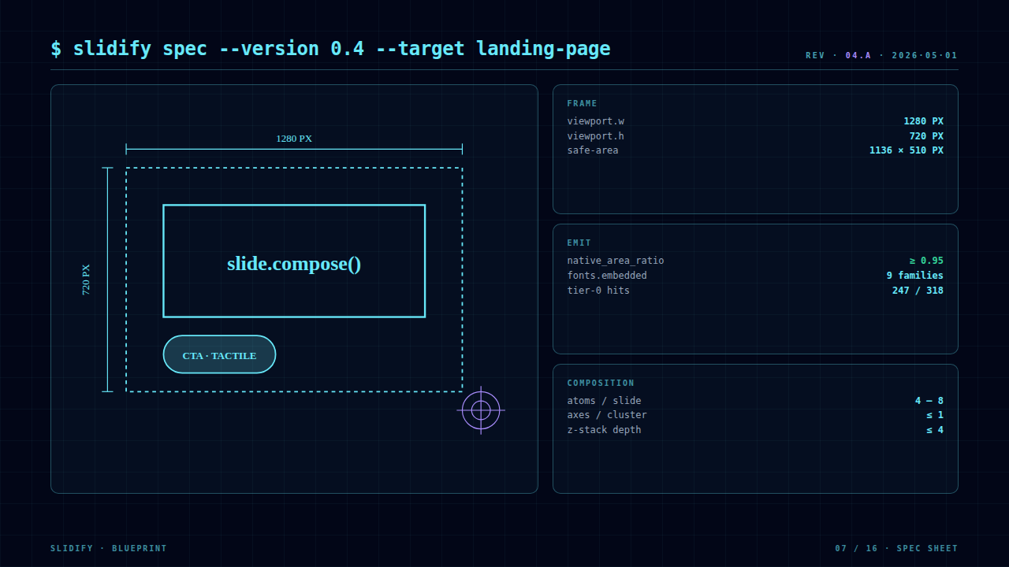
$ slidify spec --version 0.4 --target landing-page
REV · 04.A · 2026·05·01
FRAME
viewport.w
1280 PX
1280 PX
viewport.h
720 PX
safe-area
1136 × 510 PX
EMIT
slide.compose()
native_area_ratio
≥ 0.95
720 PX
fonts.embedded
9 families
tier-0 hits
247 / 318
CTA · TACTILE
COMPOSITION
atoms / slide
4 — 8
axes / cluster
≤ 1
z-stack depth
≤ 4
SLIDIFY · BLUEPRINT
07 / 16 · SPEC SHEET

Slide 8
PIPELINE · LIVE
Render. Cluster. Classify. Emit. — looped.
08 / 16 · PROCESS RING
01
Render
Headless Chromium captures resolved pixel layout.
04
$ slidify convert
02
native_area_ratio
Emit
0.97
Cluster
python-pptx writes native shapes with EMU precision.
DOM elements grouped into atomic visual units.
23 s · 12 slides · 0 raster fallbacks
03
Classify
Tier-0 atom registry → tier-1 rules → tier-2 heuristics.
SLIDIFY · ATOMIC SEED
08 / 16 · PROCESS RING

Slide 9
$ slidify ticker --live
Live deployment tape — every commit, every region.
09 / 16 · TICKER
SHIP
▲ 2,184
·
STAR
▲ 14k
·
BUG
▼ 3
·
NET
▲ 99.98%
·
P95
▲ 248ms
·
ARR
▲ $14.2M
v0.4.2 atoms.yaml · v0.4.1 longshadow recipe · v0.4.0 atomic seed · v0.3.9 anim capture · v0.3.8 native tables
CHANGELOG
▲ DEPLOYS · 24H
⌁ ACTIVE COMPILES
▼ ERROR BUDGET
312
14
0.02%
across us-east, eu-west, apac
0 rollbacks · 0 SSIM regressions
HEALTHY
3 retries · all auto-recovered
SLA · 99.95% met
SLIDIFY · ATOMIC SEED
09 / 16 · TICKER · LIVE

Slide 10
DISPLAY · CHAPTER 03
10 / 16 · LONGSHADOW
SOLAR.
SOLAR.
SOLAR.
SOLAR.
SOLAR.
SOLAR.
SOLAR.
SOLAR.
SOLAR.
A type treatment that survives the round-trip. Eight stacked spans, each translated 12 px on both axes — emitted as nine native text frames, fully editable, zero rasterization.
SLIDIFY · ATOMIC SEED
10 / 16 · LONGSHADOW · BILLBOARD

Slide 11
PIPELINE · OBSERVABILITY
Editability dashboard — last 90 days, every cluster.
11 / 16 · DASHBOARD
▲ ARR · MAY
$14.2M
▲
+18.2%
vs Apr · best month on record
0.97
NATIVE_AREA_RATIO
HEATMAP · ATOM HIT-RATE BY AXIS · 12 WEEKS
W01
W03
W05
W07
W09
W11
W12
comp · bg · type · surf · — coverage 76% → 96%
SLIDIFY · ATOMIC SEED
11 / 16 · DASHBOARD

Slide 12
VOICES · LOVED BY DESIGNERS
"It's the first deck tool that respects typography."
12 / 16 · TESTIMONIALS
✱
M
J
T
"We replaced screenshots with slidify and our investor decks now ship in PowerPoint as if a designer touched every gradient. Nothing about the deck rasterizes."
"The atom catalog is the missing UI grammar. Once you start composing in atoms, you stop fighting PowerPoint forever — every slide stays editable."
"95% native_area_ratio across 1,184 decks a week. The pipeline is the only thing standing between our team and another animated GIF career."
Mira Okafor
Jordan Liu
Thiago Sousa
Head of Brand · Vector Labs
Design Engineer · Modular
DesignOps · Atelier 04
VR
JL
MK
TS
PA
+318
318 teams · 1,184 decks / week · NPS 76
★ ★ ★ ★ ★ · G2 · 4.9 / 5
✱
SLIDIFY · ATOMIC SEED
12 / 16 · TESTIMONIALS

Slide 13
MOTION · IMPLIED
13 / 16 · ECHO
RUSH
RUSH
RUSH
RUSH
RUSH
RUSH
Same word, six native text frames, decreasing opacity, increasing offset. Editable in PowerPoint as six independent runs. No `filter: blur` — no raster.
SLIDIFY · ATOMIC SEED
13 / 16 · ECHO · MOTION

Slide 14
FULL-BLEED · MARQUEE WALL
Edge-to-edge type bands. Each band is one editable native run.
14 / 16 · MARQUEE
SHIP
ITERATE
SHIP
·
·
NATIVE
EDITABLE
NATIVE
·
·
RENDER
CLUSTER
EMIT
·
·
SLIDIFY
0.4
2026
·
·
⏵ MOTION · IMPLIED
4 BANDS · 4 NATIVE TEXT FRAMES · 0 RASTER PASSES
SLIDIFY · ATOMIC SEED
14 / 16 · MARQUEE WALL

Slide 15
CREDITS · TEAM 04
The atomic seed was authored by a small Brooklyn studio.
15 / 16 · TEAM
VR
JL
MK
TS
PA
+12
Vamsi Ramakrishnan
Jordan Liu
Mira Kovač
Thiago Sousa
Priya Ananth
17 contributors
FOUNDER · COMPILER
DESIGN ENGINEER
TYPOGRAPHY
DESIGNOPS
RENDERER
SHIPPING SINCE 2024
BACKED BY · TRUSTED BY
VECTOR
Modular
atelier/04
PIXELPITCH
Drafting Co.
render.sh
NORTHFIELD
Studio Eight
SLIDIFY · ATOMIC SEED
15 / 16 · TEAM

Slide 16
FINAL · CHAPTER FOUR · GO BUILD
RECIPE 16 OF 16 · CLOSING
SHIPPED
2026 · Q2
Go build a deck
that stays alive.
slidify@0.4 ships today. Sixteen recipes, seventy atoms, eight typographic registers — every pixel native, every word editable.
Read the docs
→
→
$ uv add slidify · $ slidify deck.html out.pptx
SLIDIFY · ATOMIC SEED
16 / 16 · CLOSING CTA

