Slide 1
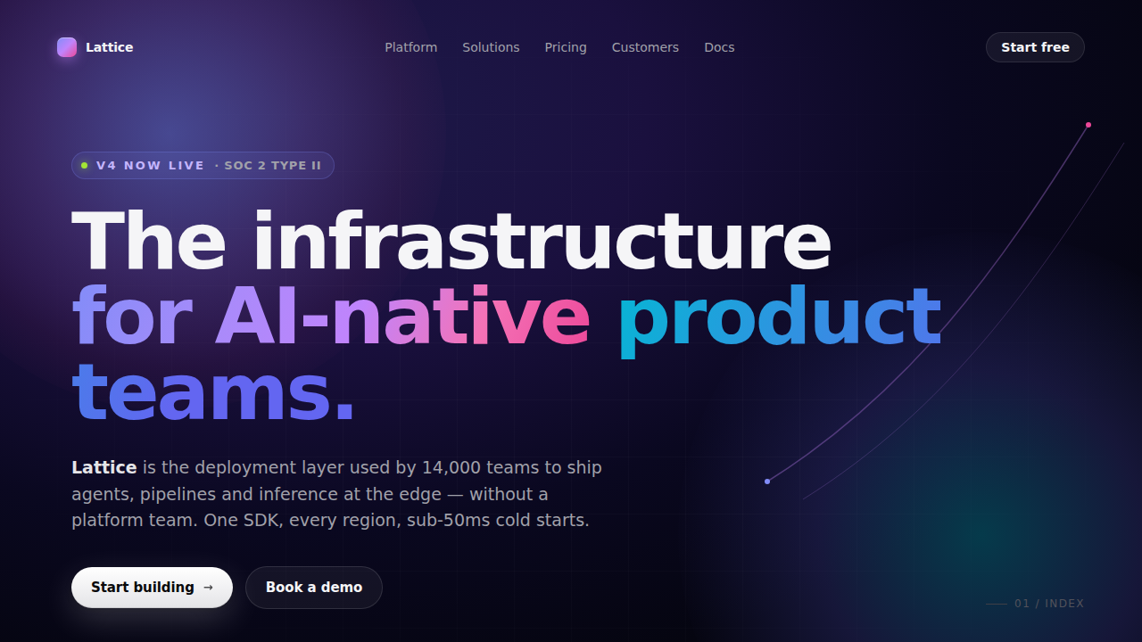
Start free
The infrastructure
for AI-native product teams.
Lattice is the deployment layer used by 14,000 teams to ship agents, pipelines and inference at the edge — without a platform team. One SDK, every region, sub-50ms cold starts.
Book a demo
Start building→

