Slide 1
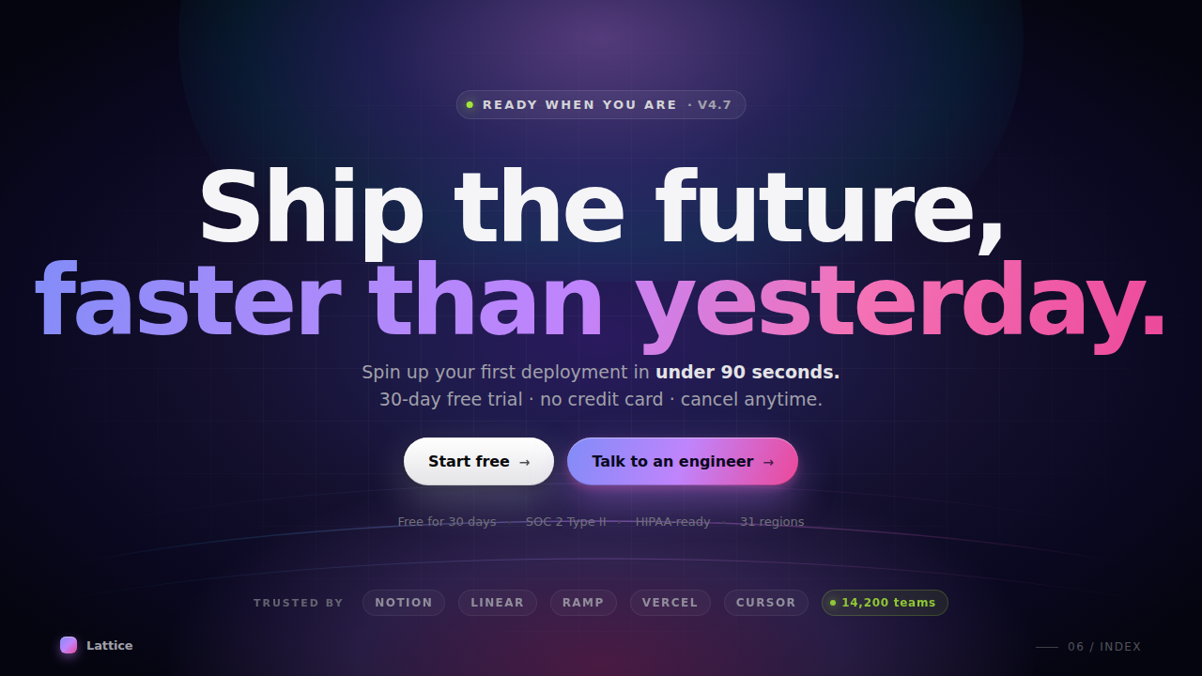
READY WHEN YOU ARE · v4.7
Ship the future,
faster than yesterday.
Spin up your first deployment in under 90 seconds.
30-day free trial · no credit card · cancel anytime.
Start free→
Talk to an engineer→
NOTION
LINEAR
RAMP
VERCEL
CURSOR
14,200 teams

