Slide 1
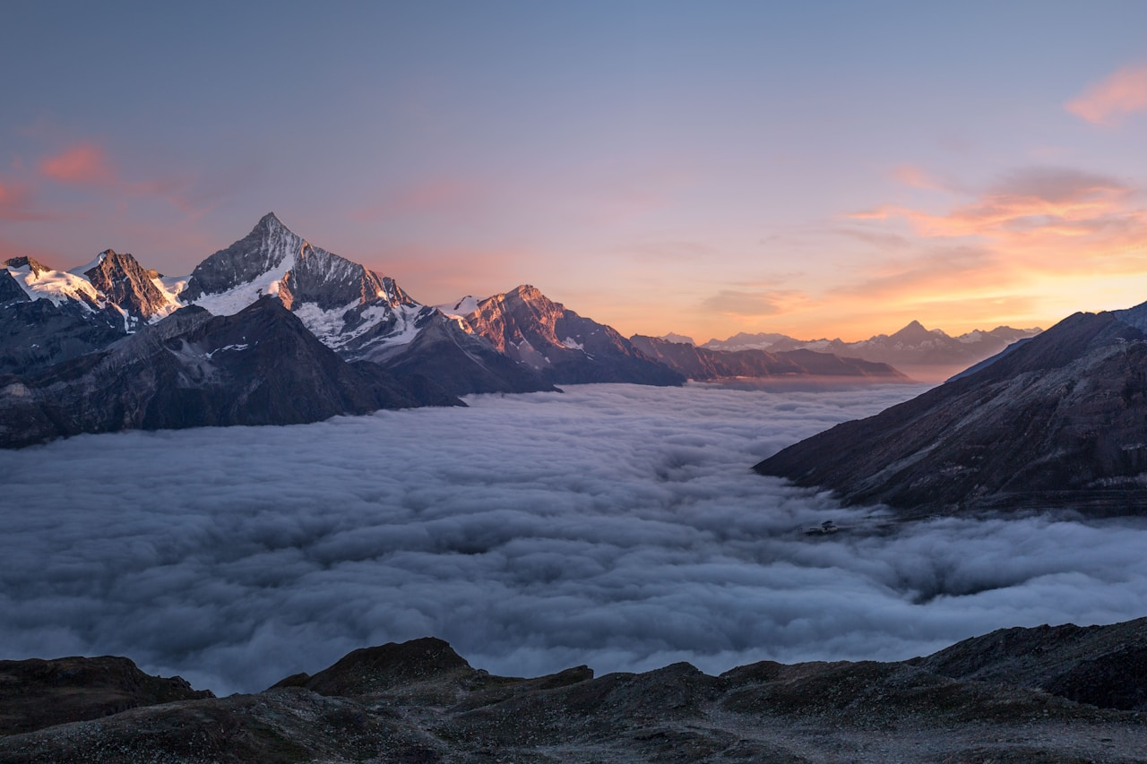
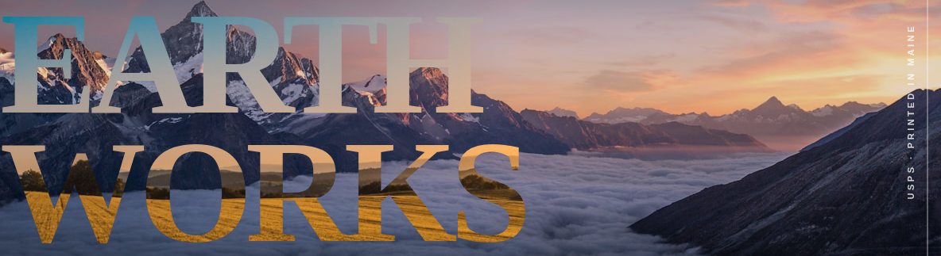
CABINET
The Long View — Issue No. 47
USPS · PRINTED IN MAINE
Six photographers spent the year tracing the geographies that hold us — from the saltline of the Aral Sea to the ridge above Glen Coe — asking what a landscape remembers.
Photographs by Maren Asher · Words by Idris Calloway

