Slide 1

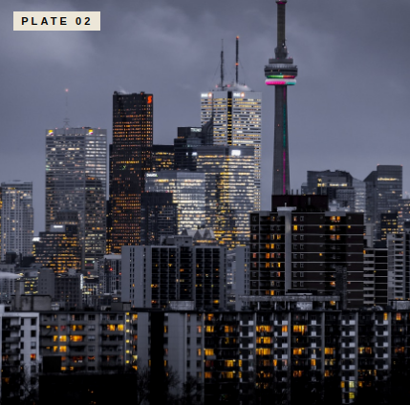
Notes from a sinking coast — two photographs
PLATE 01
PLATE 02
Plate 01 — Aerial A salt marsh at low tide, photographed from 350m above the Bay of Fundy. The bright veining is a tidal channel that has migrated nearly forty meters since the same frame was taken in 1998. Locals call this stretch the breathing field: at neap it is grass; at spring it is sea. The line between is a negotiation that the map will lose.
Plate 02 — The wall A retaining wall on the headland west of the village, poured the summer the lighthouse went automatic. The mason inscribed his initials and the year into the lower-left corner; both have since been overtaken by lichen. We photographed it in February, when the cold gives the concrete back its first colour — pale, faintly pink, the colour of an apology that is already too late.
P. 084–085

