Slide 1
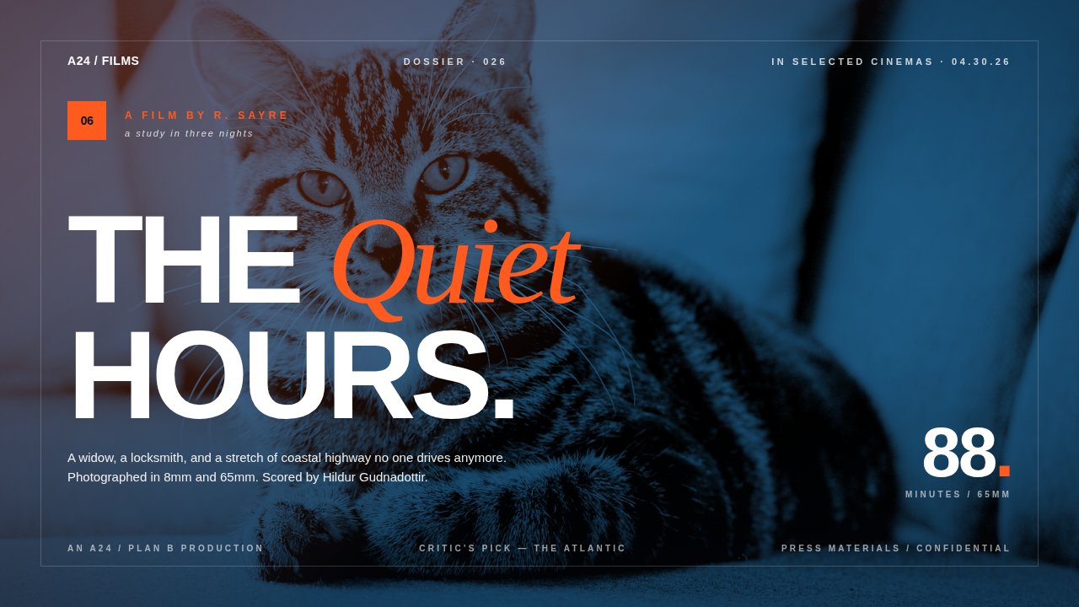
06
A film by R. Sayre
a study in three nights
THE Quiet
HOURS.
88.
A widow, a locksmith, and a stretch of coastal highway no one drives anymore. Photographed in 8mm and 65mm. Scored by Hildur Gudnadottir.
Minutes / 65mm

