Slide 1
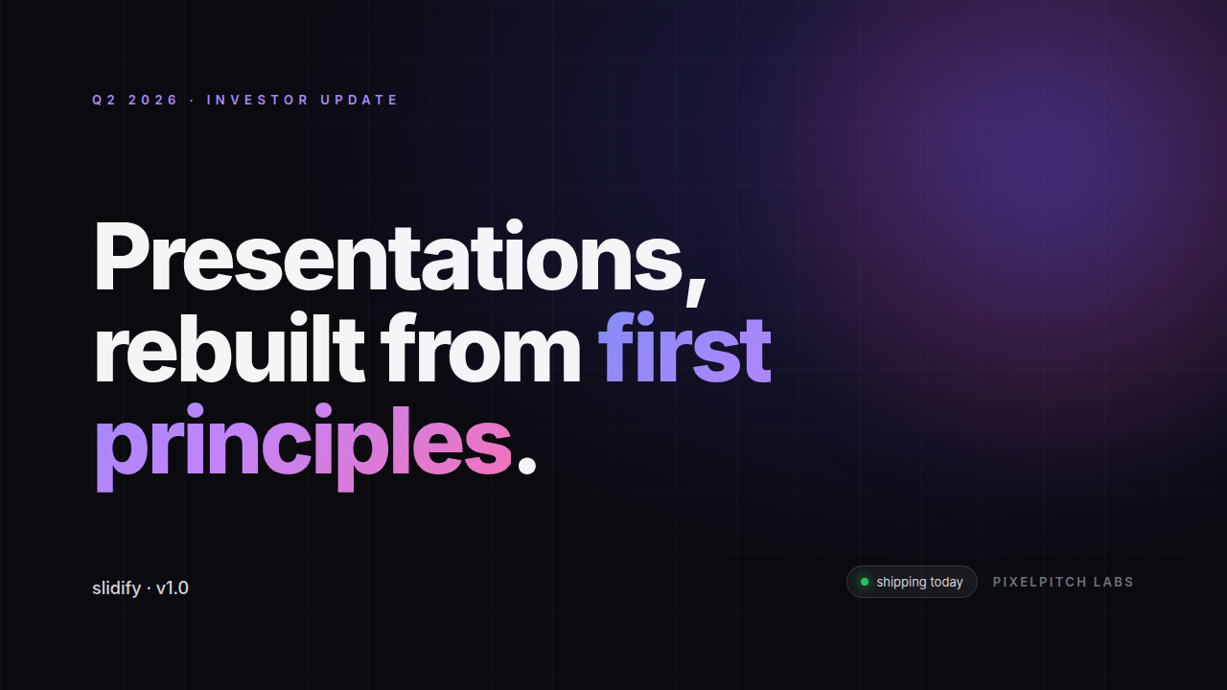

Slide 2
By the numbers
Editability that compounds across every deck you ship.
87%
23s
$0.04
Native area ratio
Per 10-slide deck
LLM cost per deck
Average across the 200-deck Genspark + v0 corpus. 0.95 stretch target.
P95 conversion time on a single 8-core box, no GPU. 4-way render parallelism.
Three-tier classifier means tier-3 only fires on the ambiguous 10%.
SOURCE · Internal benchmark, April 2026
02 / 08

Slide 3
Six pillars of the rendering pipeline.
03 / 08
▦
◈
⊞
Render before decide
Visual units, not DOM
Real Chromium computes layout. Static analysis cannot resolve flex/grid/flow geometry.
The classification atom is a connected visual region — a card, a bullet, a chart — not a single tag.
Three-tier classifier
Rules → heuristics → LLM. 70% decided free, 20% by score, 10% adjudicated.
◐
✓
⌘
Self validating
Cache aggressively
Confidence aware
SSIM + OCR oracle catches regressions. Failing regions auto-promote to raster and re-emit.
Structural hashes hit 60–80% within a generator after warmup. Decisions are cheap to reuse.
Every decision carries a confidence. Low confidence triggers dual-emit fallback.

Slide 4
The pipeline
Render. Cluster. Classify. Emit. Validate.
01
02
03
04
05
Render
Cluster
Classify
Emit
Validate
Headless Chromium with animation freeze, font preload, two-rAF wait.
DOM elements grouped into atomic visual units by anchor + spatial overlap.
Tier 1 rules → tier 2 heuristics → tier 3 LLM, batched per slide.
python-pptx writes native text, shapes, bullets, pictures with EMU precision.
LibreOffice re-renders. SSIM + OCR oracle. Auto-correct failing regions.
PLAYWRIGHT
3 TIERS
~10–50 UNITS / SLIDE
OOXML
SSIM ≥ 0.95
Total budget · 25 s for a 10-slide deck
Bottleneck is render parallelism (Chart.js initialization). Tier 3 LLM is batched once per slide; cost ≤ $0.10/deck at default settings.

Slide 5
Before · After
Same browser render. Two very different decks.
Naive screenshotOLD WAY
slidifyNEW WAY
• ×
• Every slide is a 50 MB PNG embedded into PPTX.
• ✓
Headlines, body copy, and bullets are real text frames.
• ×
• No text is searchable, selectable, or editable.
• ✓
Cards and dividers are native rounded rectangles.
• ×
• Resizing the window degrades pixel-by-pixel.
• ✓
Designers edit fonts, colors, alignment in PowerPoint directly.
• ×
• Translation requires re-running the whole pipeline.
• ✓
Only complex visuals (Chart.js, gradients) rasterize.
• ×
• Brand colors locked into raster — no theme swap.
• ✓
Output is 4 MB instead of 50 MB. Email-friendly.

Slide 6
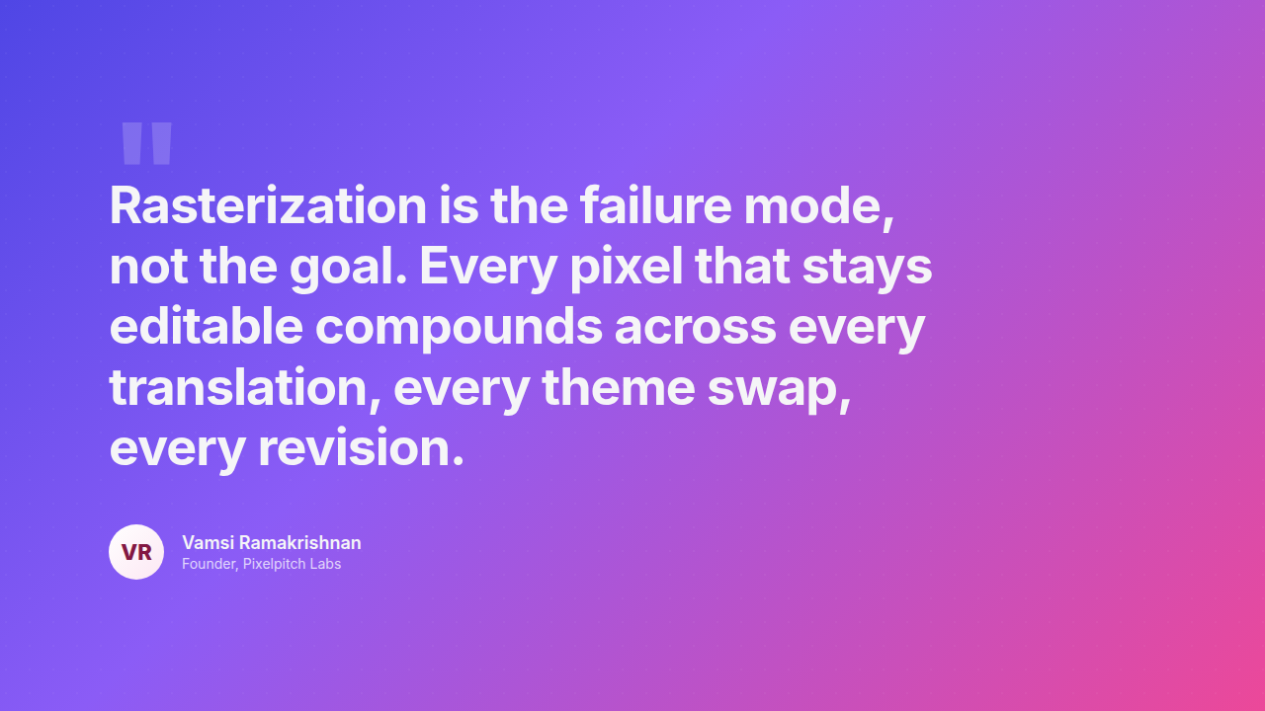

Slide 7
Pricing
Pay for the slides you ship, not the seats you don't fill.
MOST POPULAR
Starter
Studio
Enterprise
$0/mo
$29/mo
Custom
For solo founders shipping their first deck. No credit card.
For design teams converting decks every day. LLM credits included.
Self-hosted, custom backends, SOC 2, dedicated success engineer.
• ✓
50 slides / month
• ✓
1,000 slides / month
• ✓
Unlimited slides
• ✓
Tier 1 + Tier 2 only
• ✓
Full three-tier classifier
• ✓
Self-hosted runner
• ✓
SSIM oracle included
• ✓
Gemini + Claude backends
• ✓
BYO LLM provider
• ✓
Community support
• ✓
Diskcache + warm cache
• ✓
SLA + dedicated support
• ✓
Priority email support
Start free
Try Studio →
Talk to sales

Slide 8
