Slide 1


EMPLOYEE MANAGEMENT SYSTEM

Slide 2

INTRODCUTION
The Employee Management System (EMS) is designed to streamline the management of employee data, job roles, and departmental information within an organization. This system allows for efficient tracking of employee details, job assignments, qualifications, and performance metrics.
Key domain knowledge elements for this system include :
Employee Information Management
Job Role Assignment
Departmental Structure
Payroll and Compensation
Qualifications and Skills Tracking
Leave and Absence Management
This system ensures that all employee-related information is stored securely, easily accessible for reporting, and aligned with organizational goals for performance, compensation, and growth.

Slide 3
PROBLEM STATEMENT
The objective of this project is to design and implement an Employee Management System that efficiently stores and manages employee-related data within an organization. The system needs to track various aspects of employee information, including personal details, job roles, salary structures, qualifications, leave records, and payroll data.
The system should ensure the integrity and consistency of data by using relational tables with appropriate foreign keys and cascading actions. The system should allow for easy management and querying of employee data, providing insights such as payroll calculation, leave tracking, and department-specific job roles. The goal is to streamline HR operations, ensuring that all relevant employee data is accessible and accurately updated across different modules.

Slide 4
OBJECTIVE
The objective of the Employee Management System using SQL is to design and implement a relational database that efficiently stores, manages, and retrieves employee-related information.
The system uses SQL tables and queries to maintain employee details, job roles, departments, payroll information, qualifications, and leave records.
It ensures data integrity through primary and foreign keys, enables quick data access using SQL queries, and supports effective decision-making by generating reports related to employee performance, salaries, and departmental activities.
This system helps organizations manage employee data in a structured, secure, and efficient manner.

Slide 5
TABLES
TABLES_IN_EMS
1. JOBDEPARTMENT
2. SALARYBONUS
3. EMPLOYEE
4. QUALIFICATION
5. LEAVES
6. PAYROLL

Slide 6
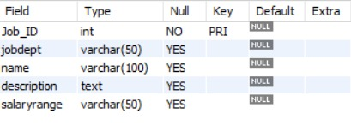
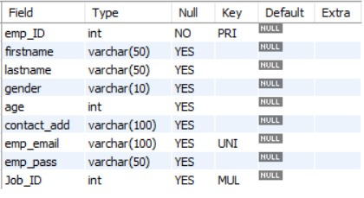
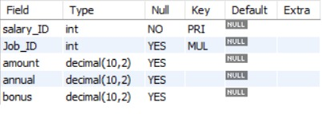
TABLES STRUCTURES
JOBDEPARTMENT
EMPLOYEE
SALARYBONUS

Slide 7
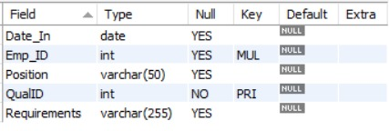
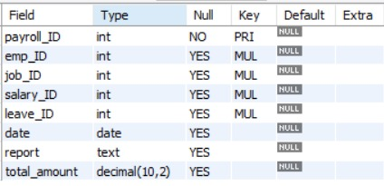
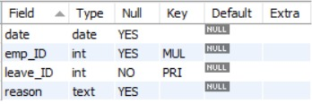
TABLES STRUCTURES
QUALIFICATION
LEAVES
PAYROLL

Slide 8
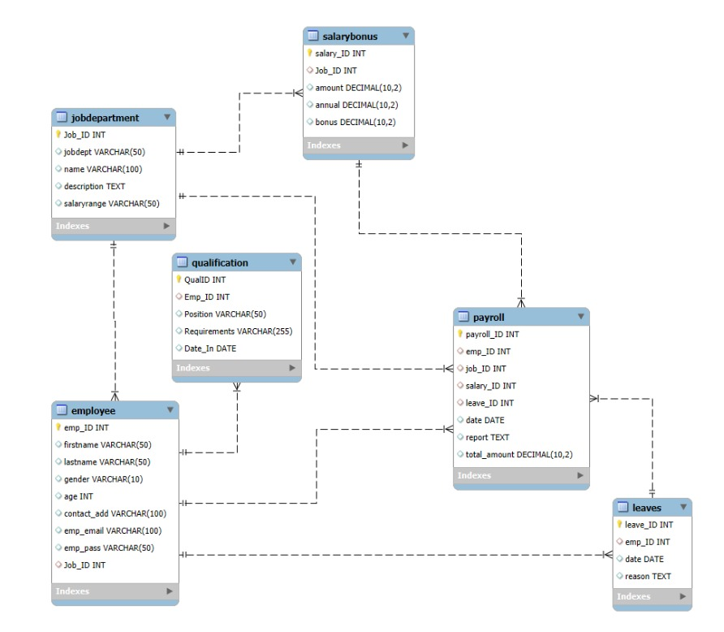
ER DIAGRAM

Slide 9

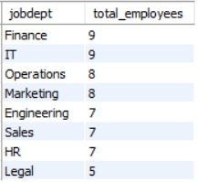
ANALYSIS
1. EMPLOYEE INSIGHTS
A. How many unique employees are currently in the system?
select count(distinct emp_id) AS unique_employee_count FROM employee;
B. Which departments have the highest number of employees?
select jd.jobdept, count(e.emp_ID) as total_employees from Employee e join JobDepartment jd on e.Job_ID = jd.Job_ID group by jd.jobdept order by total_employees desc;

Slide 10
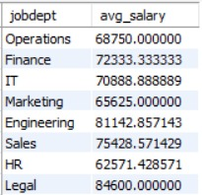
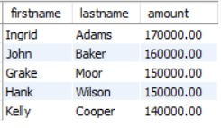
ANALYSIS
1. EMPLOYEE INSIGHTS
C. What is the average salary per department?
select j.jobdept,avg(s.amount) as avg_salary from jobdepartment j join salarybonus s on j.job_id = s.job_id group by j.jobdept;
D. Who are the top 5 highest-paid employees?
select e.firstname, e.lastname, sb.amount from Employee e join SalaryBonus sbon e.Job_ID = sb.Job_ID order by sb.amount desc limit 5;

Slide 11

ANALYSIS
1. EMPLOYEE INSIGHTS
E. What is the total salary expenditure across the company?
select sum(s.amount) as total_salary_expenditure from employee e join salarybonus s on e.job_id = s.job_id;

Slide 12
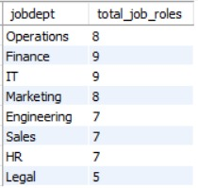
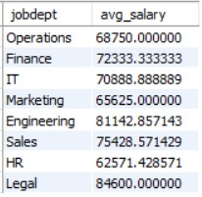
ANALYSIS
2. JOB ROLE AND DEPARTMENT ANALYSIS
A. How many different job roles exist in each department?
select jobdept,count(name) as total_job_roles from jobdepartment group by jobdept;
B. What is the average salary range per department?
select jd.jobdept, avg(sb.amount) as avg_salary from JobDepartment jd join SalaryBonus sb on jd.Job_ID = sb.Job_ID group by jd.jobdept;

Slide 13

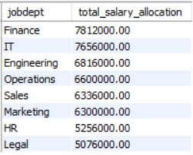
ANALYSIS
2. JOB ROLE AND DEPARTMENT ANALYSIS
C. Which job roles offer the highest salary?
select j.name,s.amount from jobdepartment j join salarybonus s on j.job_id = s.job_id where s.amount = (select max(amount) from salarybonus);
D. Which departments have the highest total salary allocation?
select j.jobdept,sum(s.annual) as total_salary_allocation from jobdepartment j join salarybonus s on j.job_id = s.job_id group by j.jobdept order by total_salary_allocation desc;

Slide 14

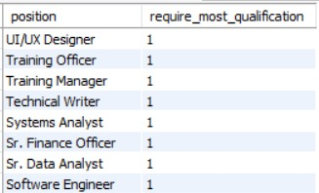
ANALYSIS
3. QUALIFICATION AND SKILLS ANALYSIS
A. How many employees have at least one qualification listed?
select count(distinct emp_id )as employee_with_qualification from qualification;
B. Which positions require the most qualifications?
select q.position,count(q.qualid) as require_most_qualification from qualification q group by q.position order by require_most_qualification desc;

Slide 15
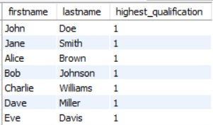
ANALYSIS
3. QUALIFICATION AND SKILLS ANALYSIS
C. Which employees have the highest number of qualifications?
select e.firstname,e.lastname,count(q.qualid) as highest_qualification from employee e join qualification q on e.emp_id = q.emp_id group by e.firstname,e.lastname order by highest_qualification desc;

Slide 16

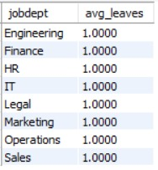
ANALYSIS
4. LEAVE AND ABSENCE PATTERNS
A. Which year had the most employees taking leaves?
select year(date) as leave_year, count(distinct emp_id) as employee_on_leave from leaves group by year(date) order by employee_on_leave;
B. What is the average number of leave days taken by its employees per department?
select j.jobdept, count(l.leave_id)/count(distinct e.emp_id)as avg_leaves from leaves l join employee e on l.emp_id = e.emp_id join jobdepartment j on e.job_id = j.job_id group by j.jobdept;

Slide 17
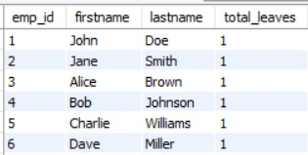

ANALYSIS
4. LEAVE AND ABSENCE PATTERNS
C. Which employees have taken the most leaves?
select e.emp_id,e.firstname,e.lastname,count(l.leave_id) as total_leaves from employee e join leaves l on e.emp_id = l.emp_id group by e.emp_id,e.firstname,e.lastname order by total_leaves desc;
D. What is the total number of leave days taken company-wide?
select count(*) as total_leaves from leaves;

Slide 18
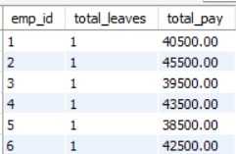
ANALYSIS
4. LEAVE AND ABSENCE PATTERNS
E. How do leave days correlate with payroll amounts?
select l.emp_id,count(l.leave_id) as total_leaves,sum(p.total_amount) as total_pay from leaves l join payroll p on l.emp_id = p.emp_id group by l.emp_id;

Slide 19

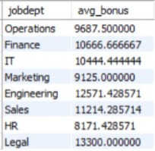
ANALYSIS
5. PAYROLL AND COMPENSATION ANALYSIS
A. What is the total monthly payroll processed?
select sum(total_amount) as monthly_pay from payroll;
B. What is the average bonus given per department?
select j.jobdept,avg(s.bonus) as avg_bonus from jobdepartment j join salarybonus s on j.job_id = s.job_id group by j.jobdept;

Slide 20
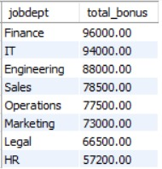

ANALYSIS
5. PAYROLL AND COMPENSATION ANALYSIS
C. Which department receives the highest total bonuses?
select j.jobdept,sum(s.bonus) as total_bonus from jobdepartment j join salarybonus s on j.job_id = s.job_id group by j.jobdept order by total_bonus desc;
D. What is the average value of total_amount after considering leave deductions?
select avg(total_amount) as avg_net_pay from payroll;

Slide 21
KEY INSIGHTS
The company maintains a structured employee management system with multiple departments, job roles, and payroll records.
Employee distribution varies across departments, indicating different operational workforce requirements.
The organization spends a significant amount on employee salaries, highlighting payroll as a major operational expense.
Finance-related roles receive the highest compensation, reflecting the importance of financial leadership within the organization.
The Finance department has the highest salary allocation, suggesting larger budget allocation for financial management functions.
Many employees possess multiple qualifications, demonstrating a skilled and professionally qualified workforce.
Leave patterns differ among employees and departments, providing insights into employee availability and workforce planning.
Bonuses and payroll amounts vary by department, indicating a performance-based compensation structure.

Slide 22
RECOMMENDATIONS
Balance Workforce Distribution: Ensure departments with higher workloads have adequate staffing to maintain productivity.
Optimize Salary Structure: Regularly review compensation policies to maintain fairness and control payroll expenses.
Implement Performance-Based Incentives: Introduce structured bonus and reward systems to motivate employees.
Monitor Leave Trends: Analyze employee leave patterns to identify potential productivity issues and improve leave management.
Promote Skill Development: Encourage employee training and professional development to enhance workforce capabilities.
Improve Payroll Monitoring: Utilize automated payroll systems for better tracking of salary expenses and financial planning.

Slide 23
CONCLUSION
The Employee Management System analysis provides a comprehensive view of workforce structure, salary distribution, qualifications, and payroll management within the organization.
The analysis highlights department-wise employee distribution, salary allocation, leave patterns, and bonus structures, helping identify key workforce and financial trends.
Insights from the data support better decision-making in HR management, payroll planning, and employee performance evaluation.
Overall, this analysis demonstrates how SQL can be effectively used to manage and analyze employee data to support organizational efficiency and strategic planning.

Slide 24



