Slide 1

End Term Project Presentation
Title: Automated Brain Cell Detection and
Segmentation Using Deep Learning
Name: K VEERA VAMSISWAR REDDY
Reg No: 215890028
Guide Name: Dr. Manaswita Saikia
School Of Computer Engineering
MIT, BENGALURU.
Academic Year:2025-2026

Slide 2
Introduction
Brain microscopy image analysis is important in biomedical research.
Manual cell detection is time-consuming and difficult.
Deep learning helps automate segmentation and detection tasks.
The project focuses on automated brain cell detection.
Multiple AI models are used for comparative analysis

Slide 3
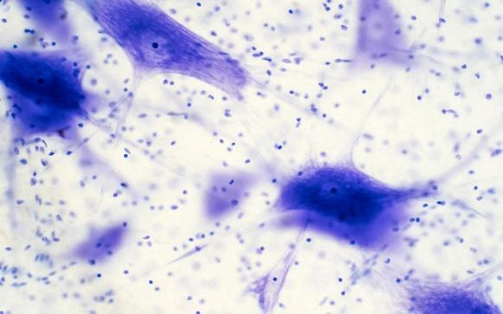
Introduction
Figure 1.1 Sample Brain Microscopy Images

Slide 4
Motivation
Manual analysis may lead to human errors.
High-resolution images are difficult to process manually.
Existing systems mostly use single-model approaches.
Automated analysis improves speed and efficiency.
Comparative frameworks improve flexibility

Slide 5
Contribution
Developed a unified deep learning framework.
Integrated segmentation and detection models.
Compared YOLOv8, BDA, and MEDIAR outputs.
Added GUI and backend workflow support.
Improved automated microscopy analysis.

Slide 6
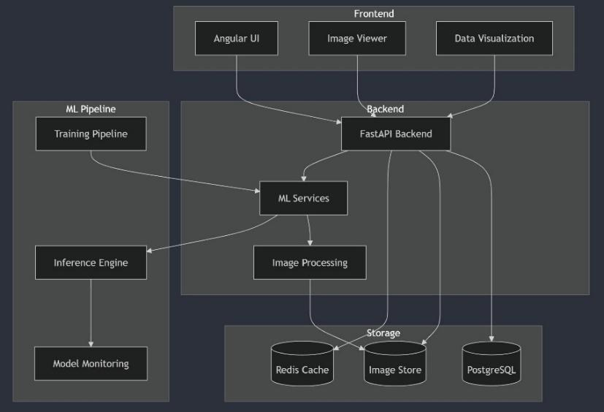
Contribution
Figure 1.2 GUI and Backend Architecture

Slide 7
Literature Review
SAM provides general-purpose segmentation masks.
YOLOv8 performs fast real-time object detection.
MEDIAR supports microscopy image segmentation.
BDA focuses on contour and boundary extraction.
Mask R-CNN provides instance-level segmentation.

Slide 8
Literature Review
Segmentation Models | Detection Models | Cell Detection Models
SAM | SAHI | BDA
CA-Net | DETR | MEDIAR
Mask R-CNN | FreeSolo | YOLOv8
Figure 1.3 Classification of Deep Learning Models Used

Slide 9
System Architecture
Input microscopy image is uploaded through GUI.
Image preprocessing is performed in backend.
Selected model processes the image.
Detection or segmentation outputs are generated.
Results are visualized in GUI.

Slide 10
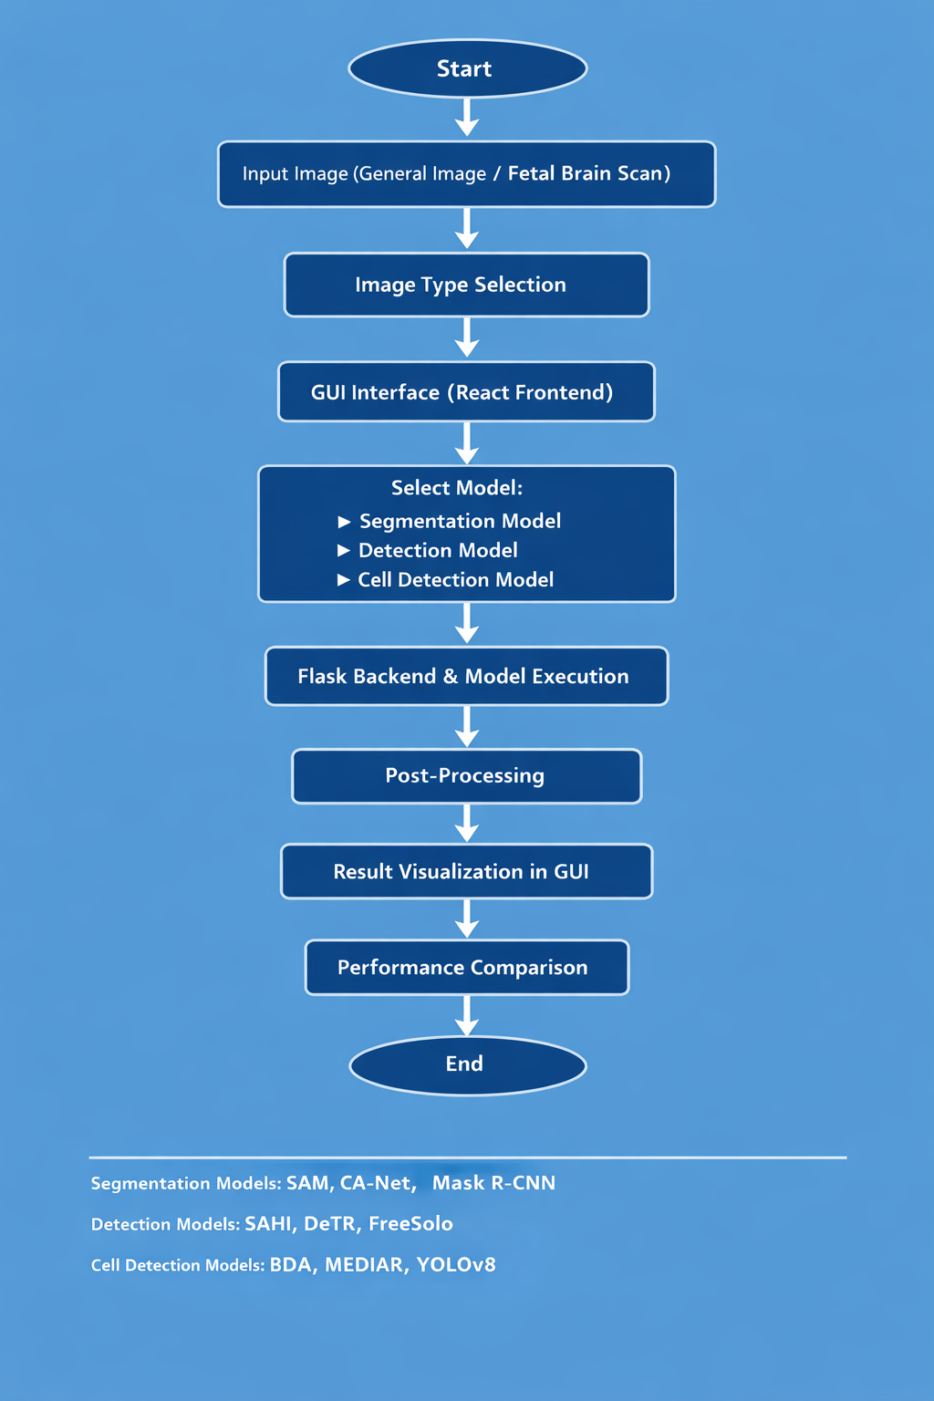
System Architecture

Slide 11
Methodology
Dataset images are preprocessed.
Images are resized and normalized.
YOLOv8 performs cell detection.
BDA extracts contour boundaries.
MEDIAR generates segmentation outputs.

Slide 12
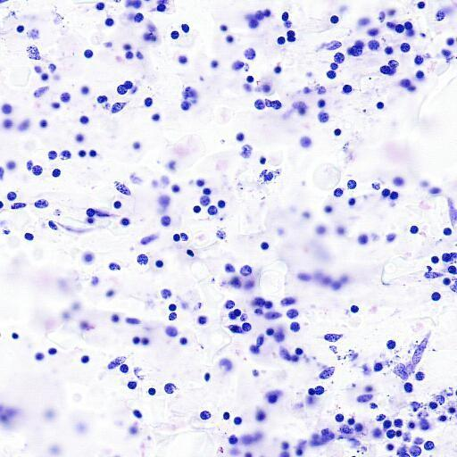
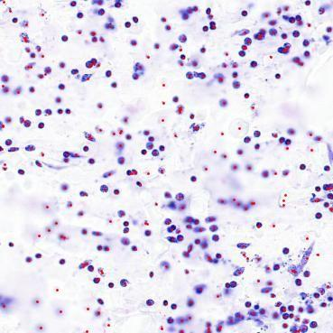
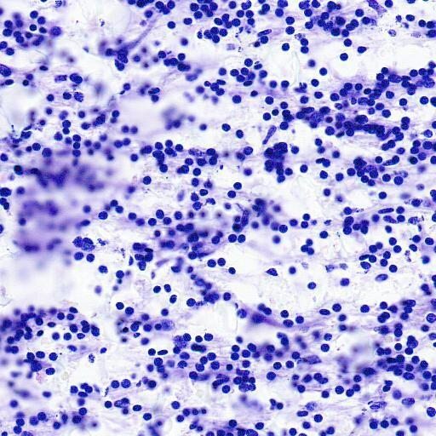
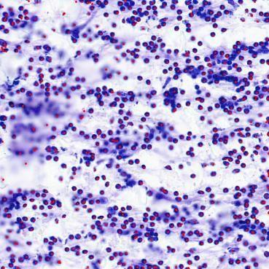
Methodology
(a) Input image (b) Yolov8/F-T results
(a) Input image (b) BDA results
Figure 1.6 YOLOV8 and BDA Detection Results

Slide 13
Tools & Tech
Python used for implementation.
OpenCV used for image preprocessing.
PyTorch and TensorFlow used for deep learning.
Flask used for backend integration.
Google Colab used for GPU execution

Slide 14
Results
YOLOv8 generated accurate cell detections.
MEDIAR produced detailed segmentation outputs.
BDA generated contour-based cell boundaries.
Outputs were compared with Ground Truth values.
Comparative analysis was performed on two datasets.

Slide 15
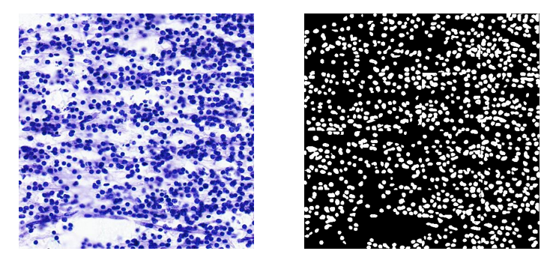
Results
Figure 1.6 MEDIAR Detection Results

Slide 16
Performance Metrics
YOLOv8/F-T achieved highest average accuracy.
MEDIAR performed well for segmentation tasks.
BDA was effective for contour extraction.
YOLOv8 showed faster inference speed.
Comparative evaluation improved analysis quality.

Slide 17
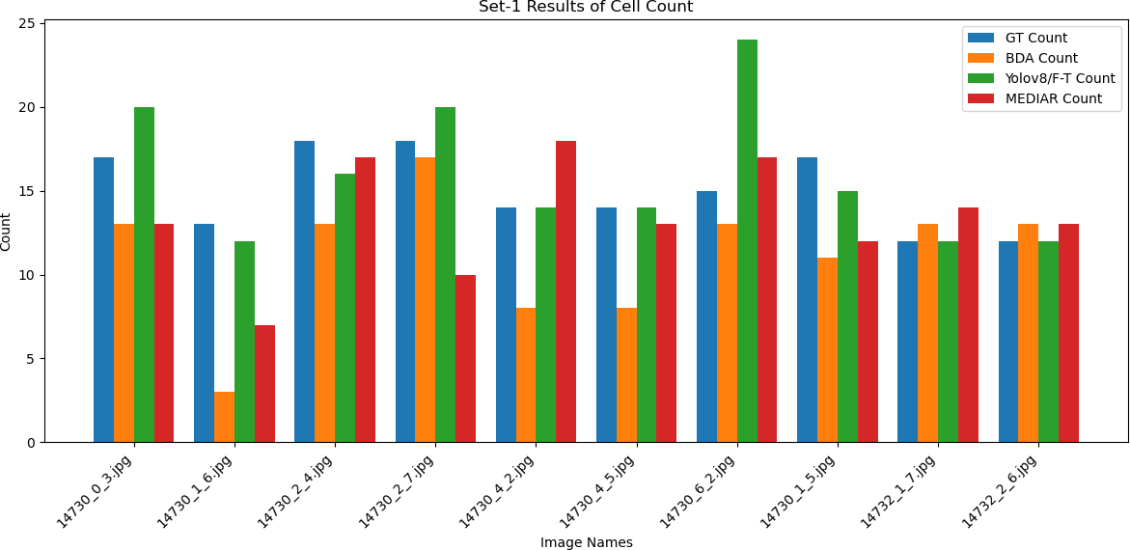
Performance Metrics
Figure 1.7 Set-1 Results of cell count

Slide 18
Analysis
YOLOv8 produced results closer to Ground Truth.
MEDIAR improved segmentation quality.
BDA performed better for contour visualization.
Multi-model integration improved flexibility.
Deep learning improved automated analysis.

Slide 19
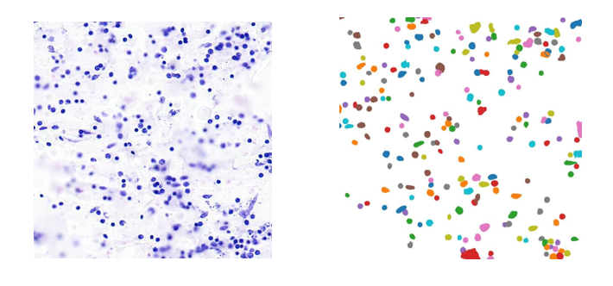
Analysis
Figure 1.8 BDA Contour Detection Output

Slide 20
Conclusion
Automated brain cell detection framework was developed.
Multiple models were integrated successfully.
YOLOv8 achieved highest detection accuracy.
MEDIAR improved segmentation performance.
The framework supports biomedical image analysis.

Slide 21
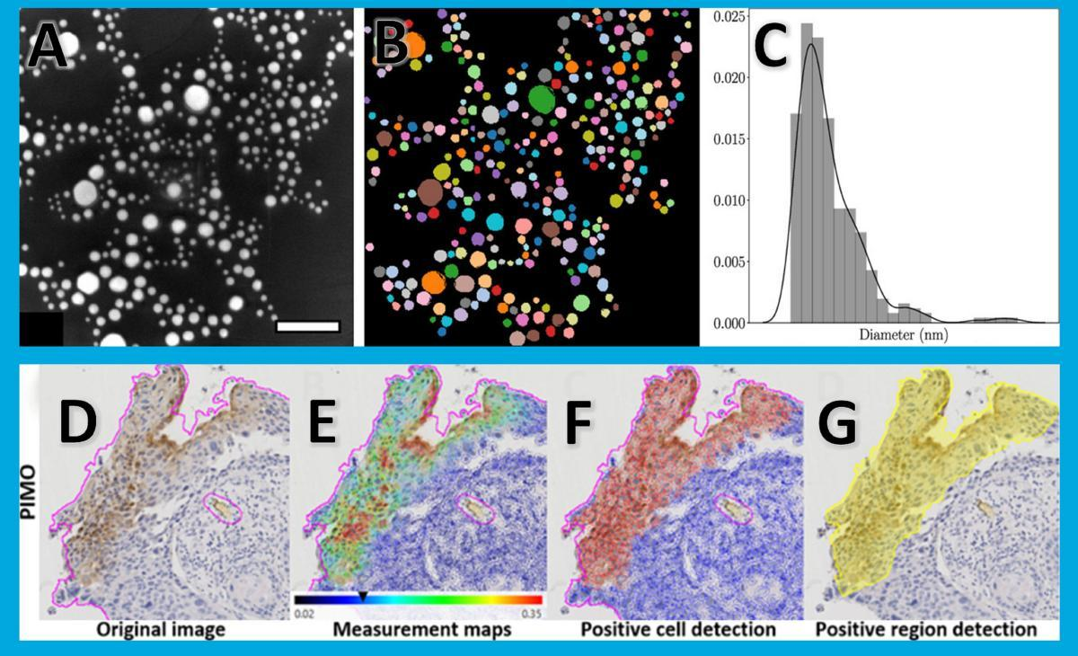
Conclusion
Figure 1.9 Comparative Output Visualization

Slide 22
Future Scope
Add larger microscopy datasets.
Improve model optimization.
Develop real-time web deployment.
Integrate additional AI models.
Extend system for medical diagnosis.

Slide 23
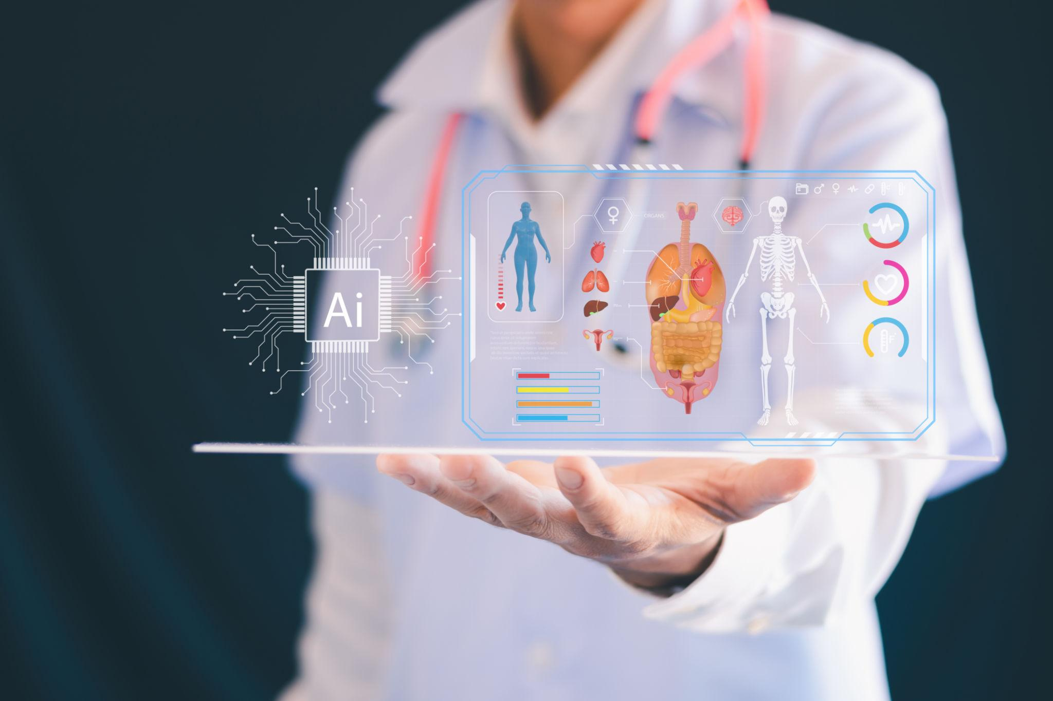
Future Scope

Slide 24
References
[1] Kirillov et al., Segment Anything, ICCV 2023
[2] Redmon et al., You Only Look Once, CVPR 2016
[3] He et al., Mask R-CNN, ICCV 2017
[4] Carion et al., End-to-End Object Detection with Transformers (DETR), ECCV 2020
[5] Lee et al., MEDIAR: Harmony of Data-Heterogeneity and Model-Uncertainty, NeurIPS 2022
[6] Upschulte et al., Contour Proposal Networks for Biomedical Instance Segmentation, 2022

Slide 25
Thank You

