Slide 1
Solutions
Tutorial 15th Feb,2019

Slide 2
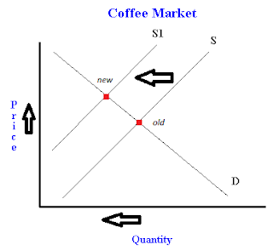
Answer to Q-2
If a drought kills off coffee plants then we will see a decrease in supply. This happens because productivity goes down due to drastic weather. Nothing happens to demand, so equilibrium price goes up.

Slide 3
Answer to Q 3
Now suppliers do not get the full price when they make a sale - they get Rs.6 less. This changes our supply curve to: P - 6 = 20 + 2Q (Supply)
P = 26 + 2Q (Supply)
To find the equilibrium price, set the demand and supply equations equal to each other:
80 - Q = 26 + 2Q
54 = 3Q
Q = 18
Thus our equilibrium quantity is 18. To find our equilibrium (tax inclusive) price, we substitute our equilibrium quantity into one of our equations. I'll substitute it into our demand equation:
P = 80 - Q
P = 80 - 18
P = 62
Thus the equilibrium quantity is 18, the equilibrium price (with tax) is Rs.62, and the equilibrium price without tax is rs.56. (62-6)

Slide 4
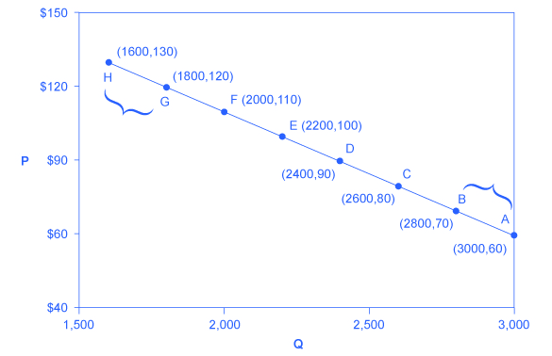
Answer to Q-4 Calculating the Price Elasticity of Demand. The price elasticity of demand is calculated as the percentage change in quantity divided by the percentage change in price.

Slide 5
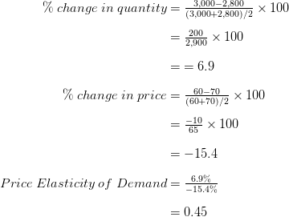
First, apply the formula to calculate the elasticity as price decreases from $70 at point B to $60 at point A:

Slide 6
Explanation of Q-4
Therefore, the elasticity of demand between these two points is which is 0.45, an amount smaller than one, showing that the demand is inelastic in this interval.
Price elasticities of demand are always negative since price and quantity demanded always move in opposite directions (on the demand curve). By convention, we always talk about elasticities as positive numbers. So mathematically, we take the absolute value of the result.
This means that, along the demand curve between point B and A, if the price changes by 1%, the quantity demanded will change by 0.45%. A change in the price will result in a smaller percentage change in the quantity demanded.

Slide 7
Answers (Q-4)
From point B to point C, price rises from $70 to $80, and Qd decreases from 2,800 to 2,600. So: EoD= 0.56
(from %ΔQ / % ΔP). Demand Curve is inelastic in this area; that is, its elasticity value is less than one.
From Point D to point E: EoD=0.83(Inelastic)
From Point G to point H: EoD= 1.51(Elastic as >1)

Slide 8
Answer to Q -5
Cars Computers
United States 4 20
Russia 1 5
.
b) No. Each can get the same tradeoff between goods domestically.
c) Yes. There needs to be differences in opportunity costs of producing goods across countries for there to be gains from trade.

Slide 9
Answer to Q-6
With a price elasticity of demand of 0.4, reducing the quantity demanded of cigarettes by 20% requires a 50% increase in price, because 20/50 = 0.4. With the price of cigarettes currently $2, this would require an increase in the price to $3.33 a pack using the midpoint method (note that ($3.33 – $2)/$2.67 = .50).
The policy will have a larger effect five years from now than it does one year from now. The elasticity is larger in the long run, because it may take some time for people to reduce their cigarette usage. The habit of smoking is hard to break in the short run.

Slide 10
Answer to Q-1
We know that the equilibrium quantity will be where supply meets or equals, demand. So first we'll set supply equal to demand:
100 - 6P = 28 + 3P
If we re-arrange this we get:
72 = 9P
Which simplifies to P = 8.
Now we know the equilibrium price, we can solve for the equilibrium quantity by simply substituting P = 8 into the supply or the demand equation. For instance, substitute it into the supply equation to get:
S = 28 + 3*8 = 28 + 24 = 52.
Thus, the equilibrium price is 8, and the equilibrium quantity is 52

