Slide 1
Unified Insights from Structured and Unstructured Data
Hybrid Agent Validation
Structured Claims Data
Unstructured Policy Docs

Slide 2
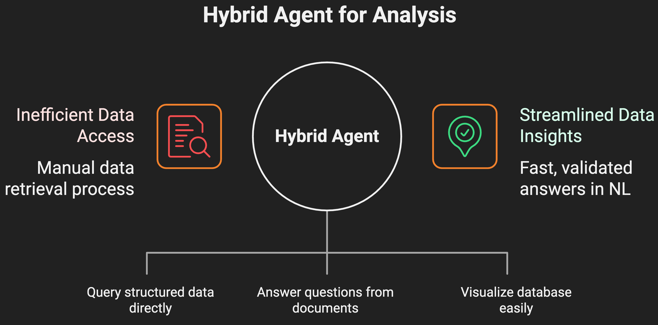

Slide 3
RAG+ Text2SQL Architecture Overview
User Query
Streamlit UI
Sidebar DB Selector
RAG+ Text2SQL Architecture
Database Explorer
Chat Panel
Tools
Model
SQL over SQLite
Grok Free
Document Search
Enterprise LLMs

Slide 5
Reliability and Future Steps
Dialect Hints
Future Postgres Version
Dialect hints are used, nothing is cached, and trust scores are included in document answers.
A future version of Postgres will be implemented.
NER
Schema Primer
Named entity recognition will be implemented.
A schema primer or few- shots will be provided.
Evaluation Harness
MAUs Dashboards
An evaluation harness will be created.
Monthly active users dashboards will be created.

Slide 6
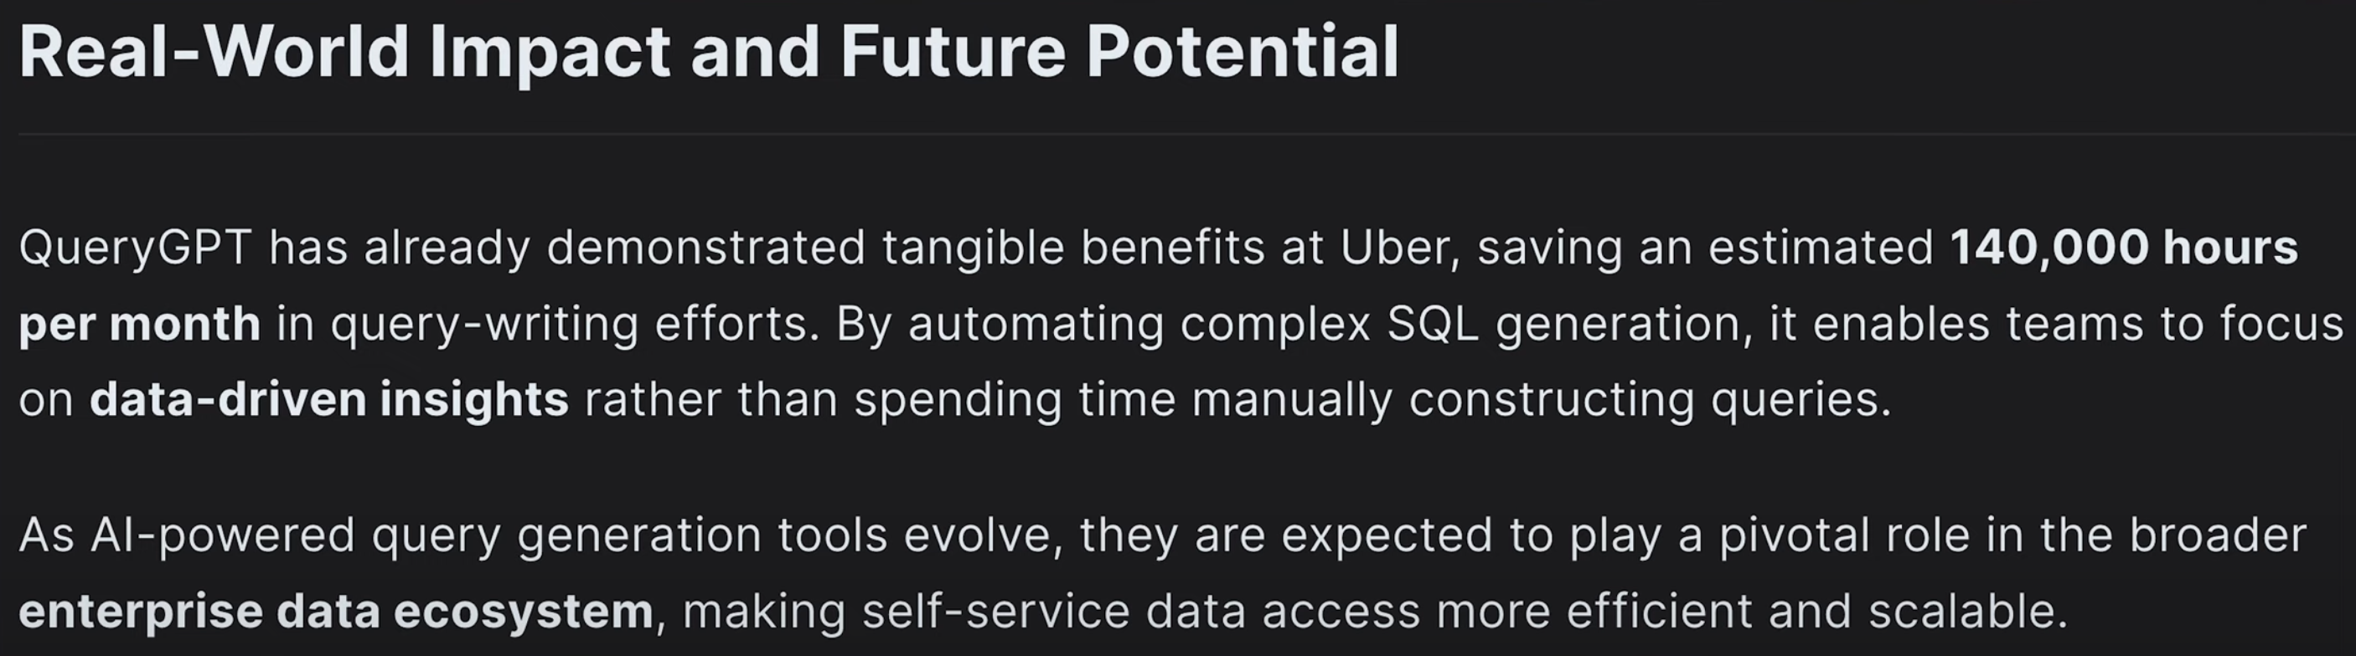
Bussiness Impact

