Slide 1
The Coming War: ARM versus x86
5/19/2011 by: Van Smith

Slide 2
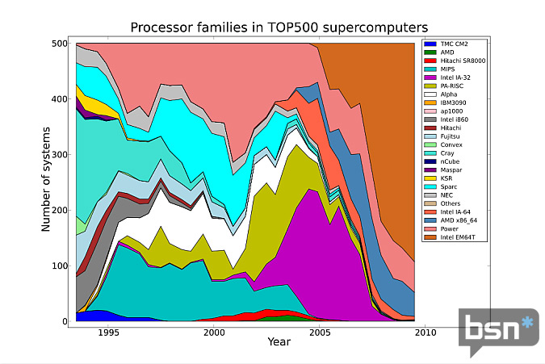
x86 microprocessor have taken over supercomputing

Slide 3
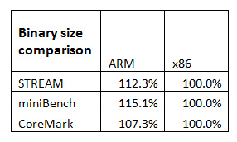
This table shows that ARM Cortex binaries are indeed larger than x86 binaries, but the difference is only about 10-15 percent.

Slide 4
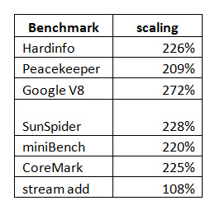
Benchmarking Considerations
… all of the benchmarks scaled appropriately with the exception of Google V8 and Stream Add, a memory bandwidth test that is constrained by memory performance and is included here as a counter example.

Slide 5
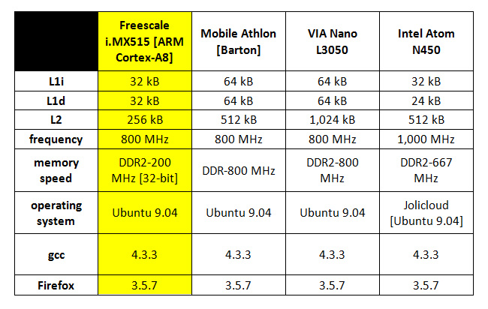
CPUs under test

Slide 6
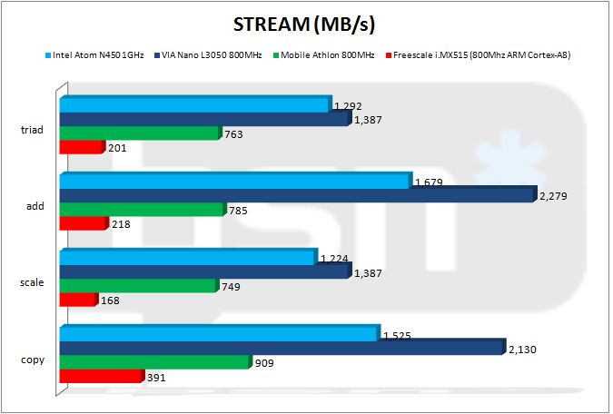
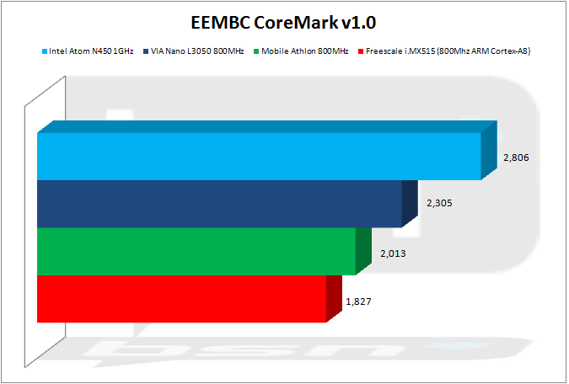
STREAM and EEMBC
STREAM
EEMBC CoreMark v1.0

Slide 7
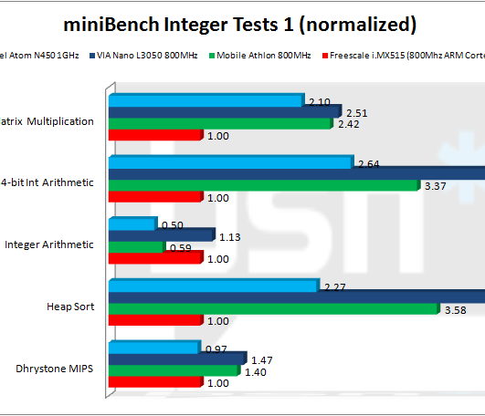
OpenSourceMark Benchmarking
"miniBench" is a diverse benchmark that I’ve been working on for several years. It’s part of my OpenSourceMark benchmarking project. miniBench contains a wide variety of popular tests and runs quickly from the command-line. I also have a GUI-based version that I wanted to use for this report but could not do so because the Qt tool chain would not install completely on the ARM system. Instead, I used the excellent and relatively lightweight Code::Blocks IDE to create and manage the necessary C++ project files for a command-line binary.

Slide 8
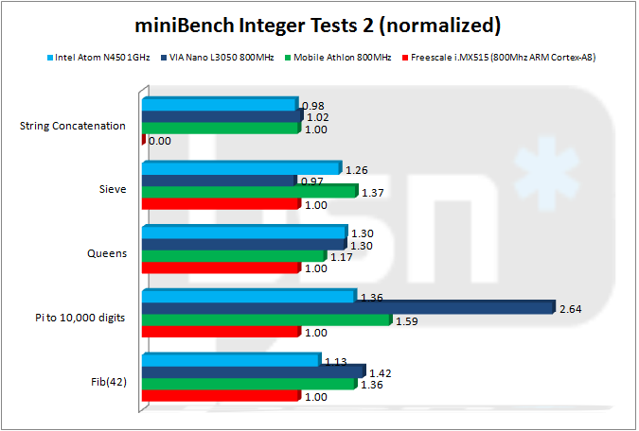
More miniBench
On the second set of miniBench integer tests, the ARM Cortex-A8 holds its own against the brawnier x86 CPUs. The ARM Cortex-A8 even beat the VIA Nano L3050 on the Sieve test. More remarkably, the Cortex-A8 is very close to parity with the Atom across all of these tests, save for one, if the Atom’s 25 percent clock speed advantage is considered.

Slide 9
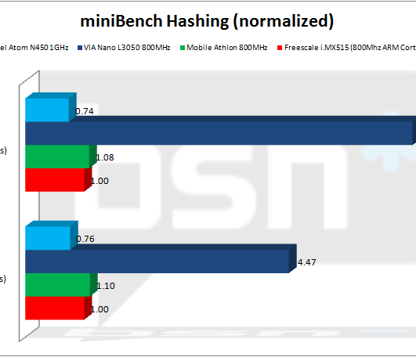
Nano Hashes Best
The VIA Nano L3050 obliterates all of the competition on the hashing tests because the Nano features hardware support for these important security functions. However, the 800MHz ARM Cortex-A8 is amazingly good at hashing and thoroughly beats the 1GHz Atom on both tests and is only slightly slower than the Athlon.

Slide 10
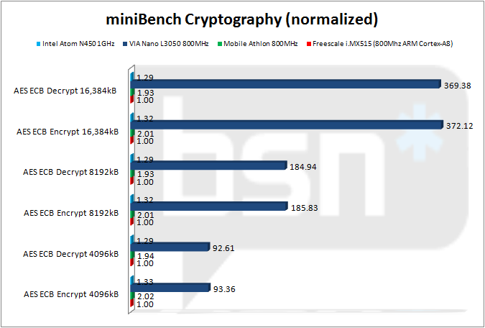
Cryptography

Slide 11
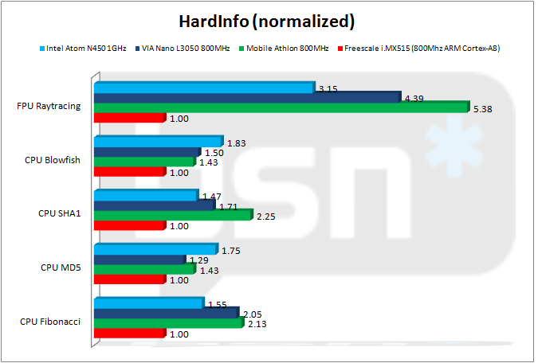
Ubuntu CPU Benchmark
HardInfo is one of the few CPU benchmarks available from within Ubuntu’s repositories.

Slide 12
Floating Point Performance
0
.005
Gaming
1/2
01
Spreadsheets
*
1A
Scientific Computation

Slide 13
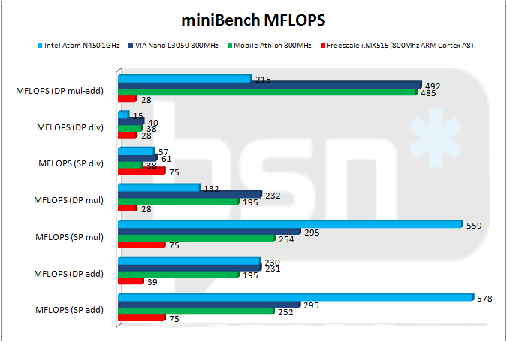
It is also worthwhile to recognize the very good floating-point division performance of the ARM Cortex-A8’s Neon.

Slide 14
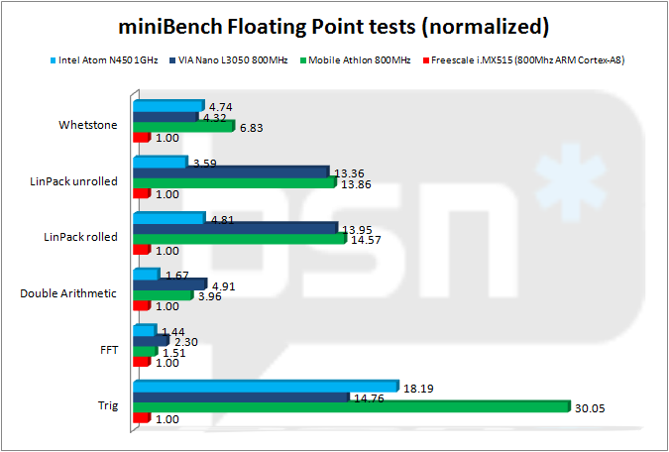
Floating Point

Slide 15
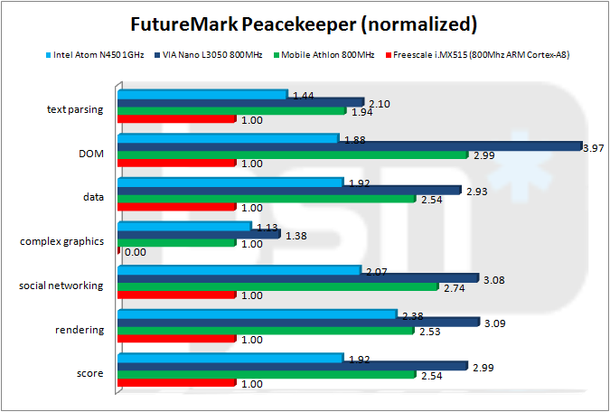
Java Script Performance

Slide 16
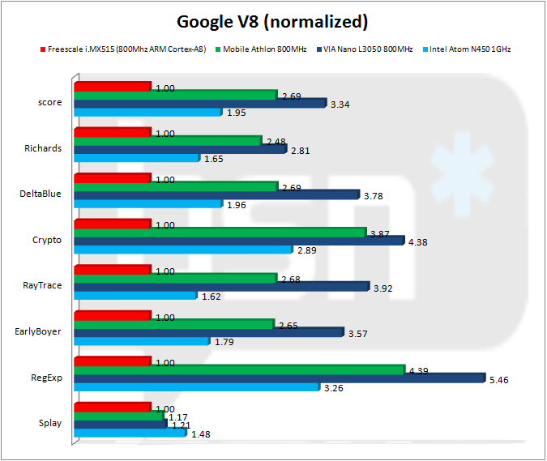
G
O
O
G
L
E
V8
Flawed but popular

Slide 17
SunSpider JavaScript Test
ARM Cortex-A8 fares only slightly better than on the other two JavaScript benchmarks.
VIA Nano L3050 barely pulls out an overall win, its score hurt by very poor performance on bit level operations.
ARM Cortex-A8 beats the Nano on two of these tests.
AMD Mobile Athlon based on the Barton core has delivered competitive performance across nearly all tests.

Slide 18
2D Graphics Performance
Ran GtkPerf 0 0.40
The VIA, Intel and Freescale systems all used integrated graphics while the AMD system was equipped with a discrete NVIDIA NX6200 AGP card.
The three x86 systems ran at 24-bit color depth
They were two to three times faster than the ARM system.
ARM ran at only 16-bit color depth.
All systems tested at 1024x768 [XGA] resolution
Except the Atom, which was tested at the native panel resolution of 1024x600.

Slide 19
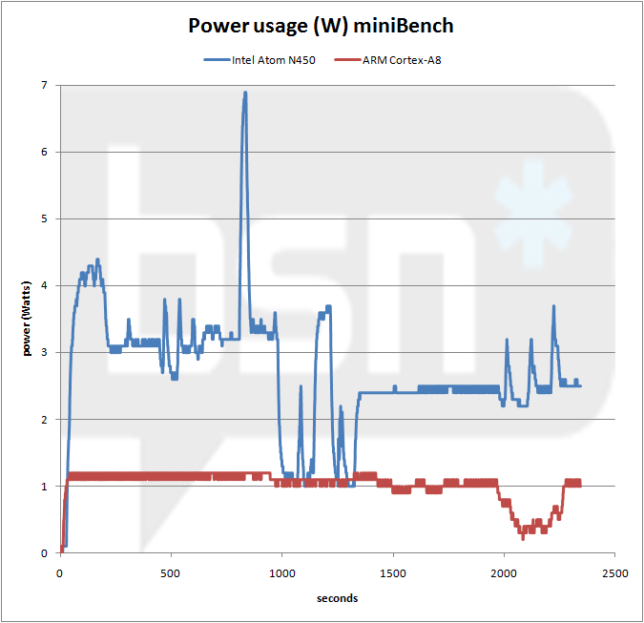
Power consumption
This chart contrasts power consumption between the Intel Atom N450 and the ARM Cortex-A8 while running miniBench.
The power curves were generated from system power usage adjusted downwards so that idle system power was discarded.
For the Atom, idle power was 13.7W with the Gateway netbook’s integrated panel disabled
The idle power for the Pegatron system was only 5.4W.

Slide 20
Conclusion
The ARM Cortex-A8 achieves competitive performance across many integer-based benchmarks while consuming power at levels far below the most energy miserly x86 CPU, the Intel Atom.
However, the ARM Cortex-A8 sample that we tested in the form of the Freescale i.MX515 lived in an ecosystem that was not competitive with the x86 rivals in this comparison. The video subsystem is very limited. Memory support is a very slow 32-bit, DDR2-200MHz.

Slide 21
About the author Van Smith is currently working in his own company called Cossatot Analytics Laboratories. Van was head of benchmarking for Centaur and represented VIA Technologies within the BAPCo benchmark consortium. Van has written a number of computer benchmarks including OpenSourceMark and miniBench and he has influenced or directly contributed to many others. For instance, Van wrote the cryptography tests in SiSoftware Sandra.

Slide 22
Notes:
Slideshow complete.

