Slide 1
SLIDE BÁO CÁO
Model du bao thue bao dat 3k3d

Slide 2
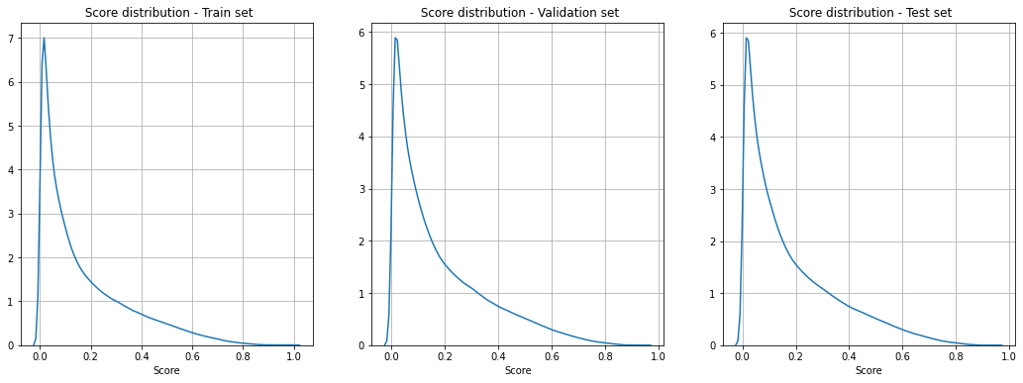
Score Distribution

Slide 3
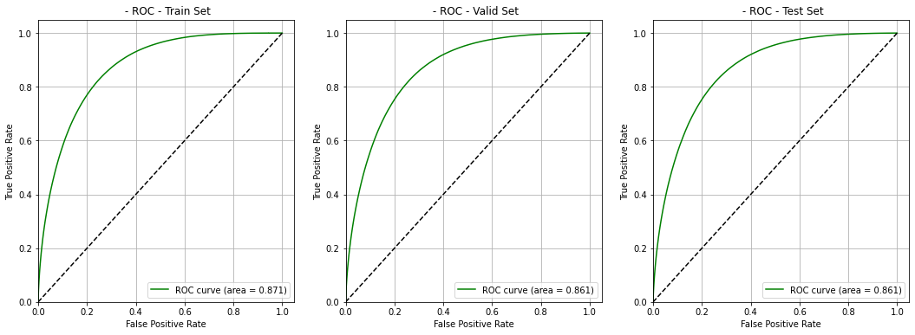
ROC

Slide 4
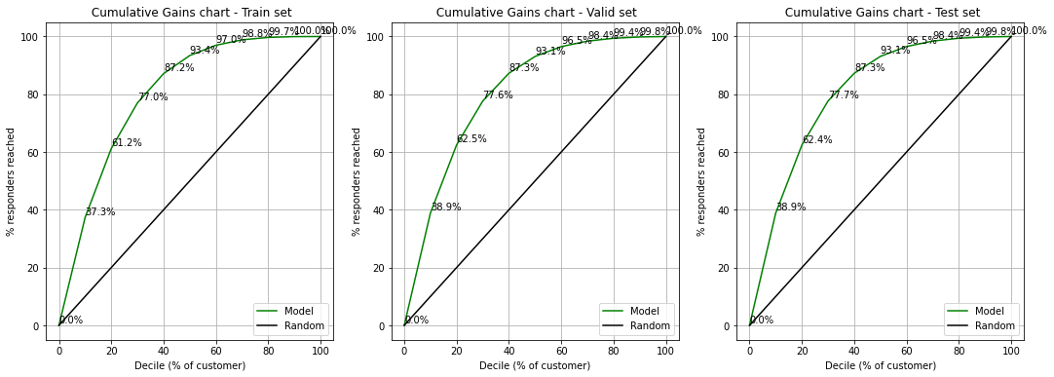
Cumulative Gain Chart

Slide 5
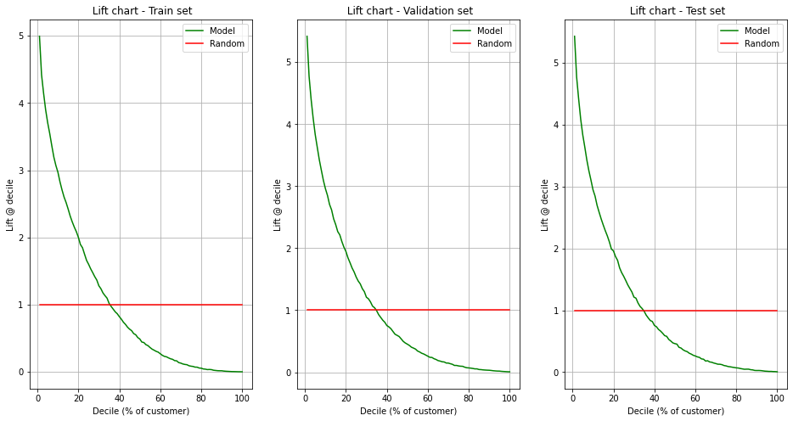
Lift chart

Slide 6
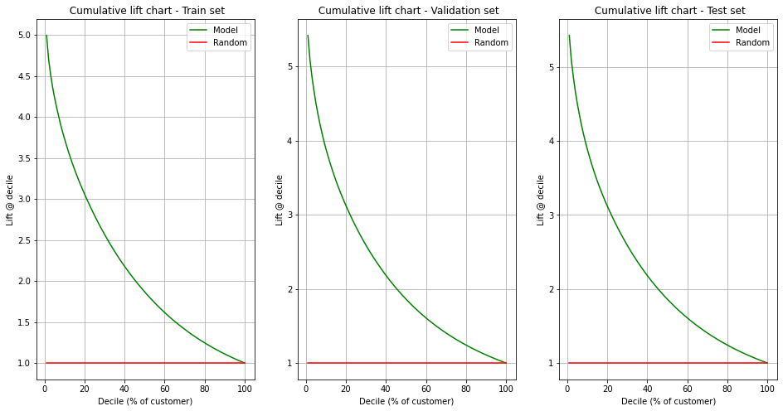
Cumulative lift chart

Slide 7
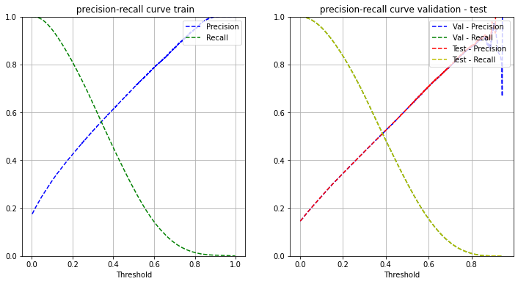
Precision-Recall curve

