Slide 1
Team Members
Yash – E21CSEU0703 Abhiram – E21CSEU0673 Dhurv Chauhan – E21CSEU0863 Vanshika Agrawal – E21CSEU0682 Utkarsh Singh – E21CSEU0672
Title: Metro Connectivity

Slide 2

Introduction
The app's purpose is to enable users to communicate in real-time while traveling on a metro network, facilitating networking, coordination, and social interaction. The app's features include real-time messaging, user authentication based on a unique nickname, and a centralized server that facilitates communication between users.

Slide 3
Why this project?
Lack of communication in public transport
Convenience and speed
Group messaging
Real-time communication
Privacy

Slide 4
Target Audience
The app is designed primarily for users traveling on a metro network, such as commuters, travelers, and tourists. These users can benefit from the app by connecting with other users, sharing information about the metro network, and enhancing their overall travel experience.

Slide 5
Technical Details
The app uses Python programming language and several libraries such as threading, socket libraries, and the tkinter library for the GUI.

Slide 6
Client and Server
Client
Server
The app creates a TCP/IP socket connection to the server's IP address and port, and the socket library is responsible for the creation and management of sockets.
The app uses the socket library to create a TCP/IP socket and bind it to a specified IP address and port.

Slide 7
User Interface
Text input field
Send Button
Chat Window
a Text input field for users to enter messages
a send button to send the message to the server
a chat window or text output field where the messages from other users and the user's own messages are displayed.

Slide 8
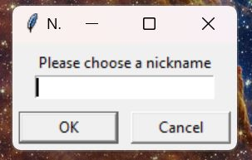
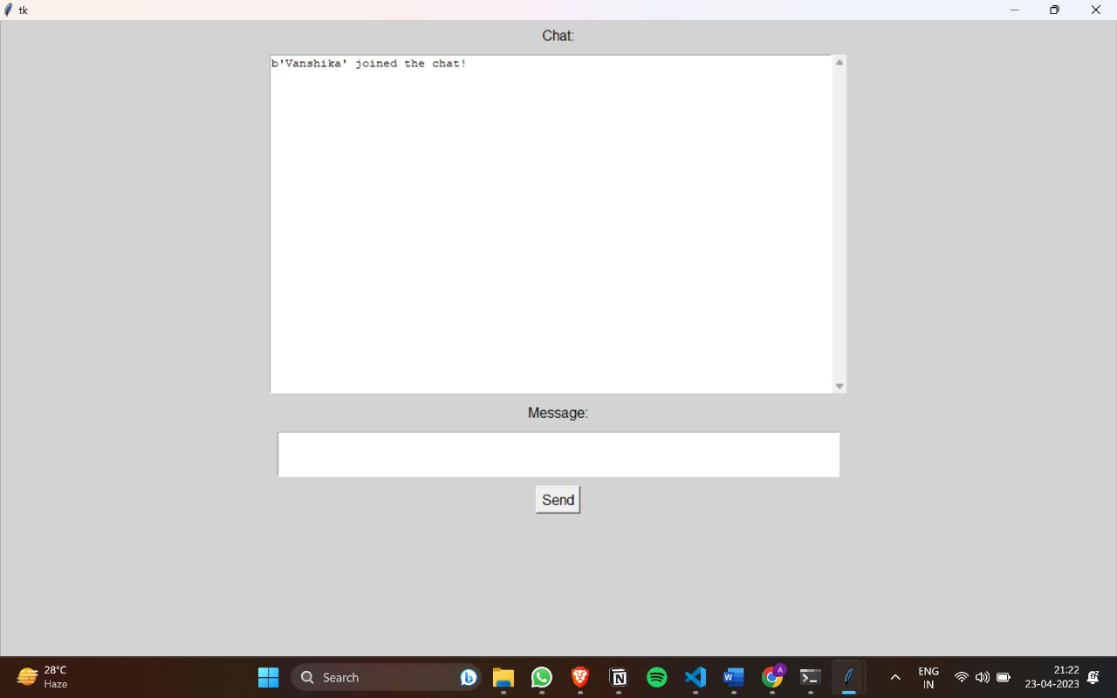
User Interface

Slide 9
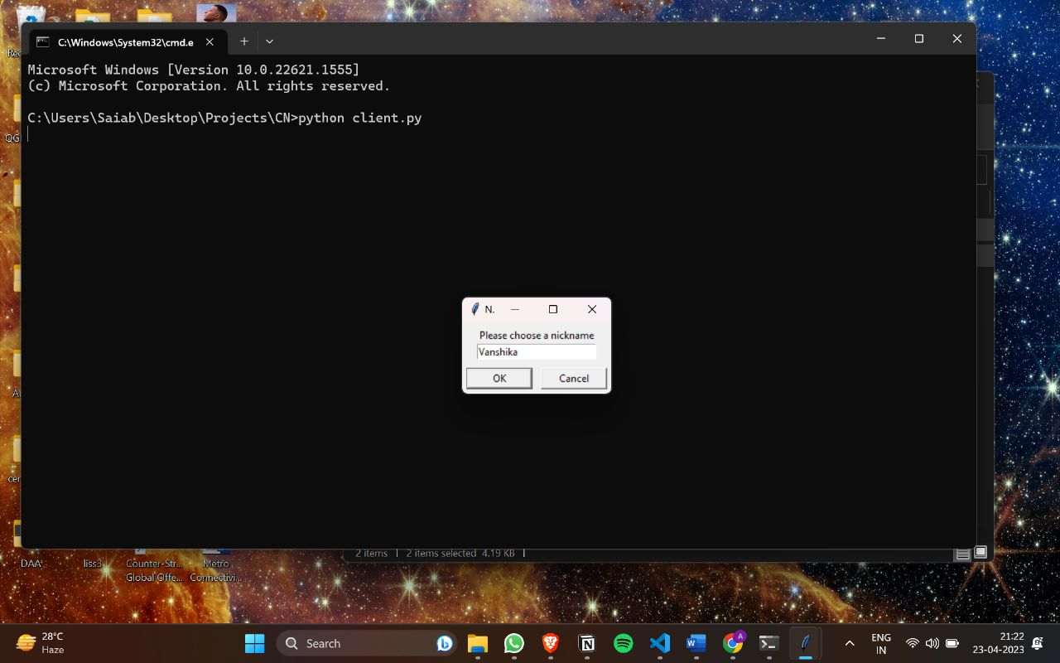
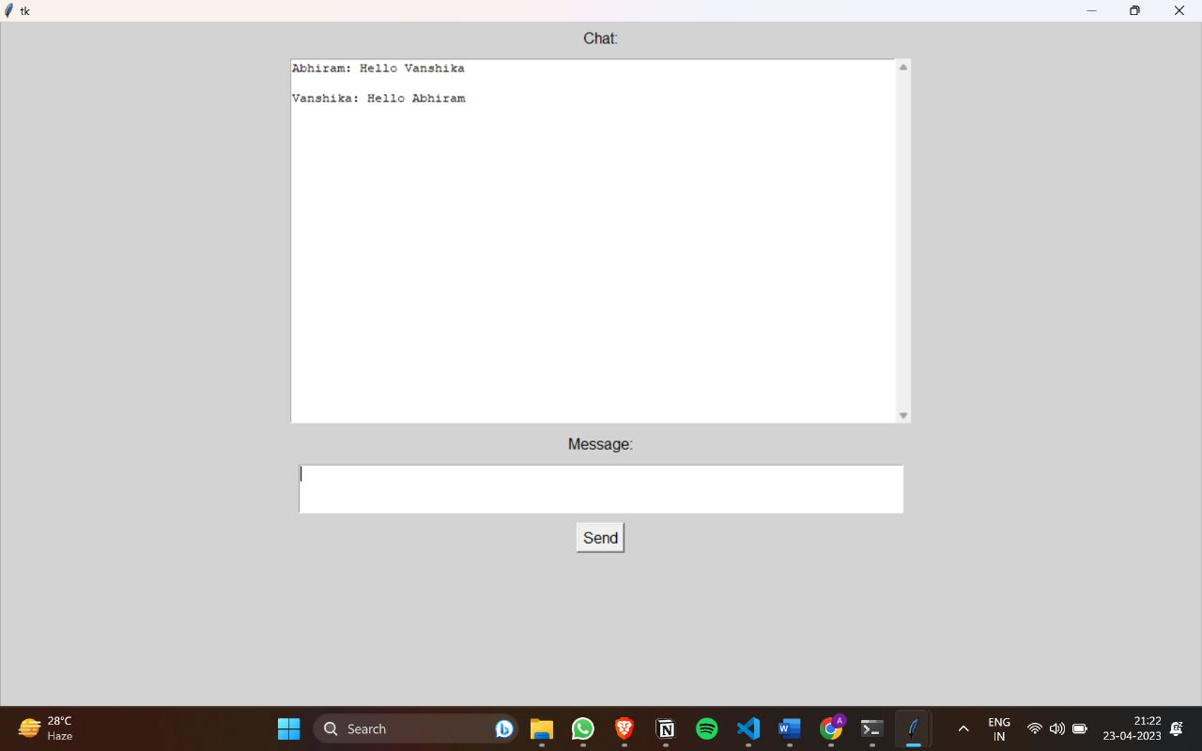
User Interface

Slide 10
Conclusion
Overall, the metro network communication app project offers a solid foundation for building a messaging app that connects users in a metro network. Its technical details that involve threading, socket libraries, and tkinter libraries for the GUI make it efficient, reliable, and user-friendly. With some improvements in security, input validation, load balancing, and scaling mechanisms, this app can accommodate a large number of users and provide a secure messaging platform.

Slide 11
Thank You

