Slide 1
Aspect-Based
Sentiment Analysis
Vietnamese Shopee Product Reviews using Traditional Machine Learning
TF-IDF
Logistic Regression
Linear SVM
2,466
4
0.7964
Shopee review comments
Aspect classifiers
LR avg. Macro F1
From one review → four aspect-level sentiment labels

Slide 2
Project framing: one review, multiple opinions
Traditional sentiment analysis loses aspect-specific information; ABSA keeps it.
Input review example
Output labels
Product quality
negative
“Giao hàng nhanh, đóng gói cẩn thận nhưng sản phẩm hơi mỏng so với giá.”
→
Packaging
positive
Delivery
positive
Price
negative
Why this matters
Modeling decision
• The same comment can mention several aspects.
• Each aspect may carry a different sentiment polarity.
• Aspect-level labels are more useful than one overall sentiment.
• Train four separate 3-class classifiers.
• Use the same cleaned comment and TF-IDF vector for each classifier.
• Evaluate per aspect and average across aspects.
ABSA Vietnamese Shopee Reviews
02

Slide 3
Dataset and labeling scheme
Four independent aspect-level labels are attached to each review.
2,466
4
3
✓
Rows / customer reviews
Aspect label columns
Sentiment classes
Labels standardized
Aspect columns
Label meaning
Column
Meaning
Label
Interpretation
chat_luong
Product quality
positive
Satisfaction toward the aspect
dong_goi
Packaging
negative
Complaint or dissatisfaction
van_chuyen
Delivery
neutral
Aspect not clearly mentioned or sentiment unclear
gia_ca
Price
Key design: labels are assigned independently, so one review can be positive for delivery but negative for price or quality.
ABSA Vietnamese Shopee Reviews
03

Slide 4
Preprocessing and feature extraction pipeline
The pipeline reduces informal review noise and converts Vietnamese text into sparse numerical features.
Raw comment
→
Clean text
→
Normalize Vietnamese
→
TF-IDF vector
→
Four classifiers
Shopee text
lowercase, URLs, punctuation
teencode + repeated chars
unigrams + bigrams
one per aspect
Preprocessing choices
TF-IDF configuration
• Lowercasing, URL removal, punctuation normalization, whitespace normalization.
• Repeated character and repeated punctuation normalization.
• Vietnamese teencode normalization: “ko/k/khum” → “không”; “sp” → “sản phẩm”.
• Negation words are preserved because they change sentiment polarity.
Item
Setting
Samples fitted on
1,972 training comments
N-gram range
unigram + bigram
min_df / max_df
2 / 0.95
Final features
3,084 TF-IDF dimensions
ABSA Vietnamese Shopee Reviews
04

Slide 5
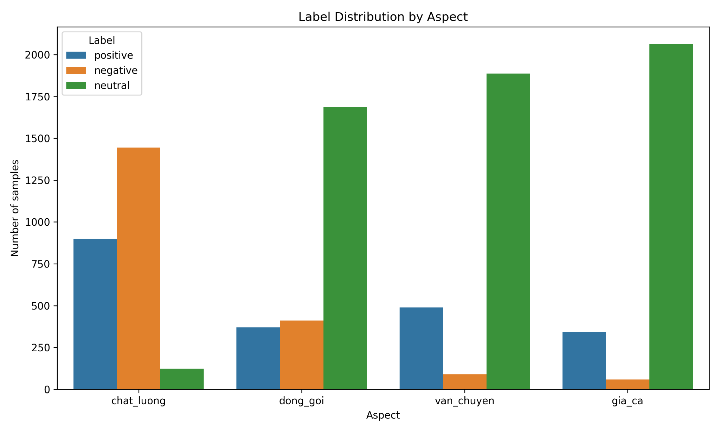
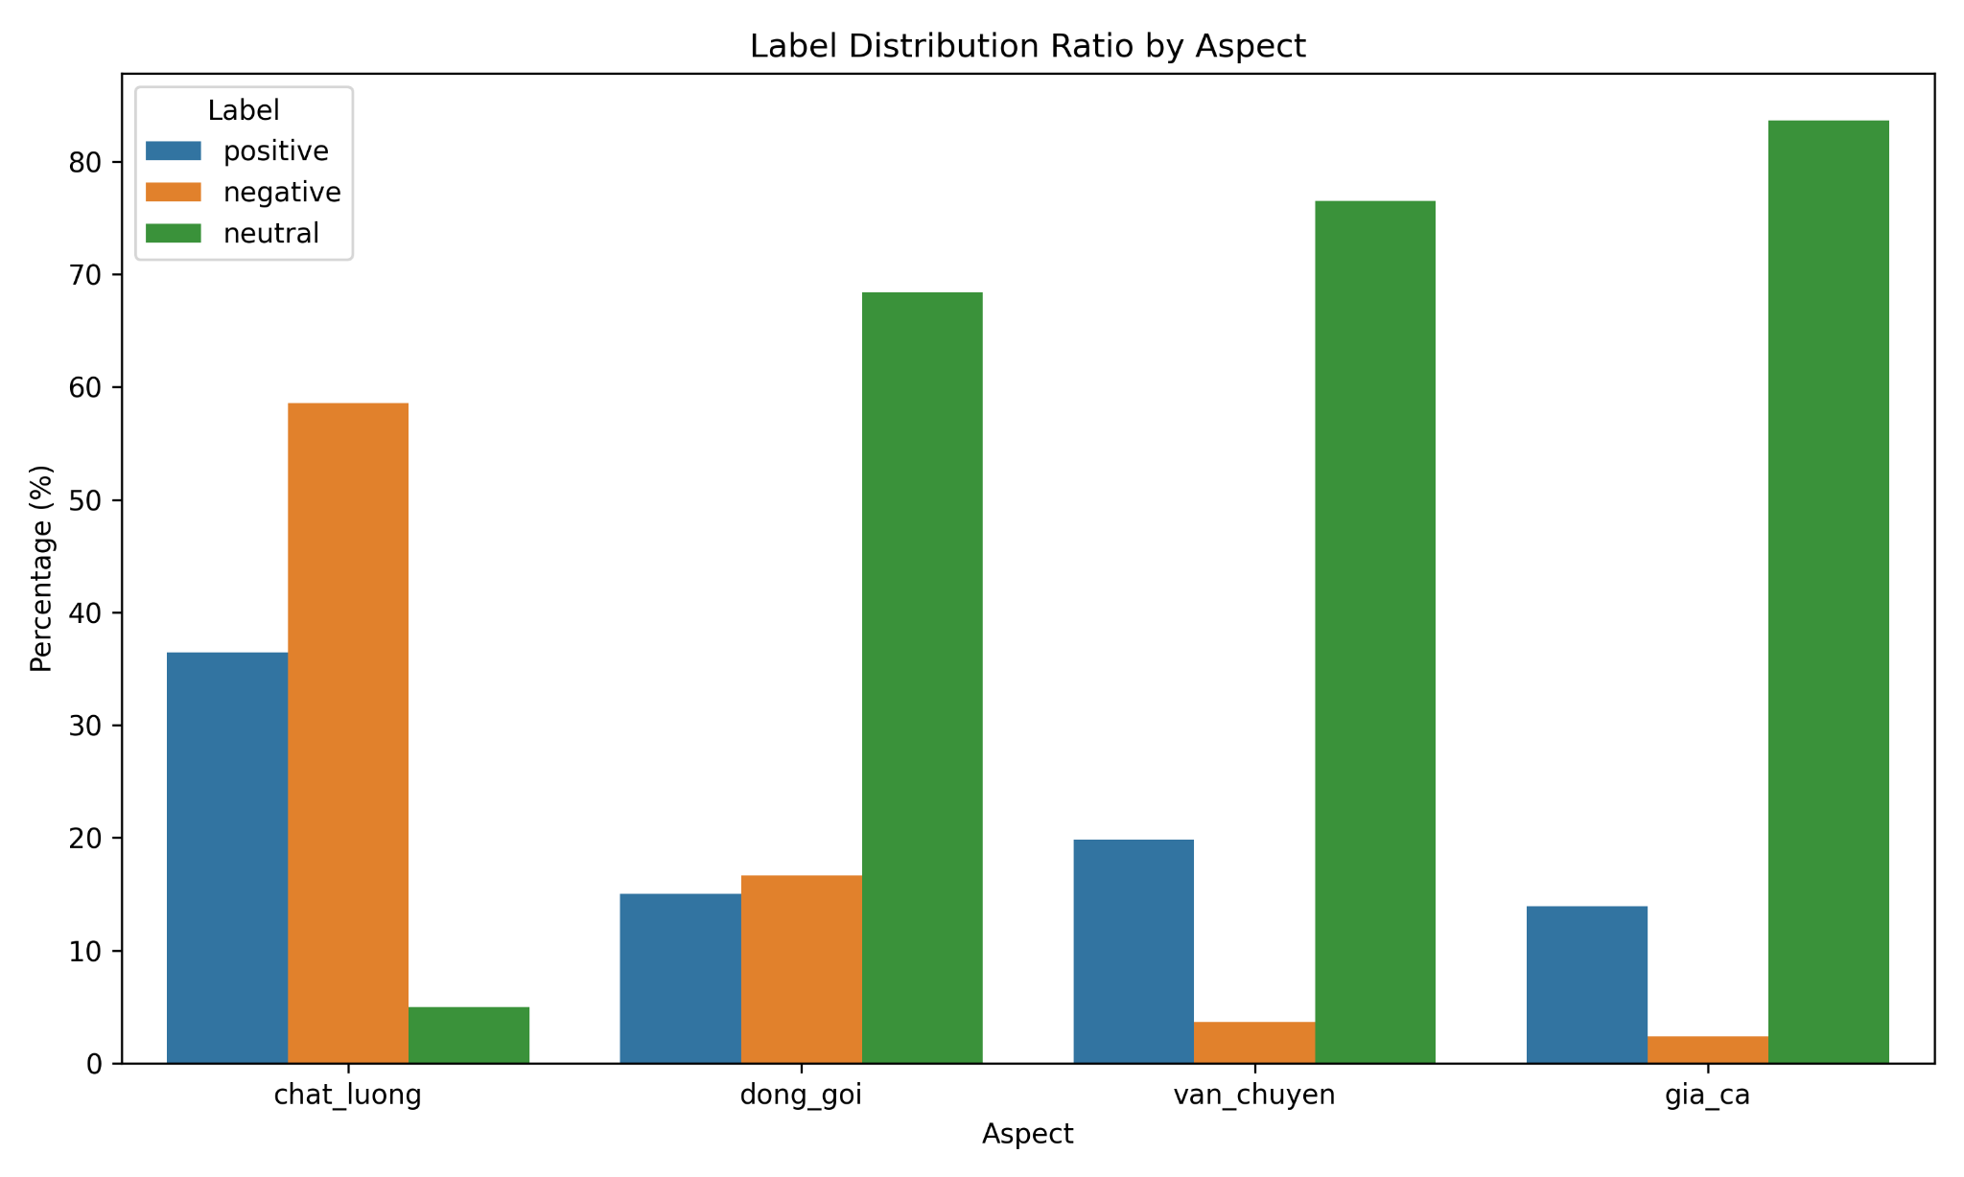
Class imbalance is the central data challenge
Price and delivery are dominated by neutral labels, while product quality is dominated by negative labels.
Interpretation: Macro F1 is necessary because accuracy would be inflated by majority classes, especially neutral labels in gia_ca and van_chuyen.
ABSA Vietnamese Shopee Reviews
05

Slide 6
Main model: Logistic Regression as four interpretable classifiers
Each aspect is trained separately but uses the same TF-IDF representation.
Architecture
→
chat_luong
pos / neg / neu
Cleaned
comment
→
TF-IDF
3,084 features
→
dong_goi
→
pos / neg / neu
van_chuyen
→
pos / neg / neu
gia_ca
→
pos / neg / neu
Why Logistic Regression?
Main evaluation focus
• Strong baseline for sparse TF-IDF text features.
• Efficient for small-to-medium datasets.
• Feature weights are useful for interpretation.
• class_weight="balanced" reduces majority-class dominance.
• Accuracy, precision, recall, Macro F1, Weighted F1.
• Macro F1 is the primary metric under imbalance.
• Confusion matrices are used for class-wise error analysis.
ABSA Vietnamese Shopee Reviews
06

Slide 7
Logistic Regression performance by aspect
Packaging performs best; price is hardest due to extreme minority-class scarcity.
Aspect
Accuracy
Macro F1
Weighted F1
Key readings
chat_luong
0.8725
0.7813
0.8754
• Best Macro F1: dong_goi = 0.8435.
• Lowest Macro F1: gia_ca = 0.7552.
• High accuracy on delivery and price mostly reflects many neutral samples.
• Macro F1 reveals minority-class difficulty better than accuracy.
dong_goi
0.8846
0.8435
0.8847
van_chuyen
0.9575
0.8058
0.9640
gia_ca
0.9555
0.7552
0.9546
Takeaway: Logistic Regression is competitive and interpretable, but minority classes remain fragile when labels are strongly imbalanced.
ABSA Vietnamese Shopee Reviews
07

Slide 8
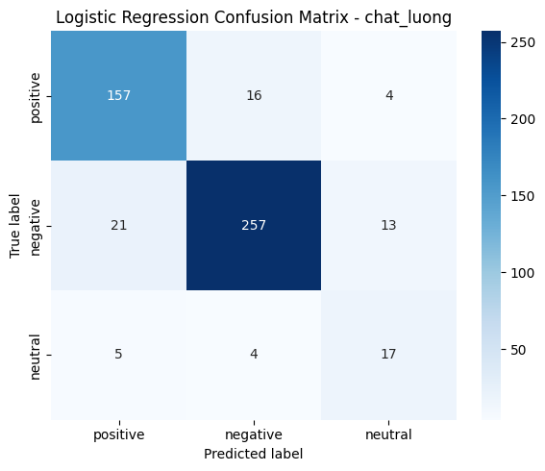
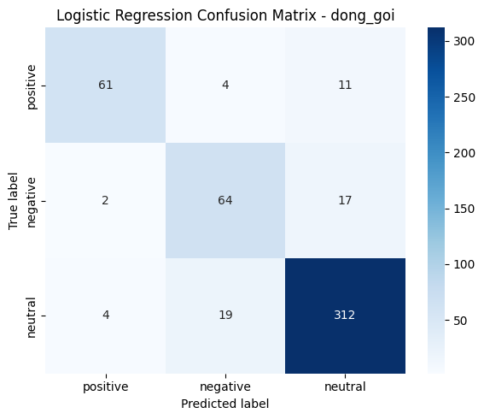
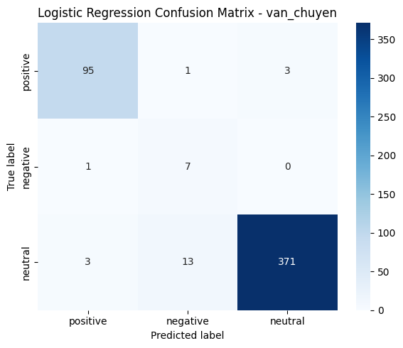
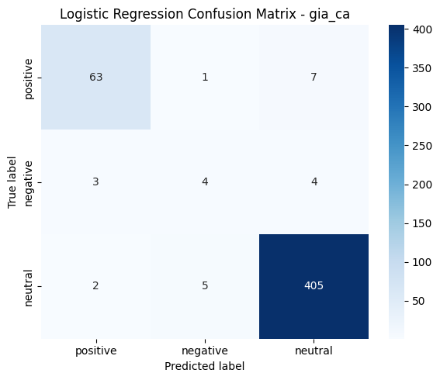
Confusion matrix inspection: what the model gets right and wrong
Most classes are learned reasonably well, but small classes create unstable performance.
Class-wise observations
• chat_luong: negative is learned strongly, but neutral is harder.
• dong_goi: neutral is dominant but positive/negative remain usable.
• van_chuyen: negative has only 8 test samples, so estimates are unstable.
• gia_ca: negative has only 11 test samples and is the hardest class.
ABSA Vietnamese Shopee Reviews
08

Slide 9
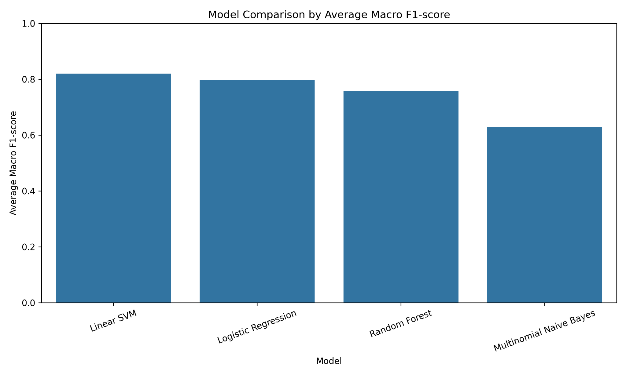
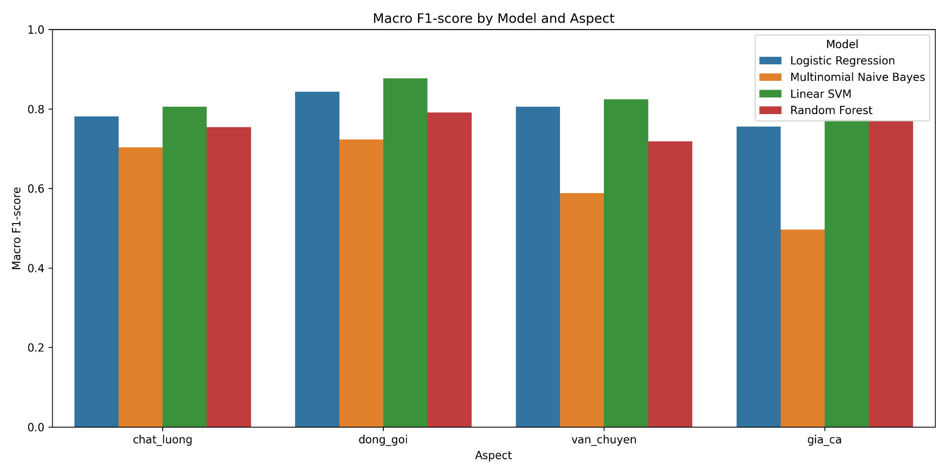
Model comparison: linear models fit TF-IDF best
Linear SVM achieves the strongest average Macro F1; Logistic Regression remains close and more interpretable.
Linear SVM: 0.8200 average Macro F1 | Logistic Regression: 0.7964 | Gap: 0.0236
ABSA Vietnamese Shopee Reviews
09

Slide 10
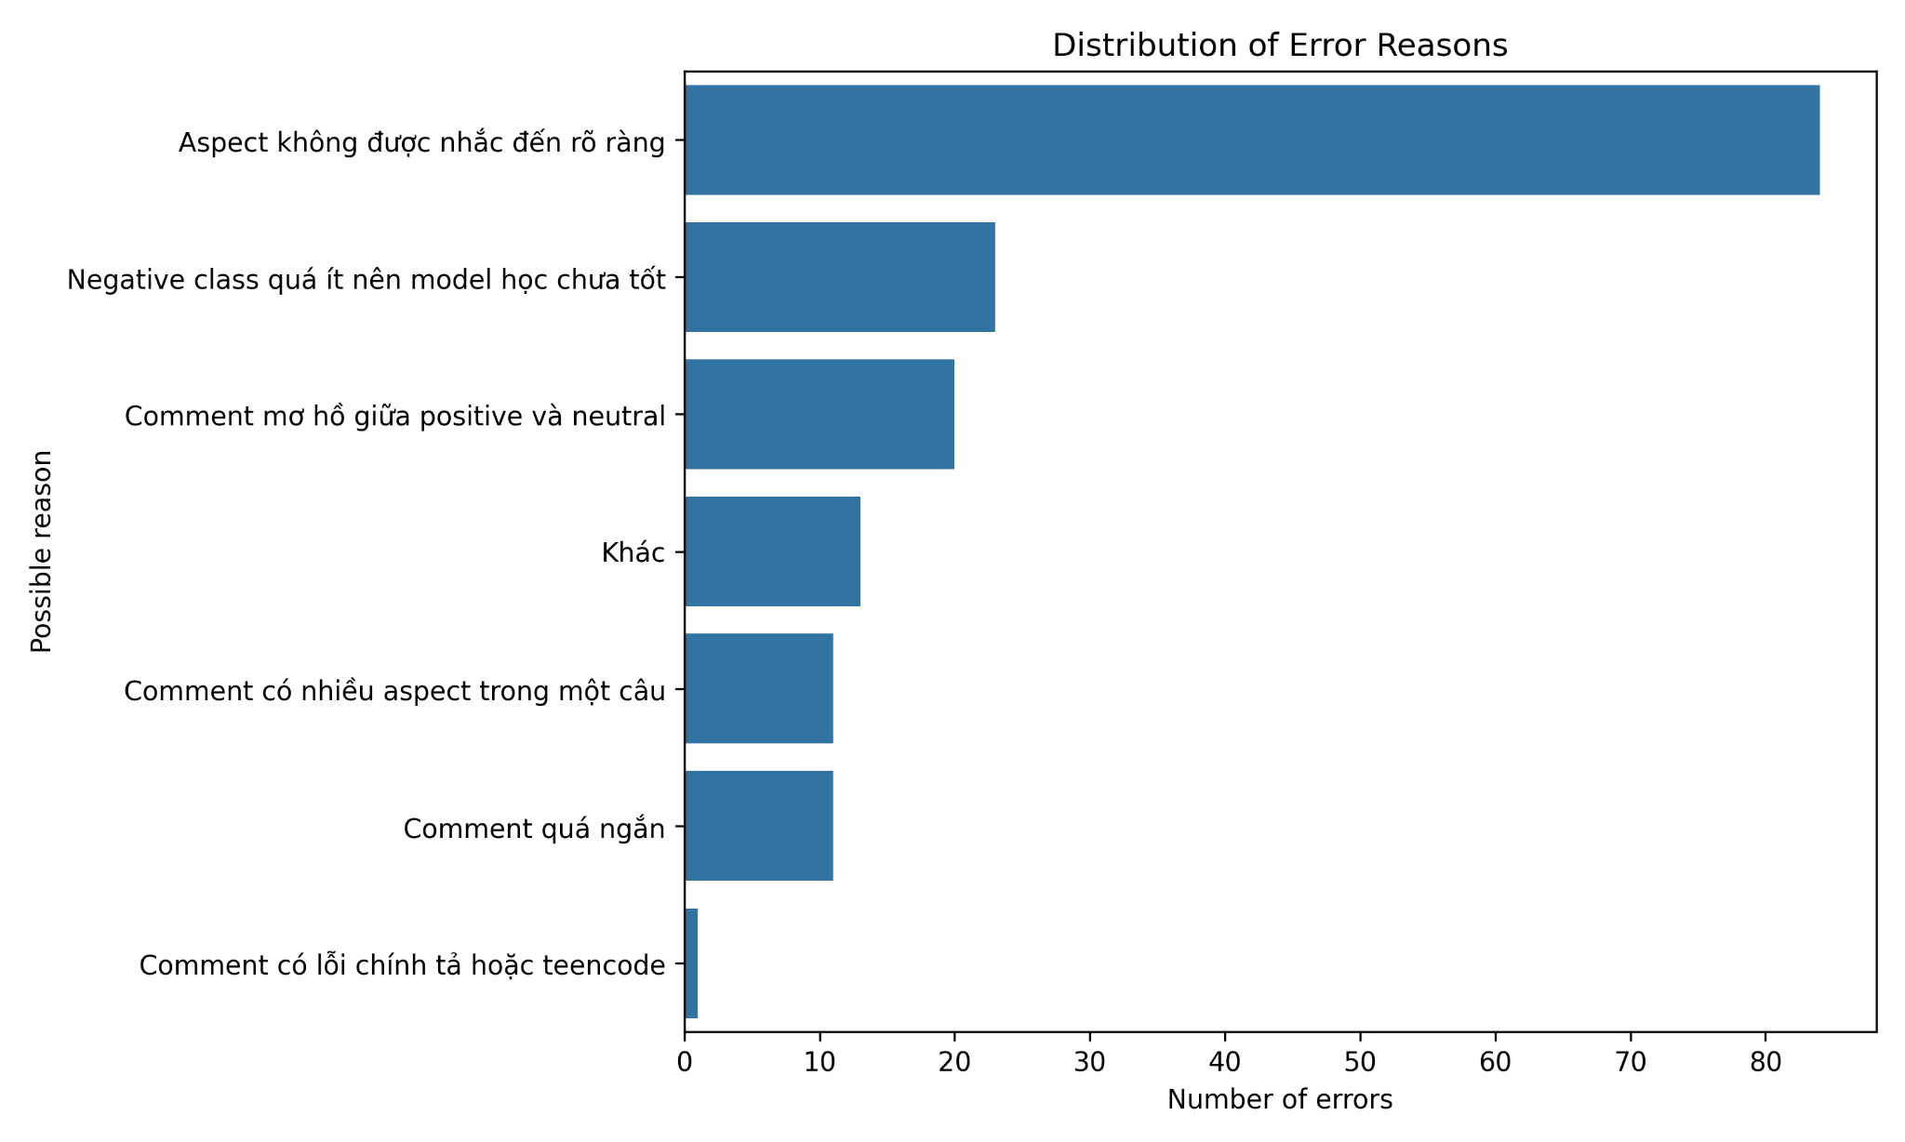
Error analysis: the largest problem is unclear aspect mention
Inspection of incorrect predictions explains limitations beyond aggregate metrics.
Main error sources
• Aspect not clearly mentioned: 84 errors (51.53%).
• Negative class too small: 23 errors (14.11%).
• Ambiguity between positive and neutral: 20 errors (12.27%).
• Multiple aspects in one sentence can leak sentiment across classifiers.
• Very short comments do not provide enough aspect evidence.
Most errors come from task ambiguity, not only model weakness.
ABSA Vietnamese Shopee Reviews
10

Slide 11
Final model decision
The best predictive model and the final interpretable model are intentionally separated.
Strongest predictive model
Final interpretable model
Linear SVM
Logistic Regression
→
Average Macro F1 = 0.8200
Average Macro F1 = 0.7964
Best overall predictive performance on high-dimensional TF-IDF features.
Competitive performance with simpler explanation through feature weights.
Decision logic
• Use Linear SVM as evidence of strongest predictive capability.
• Use Logistic Regression as the main final model for interpretation.
• This balances performance, simplicity, reproducibility, and explainability.
ABSA Vietnamese Shopee Reviews
11

Slide 12
Conclusion and future work
Traditional ML works well for Vietnamese ABSA, but ambiguity and imbalance remain open challenges.
Conclusion
Future work
• Built a complete ABSA pipeline for four aspects of Vietnamese Shopee reviews.
• TF-IDF + Logistic Regression achieved competitive and interpretable results.
• Linear SVM delivered the best average Macro F1-score at 0.8200.
• Error analysis showed that unclear aspect mentions and class imbalance dominate mistakes.
• Collect more minority-class samples, especially negative delivery and price reviews.
• Refine labeling guidelines for weak expressions such as “ổn” or “tạm được”.
• Add aspect detection before sentiment classification.
• Test Vietnamese word segmentation and PhoBERT for stronger representations.
Final takeaway: the project demonstrates a clear, reproducible, and interpretable machine learning approach to aspect-level sentiment classification.
ABSA Vietnamese Shopee Reviews
12

