Slide 1
Instrumental Variables and Mediation
Introduction to Causal Inference and Causal Data Science
Oisin Ryan

Slide 2
Instrumental Variables
In our lectures so far we have considered different identification and estimation strategies
Blocking back-door paths (conditioning on confounders)
- Stratification, matching, regression adjustment
Creating “pseudo-populations”
- IP weighting, G-methods

Slide 3
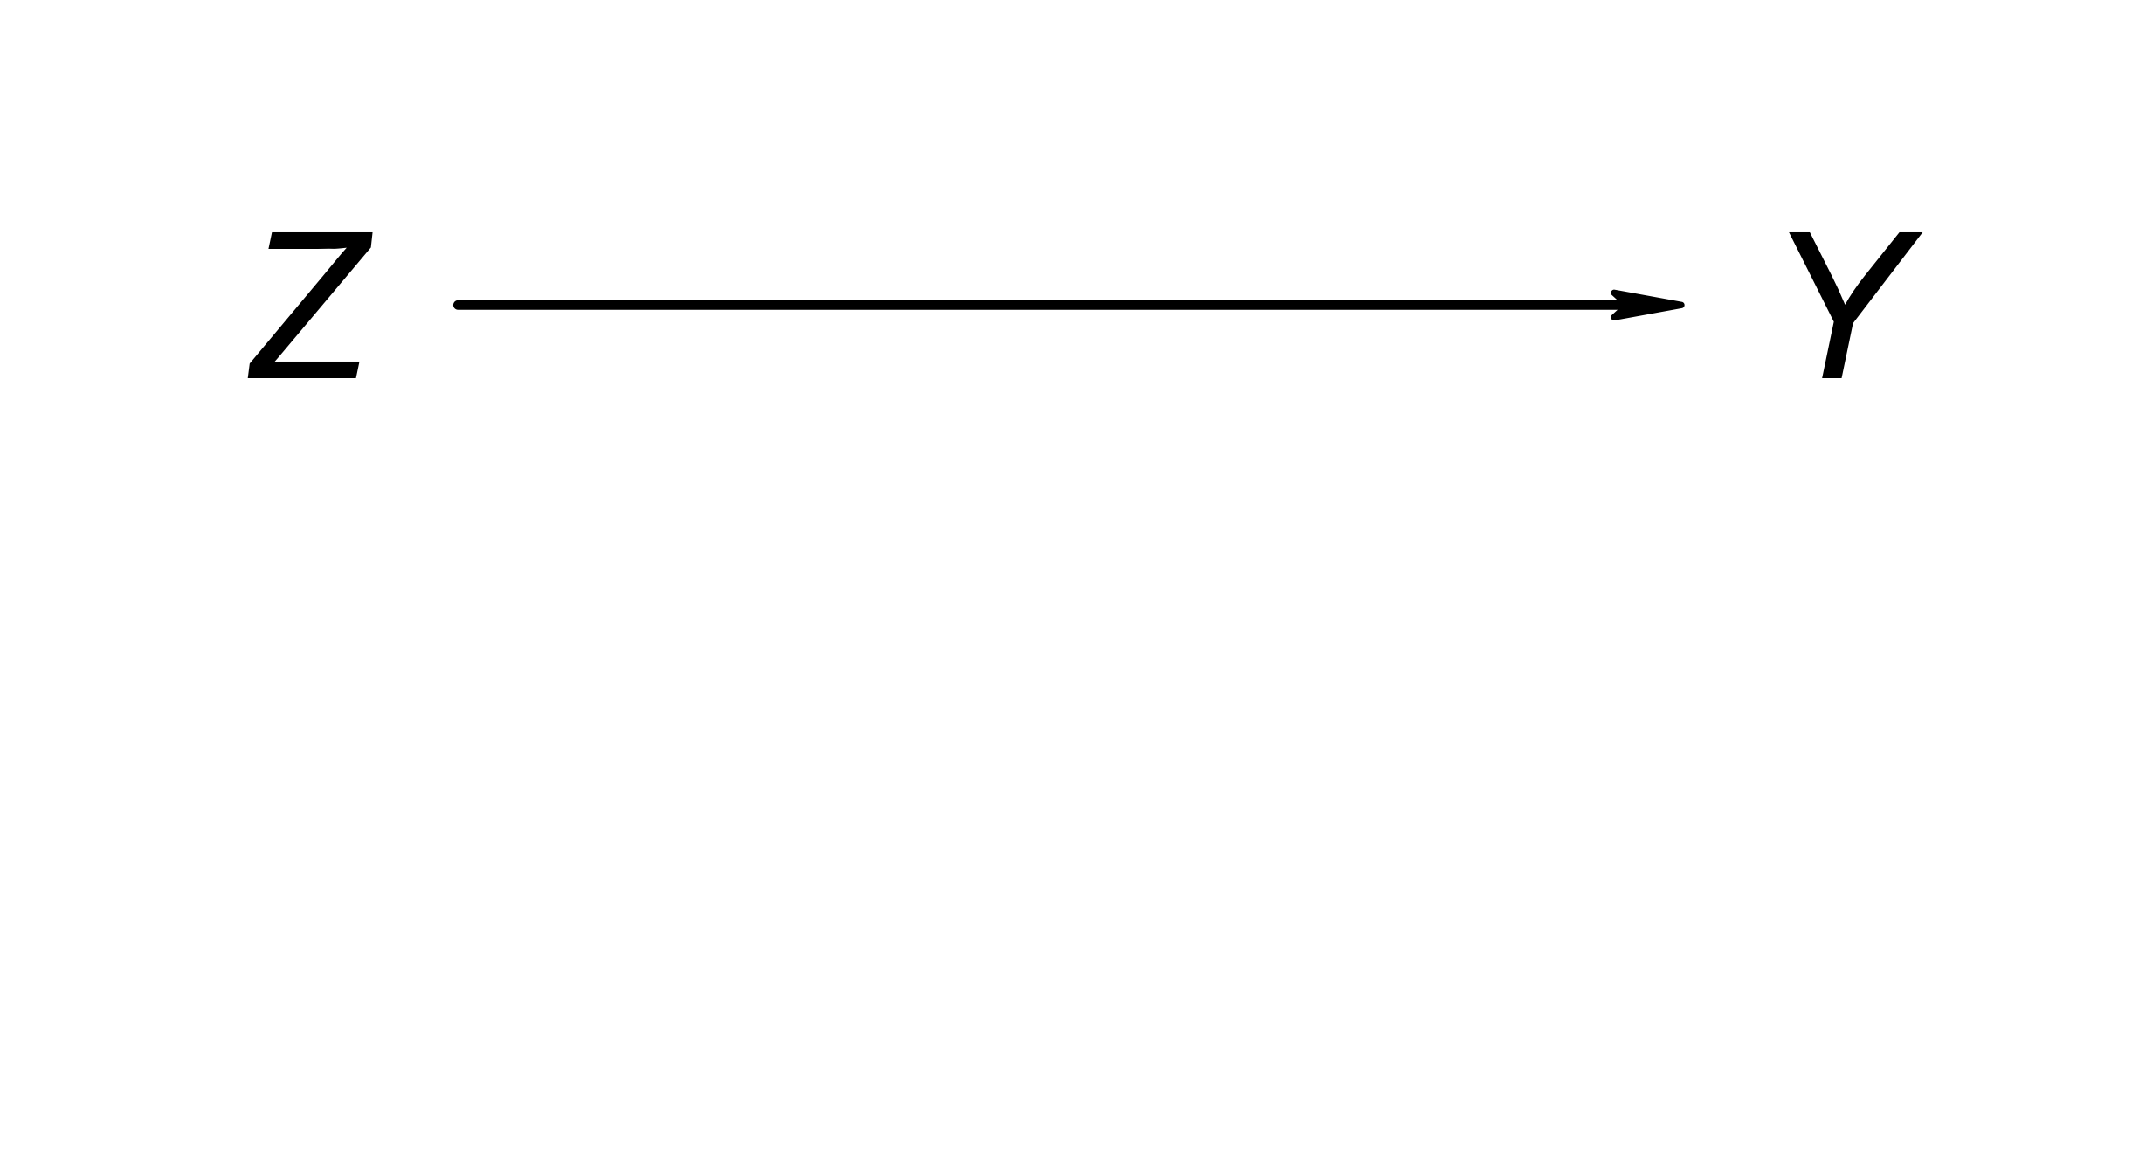
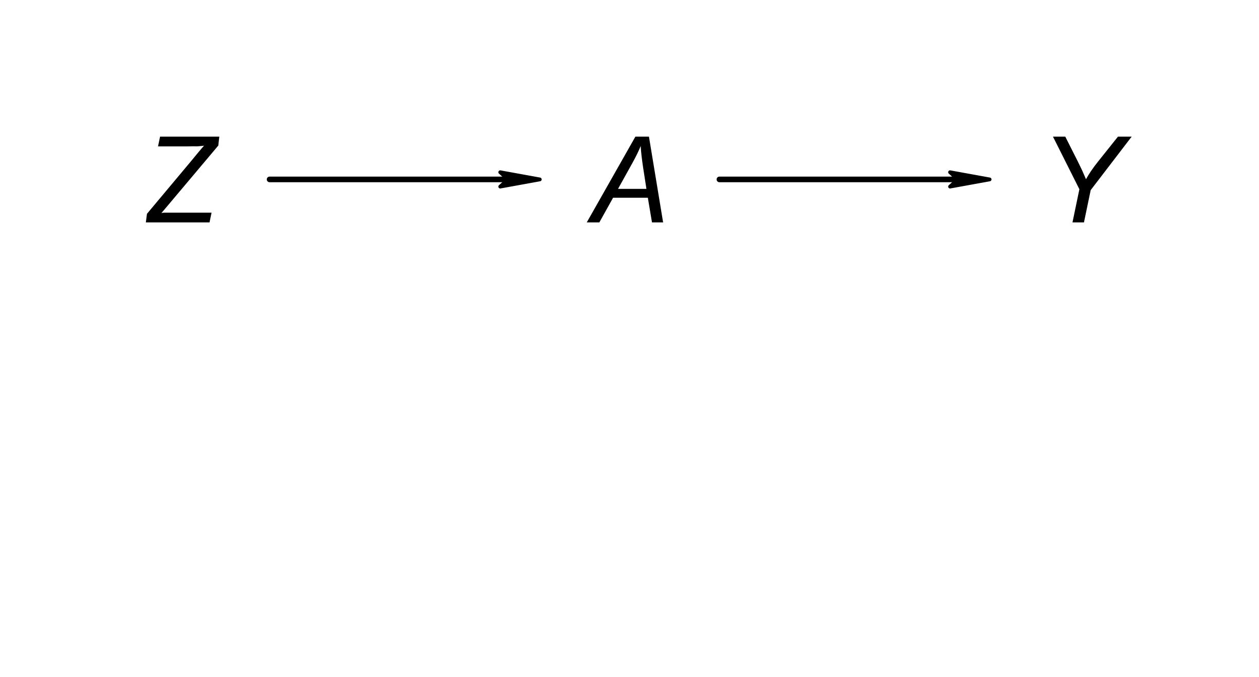
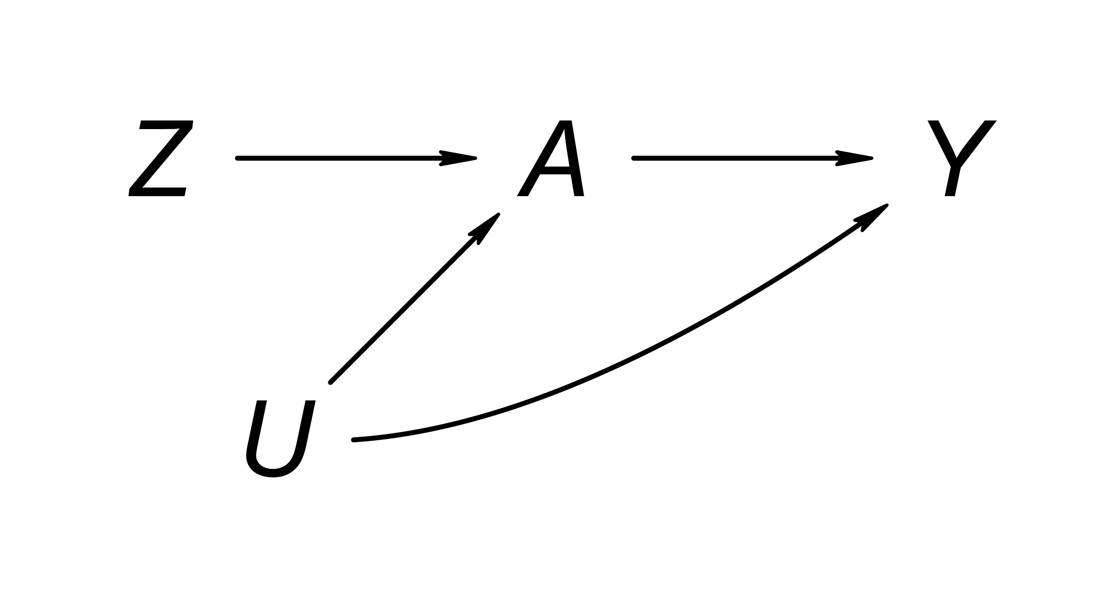
Instrumental Variables
Instrumental Variables (IV) methods are a different identification strategy, which relies on exploiting a particular structure that may occur in a DAG

Slide 4
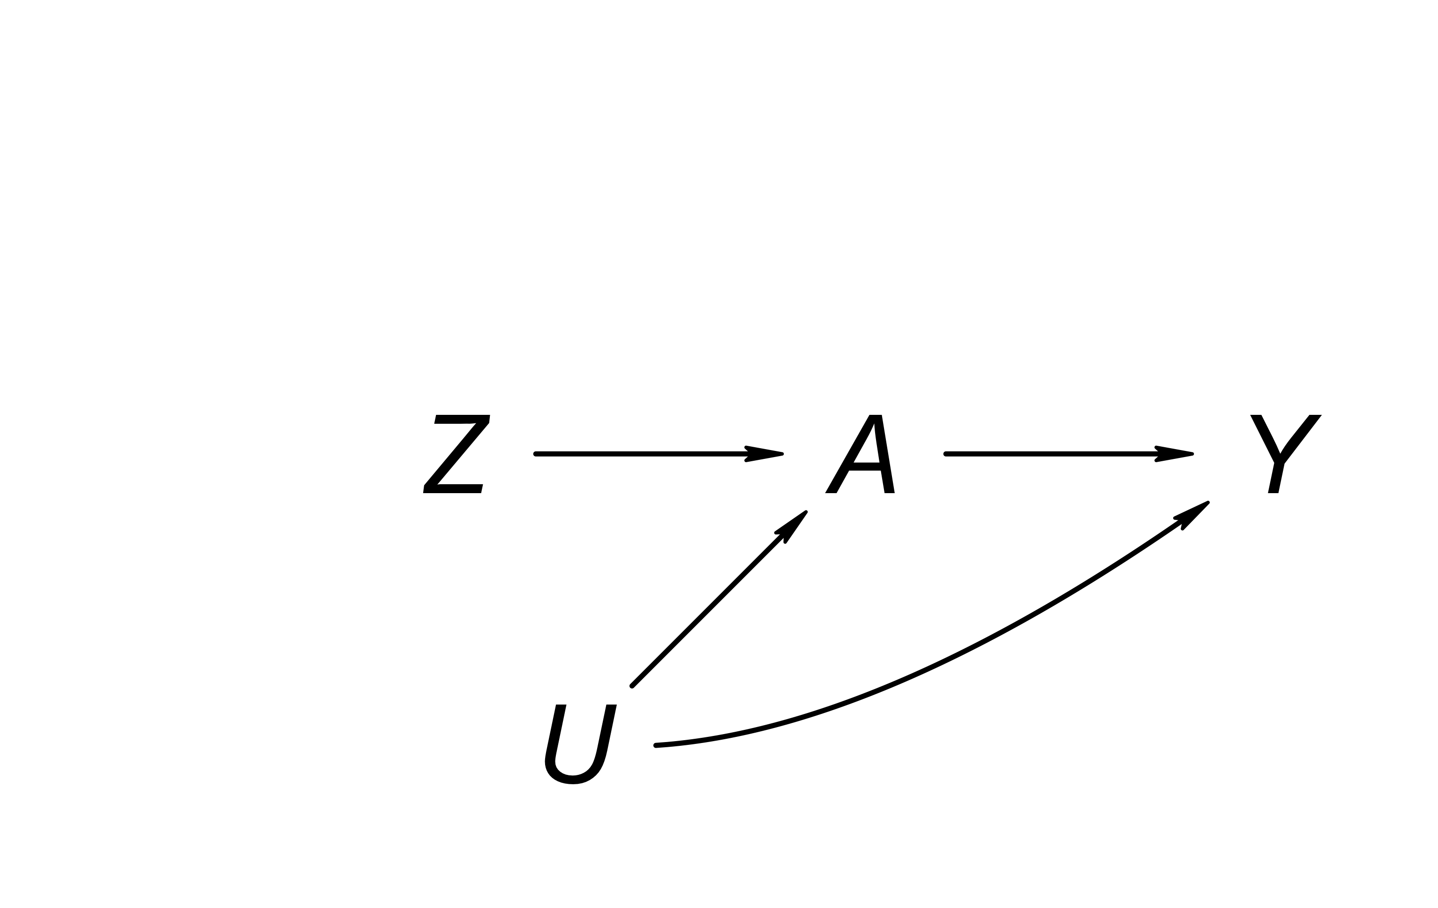
Z is an instrumental variable (IV) for treatment A and outcome Y if
Cov(Z,A) ≠ 0 (relevance)
Y(z,a) constant across levels of z (no direct effect of IV on Y; exclusion restriction)
IV exchangeability
E.g., no causes shared by Z and Y or by Z and A

Slide 5
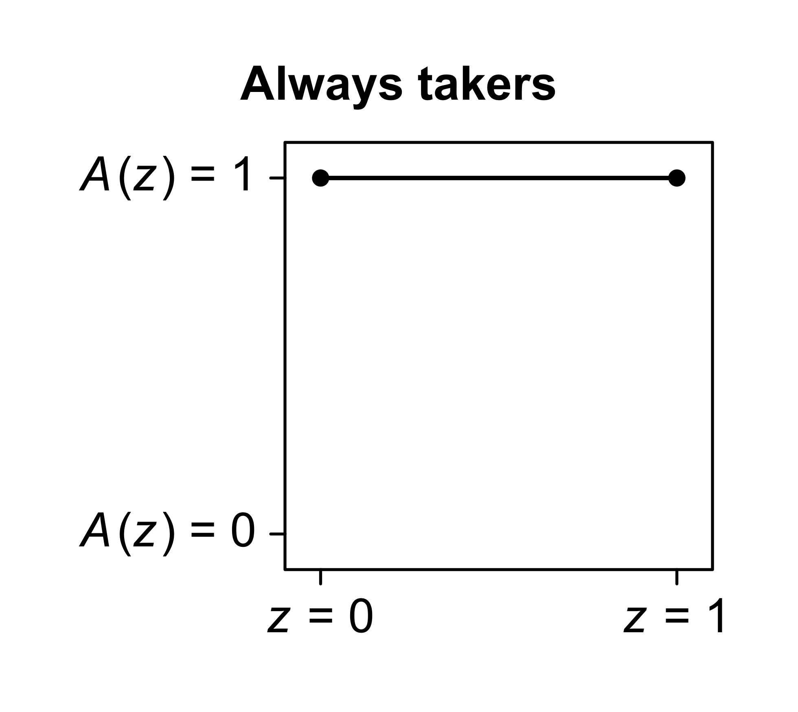
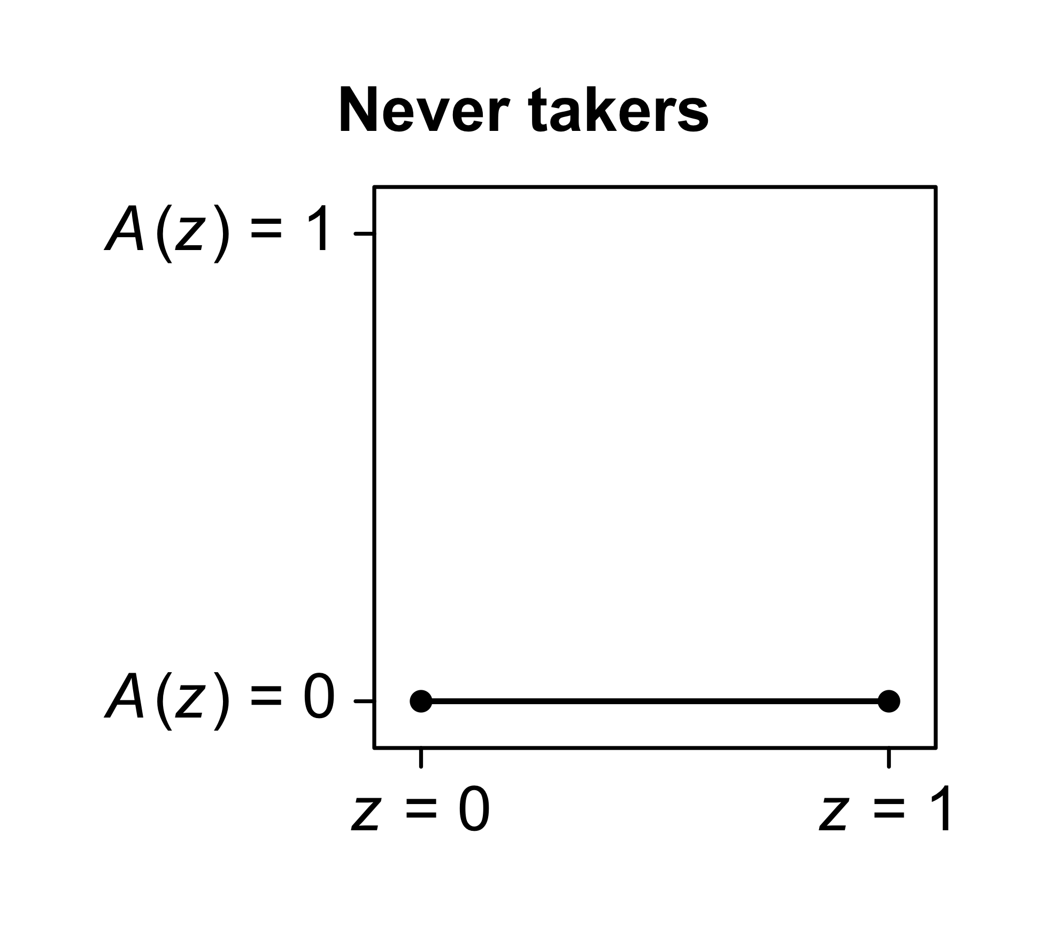

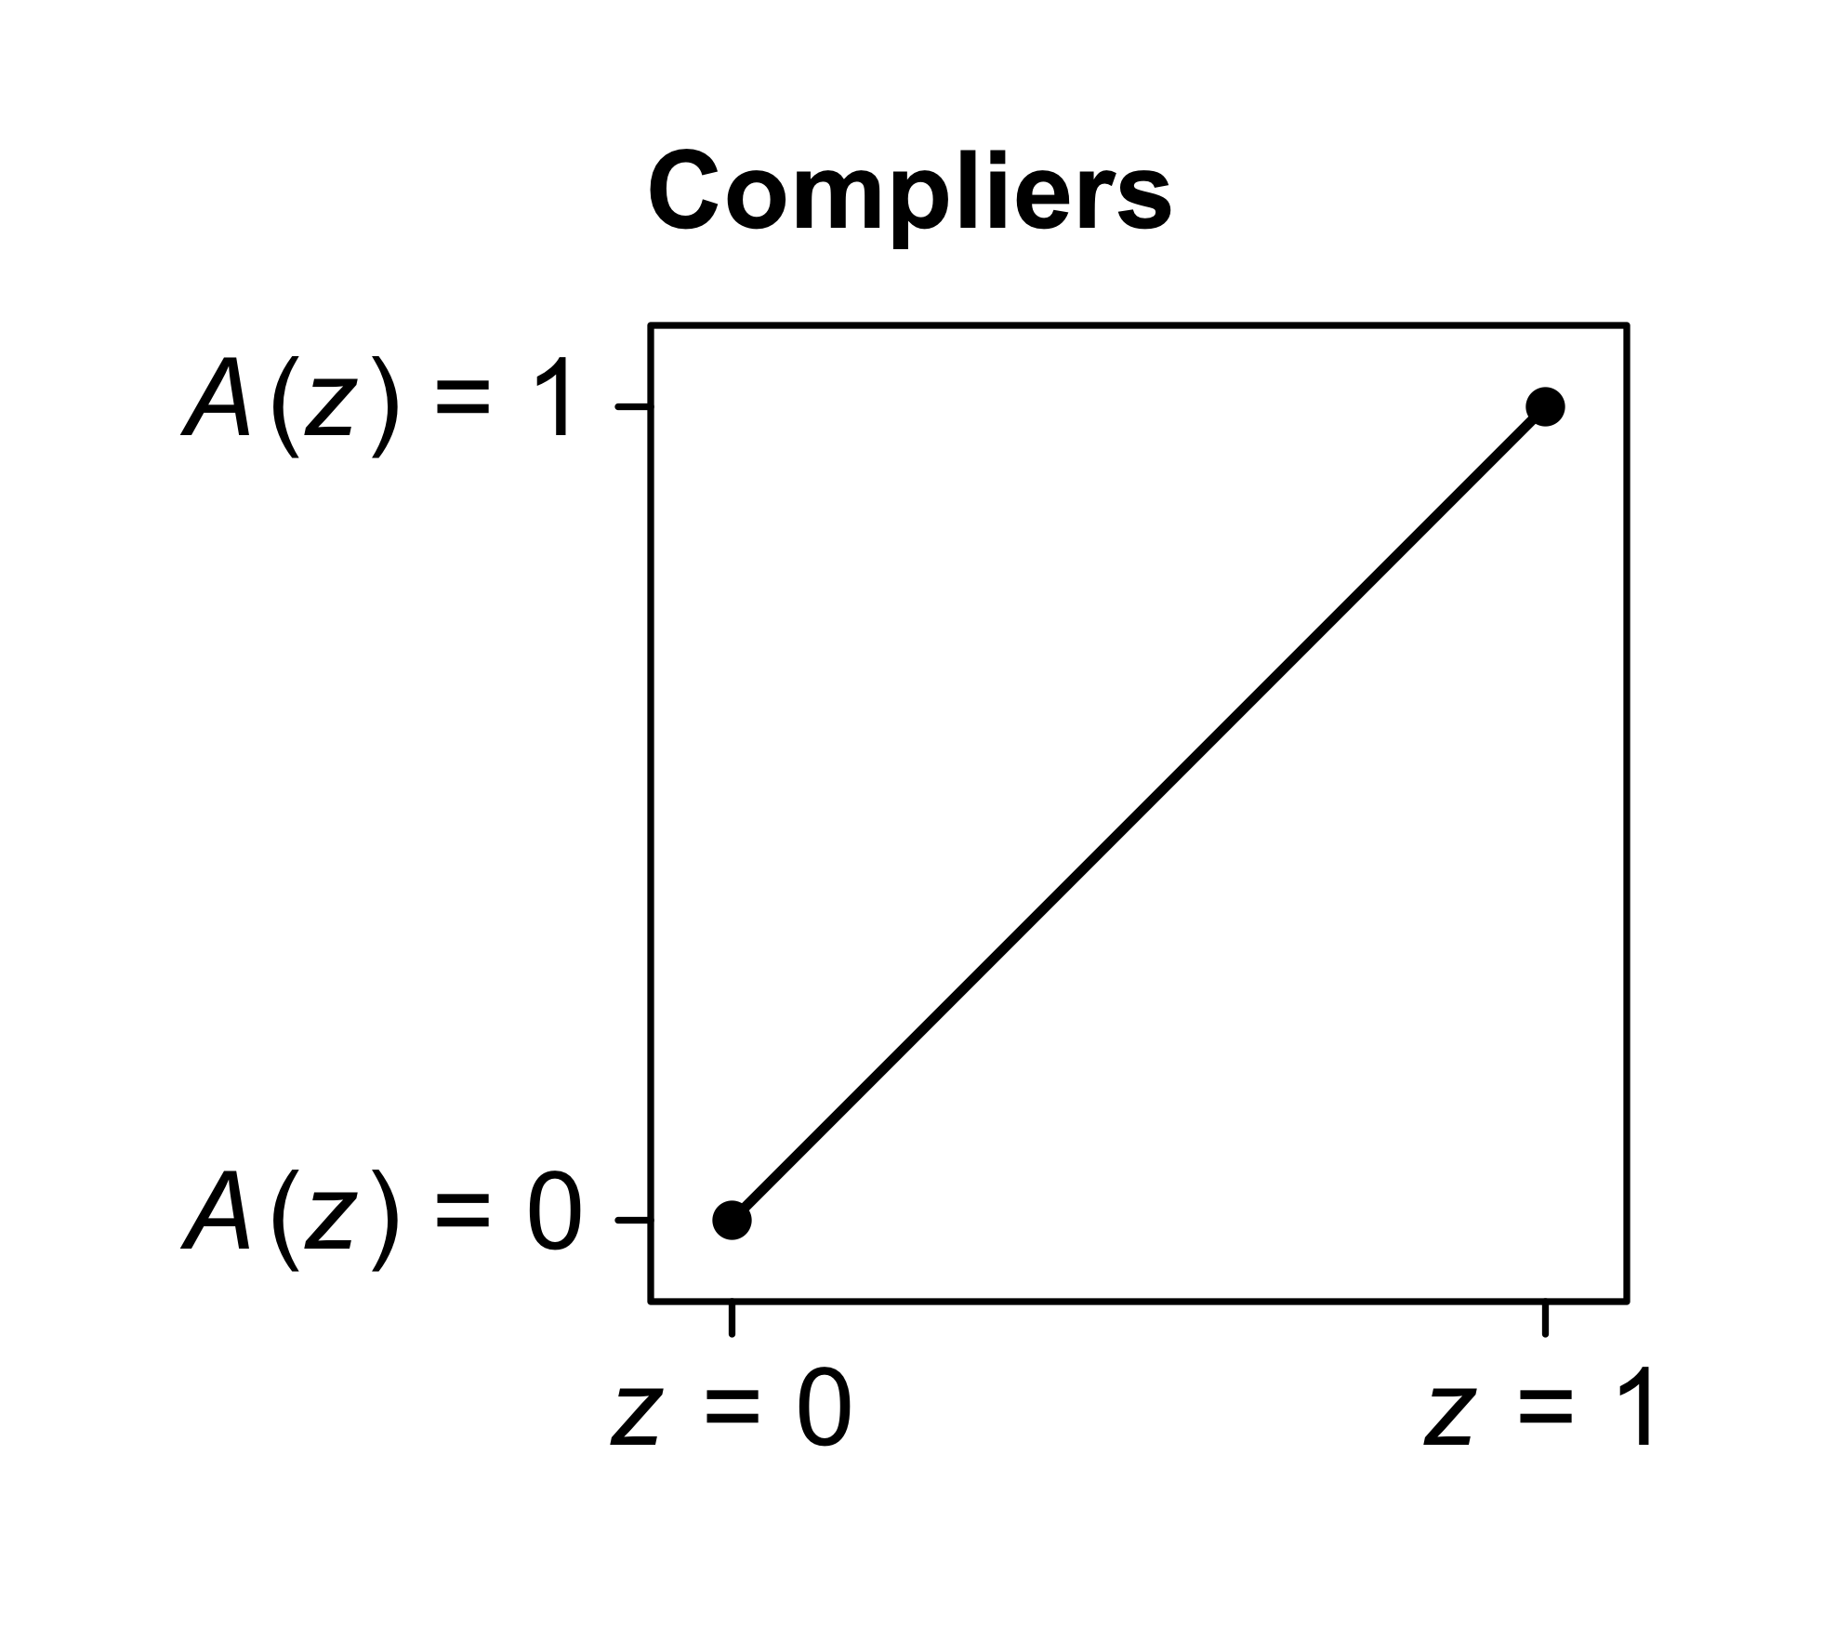
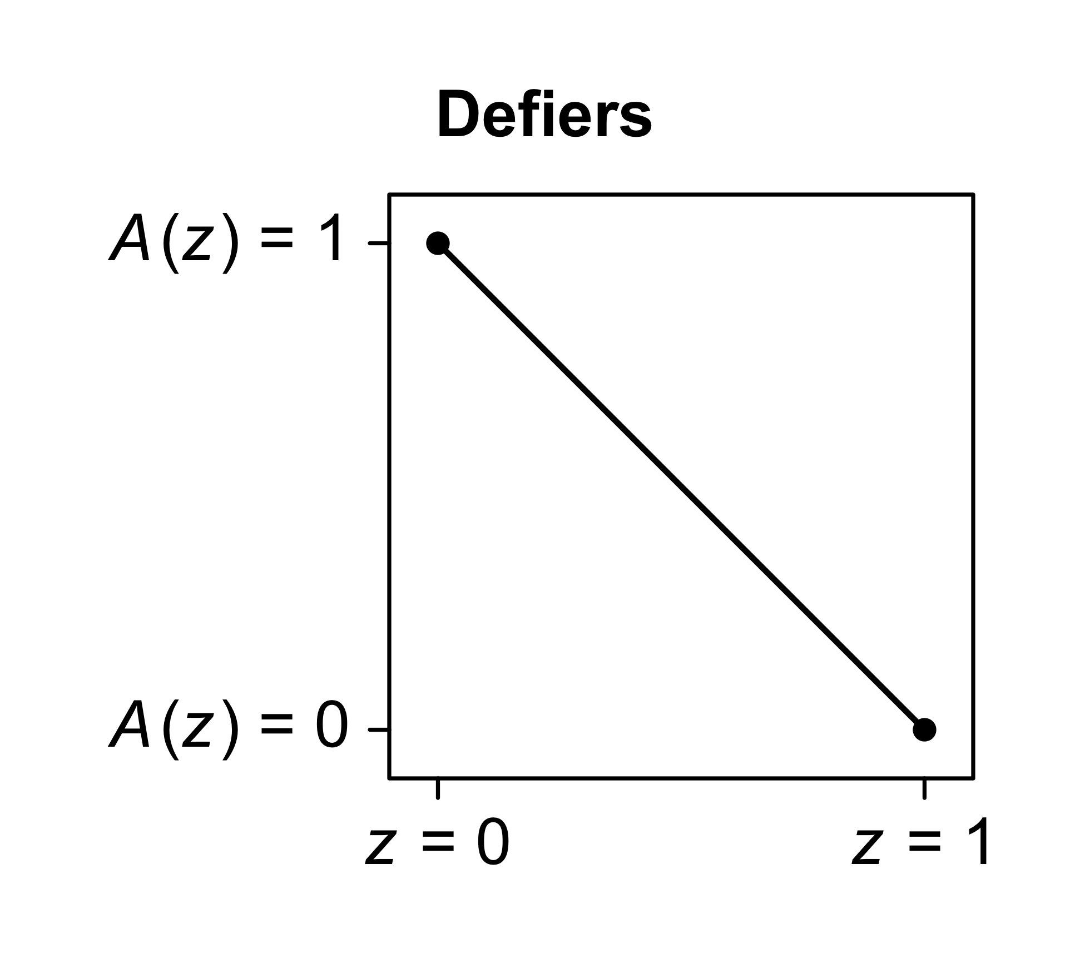

A fourth assumption: monotonicity

Slide 6
Suppose instrument Z and treatment A are binary and, in addition to consistency and positivity, the following assumptions hold:
Relevance
Exclusion restriction
Exchangeability: Y(z,A(z)) and A(z) are both independent of Z, for all z
Monotonicity: there are no defiers
Then, the mean per-protocol effect among compliers, E[Y(1) – Y(0) | Compliers], equals Cov(Y,Z) / Cov(A,Z) or, equivalently,
E[Y | Z = 1] – E[Y | Z = 0]
E[A | Z = 1] – E[A | Z = 0]

Slide 7
Critiques of IV methods
IV methods in particular are/were very popular in economic fields
Main critique of this is: How often can you actually find a true instrument / instrumental variable?
Highly context dependent!
In health sciences many have argued that this is quite rare

Slide 8
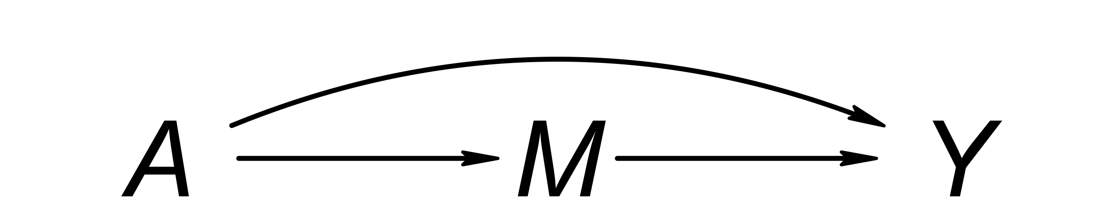
Mediation
For most of this week we have focused on estimating total effects
- Even though we often did not use that term directly
The distinction between a “total” and a “direct” effect becomes relevant in situations where a target variable A can effect the outcome Y through many distinct pathways

Slide 9
Direct Effects
Mediation analysis has a long (and controversial) history across many traditions
- E.g., in social sciences, tied up with the idea of using linear regression models, taking product terms of coefficients, etc.
There has also been much debate about this in the causal inference literature, and many different frameworks of how to give “mediation analysis” a firm causal foundation
Many debates focus around the definition of a direct effect and its relevance for real life decision making

Slide 10
Controlled vs Natural Direct Effects
The controlled direct effect (CDE) represents the effect of an intervention on A, combined with an intervention to keep M fixed at a certain value (say m)
Can often be estimated by conditioning on M = m.
What is the effect of smoking on lung cancer, if we could force smokers and non-smokers to have the same tar levels in their lungs?

Slide 11
Natural Direct Effects
The natural direct effect (NDE) represents the effect of an intervention on A, combined with an intervention that ensures M takes on whatever value it “naturally” would have without that intervention
A
*
A`
Estimation requires a model for the A -> M relationship
Imagine we can make everyone smoke, but we can create “tar free” cigarettes, and a “tar creation” mechanism

Slide 12
Direct Effects and Policy Relevance
Many causal questions that people come up with can be framed as total effects, or as CDE or NDE questions
- Related to “intention to treat” and “per protocol” effects in TTE
But, they may still be of more or less questionable policy relevance.
Covid Vaccination (A), Death (M) and Experiencing Covid (Y)
CDE: What is the effect of vaccination on covid-risk given we could keep vaccine takers alive?
NDE: What is the effect of vaccination on covid-risk given that we can ensure that vaccine takers would have the same risk of death as they would have in the absence of vaccination?

Slide 13
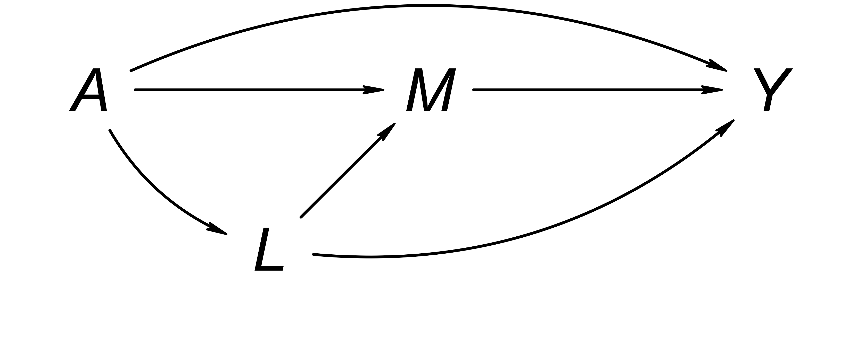
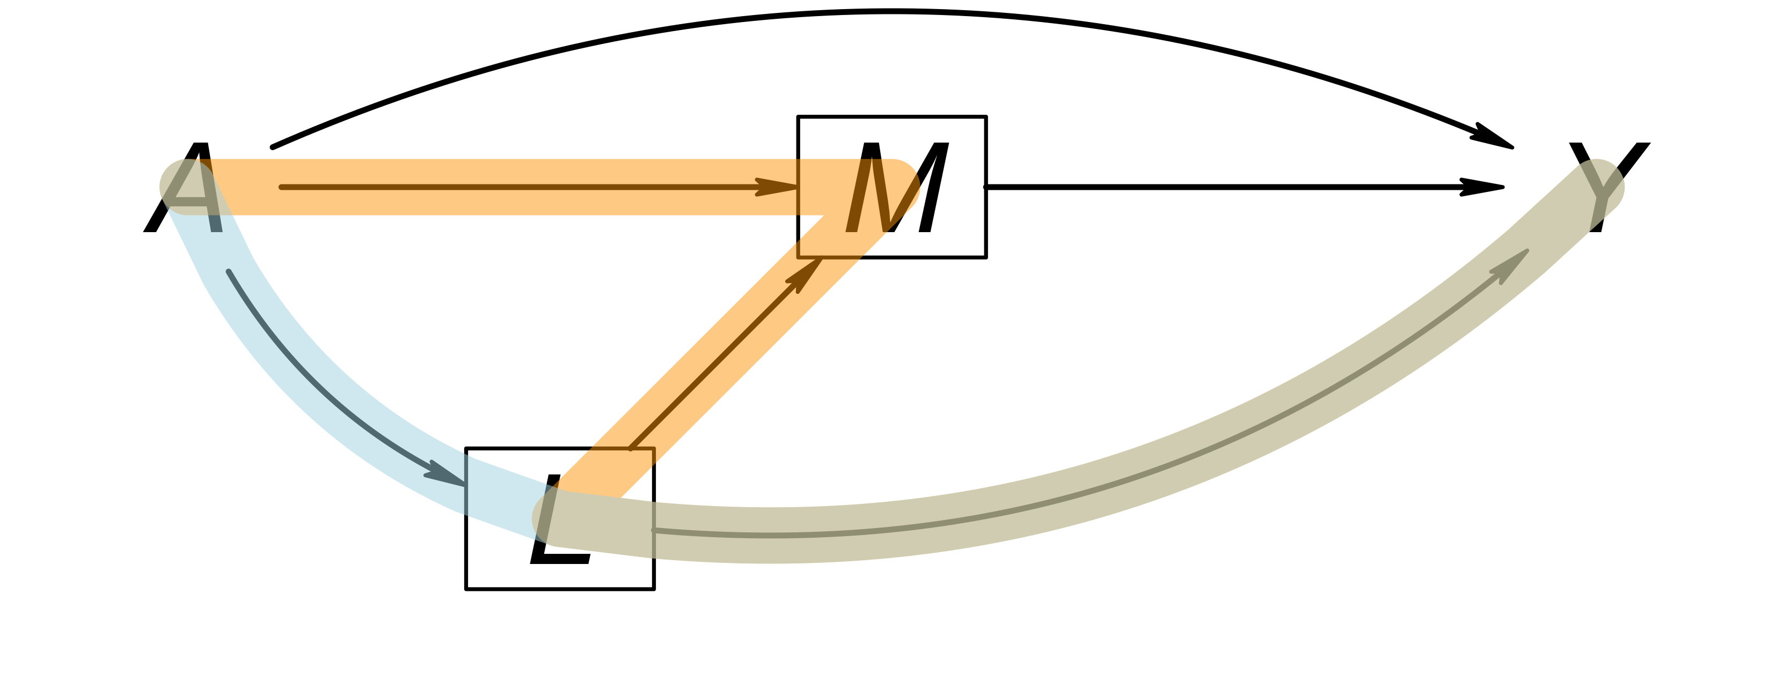

CDEs and Estimation: Confounder-feedback
Conditioning
Collider bias!

Slide 14

CDEs and Estimation: Confounder-feedback
IP-weighting

Slide 15
Longitudinal Settings
These concerns become especially important in longitudinal settings
We may have baseline confounding and post-baseline confounding
Survival models / approaches; known as informative censoring

