Slide 1
Complex longitudinal settings: When traditional methods fail
Introduction to Causal Inference and Causal Data Science
Bas Penning de Vries

Slide 2
Statin-cancer example revisited
Previous studies implicitly compared long-term statin users versus non-users – doesn’t necessarily answer questions like …
What would be my 10-year cancer risk if – possibly contrary to fact – I would start statin treatment now? And what if I wouldn’t?
What would be my 10-year cancer risk if – possibly contrary to fact – I would start statin treatment now and adhered to it? And what if I wouldn’t start now or in the future?

Slide 3
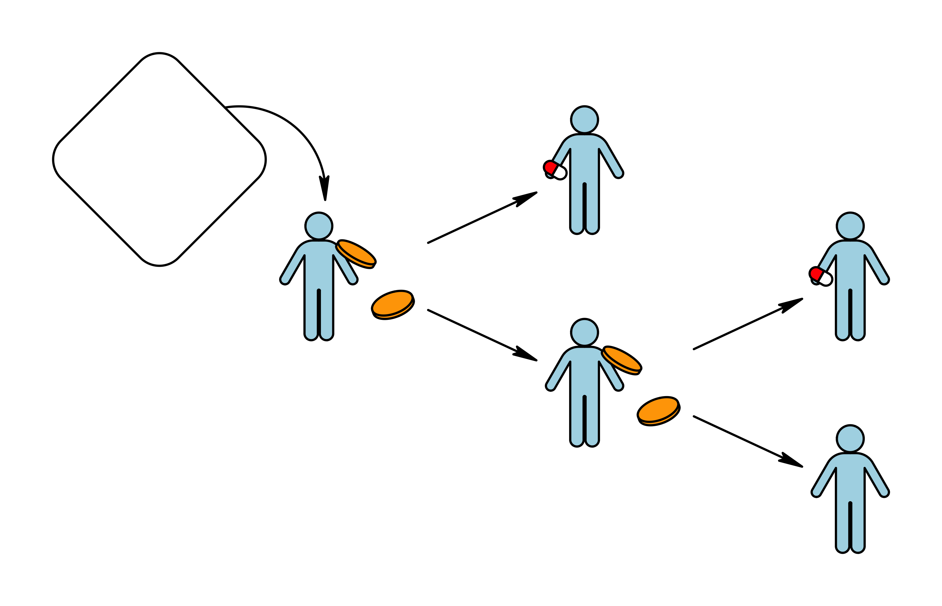
Inference about time-varying treatments
If treatment/exposure is time-varying, there are many possible causal contrasts …

Slide 4
Single versus multiple-point interventions
Single-point (baseline) intervention
Eg: assign/initiate versus withhold drug treatment at baseline
Individuals are allowed to deviate (intention-to-treat)
Randomisation at baseline only
Multiple-point (joint) intervention
Eg: sustained/daily/weekly/monthly drug use versus continuous non-use (per-protocol)
Randomisation at multiple points

Slide 5
Static versus dynamic interventions
Static treatment rule/regime/protocol/…
… assigns the same treatment option to everyone
Eg: assign versus withhold treatment regime at baseline (intention-to-treat)
Eg: always treat versus never treat (per-protocol)
Dynamic (individualised) treatment rule
… assigns treatment based on the then-available information
Eg: choose dose depending on baseline covariates
Eg: start when blood marker first drops below threshold
Eg: stop when toxicity occurs

Slide 6
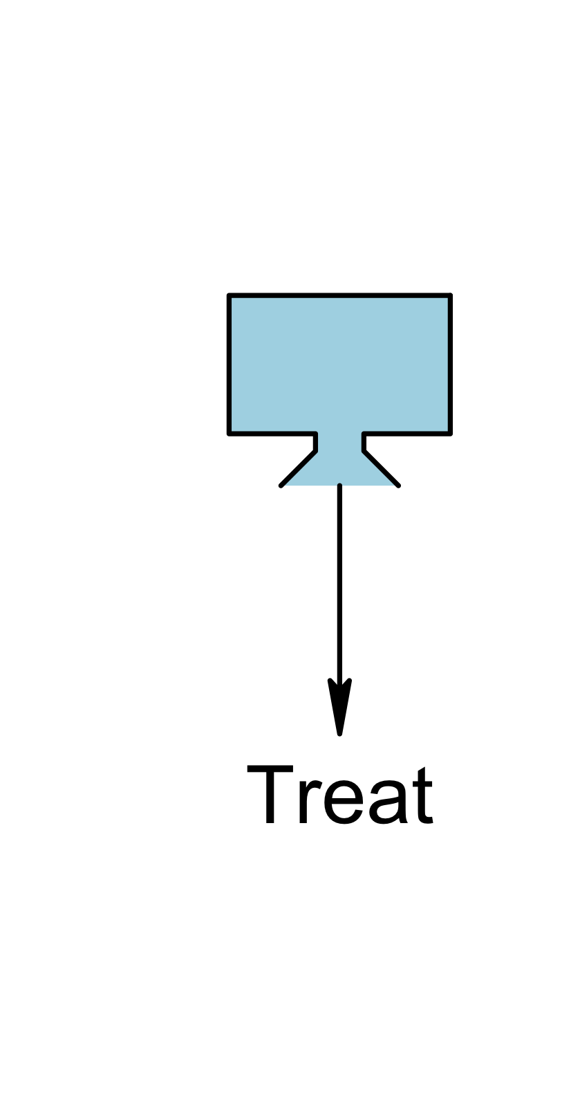

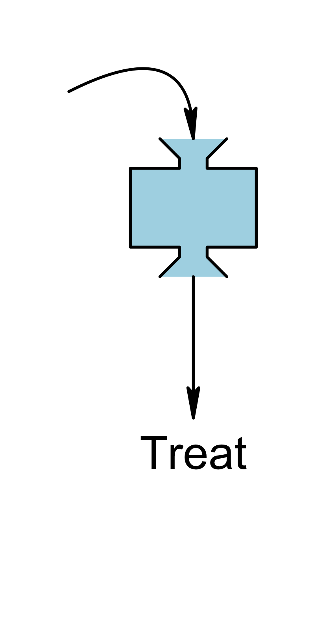

Single-point
Multiple-point
Static
Dynamic

Slide 7


Slide 8
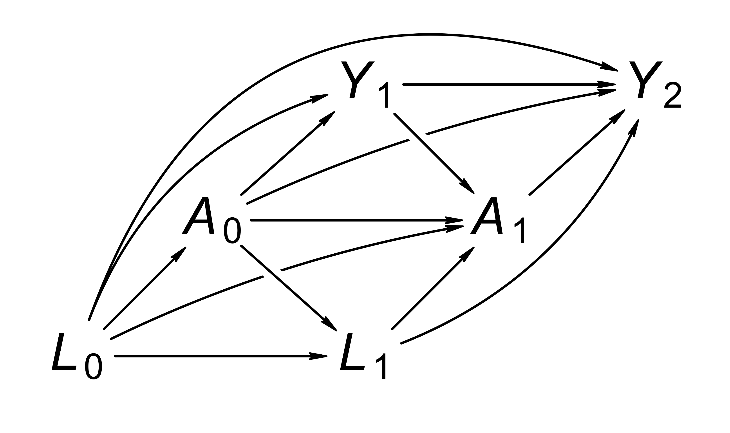
Treatment-covariate feedback
Adjust for L₁ if we want to know the effect of always- versus never treatment?

Slide 9
Treatment-covariate feedback
Traditional methods (multivariable regression modelling) are not suited to deal with time-varying confounding when it is affected by past treatment (treatment-covariate feedback)
Methods that can handle treatment-covariate feedback and adjusting for time-varying confounding:
G-computation
Inverse probability weighting (IPW)

Slide 10
IPW for sustained treatments
Let Y₁^{a0},Y₂^{a0,a1} be counterfactual Y₁,Y₂ if all A₀,A₁ were a₀,a₁
Target: Pr(Y₁^{a0} = Y₂^{a0,a1} = 0) – survival probability if …?
Same assumptions but slightly different form – eg, sequential conditional exchangeability: Y₁^{a0},Y₂^{a0,a1} independent of
independent of A₀ given L₀
independent of A₁ given L₀, L₁, A₀=a₀, Y₁=0
Idea: patients who do not deviate from protocol compensate for “similar” patients who do
Weights are time-varying

Slide 11
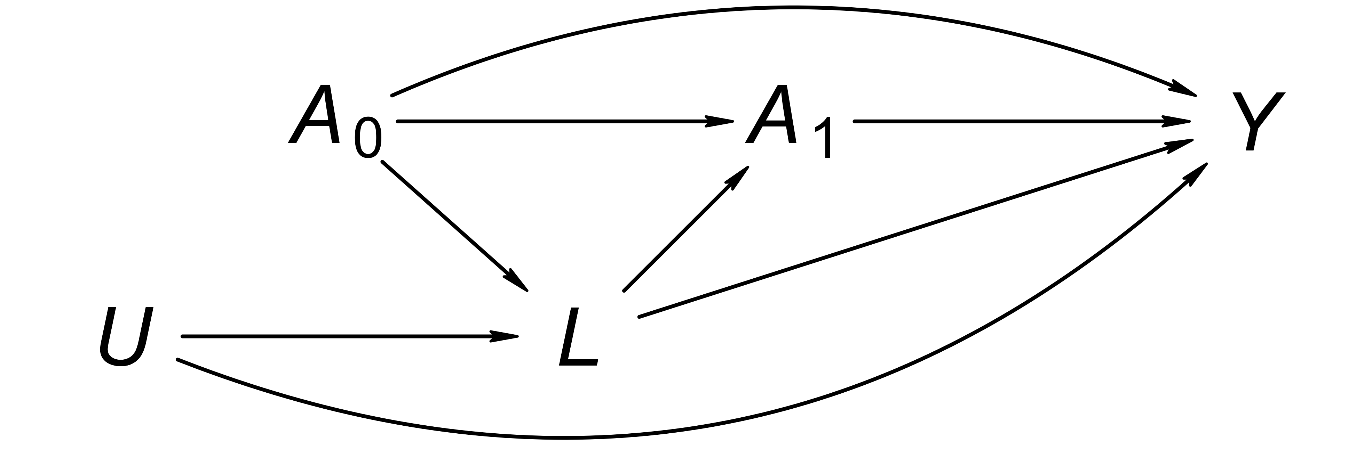
Example
Two time points at which we might intervene, t = 0 (baseline) and t = 1 (e.g., one month after baseline)
At each time t, there are two options: issuing (A_{t} = 1) or withholding (A_{t} = 0) a one-month drug prescription

Slide 12
Example
Should we condition on (‘adjust for’) L to identify the effect of ‘always treat’ (A₀ = A₁ = 1) versus ‘never treat’ (A₀ = A₁ = 0)?

Slide 13
Example: IPW
Under a version of the three identifiability conditions (positivity, consistency and exchangeability), we can use IPW to identify the effect of the time-varying treatment, expressed as a contrast between the average counterfactual outcomes under ‘treat always’ and ‘treat never’ regimes:
E[Y ^{1,1}] versus E[Y ^{0,0}]

Slide 14
Example: IPW
IPW for time-varying confounding starts with time-varying propensity scores. For the example with two time points, every individual will have two propensity scores:
PS₀ = Pr(A₀ = 1)
PS₁ = Pr(A₁ = 1 | A₀, L)

Slide 15
Example: IPW
What we ‘include’ in the propensity scores (i.e., wat we ‘condition on’) depends on the setting – here, we condition on nothing for t = 0, because we’re assuming thatY ^{a0,a1} is (marginally) independent of A₀ (no baseline confounding). For t = 1, we condition on A₀ and L because we’re assuming that Y ^{a0,a1} is independent of A₁ given A₀ = a₀ and L (no uncontrolled confounding at t = 1 given A₀ and L).

Slide 16
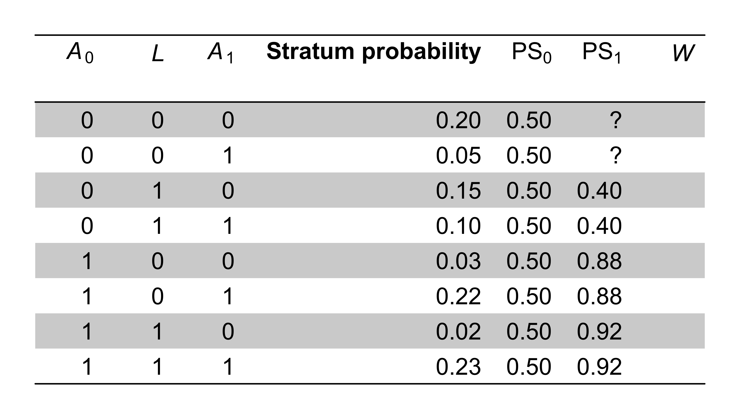

Slide 17
Example: IPW
The next step is computing the weights. These look much like the weights for time-fixed treatments:
W₀ = 1/PS₀ if A₀ = 1 (treated at t = 0) and W₀ = 1/(1 – PS₀) if A₀ = 0 (untreated)
W₁ = 1/PS₁ if A₁ = 1 (treated at t = 1) and W₁ = 1/(1 – PS₁) if A₁ = 0 (untreated)
The final weights W are obtained by taking the product of these time-varying weights: W = W₀W₁

Slide 18
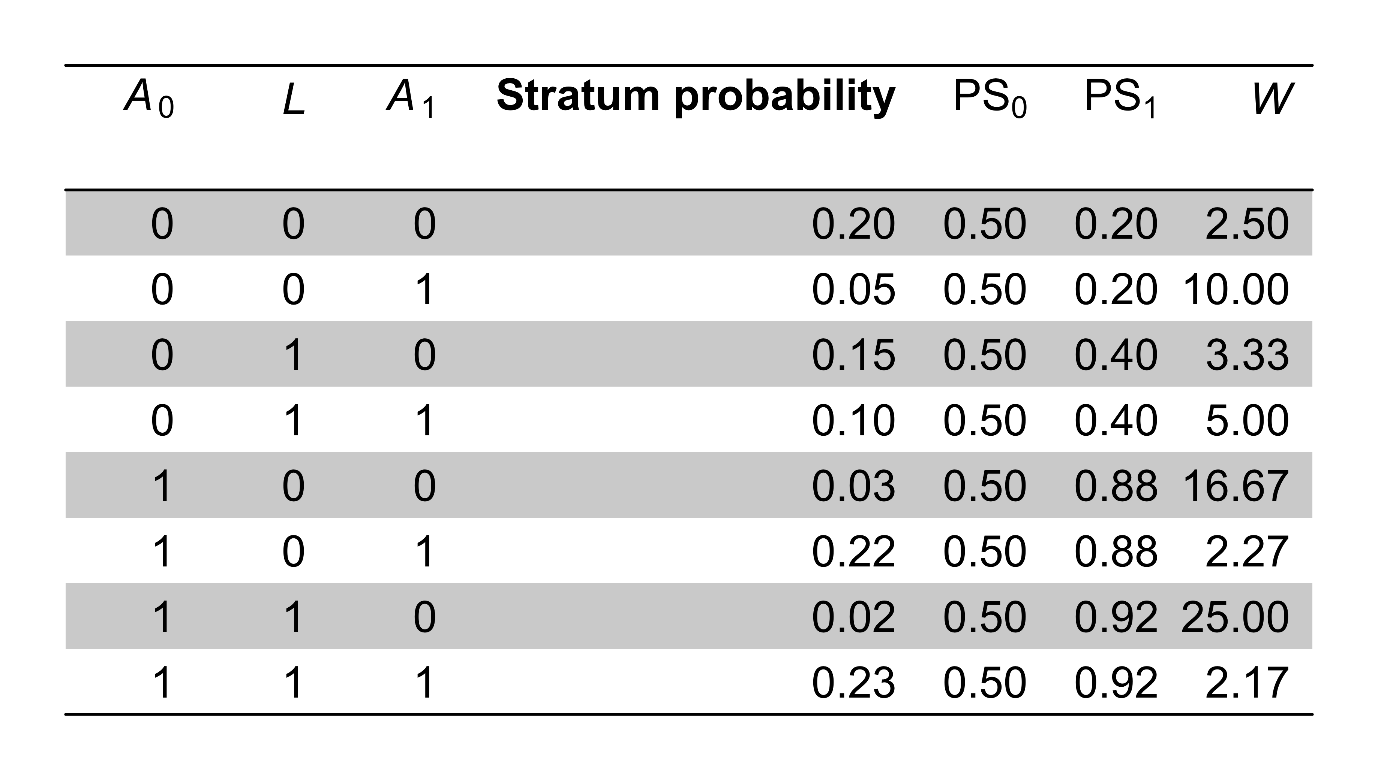
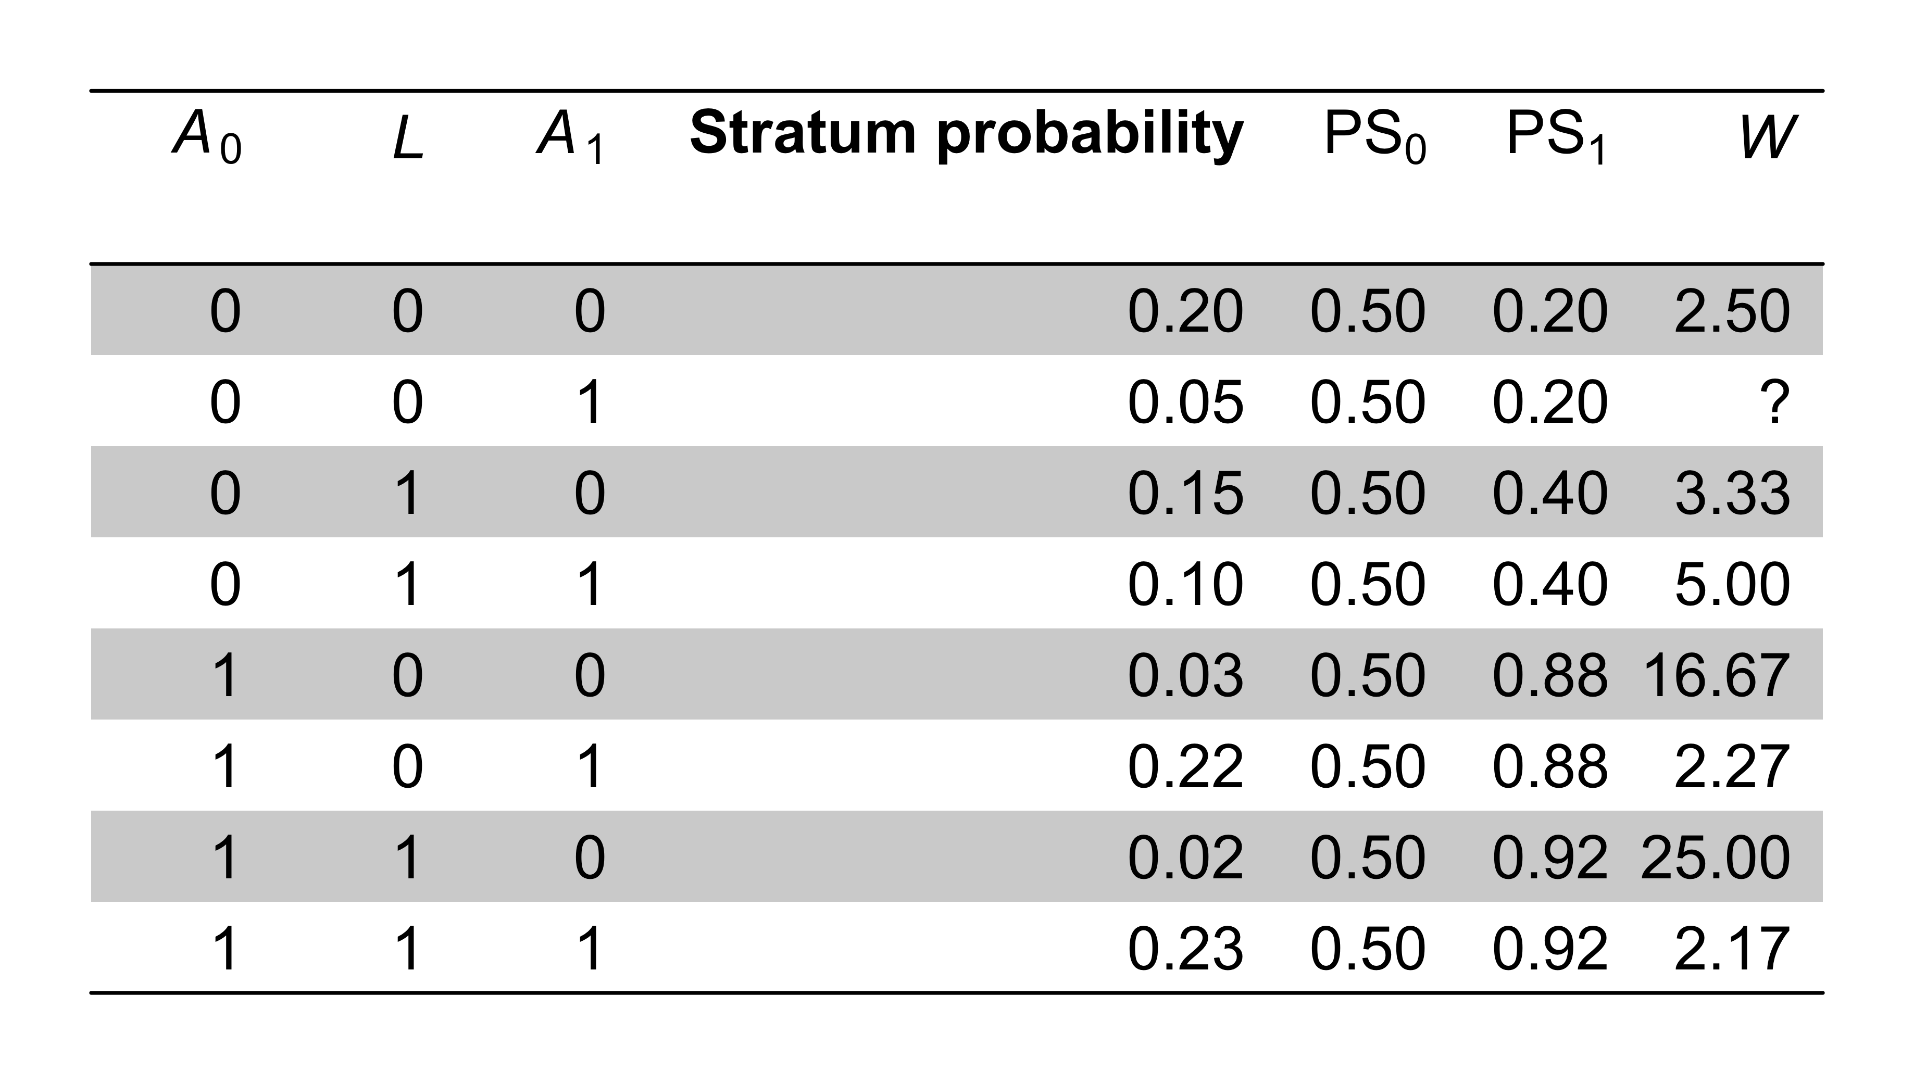

Slide 19
Example: IPW
Finally, having computed the weights W, an estimate of the always-versus-never treatment effects is obtained by taking the difference in mean outcome between the always treated (A₀ = A₁ = 1) and never treated (A₀ = A₁ = 0) individuals, weighted by W.

Slide 20
Concluding remarks
IPW and g-computation, but not traditional methods, are suited to handle time-varying confouding affected by past treatment (feedback)
As with IPW for time-fixed confounding, default standard error estimators of many software packages are not appropriate for weighted regressions, because the weights are falsely assumed to reflect actual observation frequencies
IPW can (and need sometimes) be combined with marginal structural modelling (Robins et al., Epidemiology, 2000;11:550-560)

